Slide 1
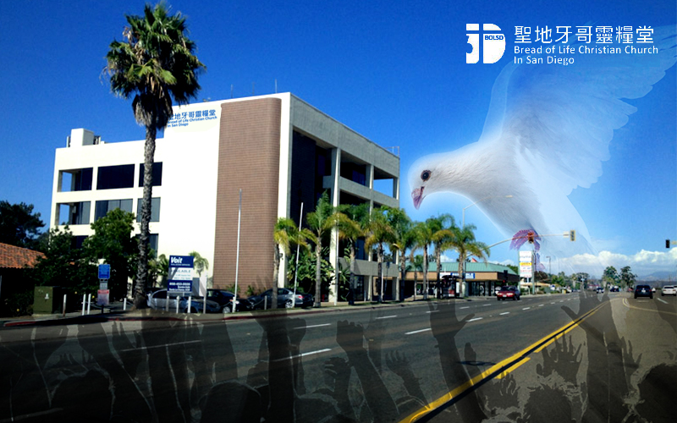
用信心 來承接神的應許 RECEIVE THE PROMISE OF GOD WITH FAITH

Slide 2
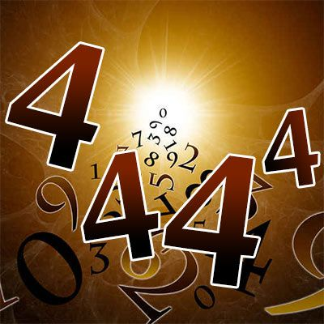
「444」的經歷

Slide 3
一 . 信心的熬煉-「死？」 the REFINEMENT of faith
詩篇 116:3-4
死亡的繩索纏繞我；
陰間的痛苦抓住我；
我遭遇患難愁苦。
那時，我便求告耶和華的名，說：耶和華啊，求你救我的靈魂！
Psalm 116:3-4
The cords of death entangled me, the anguish of the grave came upon me; I was overcome by trouble and sorrow. Then I called on the name of the LORD:
"O LORD, save me!"

Slide 4
A. 上帝啊,祢為何離棄我？ God, why did you forsake me?
約伯記 23:10
然而他知道我
所行的路；
他試煉我之後，
我必如精金。
Job 23:10
But he knows the way that I take; when he has tested me, I will come forth as gold.

Slide 5
B. 在熬煉中單單仰望神 In the trial we still look up to God
詩篇 17:3
你已經試驗我的心；
你在夜間鑒察我；
你熬煉我，卻找不著
甚麼；我立志叫我口中
沒有過失。
Psalm17:3
Though you probe my heart and examine me at night, though you test me, you will find nothing;
I have resolved that my mouth will not sin.

Slide 6
二. 信心的跨越-「化咒詛為祝福」 The leap of faith
雅各書 1:2-4
我的弟兄們，你們落在百般試煉中，都要以為大喜樂；因為知道你們的信心經過試驗，就生忍耐。但忍耐也當成功，使你們成全、完備，毫無缺欠。
James 1:2-4
Consider it pure joy, my brothers, whenever you face trials of many kinds, because you know that the testing of your faith develops perseverance. Perseverance must finish its work so that you may be mature and complete, not lacking anything.

Slide 7
A. 尋求神的智慧來跨越 Seek the wisdom of God to cross
雅各書 1:5-7
你們中間若有缺少智慧的，應當求那厚賜與眾人、
也不斥責人的神，主就必賜給他。只要憑著信心求，
一點不疑惑；因為那疑惑的人，就像海中的波浪，
被風吹動翻騰。這樣的人
不要想從主那裡得甚麼。
James 1:5-7
If any of you lacks wisdom, he should ask God, who gives generously to all without finding fault, and it will be given to him. But when he asks, he must believe and not doubt, because he who doubts is like a wave of the sea, blown and tossed by the wind. That man should not think he will receive anything from the Lord;

Slide 8
B. 握住神的話來跨越 Holding the words of God to cross
哥林多後書 1:20
神的應許，不論有
多少，在基督都是是的。所以藉著他也都是實在的（原文作阿們），叫神因我們得榮耀。
2 Corinthians 1:20
For no matter how many promises God has made, they are "Yes" in Christ. And so through him the "Amen" is spoken by us to the glory of God.

Slide 9
Ｃ. 抓住神的時機來跨越 Seize the time and chance of God to cross
傳道書 9:11
我又轉念：見日光之下，快跑的未必能贏；力戰的未必得勝；智慧的未必得糧食；明哲的未必得資財；靈巧的未必得喜悅。所臨到眾人的是在乎
當時的機會。
Ecclesiast 9:11
I have seen something else under the sun: The race is not to the swift or the battle to the strong, nor does food come to the wise or wealth to the brilliant or favor to the learned; but time and chance happen to them all.

Slide 10
三. 信心的應許-「only Yes」 The promises of faith
哥林多前書 2:9 -10
如經上所記：神為愛他的人所預備的是眼睛未曾看見，耳朵未曾聽見，人心也未曾想到的。只有神藉著聖靈向我們顯明了，因為聖靈參透萬事，就是神深奧的事也參透了。
1Cor 2:9-10
However, as it is written: "No eye has seen, no ear has heard, no mind has conceived what God has prepared for those who love him"--but God has revealed it to us by his Spirit. The Spirit searches all things, even the deep things of God.

Slide 11
A. 主用話語來確認 Confirmation from the Word of God
馬太福音 4:4
耶穌卻回答說：
經上記著說：人活著，不是單靠食物，
乃是靠神口裡所出的
一切話。
Matthew 4:4
Jesus answered,
"It is written: 'Man does not live on bread alone, but on every word that comes from the mouth
of God.'"

Slide 12
B. 主用神蹟來印證 The Lord proves it with signs
馬可福音 16:20
主和他們同工，
用神蹟隨著，
證實所傳的道。
阿們！
Mark 16:20
the Lord worked with them and confirmed his word by the signs that accompanied it.

