Slide 1
The Kite doesn’t Fly without Constraint 不拉的風箏不能飛
4/23/2017
BOLGPC 爾灣大公園靈糧堂
Rev. Joseph Chang 張玉明牧師

Slide 2
Henry Cloud & John Townsend, Boundaries, When to say yes, how to say no, take control of your life, (Zondervan, 1992)

Slide 4
I. We need boundary我們需要界線

Slide 5
約翰福音 John 11:45-48
⁴⁵那些來看馬利亞的猶太人見了耶穌所做的事，就多有信他的；⁴⁶但其中也有去見法利賽人的，將耶穌所做的事告訴他們。⁴⁷祭司長和法利賽人聚集公會，說：這人行好些神蹟，我們怎麼辦呢？⁴⁸若這樣由著他，人人都要信他，羅馬人也要來奪我們的地土和我們的百姓。
⁴⁵Many of the Jews therefore, who had come with Mary and had seen what he did, believed in him, ⁴⁶but some of them went to the Pharisees and told them what Jesus had done. ⁴⁷So the chief priests and the Pharisees gathered the Council and said, "What are we to do? For this man performs many signs. ⁴⁸If we let him go on like this, everyone will believe in him, and the Romans will come and take away both our place and our nation."

Slide 6
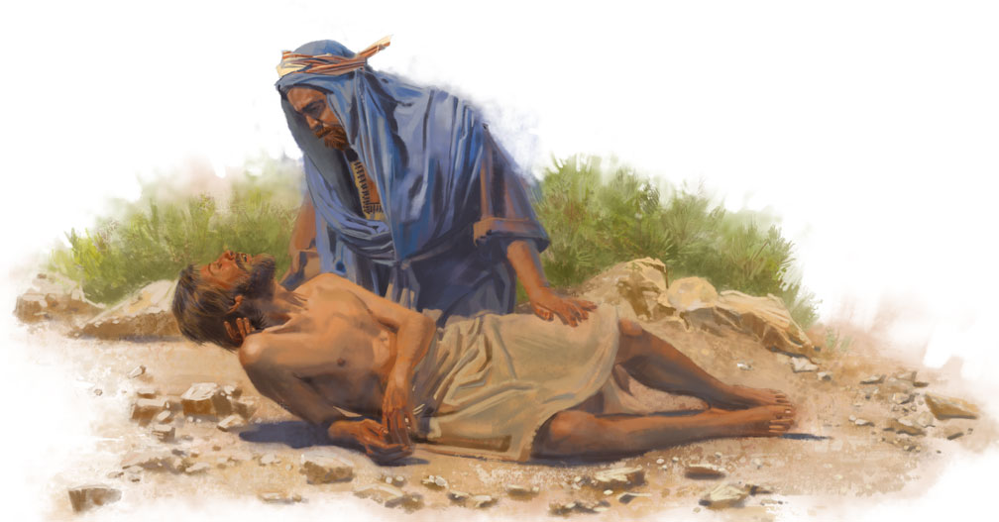
Good Samaritan 好撒瑪利亞人

Slide 7
II. Boundary Problems 界線的錯誤模式
A. Compliant 屈就型
Saying “Yes” to the Bad/對不對的事情說 “yes”.
.Fear of abandonment and separateness 害怕被棄
.Fear of someone else’s anger 害怕別人生氣
.Fear of punishment 害怕處罰
.Fear of being ashamed 害怕羞恥
.Fear of being seen as bad or selfish 害怕被認為是自私
.Fear of being unspiritual 害怕不屬靈
.Fear of one’s overstrict, critical conscience 害怕自己尖銳的良心
. . .

Slide 8
⁷但人不都有這等知識。有人到如今因拜慣了偶像，就以為所吃的是祭偶像之物。他們的良心既然軟弱，也就污穢了。【林前 8:7】 ⁷However, not all possess this knowledge. But some, through former association with idols, eat food as really offered to an idol, and their conscience, being weak, is defiled. 【1Cor 8:7】

Slide 9
II. Boundary Problems 界線的錯誤模式
B. Avoidant 迴避型
Saying “No” to the Good對對的事情說 “不”.
¹我實實在在的告訴你們，人進羊圈，不從門進去，倒從別處爬進去，那人就是賊，就是強盜。²從門進去的，才是羊的牧人。【約 10:1~2】 ¹""Truly, truly, I say to you, he who does not enter the sheepfold by the door but climbs in by another way, that man is a thief and a robber." ²"But he who enters by the door is the shepherd of the sheep." 【John 10:1~2】

Slide 10
Avoidant 迴避型 + Compliant 屈就型 ?

Slide 11
II. Boundary Problems 界線的錯誤模式
C. Controller 操控型
Not Respecting Other’s Boundaries 不尊重別人的界線
1. Aggressive Controller陽剛性操控者

Slide 12
馬太福音Matthew 16:21-23
²¹從此，耶穌才指示門徒，他必須上耶路撒冷去，受長老、祭司長、文士許多的苦，並且被殺，第三日復活。²²彼得就拉著他，勸他說：主阿，萬不可如此！這事必不臨到你身上。²³耶穌轉過來，對彼得說：撒但，退我後邊去罷！你是絆我腳的；因為你不體貼神的意思，只體貼人的意思。 ²¹From that time Jesus began to show his disciples that he must go to Jerusalem and suffer many things from the elders and chief priests and scribes, and be killed, and on the third day be raised. ²²And Peter took him aside and began to rebuke him, saying, "Far be it from you, Lord! This shall never happen to you." ²³But he turned and said to Peter, ""Get behind me, Satan! You are a hindrance to me. For you are not setting your mind on the things of God, but on the things of man." "

Slide 13
II. Boundary Problems 界線的錯誤模式
C. Controller 操控型
Not Respecting Other’s Boundaries 不尊重別人的界線
2. Manipulative Controller 陰柔性操控者

Slide 14
創世記 Genesis 25:29-31
²⁹有一天，雅各熬湯，以掃從田野回來累昏了。³⁰以掃對雅各說：我累昏了，求你把這紅湯給我喝。因此以掃又叫以東(就是紅的意思)。³¹雅各說：你今日把長子的名分賣給我罷。
²⁹Once when Jacob was cooking stew, Esau came in from the field, and he was exhausted. ³⁰And Esau said to Jacob, "Let me eat some of that red stew, for I am exhausted!" (Therefore his name was called Edom.) ³¹Jacob said, "Sell me your birthright now."

Slide 15
II. Boundary Problems 界線的錯誤模式
D. Nonresponsive 無回應型
Not Hearing the Needs of Others聽不到別人的需要
²⁷你手若有行善的力量，不可推辭，就當向那應得的人施行。【箴 3:27】 ²⁷Do not withhold good from those to whom it is due, when it is in your power to do it. 【Prov 3:27】
¹⁸若是能行，總要盡力與眾人和睦。【羅 12:18】 ¹⁸If possible, so far as it depends on you, live peaceably with all. 【Rom 12:18】

Slide 16
Controller/Nonrespondent + Compliant =?
操控型/無回應型 + 屈就型=?

Slide 17
 | CAN’T SAY不能說 | CAN’T HEAR 不能聽
NO | The Compliant 屈就型—Feels guilty and controlled by others; can’t set boundaries. 不能設立界線, 否則就感覺罪惡感.
YES

Slide 18
 | CAN’T SAY不能說 | CAN’T HEAR 不能聽
NO | The Compliant 屈就型—Feels guilty and controlled by others; can’t set boundaries. 不能設立界線, 否則就感覺罪惡感. | The Controller操控型—Aggressively or manipulatively violates boundaries of others. 很陽剛或是很陰柔型的冒犯了別人的界線.
YES

Slide 19
 | CAN’T SAY不能說 | CAN’T HEAR 不能聽
NO | The Compliant 屈就型—Feels guilty and controlled by others; can’t set boundaries. 不能設立界線, 否則就感覺罪惡感. | The Controller操控型—Aggressively or manipulatively violates boundaries of others. 很陽剛或是很陰柔型的冒犯了別人的界線.
YES | The Nonresponsive無回應型—Sets boundaries against responsibility to love設下界限不願意拿起責任來愛別人.

Slide 20
 | CAN’T SAY不能說 | CAN’T HEAR 不能聽
NO | The Compliant 屈就型—Feels guilty and controlled by others; can’t set boundaries. 不能設立界線, 否則就感覺罪惡感. | The Controller操控型—Aggressively or manipulatively violates boundaries of others. 很陽剛或是很陰柔型的冒犯了別人的界線.
YES | The Nonresponsive無回應型—Sets boundaries against responsibility to love設下界限不願意拿起責任來愛別人. | The Avoidant迴避型 —Sets boundaries against receiving care of others設下界限, 不願意接受別人的關心和愛心.

Slide 21
 | CAN’T SAY不能說 | CAN’T HEAR 不能聽
NO | The Compliant 屈就型—Feels guilty and controlled by others; can’t set boundaries. 不能設立界線, 否則就感覺罪惡感. | The Controller操控型—Aggressively or manipulatively violates boundaries of others. 很陽剛或是很陰柔型的冒犯了別人的界線.
YES | The Nonresponsive無回應型—Sets boundaries against responsibility to love設下界限不願意拿起責任來愛別人. | The Avoidant迴避型 —Sets boundaries against receiving care of others設下界限, 不願意接受別人的關心和愛心.

Slide 22
III. Boundary grows in our natural process 界限成型於生命的自然成長
⁴¹每年逾越節，他父母都上耶路撒冷去。⁴²當他十二歲時，他們按著節期的慣例，照常上去。⁴³過完了節，他們回去的時候，孩童耶穌仍留在耶路撒冷，他父母卻不知道，
⁴¹Now his parents went to Je-rusalem every year at the Feast of the Passover. ⁴²And when he was twelve years old, they went up according to custom. ⁴³And when the feast was ended, as they were returning, the boy Jesus stayed behind in Jerusalem. His parents did not know it, 【Luke 2:41~49】

Slide 23
III. Boundary grows in our natural process 界限成型於生命的自然成長
⁴⁴還以為他在同行的人中間。走了一天，就在親戚和熟人中找他，⁴⁵沒有找到，就轉回耶路撒冷找他。⁴⁶過了三天，才發現他在聖殿裡，坐在教師中間，一面聽，一面問。⁴⁷所有聽見他的人，都希奇他的聰明和應對。 ⁴⁴but supposing him to be in the group they went a day's journey, but then they began to search for him among their relatives and acquaintances, ⁴⁵and when they did not find him, they returned to Jerusalem, searching for him. ⁴⁶After three days they found him in the temple, sitting among the teachers, listening to them and asking them questions. ⁴⁷And all who heard him were amazed at his understanding and his answers.

Slide 24
III. Boundary grows in our natural process 界限成型於生命的自然成長
⁴⁸他父母見了，非常驚奇，他母親說："孩子，為甚麼這樣對待我們呢？你看，你父親和我都很擔心地在找你呢！" ⁴⁹他說："為甚麼找我呢？你們不知道我必須在我父的家裡嗎？（"在我父的家裡嗎？"或譯："以我父的事為念嗎？"）" ⁴⁸And when his parents saw him, they were astonished. And his mother said to him, "Son, why have you treated us so? Behold, your father and I have been searching for you in great distress." ⁴⁹And he said to them, ""Why were you looking for me? Did you not know that I must be in my Father's house?"" 【Luke 2:41~49】

Slide 25
III. Boundary grows in our natural process 界限成型於生命的自然成長
A. A Child is to form a boundary from the parents, especially the mother.
A. 孩子在成長的過程裡面, 慢慢的要和父母, 特別是母親畫下界限. 這個是以後孩子可以為自己設下界限的一個很重要的過程.
B. The success of the boundary depends on the security of a healthy relationship to back him/her up.
B. 這個界限要能夠畫得成功, 取決於他能不能夠離開別的人, 進入和天父親密的關係裡面.

Slide 26
III. Boundary grows in our natural process 界限成型於生命的自然成長
A. Child grows into one with boundary孩子長成一個有界限的人.
1. Baby was one with mom.嬰孩和媽媽是一體的.
2. Baby becomes a different person. 嬰孩和媽媽開始不同.

Slide 27
a. Hatching: “Mommy and Me Aren’t the Same”
孵蛋期: 媽媽和我不一樣. (half a year forward)
b. Practicing: “I Can Do Anything!” (10 months to 18 months)
操練期:“我可以做任何事情.”
c. Rapprochement: “I Can’t Do Everything.”
和解期: “我不是全能的”

Slide 28
III. Boundary grows in our natural process 界限成型於生命的自然成長
B. A successful boundary depends on supportive relationship with God and others. 一個好的界限的行程必須有從神來的關係, 或者其他支持者的關係做後盾.

Slide 29
Choose one of the 2 evils 兩惡選其一
1. We set limits and risk losing a relationship. 我們設下界限, 但是害怕會失掉這一個關係.
2. We don’t set limits and remain a prisoner to the wishes of another. 我們不敢設下界限, 繼續留在別人意思的網羅裡面.

