Slide 1
Jesus’ Baptism 耶穌的洗禮
8/27/2017
BOLGPC 爾灣大公園靈糧堂
Rev. Joseph Chang 張玉明牧師

Slide 2
¹⁶約翰說：我是用水給你們施洗，但有一位能力比我更大的要來，我就是給他解鞋帶也不配。他要用聖靈與火給你們施洗。¹⁷他手裡拿著簸箕，要揚淨他的場，把麥子收在倉裡，把糠用不滅的火燒盡了。【路 3:16~17】 ¹⁶John answered them all, "I baptize you with water. But one more powerful than I will come, the thongs of whose sandals I am not worthy to untie. He will baptize you with the Holy Spirit and with fire. ¹⁷His winnowing fork is in his hand to clear his threshing floor and to gather the wheat into his barn, but he will burn up the chaff with unquenchable fire." 【Luke 3:16~17】

Slide 3
¹⁶約翰說：我是用水給你們施洗，但有一位能力比我更大的要來，我就是給他解鞋帶也不配。他要用聖靈與火給你們施洗。¹⁷他手裡拿著簸箕，要揚淨他的場，把麥子收在倉裡，把糠用不滅的火燒盡了。【路 3:16~17】 ¹⁶John answered them all, "I baptize you with water. But one more powerful than I will come, the thongs of whose sandals I am not worthy to untie. He will baptize you with the Holy Spirit and with fire. ¹⁷His winnowing fork is in his hand to clear his threshing floor and to gather the wheat into his barn, but he will burn up the chaff with unquenchable fire." 【Luke 3:16~17】

Slide 4
¹⁶約翰說：我是用水給你們施洗，但有一位能力比我更大的要來，我就是給他解鞋帶也不配。他要用聖靈與火給你們施洗。¹⁷他手裡拿著簸箕，要揚淨他的場，把麥子收在倉裡，把糠用不滅的火燒盡了。【路 3:16~17】 ¹⁶John answered them all, "I baptize you with water. But one more powerful than I will come, the thongs of whose sandals I am not worthy to untie. He will baptize you with the Holy Spirit and with fire. ¹⁷His winnowing fork is in his hand to clear his threshing floor and to gather the wheat into his barn, but he will burn up the chaff with unquenchable fire." 【Luke 3:16~17】

Slide 5
I. John’s Baptism—A Baptism of Repentance 約翰的洗禮—悔改之洗禮
⁴正如先知以賽亞書上所記的話，說：在曠野有人聲喊著說：預備主的道，修直他的路！⁵一切山窪都要填滿；大小山崗都要削平！彎彎曲曲的地方要改為正直；高高低低的道路要改為平坦！⁶凡有血氣的，都要見神的救恩！【路 3:4~6】 ⁴As is written in the book of the words of Isaiah the prophet: "A voice of one calling in the desert, 'Prepare the way for the Lord, make straight paths for him. ⁵Every valley shall be filled in, every mountain and hill made low. The crooked roads shall become straight, the rough ways smooth. ⁶And all mankind will see God's salvation.'" 【Luke 3:4~6】

Slide 6
^{17 . . .} 康健的人用不著醫生，有病的人才用得著。我來本不是召義人，乃是召罪人。【可 2:17】
¹⁷On hearing this, Jesus said to them, "It is not the healthy who need a doctor, but the sick. I have not come to call the righteous, but sinners." 【Mark 2:17】

Slide 7
⁷約翰對那出來要受他洗的眾人說：毒蛇的種類！誰指示你們逃避將來的忿怒呢？⁸你們要結出果子來，與悔改的心相稱。不要自己心裡說：有亞伯拉罕為我們的祖宗。我告訴你們，神能從這些石頭中，給亞伯拉罕興起子孫來。⁹現在斧子已經放在樹根上，凡不結好果子的樹就砍下來，丟在火裡。【路 3:7~9】 ⁷John said to the crowds coming out to be baptized by him, "You brood of vipers! Who warned you to flee from the coming wrath? ⁸Produce fruit in keeping with repentance. And do not begin to say to yourselves, 'We have Abraham as our father.' For I tell you that out of these stones God can raise up children for Abraham. ⁹The ax is already at the root of the trees, and every tree that does not produce good fruit will be cut down and thrown into the fire." 【Luke 3:7~9】

Slide 8
¹⁰眾人問他說：這樣，我們當作甚麼呢？¹¹約翰回答說：有兩件衣裳的，就分給那沒有的；有食物的，也當這樣行。【路 3:10-11】 ¹⁰"What should we do then?" the crowd asked. ¹¹John answered, "The man with two tunics should share with him who has none, and the one who has food should do the same." 【Luke 3:10-11】

Slide 9
¹²又有稅吏來要受洗，問他說：夫子，我們當作甚麼呢？¹³約翰說：除了例定的數目，不要多取。【路 3:12-13】 ¹²Tax collectors also came to be baptized. "Teacher," they asked, "what should we do?" ¹³"Don't collect any more than you are required to," he told them. 【Luke 3:12-13】

Slide 10
¹⁴又有兵丁問他說：我們當作甚麼呢？約翰說：不要以強暴待人，也不要訛詐人，自己有錢糧就當知足。【路 3:14】 ¹⁴Then some soldiers asked him, "And what should we do?" He replied, "Don't extort money and don't accuse people falsely--be content with your pay." 【Luke 3:14】

Slide 11
II. Jesus’ Baptism—A Baptism of Regeneration 耶穌的洗禮—重生的洗禮
¹⁶「神愛世人，甚至將他的獨生子賜給他們，叫一切信他的，不至滅亡，反得永生。¹⁷因為神差他的兒子降世，不是要定世人的罪，乃是要叫世人因他得救。¹⁸信他的人，不被定罪；不信的人，罪已經定了，因為他不信神獨生子的名。【約 3:16~18】 ¹⁶"For God so loved the world that he gave his one and only Son, that whoever believes in him shall not perish but have eternal life. ¹⁷For God did not send his Son into the world to condemn the world, but to save the world through him. ¹⁸Whoever believes in him is not condemned, but whoever does not believe stands condemned already because he has not believed in the name of God's one and only Son. 【John 3:16~18】

Slide 12
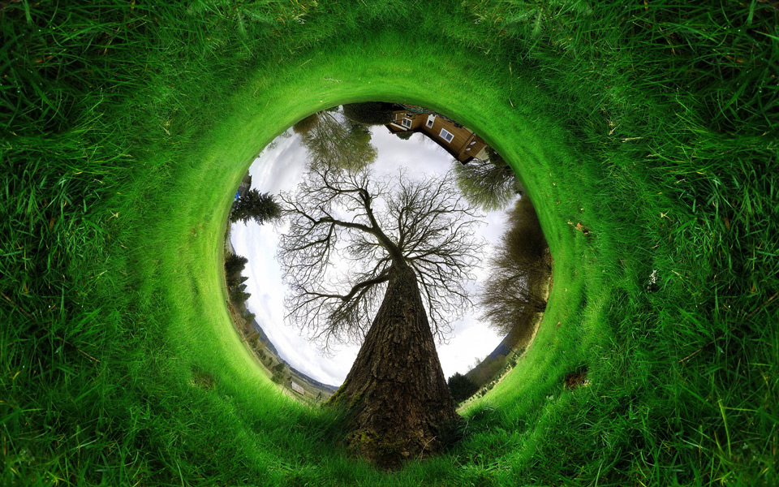

Slide 13
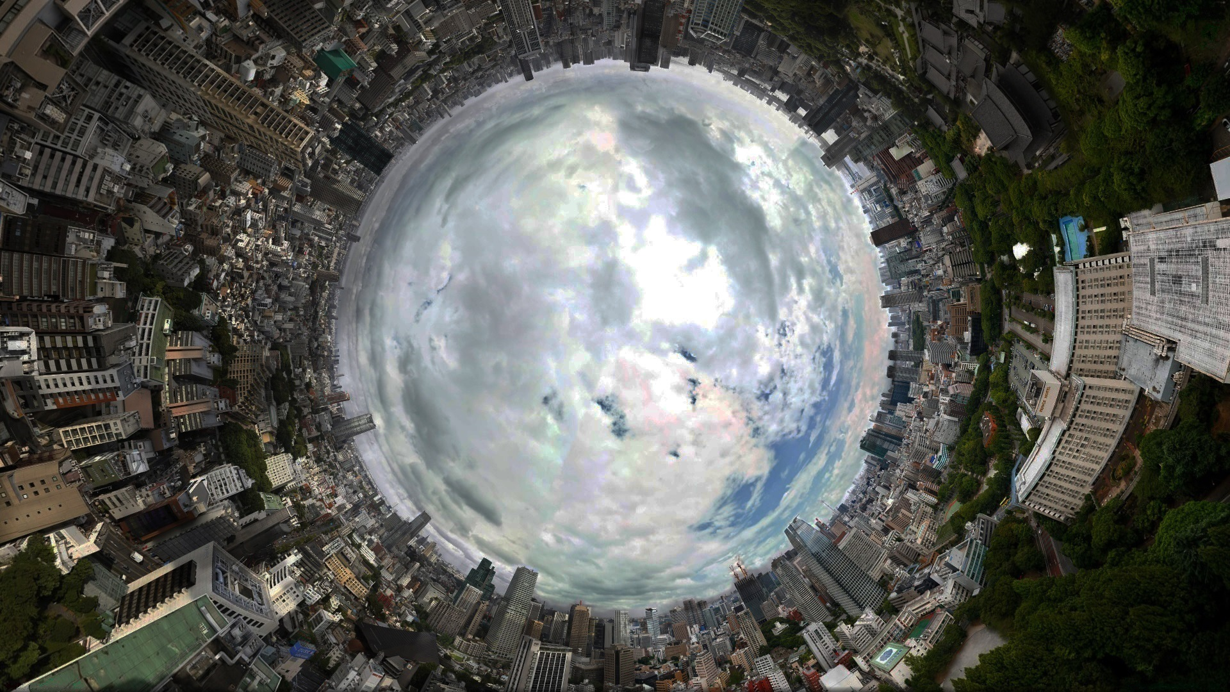

Slide 14
Jesus & Nicodemus 耶穌和尼哥底母對話
³耶穌回答說：「我實實在在地告訴你，人若不重生，就不能見神的國。」【約 3:3】 ³In reply Jesus declared, "I tell you the truth, no one can see the kingdom of God unless he is born again." 【John 3:3】
⁴尼哥底母說：「人已經老了，如何能重生呢？豈能再進母腹生出來嗎？」【約 3:4】 ⁴"How can a man be born when he is old?" Nicodemus asked. "Surely he cannot enter a second time into his mother's womb to be born!" 【John 3:4】

Slide 15
How to be born again? 如何可以重生?
¹⁴摩西在曠野怎樣舉蛇，人子也必照樣被舉起來，【約 3:14】 ¹⁴Just as Moses lifted up the snake in the desert, so the Son of Man must be lifted up, 【John 3:14】

Slide 16
⁴他們從何珥山起行，往紅海那條路走，要繞過以東地。百姓因這路難行，心中甚是煩燥，⁵就怨讟 神和摩西說：你們為甚麼把我們從埃及領出來、使我們死在曠野呢？這裡沒有糧，沒有水，我們的心厭惡這淡薄的食物。⁶於是耶和華使火蛇進入百姓中間，蛇就咬他們。以色列人中死了許多。【民 21:4~6】 ⁴They traveled from Mount Hor along the route to the Red Sea, to go around Edom. But the people grew impatient on the way; ⁵they spoke against God and against Moses, and said, "Why have you brought us up out of Egypt to die in the desert? There is no bread! There is no water! And we detest this miserable food!" ⁶Then the LORD sent venomous snakes among them; they bit the people and many Israelites died. 【Num 21:4~6】

Slide 17
⁷百姓到摩西那裡，說：我們怨讟耶和華和你，有罪了。求你禱告耶和華，叫這些蛇離開我們。於是摩西為百姓禱告。⁸耶和華對摩西說：你製造一條火蛇，掛在杆子上；凡被咬的，一望這蛇，就必得活。⁹摩西便製造一條銅蛇，掛在杆子上；凡被蛇咬的，一望這銅蛇就活了。【民 21:7~9】 ⁷The people came to Moses and said, "We sinned when we spoke against the LORD and against you. Pray that the LORD will take the snakes away from us." So Moses prayed for the people. ⁸The LORD said to Moses, "Make a snake and put it up on a pole; anyone who is bitten can look at it and live." ⁹So Moses made a bronze snake and put it up on a pole. Then when anyone was bitten by a snake and looked at the bronze snake, he lived. 【Num 21:7~9】

Slide 19
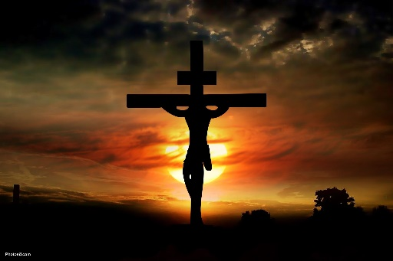
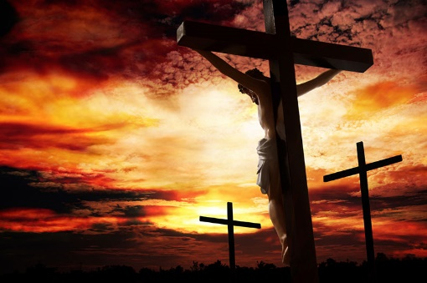

Slide 20
III. Jesus’ Baptism from John—A Baptism of Rightfulness 耶穌接受約翰的洗禮
¹⁶約翰說：我是用水給你們施洗，但有一位能力比我更大的要來，我就是給他解鞋帶也不配。他要用聖靈與火給你們施洗。【路 3:16】
¹⁶John answered them all, "I baptize you with water. But one more powerful than I will come, the thongs of whose sandals I am not worthy to untie. He will baptize you with the Holy Spirit and with fire. 【Luke 3:16】

Slide 21
III. Jesus’ Baptism from John—A Baptism of Rightfulness 耶穌接受約翰的洗禮
²⁸我告訴你們，凡婦人所生的，沒有一個大過約翰的；然而神國裡最小的比他還大。【路 7:28】 ²⁸I tell you, among those born of women there is no one greater than John; yet the one who is least in the kingdom of God is greater than he." 【Luke 7:28】

Slide 22
III. Jesus’ Baptism from John—A Baptism of Rightfulness 耶穌接受約翰的洗禮
A. The Transition from OT to NT 舊約和新約的轉接
B. Our Model 我們的榜樣

Slide 23
¹³當下耶穌從加利利來到約但河，見了約翰，要受他的洗。¹⁴約翰想要攔住他，說：我當受你的洗，你反倒上我這裡來麼？¹⁵耶穌回答說：你暫且許我，因為我們理當這樣盡諸般的義（或作：禮）。於是約翰許了他。【太 3:13~15】 ¹³Then Jesus came from Galilee to the Jordan to be baptized by John. ¹⁴But John tried to deter him, saying, "I need to be baptized by you, and do you come to me?" ¹⁵Jesus replied, "Let it be so now; it is proper for us to do this to fulfill all righteousness." Then John consented. 【Matt 3:13~15】

Slide 24
¹⁶信而受洗的，必然得救；不信的，必被定罪。【可 16:16】 ¹⁶Whoever believes and is baptized will be saved, but whoever does not believe will be condemned. 【Mark 16:16】

