Slide 1
Rest 安息
5/28/2017
BOLGPC 爾灣大公園靈糧堂
Rev. Joseph Chang 張玉明牧師

Slide 2
現代人的精神健康 Mental Health of Modern Era
陳昌文醫師
Depression 憂鬱症
Bipolar躁鬱症
Fear畏懼症
Anxiety焦慮症
Autism自閉症
Schizophrenia 精神分裂症
Obsessive Compulsive 強迫症
Dementia 老人失智症

Slide 3
Which day is your Sabbath? 哪一天是你的安息日?
Regular Workers. 一般的工作者.
Service Busisness. 一線服務業者.
Pastors. 牧師傳道人.
Coworkers in Sunday services. 週日的同工.

Slide 4
I. 要學習我們的天父 To learn from our Heavenly Father

Slide 5
出埃及記 Exodus 20:8-11
⁸當記念安息日，守為聖日。⁹六日要勞碌做你一切的工，¹⁰但第七日是向耶和華─你 神當守的安息日。這一日你和你的兒女、僕婢、牲畜，並你城裡寄居的客旅，無論何工都不可做；¹¹因為六日之內，耶和華造天、地、海，和其中的萬物，第七日便安息，所以耶和華賜福與安息日，定為聖日。
⁸"Remember the Sabbath day by keeping it holy. ⁹Six days you shall labor and do all your work, ¹⁰but the seventh day is a Sabbath to the LORD your God. On it you shall not do any work, neither you, nor your son or daughter, nor your manservant or maidservant, nor your animals, nor the alien within your gates. ¹¹For in six days the LORD made the heavens and the earth, the sea, and all that is in them, but he rested on the seventh day. Therefore the LORD blessed the Sabbath day and made it holy.

Slide 6
Nokia 8110 - 1996

Slide 7
Nokia 9000 Communicator series - 1996 - 2007

Slide 8
Nokia 3210 - 1999

Slide 9
Nokia 6310 - 2002

Slide 10
Nokia 1110 - 2003

Slide 11
Nokia N-Gage - 2003

Slide 12
Nokia 7600 - 2003

Slide 13
Nokia 7610 - 2004

Slide 14
Nokia 7280 - 2005

Slide 15
Nokia 770 Internet Tablet - 2005

Slide 16
Nokia N95 - 2007

Slide 18
2007-iPhone

Slide 19
II. 因為我們不是奴隸For we are not slaves

Slide 20
申命記 Deuteronomy 5:12-15
¹²當照耶和華─你 神所吩咐的守安息日為聖日。¹³六日要勞碌做你一切的工，¹⁴但第七日是向耶和華─你 神當守的安息日。這一日，你和你的兒女、僕婢、牛、驢、牲畜，並在你城裡寄居的客旅，無論何工都不可做，使你的僕婢可以和你一樣安息。
¹²"Observe the Sabbath day by keeping it holy, as the LORD your God has commanded you. ¹³Six days you shall labor and do all your work, ¹⁴but the seventh day is a Sabbath to the LORD your God. On it you shall not do any work, neither you, nor your son or daughter, nor your manservant or maidservant, nor your ox, your donkey or any of your animals, nor the alien within your gates, so that your manservant and maidservant may rest, as you do.

Slide 21
申命記 Deuteronomy 5:12-15
¹⁵你也要記念你在埃及地作過奴僕；耶和華─你 神用大能的手和伸出來的膀臂將你從那裡領出來。因此，耶和華─你的 神吩咐你守安息日。
¹⁵Remember that you were slaves in Egypt and that the LORD your God brought you out of there with a mighty hand and an outstretched arm. Therefore the LORD your God has commanded you to observe the Sabbath day.

Slide 22
What are we? 我們是甚麼?
Human Beings? 我們的身分?
Human Doings? 我們的成就?

Slide 23
III. 因果關係 Cause and Effect
³六年要耕種田地，也要修理葡萄園，收藏地的出產。⁴第七年，地要守聖安息，就是向耶和華守的安息，不可耕種田地，也不可修理葡萄園。⁵遺落自長的莊稼不可收割；沒有修理的葡萄樹也不可摘取葡萄。這年，地要守聖安息。【利 25:3~5】 ³For six years sow your fields, and for six years prune your vineyards and gather their crops. ⁴But in the seventh year the land is to have a sabbath of rest, a sabbath to the LORD. Do not sow your fields or prune your vineyards. ⁵Do not reap what grows of itself or harvest the grapes of your untended vines. The land is to have a year of rest. 【Lev 25:3~5】

Slide 24
禧年 Year of Jubilee

Slide 25
歷代志下 2 Chronicles 36:21
²¹這就應驗耶和華藉耶利米口所說的話：地享受安息；因為地土荒涼便守安息，直滿了七十年。【代下 36:21】 ²¹The land enjoyed its sabbath rests; all the time of its desolation it rested, until the seventy years were completed in fulfillment of the word of the LORD spoken by Jeremiah. 【2Chr 36:21】

Slide 26
民數記 Numbers 32:23
²³倘若你們不這樣行，就得罪耶和華，要知道你們的罪必追上你們。
²³"But if you fail to do this, you will be sinning against the LORD; and you may be sure that your sin will find you out.

Slide 27
利未記 Leviticus 25:18-22
¹⁸我的律例，你們要遵行，我的典章，你們要謹守，就可以在那地上安然居住。¹⁹地必出土產，你們就要吃飽，在那地上安然居住。²⁰你們若說：這第七年我們不耕種，也不收藏土產，吃甚麼呢？
¹⁸"'Follow my decrees and be careful to obey my laws, and you will live safely in the land. ¹⁹Then the land will yield its fruit, and you will eat your fill and live there in safety. ²⁰You may ask, "What will we eat in the seventh year if we do not plant or harvest our crops?"

Slide 28
利未記 Leviticus 25:18-22
²¹我必在第六年將我所命的福賜給你們，地便生三年的土產。²²第八年，你們要耕種，也要吃陳糧，等到第九年出產收來的時候，你們還吃陳糧。
²¹I will send you such a blessing in the sixth year that the land will yield enough for three years. ²²While you plant during the eighth year, you will eat from the old crop and will continue to eat from it until the harvest of the ninth year comes in.

Slide 29
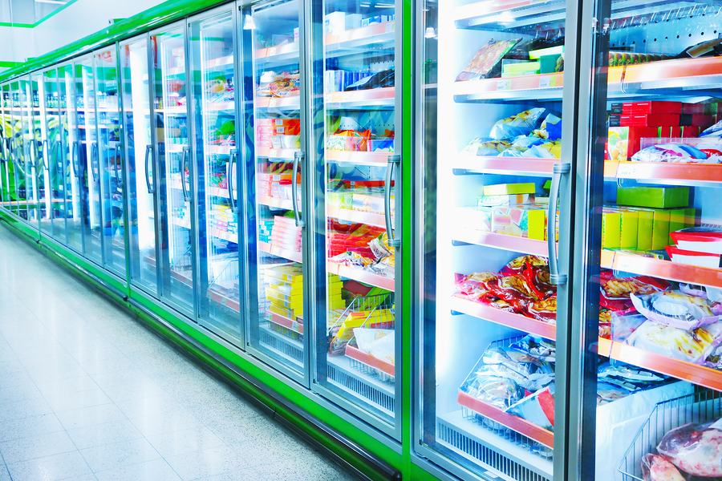

Slide 31
Energy Drinks

Slide 33
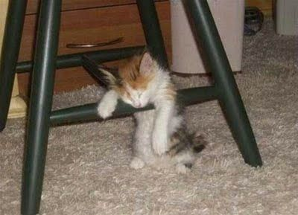
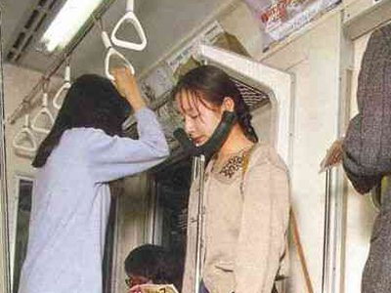

Slide 34
IV. 安息日我們做什麼? What do we do in Sabbath?
A. Leave the familiar and constraint, Join God in fellowship!離開我們熟悉, 捆綁著我們, 讓我們不能脫身的環境，尋找和神單獨相處的機會。
B. Talk to him for all your need.把你所有的需要向祂講.
C. Allow Him to talk to you about his plan. 聽聽看上帝要跟你講什麼話?

Slide 35
Testament of Peter Cho 卓永昇弟兄見證

Slide 36
V. Promise for keeping the Sabbath 守安息日的應許

Slide 37
以賽亞書 Isaiah 58:13-14
¹³你若在安息日掉轉（或作：謹慎）你的腳步，在我聖日不以操作為喜樂，稱安息日為可喜樂的，稱耶和華的聖日為可尊重的；而且尊敬這日，不辦自己的私事，不隨自己的私意，不說自己的私話，
¹³"If you keep your feet from breaking the Sabbath and from doing as you please on my holy day, if you call the Sabbath a delight and the Lord's holy day honorable, and if you honor it by not going your own way and not doing as you please or speaking idle words,

Slide 38
以賽亞書 Isaiah 58:13-14
¹⁴你就以耶和華為樂。耶和華要使你乘駕地的高處，又以你祖雅各的產業養育你。這是耶和華親口說的。 ¹⁴then you will find your joy in the LORD, and I will cause you to ride on the heights of the land and to feast on the inheritance of your father Jacob." The mouth of the LORD has spoken.

