Slide 1
You Mighty Warrior 大能的勇士
6/18/2017
BOLGPC 爾灣大公園靈糧堂
Rev. Joseph Chang 張玉明牧師

Slide 2
士師記Judges 6:1-6
¹以色列人又行耶和華眼中看為惡的事，耶和華就把他們交在米甸人手裡七年。²米甸人壓制以色列人；以色列人因為米甸人，就在山中挖穴、挖洞、建造營寨。³以色列人每逢撒種之後，米甸人、亞瑪力人，和東方人都上來攻打他們，¹Again the Israelites did evil in the eyes of the LORD, and for seven years he gave them into the hands of the Midianites. ²Because the power of Midian was so oppressive, the Israelites prepared shelters for themselves in mountain clefts, caves and strongholds. ³Whenever the Israelites planted their crops, the Midianites, Amalekites and other eastern peoples invaded the country.

Slide 3
士師記Judges 6:1-6
⁴對著他們安營，毀壞土產，直到迦薩，沒有給以色列人留下食物，牛、羊、驢也沒有留下；⁵因為那些人帶著牲畜帳棚來，像蝗蟲那樣多，人和駱駝無數，都進入國內，毀壞全地。⁶以色列人因米甸人的緣故，極其窮乏，就呼求耶和華。
⁴They camped on the land and ruined the crops all the way to Gaza and did not spare a living thing for Israel, neither sheep nor cattle nor donkeys. ⁵They came up with their livestock and their tents like swarms of locusts. It was impossible to count the men and their camels; they invaded the land to ravage it. ⁶Midian so impoverished the Israelites that they cried out to the LORD for help.

Slide 4
士師記 Judges 6:11-13
¹¹耶和華的使者到了俄弗拉，坐在亞比以謝族人約阿施的橡樹下。約阿施的兒子基甸正在酒醡那裡打麥子，為要防備米甸人。¹²耶和華的使者向基甸顯現，對他說：大能的勇士啊，耶和華與你同在！
¹¹The angel of the LORD came and sat down under the oak in Ophrah that belonged to Joash the Abiezrite, where his son Gideon was threshing wheat in a winepress to keep it from the Midianites. ¹²When the angel of the LORD appeared to Gideon, he said, "The LORD is with you, mighty warrior."

Slide 5
士師記 Judges 6:11-13
¹³基甸說：主啊，耶和華若與我們同在，我們何至遭遇這一切事呢？我們的列祖不是向我們說耶和華領我們從埃及上來麼？他那樣奇妙的作為在哪裡呢？現在他卻丟棄我們，將我們交在米甸人手裡。
¹³"But sir," Gideon replied, "if the LORD is with us, why has all this happened to us? Where are all his wonders that our fathers told us about when they said, 'Did not the LORD bring us up out of Egypt?' But now the LORD has abandoned us and put us into the hand of Midian."

Slide 6
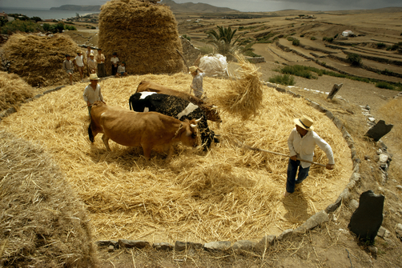
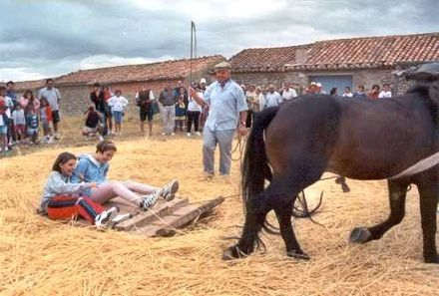
I. We are used to/familiar with living in fear. 我們習慣住在恐懼裡面.
We live in expectation of something bad.
我們等待最壞的發生.

Slide 7
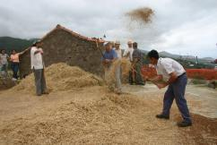
I. We are used to/familiar with living in fear. 我們習慣住在恐懼裡面.
We live in expectation of something bad.
我們等待最壞的發生.

Slide 8
I. We are used to/familiar with living in fear. 我們習慣住在恐懼裡面.
B. We look down upon ourselves. 我們輕看自己
¹⁴耶和華觀看基甸，說：你靠著你這能力去從米甸人手裡拯救以色列人，不是我差遣你去的麼？¹⁵基甸說：主啊，我有何能拯救以色列人呢？我家在瑪拿西支派中是至貧窮的。我在我父家是至微小的。【士 6:14~15】 ¹⁴The LORD turned to him and said, "Go in the strength you have and save Israel out of Midian's hand. Am I not sending you?" ¹⁵"But Lord, " Gideon asked, "how can I save Israel? My clan is the weakest in Manasseh, and I am the least in my family." 【Judg 6:14~15】

Slide 9
II. God calls us out to be brave. 神要我們勇敢.
A. We are mighty warrior, when God is with us.
當神和我們同在, 我們就是大能的勇士.
¹²耶和華的使者向基甸顯現，對他說：大能的勇士啊，耶和華與你同在！【士 6:12】 ¹²When the angel of the LORD appeared to Gideon, he said, "The LORD is with you, mighty warrior." 【Judg 6:12】

Slide 10
II. God calls us out to be brave. 神要我們勇敢.
A. We are mighty warrior, when God is with us.
當神和我們同在, 我們就是大能的勇士.
¹²耶和華的使者向基甸顯現，對他說：大能的勇士啊，耶和華與你同在！【士 6:12】 ¹²When the angel of the LORD appeared to Gideon, he said, "The LORD is with you, mighty warrior." 【Judg 6:12】

Slide 11
II. God calls us out to be brave. 神要我們勇敢.
A. We are mighty warrior, when God is with us.
當神和我們同在, 我們就是大能的勇士.
¹⁴耶和華觀看基甸，說：你靠著你這能力去從米甸人手裡拯救以色列人，不是我差遣你去的麼？【士 6:14】 ¹⁴The LORD turned to him and said, "Go in the strength you have and save Israel out of Midian's hand. Am I not sending you?" 【Judg 6:14】

Slide 12
II. God calls us out to be brave. 神要我們勇敢.
A. We are mighty warrior, when God is with us.
當神和我們同在, 我們就是大能的勇士.
¹⁴耶和華觀看基甸，說：你靠著你這能力去從米甸人手裡拯救以色列人，不是我差遣你去的麼？【士 6:14】 ¹⁴The LORD turned to him and said, "Go in the strength you have and save Israel out of Midian's hand. Am I not sending you?" 【Judg 6:14】

Slide 13
II. God calls us out to be brave. 神要我們勇敢.
B. With baby steps, the Lord pushes us forward to fight.
神逼使我們上陣殺敵.

Slide 14
II. God calls us out to be brave. 神要我們勇敢.
²⁵當那夜，耶和華吩咐基甸說：你取你父親的牛來，就是（或作：和）那七歲的第二隻牛，並拆毀你父親為巴力所築的壇，砍下壇旁的木偶，²⁶在這磐石（原文作保障）上整整齊齊地為耶和華─你的 神築一座壇，將第二隻牛獻為燔祭，用你所砍下的木偶作柴。²⁵That same night the LORD said to him, "Take the second bull from your father's herd, the one seven years old. Tear down your father's altar to Baal and cut down the Asherah pole beside it. ²⁶Then build a proper kind of altar to the LORD your God on the top of this height. Using the wood of the Asherah pole that you cut down, offer the second bull as a burnt offering." 【Judg 6:25~27】

Slide 15
II. God calls us out to be brave. 神要我們勇敢.
B. With baby steps, the Lord pushes us forward to fight.
神逼使我們上陣殺敵.
²⁷基甸就從他僕人中挑了十個人，照著耶和華吩咐他的行了。他因怕父家和本城的人，不敢在白晝行這事，就在夜間行了。【士 6:25~27】 ²⁷So Gideon took ten of his servants and did as the LORD told him. But because he was afraid of his family and the men of the town, he did it at night rather than in the daytime. 【Judg 6:25~27】

Slide 16
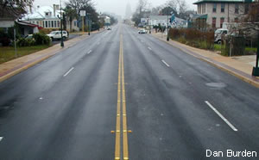
Conclusion 結論

