Slide 1
Thanksgiving 感恩
11/26/2017
BOLGPC 爾灣大公園靈糧堂
Rev. Joseph Chang 張玉明牧師

Slide 2
²我的弟兄們，你們落在百般試煉中，都要以為大喜樂；【雅 1:2】 ²Consider it pure joy, my brothers, whenever you face trials of many kinds, 【Jam 1:2】

Slide 3
⁶耶和華如此說：以色列人三番四次地犯罪，我必不免去他們的刑罰；因他們為銀子賣了義人，為一雙鞋賣了窮人。⁷他們見窮人頭上所蒙的灰也都垂涎，阻礙謙卑人的道路。父子同一個女子行淫，褻瀆我的聖名。⁸他們在各壇旁鋪人所當的衣服，臥在其上，又在他們 神的廟中喝受罰之人的酒。【摩 2:6~8】 ⁶This is what the LORD says: "For three sins of Israel, even for four, I will not turn back my wrath. They sell the righteous for silver, and the needy for a pair of sandals. ⁷They trample on the heads of the poor as upon the dust of the ground and deny justice to the oppressed. Father and son use the same girl and so profane my holy name. ⁸They lie down beside every altar on garments taken in pledge. In the house of their god they drink wine taken as fines. 【Amos 2:6~8】

Slide 4
²⁶你即或拿鄰舍的衣服作當頭，必在日落以先歸還他；【出 22:26】 ²⁶If you take your neighbor's cloak as a pledge, return it to him by sunset, 【Exod 22:26】
⁶不可拿人的全盤磨石或是上磨石作當頭，因為這是拿人的命作當頭。【申 24:6】 ⁶Do not take a pair of millstones--not even the upper one--as security for a debt, because that would be taking a man's livelihood as security. 【Deut 24:6】

Slide 5
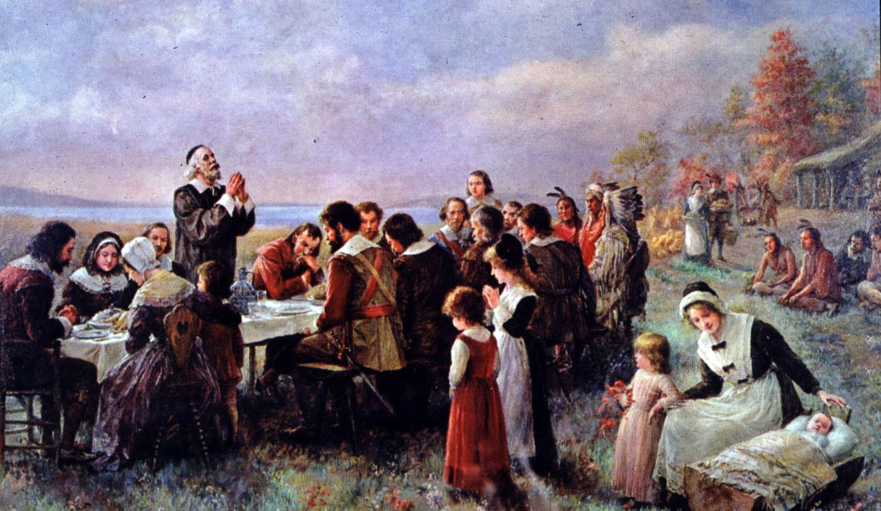
Thanksgiving of 1621/1621年的感恩節

Slide 6
What they had/他們所有的
Log cabin/有木屋可以住.
Harvest of Corns/有玉米的收成.
Hunted Turkey/有打獵到的火雞.
A wife/有一個太太.
Many children/有一大堆小孩.

Slide 7
What they did not have/他們沒有的
No tap water/沒有自來水, 過濾水.
No electricity/沒有電.
No car, only horse and carriage/沒有車子, 可能像Amish people 一樣有馬和馬車.
No internet/沒有internet.
No iPad/沒有iPad.
No iPhone/沒有iPhone.
No restaurant/沒有餐館.
Yet they were happy./但是他們很高興.

Slide 8
Thanksgiving at 1863/1863 感恩節

Slide 9
What they just experienced/他們剛經歷過:
1. 51,000 wounded, 8,000 dead in Gettysburg. 蓋次堡戰役 51,000 傷, 8,000亡.
2. Enraged by draft laws and emancipation, rioters in Northern cities like New York went on blood rampage. 徵兵法案和釋奴法案帶來北方許多城市的動亂.
3. Licoln’s 11 year old son Willie just died a year ago. 林肯11歲的兒子Billie一年前剛死掉.

Slide 10
Lincoln proclaimed “In the midst of a civil war of unequaled magnitude and severity . . . 林肯宣告, “在一個從未有的嚴重的內戰 . . .”
Peace has been preserved with all nations, 和世界各國有和平的關係,
Order has been maintained, 次序維持住了,
The laws have been respected and obeyed, 法律被遵守了,
Harmony has prevailed everywhere, except in the theater of military conflict. 除了戰場以外, 社會充滿和諧.

Slide 11
I. Thanksgiving is a Heart Issue.感恩是心的問題
⁶然而，敬虔加上知足的心便是大利了；【提前 6:6】 ⁶But godliness with contentment is great gain. 【1Tim 6:6】
A thanksgiving person is a content person/.一個會感恩的人是一個知足的人.

Slide 12
I. Thanksgiving is a Heart Issue.感恩是心的問題
A. Seeing what we do have, not what we don’t have.知足是看到自己有的, 而不是看到自己沒有的.

Slide 13
⁷拿單對大衛說：你就是那人！耶和華─以色列的 神如此說：我膏你作以色列的王，救你脫離掃羅的手。⁸我將你主人的家業賜給你，將你主人的妻交在你懷裡，又將以色列和猶大家賜給你；你若還以為不足，我早就加倍地賜給你。⁹你為甚麼藐視耶和華的命令，行他眼中看為惡的事呢？你借亞捫人的刀殺害赫人烏利亞，又娶了他的妻為妻。【撒下 12:7~9】 ⁷Then Nathan said to David, "You are the man! This is what the LORD, the God of Israel, says: 'I anointed you king over Israel, and I delivered you from the hand of Saul. ⁸I gave your master's house to you, and your master's wives into your arms. I gave you the house of Israel and Judah. And if all this had been too little, I would have given you even more. ⁹Why did you despise the word of the LORD by doing what is evil in his eyes? You struck down Uriah the Hittite with the sword and took his wife to be your own. You killed him with the sword of the Ammonites. 【2Sam 12:7~9】

Slide 14
⁷拿單對大衛說：你就是那人！耶和華─以色列的 神如此說：我膏你作以色列的王，救你脫離掃羅的手。⁸我將你主人的家業賜給你，將你主人的妻交在你懷裡，又將以色列和猶大家賜給你；你若還以為不足，我早就加倍地賜給你。⁹你為甚麼藐視耶和華的命令，行他眼中看為惡的事呢？你借亞捫人的刀殺害赫人烏利亞，又娶了他的妻為妻。【撒下 12:7~9】 ⁷Then Nathan said to David, "You are the man! This is what the LORD, the God of Israel, says: 'I anointed you king over Israel, and I delivered you from the hand of Saul. ⁸I gave your master's house to you, and your master's wives into your arms. I gave you the house of Israel and Judah. And if all this had been too little, I would have given you even more. ⁹Why did you despise the word of the LORD by doing what is evil in his eyes? You struck down Uriah the Hittite with the sword and took his wife to be your own. You killed him with the sword of the Ammonites. 【2Sam 12:7~9】

Slide 15
I. Thanksgiving is a Heart Issue.感恩是心的問題
B. Have Faith in God, do not fear. 對神有信心, 不要害怕.

Slide 16
¹⁶就用比喻對他們說：有一個財主田產豐盛；¹⁷自己心裡思想說：我的出產沒有地方收藏，怎麼辦呢？¹⁸又說：我要這麼辦：要把我的倉房拆了，另蓋更大的，在那裡好收藏我一切的糧食和財物，【路 12:16~18】 ¹⁶And he told them this parable: "The ground of a certain rich man produced a good crop. ¹⁷He thought to himself, 'What shall I do? I have no place to store my crops.' ¹⁸"Then he said, 'This is what I'll do. I will tear down my barns and build bigger ones, and there I will store all my grain and my goods. 【Luke 12:16~18】

Slide 17
¹⁹然後要對我的靈魂說：靈魂哪，你有許多財物積存，可作多年的費用，只管安安逸逸的吃喝快樂罷！²⁰神卻對他說：無知的人哪，今夜必要你的靈魂；你所預備的要歸誰呢？²¹凡為自己積財，在神面前卻不富足的，也是這樣。【路 12:19~21】 ¹⁹And I'll say to myself, "You have plenty of good things laid up for many years. Take life easy; eat, drink and be merry."' ²⁰"But God said to him, 'You fool! This very night your life will be demanded from you. Then who will get what you have prepared for yourself?' ²¹"This is how it will be with anyone who stores up things for himself but is not rich toward God." 【Luke 12:19~21】

Slide 18
⁶然而，敬虔加上知足的心便是大利了；【提前 6:6】 ⁶But godliness with contentment is great gain. 【1Tim 6:6】

Slide 19
II. Thankful man is God-loving man. 感恩的人是愛神的人
10,000 talents vs 100 denarii. 10,000,000銀子 vs 10 兩銀子.
In appreciation of God’s grace, be willing to treat others the way God treats us. 感恩神的恩典, 願意照神的心意去待其他的人.

Slide 20
¹⁰你借給鄰舍，不拘是甚麼，不可進他家拿他的當頭。¹¹要站在外面，等那向你借貸的人把當頭拿出來交給你。¹²他若是窮人，你不可留他的當頭過夜。¹³日落的時候，總要把當頭還他，使他用那件衣服蓋著睡覺，他就為你祝福；這在耶和華─你 神面前就是你的義了。【申 24:10~13】 ¹⁰When you make a loan of any kind to your neighbor, do not go into his house to get what he is offering as a pledge. ¹¹Stay outside and let the man to whom you are making the loan bring the pledge out to you. ¹²If the man is poor, do not go to sleep with his pledge in your possession. ¹³Return his cloak to him by sunset so that he may sleep in it. Then he will thank you, and it will be regarded as a righteous act in the sight of the LORD your God. 【Deut 24:10~13】

Slide 21
¹⁴困苦窮乏的雇工，無論是你的弟兄或是在你城裡寄居的，你不可欺負他。¹⁵要當日給他工價，不可等到日落─因為他窮苦，把心放在工價上─恐怕他因你求告耶和華，罪便歸你了。【申 24:14~15】 ¹⁴Do not take advantage of a hired man who is poor and needy, whether he is a brother Israelite or an alien living in one of your towns. ¹⁵Pay him his wages each day before sunset, because he is poor and is counting on it. Otherwise he may cry to the LORD against you, and you will be guilty of sin. 【Deut 24:14~15】

Slide 22
⁶然而，敬虔加上知足的心便是大利了；【提前 6:6】 ⁶But godliness with contentment is great gain. 【1Tim 6:6】
敬虔加上知足就是感恩了.
Godliness and Contentment is thanksgiving.

