Slide 1
Busy Bee Provoker 忙碌的虎頭蜂
1/14/2018
BOLGPC 爾灣大公園靈糧堂
Rev. Joseph Chang 張玉明牧師

Slide 2
I. Ahab—a busy man. 大忙人—亞哈
²⁹猶大王亞撒三十八年，暗利的兒子亞哈登基作了以色列王。暗利的兒子亞哈在撒瑪利亞作以色列王二十二年。³⁰暗利的兒子亞哈行耶和華眼中看為惡的事，比他以前的列王更甚，³¹犯了尼八的兒子耶羅波安所犯的罪；他還以為輕，又娶了西頓王謁巴力的女兒耶洗別為妻，去事奉敬拜巴力，【王上 16:29~31】 ²⁹In the thirty-eighth year of Asa king of Judah, Ahab son of Omri became king of Israel, and he reigned in Samaria over Israel twenty-two years. ³⁰Ahab son of Omri did more evil in the eyes of the LORD than any of those before him. ³¹He not only considered it trivial to commit the sins of Jeroboam son of Nebat, but he also married Jezebel daughter of Ethbaal king of the Sidonians, and began to serve Baal and worship him. 【1King 16:29~31】

Slide 3
I. Ahab—a busy man. 大忙人—亞哈
³²在撒瑪利亞建造巴力的廟，在廟裡為巴力築壇。³³亞哈又做亞舍拉，他所行的惹耶和華─以色列 神的怒氣，比他以前的以色列諸王更甚。³⁴亞哈在位的時候，有伯特利人希伊勒重修耶利哥城；立根基的時候，喪了長子亞比蘭；安門的時候，喪了幼子西割，正如耶和華藉嫩的兒子約書亞所說的話。【王上 16:32~34】
³²He set up an altar for Baal in the temple of Baal that he built in Samaria. ³³Ahab also made an Asherah pole and did more to provoke the LORD, the God of Israel, to anger than did all the kings of Israel before him. ³⁴In Ahab's time, Hiel of Bethel rebuilt Jericho. He laid its foundations at the cost of his firstborn son Abiram, and he set up its gates at the cost of his youngest son Segub, in accordance with the word of the LORD spoken by Joshua son of Nun. 【1King 16:32~34】

Slide 5
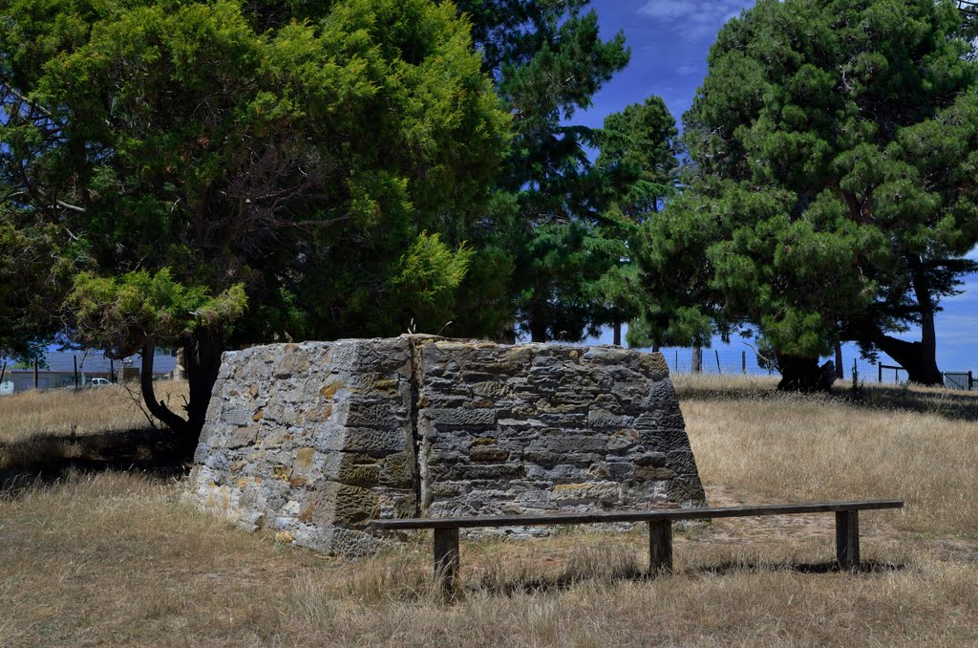
Baal and its altar 巴力和他的壇

Slide 6
Ashera 亞舍拉

Slide 7
I. Ahab—a busy man. 大忙人—亞哈
1. He built the temple, set up altar, made Asherah pole.
造廟, 築壇, 做亞舍拉 (1 Kings 6:32, 33).
2. Took Naboth’s vineyard for garden expansion.
拿了拿伯的葡萄園來增建皇宮(1 Kings 21:16).
3. Battle 3 times against Aram, 2 wins, 1 loss.
三次與亞蘭王便哈達戰爭, 二勝一負(1 Kings 20, 22)

Slide 8
II. Joe Biden—A political correct busy man 政治正確的大忙人Joe Biden
This is not a game.
1 message
Joe Biden <info@americanpossibilities.org> Wed, Jan 10, 2018 at 12:43 PM
Reply-To: info@americanpossibilities.org
To: Joseph Chang <prjosephchang@gmail.com>
Joseph --
What we saw last summer violated every core belief America holds in its
soul -- a president giving rhetorical comfort to Neo-Nazis after
Charlottesville, saying there were "fine people" on both sides. Fine
people?
Now what we just saw last week is downright dangerous -- a president
tweeting about the size of his nuclear button? The only thing worse than
an intended conflict is an unintended one, and these loose, irresponsible
tweets from the highest office in the country put us all at risk.
He attacks the bulwarks of our freedom. Labels the free press "fake
news." And has attacked our courts as political and biased.
Words matter, Joseph -- especially when they're coming from a president.
The foreign policy of the United States of America is not a game. The
American presidency is not a platform for chest-puffing.
If you're feeling powerless -- don't. Because we've got important work to
do, and it's work that can deliver the strongest-possible referendum on
this president's irresponsible behavior.
1/11/2018 Gmail - This is not a game.
https://mail.google.com/mail/u/0/?ui=2&ik=fde3a5db1e&jsver=pkG7biCEwPU.en.&view=pt&search=inbox&th=160e1d09c49ceb60&siml=160e1d09c49… 2/3
From now until this fall and beyond, I'm putting everything I can into
electing a new set of American leaders up and down the ballot -- folks who
will stand up for our core values and against the kind of reckless behavior
we're seeing from the President. Who truly understand the day-to-day
struggles of working families. Humble people with actual respect for the
offices they hold.
Are you with me? Then help make sure we have the resources to
make a difference in as many races this year as possible.
What have donations like yours done so far?
Last week, Doug Jones was sworn in as the next United States Senator
from Alabama. You helped make that happen when you asked this
organization to endorse him, and when you gave what you could to help
elect him.
And today, Danica Roem -- the first openly transgender elected official in
Virginia's history -- will convene with her state's General Assembly as its
next Delegate from Manassas. She's bound and determined to reduce
traffic congestion in her community, and I know she will. Your support
helped elect her.
I can't wait to see what we do this year. And I can tell you right now that
I'm going to beat a path all across this country to stump for as many
candidates as I can.
But I need your help to do it, Joseph. And so when I say your donations
help make sure we can support and campaign for as many promising
leaders as possible, I mean it.
So give what you can today, and let's make 2018 the year this
president realized, once and for all, that the American people are
done with his malarkey.
We've got to start right now.
Thanks -- and Happy New Year.
1/11/2018 Gmail - This is not a game.
https://mail.google.com/mail/u/0/?ui=2&ik=fde3a5db1e&jsver=pkG7biCEwPU.en.&view=pt&search=inbox&th=160e1d09c49ceb60&siml=160e1d09c49… 3/3
-Joe
Website Donate
Contributions or gifts to American Possibilities are not
tax deductible.
Paid for by American Possibilities and not authorized
by any candidate or candidate’s committee.
© 2017 American Possibilities. All Rights Reserved.
918 Pennsylvania Ave SE, Washington DC 20003
Privacy Policy | Terms of Service | Unsubscribe

Slide 9
II. Joe Biden—A political correct busy man 政治正確的大忙人Joe Biden
Joe Biden 大力攻擊川普總統的不適任以後, 提到民主黨的成就, 包括在阿拉巴馬州選出一個民主黨的參議員Doug Jones來補擔任Attorney General of US (美國的法務部長)的 Jeff Session的參議員的空缺. 以及民主黨第一位被選為維吉尼亞州的州議員的變性人 Danica Roem. 這是Joe Biden所引以為豪的成就, 在他忙碌的政治工作上面, 這是他支持性別平權的成就之一. 這是Political Correct 的一個信, 也反映出了這忙碌的美國政客的道德觀. 看起來很好, 但是上帝喜歡嗎?

Slide 10
III. Hiel—A Humanistic Busy man 一個人文主義的大忙人—希伊勒
Destruction of Jericho –1406 B.C.
耶利哥被毀—1406 B.C.
Ahab served as king of Israel—874 B.C.
亞哈做以色列王—874 B.C.
1406-874 = 532 years.

Slide 11
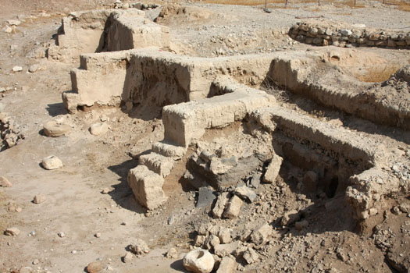
Father & Son Conversation 父子的對話

Slide 12
Father & Son Conversation 父子的對話
“²⁶當時，約書亞叫眾人起誓說：有興起重修這耶利哥城的人，當在耶和華面前受咒詛。他立根基的時候，必喪長子，安門的時候，必喪幼子。【書 6:26】 ²⁶At that time Joshua pronounced this solemn oath: "Cursed before the LORD is the man who undertakes to rebuild this city, Jericho: "At the cost of his firstborn son will he lay its foundations; at the cost of his youngest will he set up its gates." 【Josh 6:26】

Slide 13
Ahab & Hiel Conversation 亞哈和希伊勒對話
Hiel of Bethel 伯特利人希伊勒
King Ahab 亞哈王
“他立根基的時候，必喪長子，安門的時候，必喪幼子。” "At the cost of his firstborn son will he lay its foundations; at the cost of his youngest will he set up its gates." 【Josh 6:26】

Slide 14
Lay Foundation 立根基

Slide 15
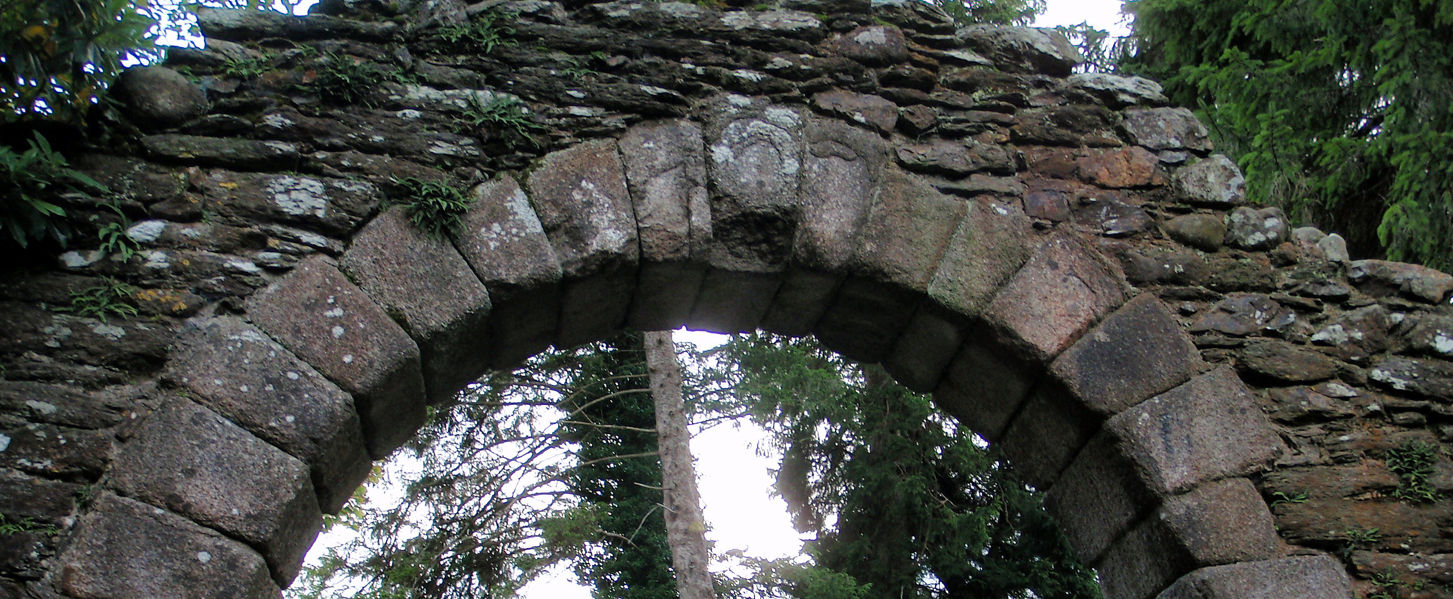
Keystone of the Gate 安城門

Slide 16
IV. Ahab—a practical busy man. 務實的大忙人—亞哈
³²在撒瑪利亞建造巴力的廟，在廟裡為巴力築壇。³³亞哈又做亞舍拉，他所行的惹耶和華─以色列 神的怒氣，比他以前的以色列諸王更甚。³⁴亞哈在位的時候，有伯特利人希伊勒重修耶利哥城；立根基的時候，喪了長子亞比蘭；安門的時候，喪了幼子西割，正如耶和華藉嫩的兒子約書亞所說的話。【王上 16:32~34】
³²He set up an altar for Baal in the temple of Baal that he built in Samaria. ³³Ahab also made an Asherah pole and did more to provoke the LORD, the God of Israel, to anger than did all the kings of Israel before him. ³⁴In Ahab's time, Hiel of Bethel rebuilt Jericho. He laid its foundations at the cost of his firstborn son Abiram, and he set up its gates at the cost of his youngest son Segub, in accordance with the word of the LORD spoken by Joshua son of Nun. 【1King 16:32~34】

Slide 17
Ahab son of Omri) Hiel of Bethel
亞哈王(暗利的兒子) 伯特利人希伊勒

Slide 18
Ahab son of Omri) Hiel of Bethel
亞哈王(暗利的兒子) 伯特利人希伊勒
Built Temple of Baal Rebuilt Jericho
建造巴力的廟 重修耶利哥城

Slide 19
Ahab son of Omri) Hiel of Bethel
亞哈王(暗利的兒子) 伯特利人希伊勒
Built Temple of Baal Rebuilt Jericho
建造巴力的廟 重修耶利哥城
Set up Altar for Baal Laid its Foundations
為巴力築壇 立根基

Slide 20
Ahab son of Omri) Hiel of Bethel
亞哈王(暗利的兒子) 伯特利人希伊勒
Built Temple of Baal Rebuilt Jericho
建造巴力的廟 重修耶利哥城
Set up Altar for Baal Laid its Foundations
為巴力築壇 立根基
Made an Asherah Pole Set up its Gates
做亞舍拉 安門

Slide 21
Ahab 亞哈王
³⁴有一人隨便開弓，恰巧射入以色列王的甲縫裡。王對趕車的說：我受了重傷，你轉過車來，拉我出陣罷！³⁵那日，陣勢越戰越猛，有人扶王站在車上，抵擋亞蘭人。到晚上，王就死了，血從傷處流在車中。【王上 22:34~35】 ³⁴But someone drew his bow at random and hit the king of Israel between the sections of his armor. The king told his chariot driver, "Wheel around and get me out of the fighting. I've been wounded." ³⁵All day long the battle raged, and the king was propped up in his chariot facing the Arameans. The blood from his wound ran onto the floor of the chariot, and that evening he died. 【1King 22:34~35】

Slide 22
Ahaziah 亞哈謝
⁵¹猶大王約沙法十七年，亞哈的兒子亞哈謝在撒瑪利亞登基，作以色列王共二年。【王上 22:51】 ⁵¹Ahaziah son of Ahab became king of Israel in Samaria in the seventeenth year of Jehoshaphat king of Judah, and he reigned over Israel two years. 【1King 22:51】
²亞哈謝在撒瑪利亞，一日從樓上的欄杆裡掉下來，就病了；【王下 1:2a】 ²Now Ahaziah had fallen through the lattice of his upper room in Samaria and injured himself.【2King 1:2a】

Slide 23
Joram 約蘭王
¹⁷亞哈謝果然死了，正如耶和華藉以利亞所說的話。因他沒有兒子，他兄弟約蘭接續他作王，正在猶大王約沙法的兒子約蘭第二年。【王下 1:17】 ¹⁷So he died, according to the word of the LORD that Elijah had spoken. Because Ahaziah had no son, Joram succeeded him as king in the second year of Jehoram son of Jehoshaphat king of Judah. 【2King 1:17】

Slide 24
Joram 約蘭王
²²約蘭見耶戶就說：耶戶啊，平安麼？耶戶說：你母親耶洗別的淫行邪術這樣多，焉能平安呢？²³約蘭就轉車逃跑，對亞哈謝說：亞哈謝啊，反了！²⁴耶戶開滿了弓，射中約蘭的脊背，箭從心窩穿出，約蘭就仆倒在車上。【王下 9:22~24】 ²²When Joram saw Jehu he asked, "Have you come in peace, Jehu?" "How can there be peace," Jehu replied, "as long as all the idolatry and witchcraft of your mother Jezebel abound?" ²³Joram turned about and fled, calling out to Ahaziah, "Treachery, Ahaziah!" ²⁴Then Jehu drew his bow and shot Joram between the shoulders. The arrow pierced his heart and he slumped down in his chariot. 【2King 9:22~24】

Slide 25
V. Are we the busy bee provoker? 我們是忙碌的虎頭蜂嗎?

Slide 26
California 加州
2 years ago, Greatest Drought in 100 years.
兩年前, 我們才經歷過100 年來最大的drought
Many years of budget deficit
我們有好多年的預算赤字.

Slide 27
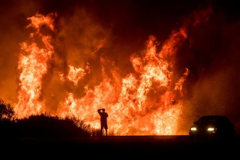
Northern California fires in October, which burned 245,000 acres, destroyed 8,900 structures and were blamed for 43 deaths.
A motorists on Highway 101 watches flames from the Thomas fire leap above the roadway north of Ventura, Calif., on Wednesday, Dec. 6, 2017. As many as five fires have closed highways, schools and museums, shut down production of TV series and cast a hazardous haze over the region. About 200,000 people were under evacuation orders. No deaths and only a few injuries were reported. (AP Photo/Noah Berger)

Slide 28
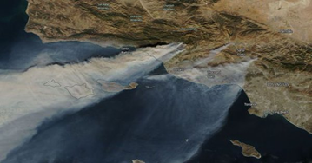
Satellite picture shows 3 brush fires are burning across Los Angeles and Ventura counties Tuesday.
(CNN) The Thomas Fire is now the largest wildfire in California's modern history after torching 273,400 acres. The blaze has surpassed the size of the Cedar Fire near San Diego, which destroyed 273,246 acres in 2003, according to the California Department of Forestry and Fire Protection, also known as Cal Fire.Dec 23, 2017

Slide 29
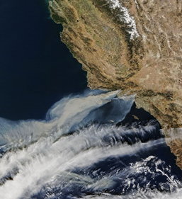
The Thomas Fire was a very large wildfire affecting Ventura and Santa Barbara counties, and one of multiple wildfires that ignited in Southern California on December 4, 2017. It burned approximately 281,893 acres (440 sq mi; 114,078 ha), becoming the largest wildfire in modern California history, and was fully contained on January 12, 2018.^{[12][13][3][6][14][a]} The Thomas Fire destroyed at least 1,063 structures, while damaging 280 others;^{[3][4][15][6]} becoming the seventh-most destructive wildfire in state history.^{[16][17]}

Slide 30
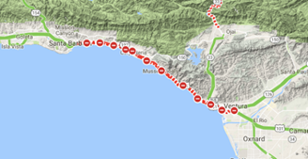
Santa Babara County Mud Slide 土石流

Slide 31
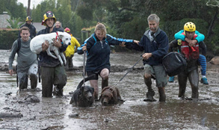
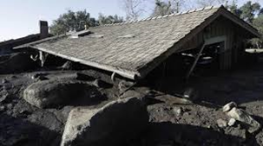

Slide 32
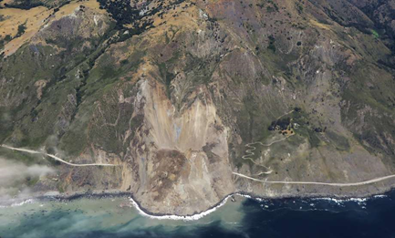
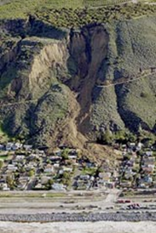

Slide 33
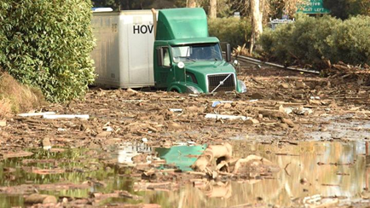
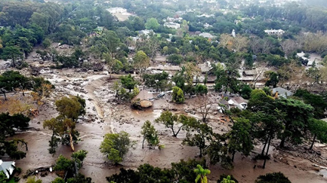
At this time 17 confirmed death and 43 missing.

Slide 34
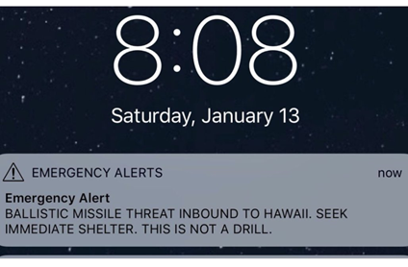

Slide 35
What are we? 我們在忙甚麼?
Busy Bee Advocator? 忙碌的虎頭蜂?
Busy in Bringing God’s Kingdom? 忙碌於帶進神的國度?

