Slide 1
Focus on the Lord 定睛在主身上
2/11/2018
BOLGPC 爾灣大公園靈糧堂
Rev. Y. Joseph Chang 張玉明牧師

Slide 2
The ‘Curse’ of Winning the Lottery? 贏樂透換來‘咒詛’?
2/6/2018

Slide 3
A woman won $559.7 million in New Hampshire
The New Hampshire woman who won the $559.7 million Powerball jackpot last month is refusing to claim her prize until she's assured anonymity.

Slide 4
Abraham Shakespeare, won $30 million in Florida’s lottery in 2009
was found buried in a makeshift grave under a concrete slab less than three years later. A woman who befriended him and offered to help manage what remained of his winnings instead murdered him; she was sentenced to life in prison.

Slide 5
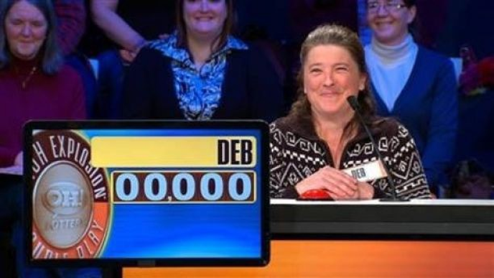
Deborah McDonald won $5,520 in the Ohio lottery’s TV game show
was run over and killed after leaving a bar where she’d been celebrating with friends.

Slide 6
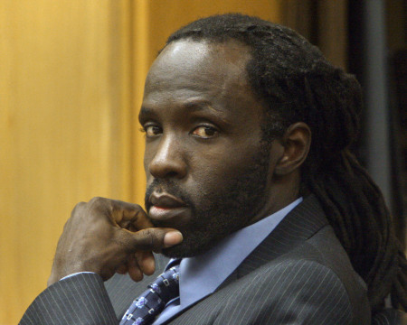
Jeffrey Dampier won an Illinois lottery jackpot of $20 million in 1996.
On July 26, 2005, Dampier was murdered by his sister-in-law, Victoria Jackson, and her boyfriend.

Slide 7
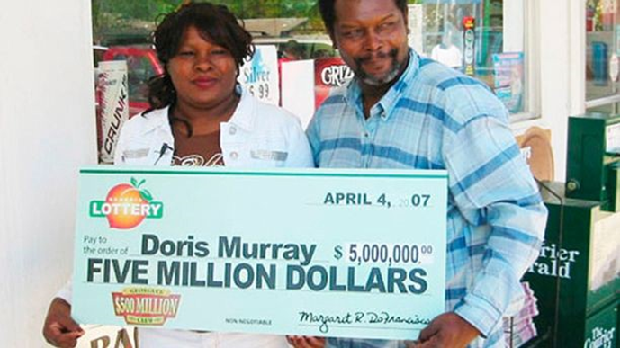
Doris Murray won $5 million in 2007 Georgia lottery
she was found stabbed to death in her home a year later, in May 2008. Murray’s ex-boyfriend was charged in her death.

Slide 8
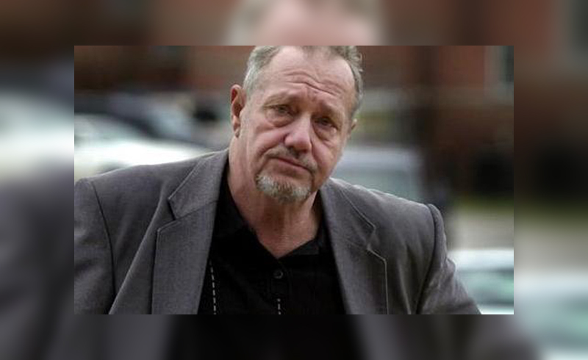
Billie Bob Harrell, Jr. won $31 million Texas Lotto, June 1997
Not long after that, he separated from his wife. He was found dead of a self-inflicted gunshot wound on May 22, 1999.

Slide 9
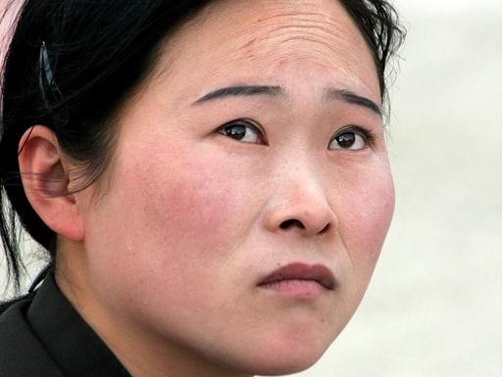
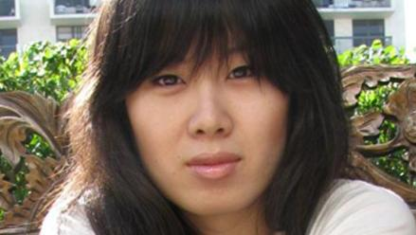
Janite Lee won $18 million in 1993
She gambled a lot and declared bankruptcy in 2001

Slide 10
"Of the thousands of lottery winners I knew, a few were happy and a few lived happily ever after," Edward Ugel, author of "Money for Nothing: One Man's Journey Through the Dark Side of Lottery Millions," told the Daily Beast. "But you would be blown away to see how many winners wish they'd never won."

Slide 11
"Of the thousands of lottery winners I knew, a few were happy and a few lived happily ever after," Edward Ugel, author of "Money for Nothing: One Man's Journey Through the Dark Side of Lottery Millions," told the Daily Beast. "But you would be blown away to see how many winners wish they'd never won.“
有多少的彩票的中獎人, 由衷的希望 “他們沒有中獎!”

Slide 12
¹過了許久，到第三年，耶和華的話臨到以利亞說：你去，使亞哈得見你；我要降雨在地上。²以利亞就去，要使亞哈得見他。那時，撒瑪利亞有大饑荒；³亞哈將他的家宰俄巴底召了來。〈俄巴底甚是敬畏耶和華，⁴耶洗別殺耶和華眾先知的時候，俄巴底將一百個先知藏了，每五十人藏在一個洞裡，拿餅和水供養他們。〉【王上 18:1~4】 ¹After a long time, in the third year, the word of the LORD came to Elijah: "Go and present yourself to Ahab, and I will send rain on the land." ²So Elijah went to present himself to Ahab. Now the famine was severe in Samaria, ³and Ahab had summoned Obadiah, who was in charge of his palace. (Obadiah was a devout believer in the LORD. ⁴While Jezebel was killing off the Lord's prophets, Obadiah had taken a hundred prophets and hidden them in two caves, fifty in each, and had supplied them with food and water.) 【1King 18:1~4】

Slide 13
⁵亞哈對俄巴底說：我們走遍這地，到一切水泉旁和一切溪邊，或者找得著青草，可以救活騾馬，免得絕了牲畜。⁶於是二人分地遊行，亞哈獨走一路，俄巴底獨走一路。⁷俄巴底在路上恰與以利亞相遇，俄巴底認出他來，就俯伏在地，說：你是我主以利亞不是？⁸回答說：是。你去告訴你主人說，以利亞在這裡。【王上 18:5-8】 ⁵Ahab had said to Obadiah, "Go through the land to all the springs and valleys. Maybe we can find some grass to keep the horses and mules alive so we will not have to kill any of our animals." ⁶So they divided the land they were to cover, Ahab going in one direction and Obadiah in another. ⁷As Obadiah was walking along, Elijah met him. Obadiah recognized him, bowed down to the ground, and said, "Is it really you, my lord Elijah?" ⁸"Yes," he replied. "Go tell your master, 'Elijah is here.'" 【1King 18:5-8】

Slide 14
⁹俄巴底說：僕人有甚麼罪，你竟要將我交在亞哈手裡，使他殺我呢？¹⁰我指著永生耶和華─你的 神起誓，無論哪一邦哪一國，我主都打發人去找你。若說你沒有在那裡，就必使那邦那國的人起誓說，實在是找不著你。【王上 18:9-10】 ⁹"What have I done wrong," asked Obadiah, "that you are handing your servant over to Ahab to be put to death? ¹⁰As surely as the LORD your God lives, there is not a nation or kingdom where my master has not sent someone to look for you. And whenever a nation or kingdom claimed you were not there, he made them swear they could not find you. 【1King 18:9-10】

Slide 15
¹¹現在你說，要去告訴你主人說，以利亞在這裡；¹²恐怕我一離開你，耶和華的靈就提你到我所不知道的地方去。這樣，我去告訴亞哈，他若找不著你，就必殺我；僕人卻是自幼敬畏耶和華的。【王上 18:11-12】 ¹¹But now you tell me to go to my master and say, 'Elijah is here.' ¹²I don't know where the Spirit of the LORD may carry you when I leave you. If I go and tell Ahab and he doesn't find you, he will kill me. Yet I your servant have worshiped the LORD since my youth. 【1King 18:11-12】

Slide 16
¹³耶洗別殺耶和華眾先知的時候，我將耶和華的一百個先知藏了，每五十人藏在一個洞裡，拿餅和水供養他們，豈沒有人將這事告訴我主麼？¹⁴現在你說，要去告訴你主人說，以利亞在這裡，他必殺我。¹⁵以利亞說：我指著所事奉永生的萬軍之耶和華起誓，我今日必使亞哈得見我。【王上 18:13~15】 ¹³Haven't you heard, my lord, what I did while Jezebel was killing the prophets of the LORD? I hid a hundred of the Lord's prophets in two caves, fifty in each, and supplied them with food and water. ¹⁴And now you tell me to go to my master and say, 'Elijah is here.' He will kill me!" ¹⁵Elijah said, "As the LORD Almighty lives, whom I serve, I will surely present myself to Ahab today." 【1King 18:13~15】

Slide 17
Obadiah, Chief of Staff for King Ahab (874-853 B.C.) ≠ Obadiah, the Minor Prophet (586 B.C.)
俄巴底, 亞哈王的家宰 (874-853 B.C.) ≠ 小先知書的作者俄巴底亞 (586 B.C.)

Slide 18
Obadiah speaks the truth (vv. 4, 13)
俄巴底說實話.
Obadiah was known as a devoted man (v. 13).
俄巴底的敬虔很多人都知道.

Slide 19
I. We are most comfortably focus on past spiritual achievement. 我們最舒服的就是注視在過去的屬靈成就上面.
Worldly Battle
世界的爭戰

Slide 20
I. We are most comfortably focus on past spiritual achievement. 我們最舒服的就是注視在過去的屬靈成就上面.
Spiritual Battle
屬靈的爭戰

Slide 21
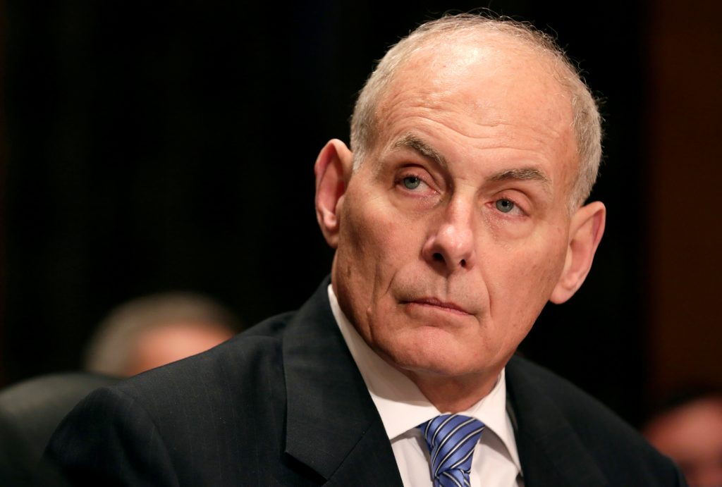
I. We are most comfortably focus on past spiritual achievement. 我們最舒服的就是注視在過去的屬靈成就上面.
Obadiah’s Battle
俄巴底的爭戰
=

Slide 22
⁹他在那裡進了一個洞，就住在洞中。耶和華的話臨到他說：以利亞啊，你在這裡做甚麼？¹⁰他說：我為耶和華─萬軍之 神大發熱心；因為以色列人背棄了你的約，毀壞了你的壇，用刀殺了你的先知，只剩下我一個人，他們還要尋索我的命。【王上 19:9~10; also 19:13-14】
⁹There he went into a cave and spent the night. And the word of the LORD came to him: "What are you doing here, Elijah?" ¹⁰He replied, "I have been very zealous for the LORD God Almighty. The Israelites have rejected your covenant, broken down your altars, and put your prophets to death with the sword. I am the only one left, and now they are trying to kill me too." 【1King 19:9~10, also 19:13-14】

Slide 23
II. We avoid facing battle of today. 我們避免面對今日的爭戰.
¹過了許久，到第三年，耶和華的話臨到以利亞說：你去，使亞哈得見你；我要降雨在地上。【王上 18:1】 ¹After a long time, in the third year, the word of the LORD came to Elijah: "Go and present yourself to Ahab, and I will send rain on the land." 【1King 18:1】

Slide 24
⁷俄巴底在路上恰與以利亞相遇，俄巴底認出他來，就俯伏在地，說：你是我主以利亞不是？⁸回答說：是。你去告訴你主人說，以利亞在這裡。⁹俄巴底說：僕人有甚麼罪，你竟要將我交在亞哈手裡，使他殺我呢？¹⁰我指著永生耶和華─你的 神起誓，無論哪一邦哪一國，我主都打發人去找你。若說你沒有在那裡，就必使那邦那國的人起誓說，實在是找不著你。¹¹現在你說，要去告訴你主人說，以利亞在這裡；¹²恐怕我一離開你，耶和華的靈就提你到我所不知道的地方去。這樣，我去告訴亞哈，他若找不著你，就必殺我；僕人卻是自幼敬畏耶和華的。【王上 18:7~12】 ⁷As Obadiah was walking along, Elijah met him. Obadiah recognized him, bowed down to the ground, and said, "Is it really you, my lord Elijah?" ⁸"Yes," he replied. "Go tell your master, 'Elijah is here.'" ⁹"What have I done wrong," asked Obadiah, "that you are handing your servant over to Ahab to be put to death? ¹⁰As surely as the LORD your God lives, there is not a nation or kingdom where my master has not sent someone to look for you. And whenever a nation or kingdom claimed you were not there, he made them swear they could not find you. ¹¹But now you tell me to go to my master and say, 'Elijah is here.' ¹²I don't know where the Spirit of the LORD may carry you when I leave you. If I go and tell Ahab and he doesn't find you, he will kill me. Yet I your servant have worshiped the LORD since my youth. 【1King 18:7~12】

Slide 25
⁷俄巴底在路上恰與以利亞相遇，俄巴底認出他來，就俯伏在地，說：你是我主以利亞不是？⁸回答說：是。你去告訴你主人說，以利亞在這裡。⁹俄巴底說：僕人有甚麼罪，你竟要將我交在亞哈手裡，使他殺我呢？¹⁰我指著永生耶和華─你的 神起誓，無論哪一邦哪一國，我主都打發人去找你。若說你沒有在那裡，就必使那邦那國的人起誓說，實在是找不著你。¹¹現在你說，要去告訴你主人說，以利亞在這裡；¹²恐怕我一離開你，耶和華的靈就提你到我所不知道的地方去。這樣，我去告訴亞哈，他若找不著你，就必殺我；僕人卻是自幼敬畏耶和華的。【王上 18:7~12】 ⁷As Obadiah was walking along, Elijah met him. Obadiah recognized him, bowed down to the ground, and said, "Is it really you, my lord Elijah?" ⁸"Yes," he replied. "Go tell your master, 'Elijah is here.'" ⁹"What have I done wrong," asked Obadiah, "that you are handing your servant over to Ahab to be put to death? ¹⁰As surely as the LORD your God lives, there is not a nation or kingdom where my master has not sent someone to look for you. And whenever a nation or kingdom claimed you were not there, he made them swear they could not find you. ¹¹But now you tell me to go to my master and say, 'Elijah is here.' ¹²I don't know where the Spirit of the LORD may carry you when I leave you. If I go and tell Ahab and he doesn't find you, he will kill me. Yet I your servant have worshiped the LORD since my youth. 【1King 18:7~12】

Slide 26
⁷俄巴底在路上恰與以利亞相遇，俄巴底認出他來，就俯伏在地，說：你是我主以利亞不是？⁸回答說：是。你去告訴你主人說，以利亞在這裡。⁹俄巴底說：僕人有甚麼罪，你竟要將我交在亞哈手裡，使他殺我呢？¹⁰我指著永生耶和華─你的 神起誓，無論哪一邦哪一國，我主都打發人去找你。若說你沒有在那裡，就必使那邦那國的人起誓說，實在是找不著你。¹¹現在你說，要去告訴你主人說，以利亞在這裡；¹²恐怕我一離開你，耶和華的靈就提你到我所不知道的地方去。這樣，我去告訴亞哈，他若找不著你，就必殺我；僕人卻是自幼敬畏耶和華的。【王上 18:7~12】 ⁷As Obadiah was walking along, Elijah met him. Obadiah recognized him, bowed down to the ground, and said, "Is it really you, my lord Elijah?" ⁸"Yes," he replied. "Go tell your master, 'Elijah is here.'" ⁹"What have I done wrong," asked Obadiah, "that you are handing your servant over to Ahab to be put to death? ¹⁰As surely as the LORD your God lives, there is not a nation or kingdom where my master has not sent someone to look for you. And whenever a nation or kingdom claimed you were not there, he made them swear they could not find you. ¹¹But now you tell me to go to my master and say, 'Elijah is here.' ¹²I don't know where the Spirit of the LORD may carry you when I leave you. If I go and tell Ahab and he doesn't find you, he will kill me. Yet I your servant have worshiped the LORD since my youth. 【1King 18:7~12】

Slide 27
What happened in Obadiah’s Life? 俄巴底的生命發生了甚麼事?
¹⁶你既如溫水，也不冷也不熱，所以我必從我口中把你吐出去。【啟 3:16】 ¹⁶So, because you are lukewarm--neither hot nor cold--I am about to spit you out of my mouth. 【Rev 3:16】

Slide 28
The older one gets, the more reluctant to engage in spiritual battle. This is one warning sign.
人愈來愈老, 愈不喜歡爭戰, 這在屬靈的靈程上面是一個警訊.
The more comfortable one gets, the more unwilling one is to engage in spiritual battle. This is another warning sign.
人愈來愈舒服, 也愈不喜歡爭戰, 這在屬靈的靈程上面也是一個警訊.

Slide 29
III. How do we keep us hot for the Lord? 如何保持在神面前的熱情?
A. Remember, “Winning the lottery could be a curse”. 要記得, “贏得彩票可能是一個咒詛.”
⁴⁷因為你富有的時候，不歡心樂意的事奉耶和華─你的 神，【申 28:47】 ⁴⁷Because you did not serve the LORD your God joyfully and gladly in the time of prosperity, 【Deut 28:47】

Slide 30
亞古珥(Agur son of Jakeh)
⁷我求你兩件事，在我未死之先，不要不賜給我：⁸求你使虛假和謊言遠離我；使我也不貧窮也不富足；賜給我需用的飲食，⁹恐怕我飽足不認你，說：耶和華是誰呢？又恐怕我貧窮就偷竊，以致褻瀆我 神的名。【箴 30:7~9】 ⁷"Two things I ask of you, O LORD; do not refuse me before I die: ⁸Keep falsehood and lies far from me; give me neither poverty nor riches, but give me only my daily bread. ⁹Otherwise, I may have too much and disown you and say, 'Who is the LORD?' Or I may become poor and steal, and so dishonor the name of my God. 【Prov 30:7~9】

Slide 31
III. How do we keep us hot for the Lord? 如何保持在神面前的熱情?
B. Keep to Your Heart Your First Love保護起初的愛心

