Slide 1
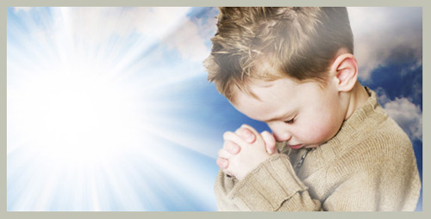
Prayer 禱告
4/28/2019
Rev. Joseph Chang
BOLGPC 爾灣大公園靈糧堂

Slide 2
⁵耶穌又說：你們中間誰有一個朋友半夜到他那裡去，說：朋友！請借給我三個餅；⁶因為我有一個朋友行路，來到我這裡，我沒有甚麼給他擺上。⁷那人在裡面回答說：不要攪擾我，門已經關閉，孩子們也同我在床上了，我不能起來給你。⁸我告訴你們，雖不因他是朋友起來給他，但因他情詞迫切的直求，就必起來照他所需用的給他。
【路 11:5~13】
⁵And he said to them, ""Which of you who has a friend will go to him at midnight and say to him, 'Friend, lend me three loaves," ⁶"for a friend of mine has arrived on a journey, and I have nothing to set before him';" ⁷"and he will answer from within, 'Do not bother me; the door is now shut, and my children are with me in bed. I cannot get up and give you anything'?" ⁸"I tell you, though he will not get up and give him anything because he is his friend, yet because of his impudence he will rise and give him whatever he needs."【Luke 11:5~13】

Slide 3
⁹我又告訴你們，你們祈求，就給你們；尋找，就尋見；叩門，就給你們開門。¹⁰因為，凡祈求的，就得著；尋找的，就尋見；叩門的，就給他開門。¹¹你們中間作父親的，誰有兒子求餅，反給他石頭呢？求魚，反拿蛇當魚給他呢？¹²求雞蛋，反給他蠍子呢？¹³你們雖然不好，尚且知道拿好東西給兒女；何況天父，豈不更將聖靈給求他的人麼？
【路 11:5~13】
⁹"And I tell you, ask, and it will be given to you; seek, and you will find; knock, and it will be opened to you." ¹⁰"For everyone who asks receives, and the one who seeks finds, and to the one who knocks it will be opened." ¹¹"What father among you, if his son asks fora fish, will instead of a fish give him a serpent;" ¹²"or if he asks for an egg, will give him a scorpion?" ¹³"If you then, who are evil, know how to give good gifts to your children, how much more will the heavenly Father give the Holy Spirit to those who ask him!" " 【Luke 11:5~13】

Slide 4
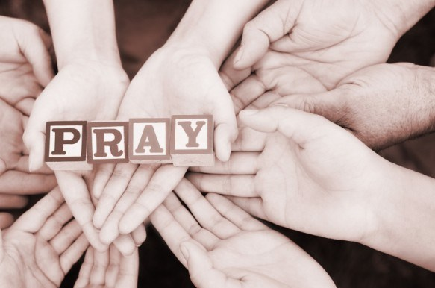
在主耶穌的教導裡面, 我們要問幾個簡單的問題:
In the teaching of the Lord Jesus, we have to ask
a few simple questions:

Slide 5
I. 禱告是單向的還是雙向的?
Is the prayer one directional or bi-directional?
➔是雙向的. 有求的, 有給的.
It is bi-directional . There is demand, there is giving.
➔而且一方還有可能改變另外一方原來的想法.
And one party may change the original idea of the other
party.

Slide 6
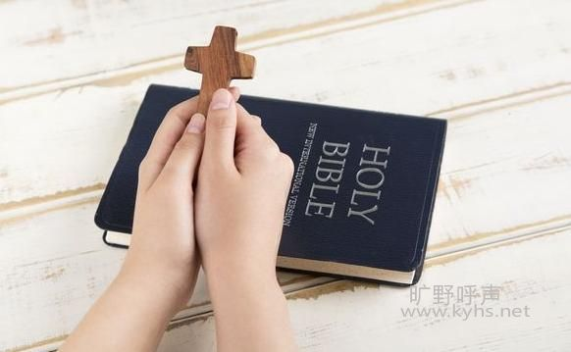
主耶穌為什麼不要我們在眾人面前作冗長的禱告呢?
Why does the Lord Jesus not want us to make lengthy
prayers before the people?

Slide 7
⁵你們禱告的時候，不可像那假冒為善的人，愛站在會堂裡和十字路口上禱告，故意叫人看見。我實在告訴你們，他們已經得了他們的賞賜。. . . ⁷你們禱告，不可像外邦人，用許多重複話，他們以為話多了必蒙垂聽。
【太 6:5, 7】 ⁵"And when you pray, you must not be like the hypocrites. For they love to stand and pray in the synagogues and at the street corners, that they may be seen by others. Truly, I say to you, they have received their reward." . . . ⁷"And when you pray, do not heap up empty phrases as the Gentiles do, for they think that they will be heard for their many words." 【Matt 6:5, 7】

Slide 8
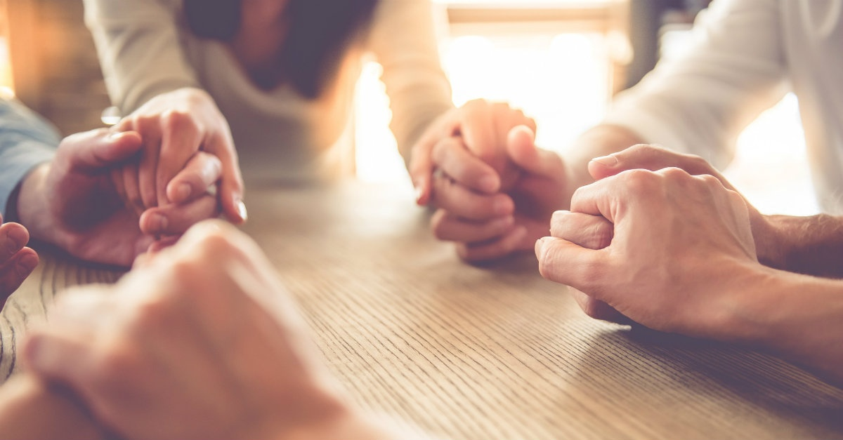
Application:

Slide 9
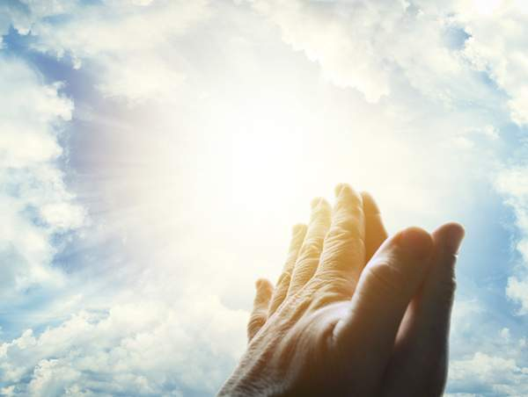
II. 禱告蒙應允的主權在誰的手上?
Who has the authority to decide the outcome of the prayer?
➔決定禱告蒙不蒙應允是在神的手中, 而不是在我們的手中.
Whether the prayer is answered or not is in the hands of
God, not in our hands.

Slide 10
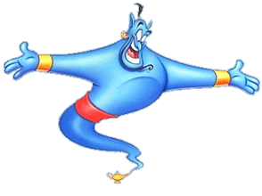
Illustration 1:

Slide 11
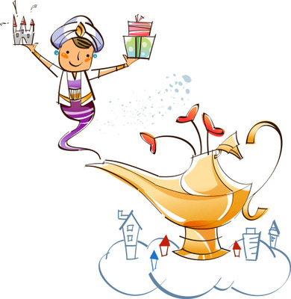
Illustration 2:

Slide 12
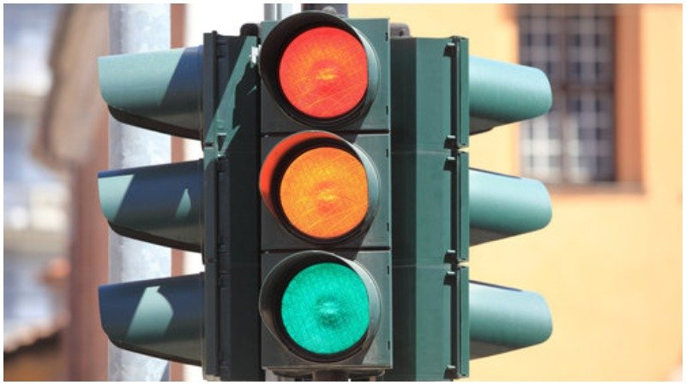
神對我們禱告的蒙應允, 可以用交通號誌來代表:
God’s answer to our prayers can be represented by
traffic signs:
紅燈:
NO
綠燈:
YES
黃燈:
SLOW DOWN

Slide 13
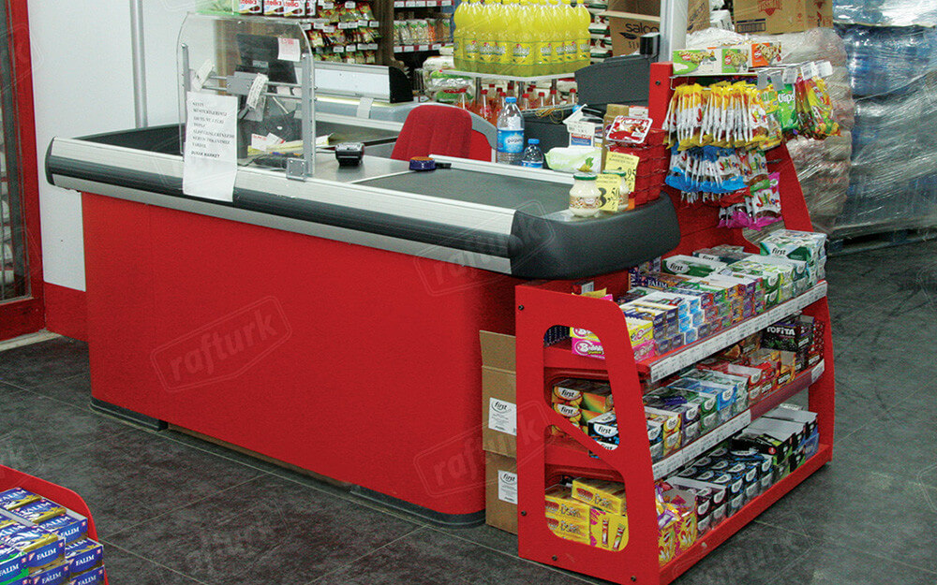
Illustration:

Slide 14
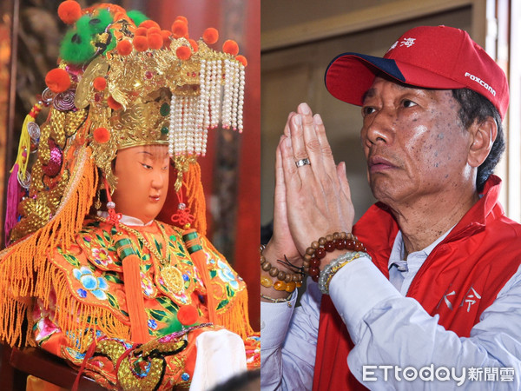
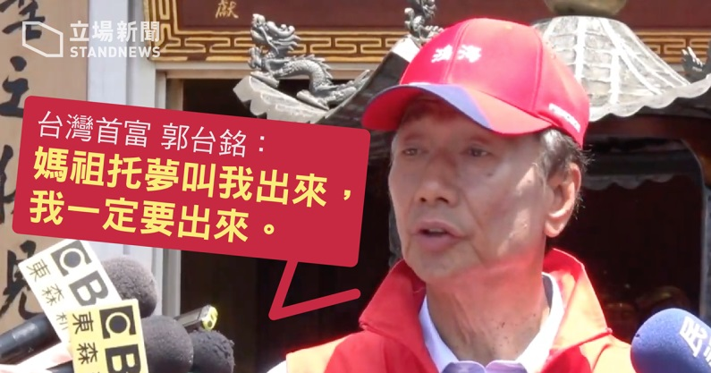
III. 禱告如何改變我們?/ How does prayer change us?
Illustration1:

Slide 15
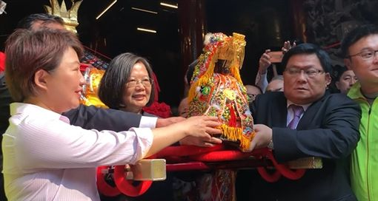
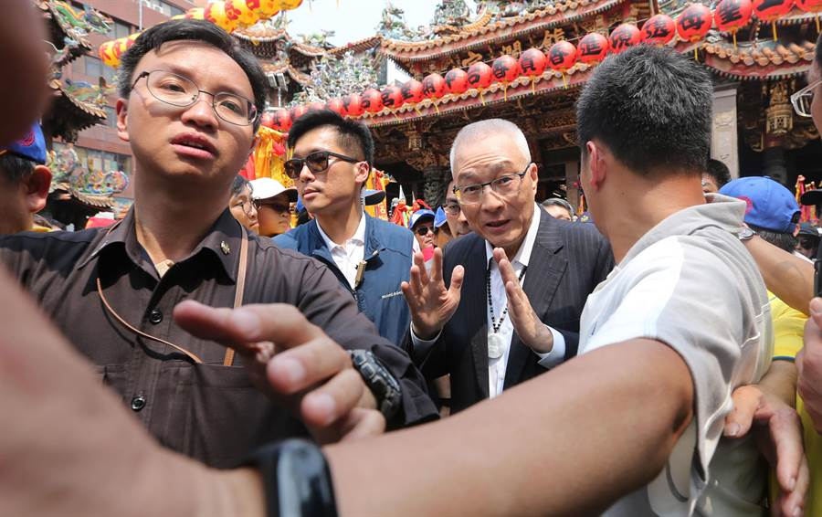
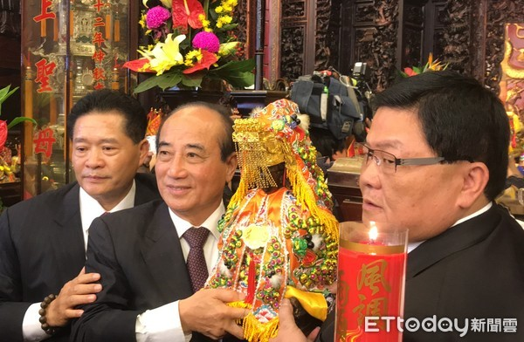
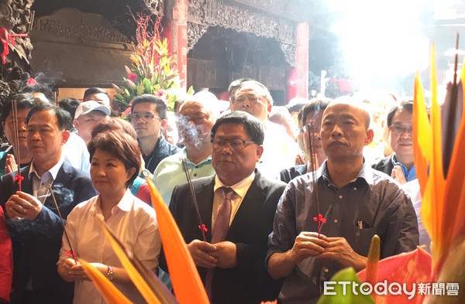
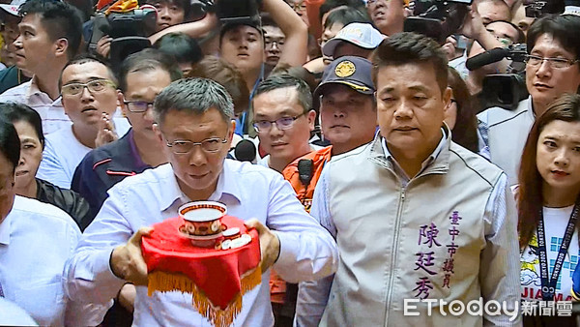
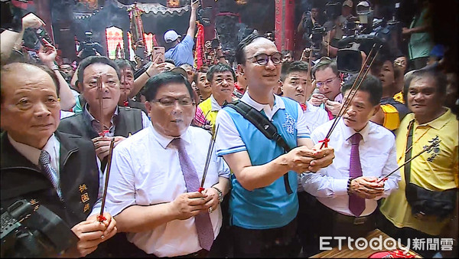

Slide 16
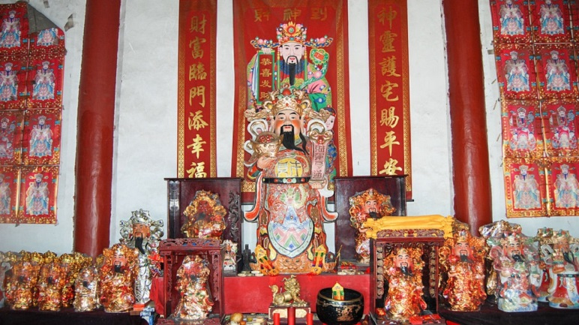
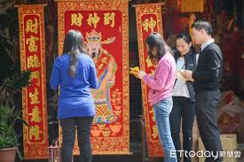
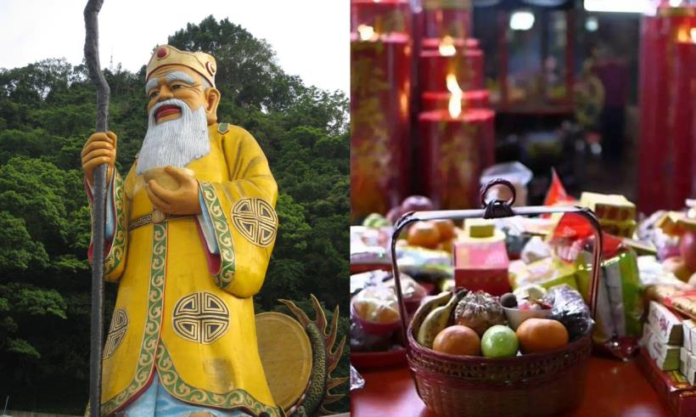
Illustration 2:

Slide 17
⁸世人哪，耶和華已指示你何為善。他向你所要的是甚麼呢？只要你行公義，好憐憫，存謙卑的心，與你的 神同行。【彌 6:8】
⁸He has told you, O man, what is good; and what does the Lord require of you but to do justice, and to love kindness, and to walk humbly with your God? 【Mic 6:8】

Slide 18
聖經不是充滿這樣子的故事嗎?/The Bible is full of such stories .
1.約瑟是如何成為埃及的宰相的?
How did Joseph become the prime minister of Egypt (2nd only to
Pharaoh)?
2.但以理是如何成為巴比倫, 波斯帝國的宰相的?
How did Daniel become the highest official in the kingdom of
Babylon & Persia?
3.尼希米是如何成為波斯王的酒政的?
How did Nehemiah become the cup bearer of the Persian King?
4. 大衛是如何成為以色列的國王的?
How did David become the king of Israel?

Slide 19
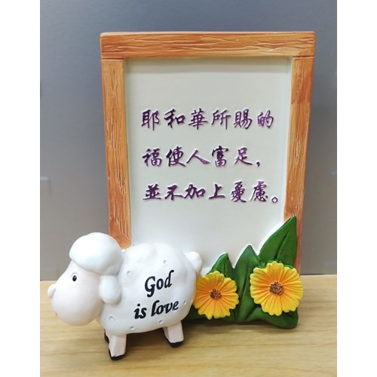
➔主耶穌要我們好好的愈來愈像神, 那麼神的祝福就會加
在我們的身上.
The Lord Jesus wants us to be more and more like God,
then God's blessing will be added to us.
²²耶和華所賜的福使人富足，並不加上憂慮。【箴 10:22】 ²²The blessing of the Lord makes rich, and he adds no sorrow with it. 【Prov 10:22】

Slide 20
我們要如何做呢? / How do we do it?
⁶應當一無罣慮，只要凡事藉著禱告、祈求，和感謝，將你們所要的告訴神。⁷神所賜、出人意外的平安必在基督耶穌裡保守你們的心懷意念。【腓 4:6~7】
⁶do not be anxious about anything, but in everything by prayer and supplication with thanksgiving let your requests be made known to God. ⁷And the peace of God, which surpasses all understanding, will guard your hearts and your minds in Christ Jesus. 【Phil 4:6~7】

Slide 21
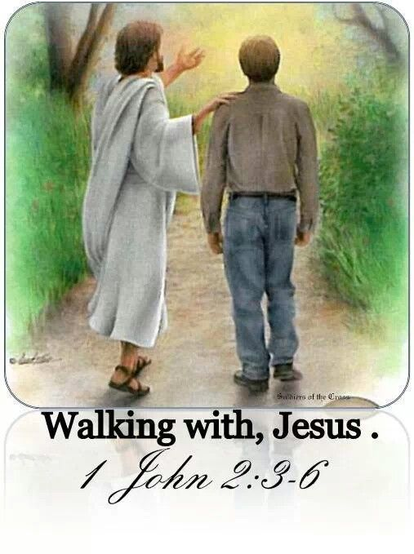
讓我們成為這樣子的人:
Let us be such people.
行公義，好憐憫，存謙卑的心，與你的 神同行。
【彌 6:8】
to do justice, and to love kindness, and to walk humbly with your God? 【Mic 6:8】

