Slide 1
True Obedience
真正的順服
Matthew 21:28-32
6/23/2019 Rev. Joseph Chang
BOLGPC 爾灣 大公園靈糧堂

Slide 2
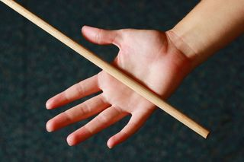
Q:要不要打小孩?
Is it necessary to beat your child as a punishment?
➔我的答案是, “要!”
My answer is, "Yes!"
特別是對於挑戰權柄, 不尊重父母, 甚至打父母的一定要
處罰.
Especially those who challenge the authority, not respect their parents, or even beat their parents must be punished.

Slide 3
神講得更嚴厲: /God speaks more harshly:
¹⁵打父母的，必要把他治死。 ^{. . . 17}咒罵父母的，必要把他治死。
【出 21:15~17】 ¹⁵"Whoever strikes his father or his mother shall be put to death. . . . ¹⁷"Whoever curses his father or his mother shall be put to death. 【Exod 21:15~17】

Slide 4
“你這樣子不乖!” "You are so bad!"
“你這樣子上帝不喜歡!” "God doesn't like you .”
“你這樣子會讓爸爸媽媽傷心歐!”
“You will make your mom and dad sad.”
“你這樣子主耶穌不愛你歐!” “The Lord Jesus does not love you !"
“阿公阿嬤會說, 我的孫子怎麼是這樣子的呢?”
“Grandpa and Grandma will say, ‘Why is my grandson so bad? '"
➔你的孩子會聽到很多負面的評語.
Your child will hear a lot of negative words.

Slide 5
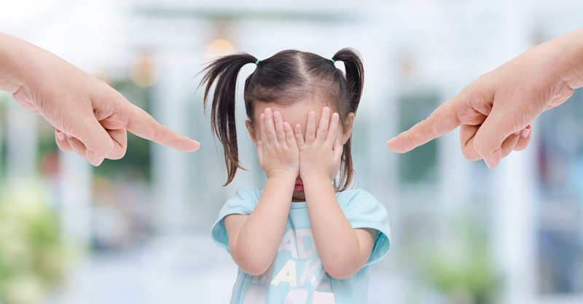
Q:話語帶來的傷害大, 還是藤條帶來的傷害大?
Which will cause more damage, the cane or your words?
➔話語的力量大多了. 藤條只是痛一時, 但是話語跟隨你
一輩子.
The power of words is much greater. Getting caned is just
a sharp pain, but the words follow you forever.

Slide 6
Q:我怎麼帶孩子? / How do I raise my children?
➔我會用棍子打孩子, 棍子是改變他們的惡劣的行為.
I hit my children with a cane to correct their bad behavior.
➔我對他們講的話都是鼓勵造就的話.
What I said to them are all encouraging and motivational
words.
影響到了他們哥哥弟弟妹妹之間的溝通, 他們彼此之間講的都
是讚美鼓勵的話. 很少看到他們Put each other down.
It affects the communication between the brothers and sisters.
They give praise and encouragement to each other. They don’t
put each other down.

Slide 7
主耶穌很清楚的告訴教會的人, 甚麼才是父神的心意?
The Lord Jesus clearly told the people in the church what God’s
will is.
➔下面就是個比喻:/Here is a metaphor:
²⁸又說：一個人有兩個兒子。他來對大兒子說：我兒，你今天到葡萄園裡去做工。²⁹他回答說：我不去，以後自己懊悔，就去了。³⁰又來對小兒子也是這樣說。他回答說：父阿，我去，他卻不去。
²⁸""What do you think? A man had two sons. And he went to the first and said, 'Son, go and work in the vineyard today.'" ²⁹"And he answered, 'I will not,' but afterward he changed his mind and went." ³⁰"And he went to the other son and said the same. And he answered, 'I go, sir,' but did not go."

Slide 8
³¹你們想，這兩個兒子是那一個遵行父命呢？他們說：大兒子。
耶穌說：我實在告訴你們，稅吏和娼妓倒比你們先進神的國。³²因為約翰遵著義路到你們這裡來，你們卻不信他；稅吏和娼妓倒信他。你們看見了，後來還是不懊悔去信他。【太 21:28~32】
³¹"Which of the two did the will of his father?" "They said, "The first. "Jesus said to them, ""Truly, I say to you, the tax collectors and the prostitutes go into the kingdom of God before you." ³²"For John came to you in the way of righteousness, and you did not believe him, but the tax collectors and the prostitutes believed him. And even when you saw it, you did not afterward change your minds and believe him. " 【Matt 21:28~32】

Slide 9
這裡有一些概要性的解釋, 來幫助大家了解:
Here are some general concepts that will help you
understand it.
1.葡萄園的工作, 就是代表神國度的工作.
The work of the vineyard is the work of the kingdom
of God.

Slide 10
2. 主耶穌所說的 “你們” 是誰?
Who is the "you" that the Lord Jesus said in this verse?
➔祭司長和文士/ the chief priests and the scribes
❖ 祭司長 = 教會中有擔負事工的人, 就是教會中的牧師傳道人,
Youth Director, Children Director, 理事, 小組長.
The chief priests are those who take on responsibilities for the
ministry. They are pastors, missionaries, Youth Directors, Children
Directors, directors, and group leaders.
文士 = 教會中很喜歡Bible Study 的人, 在教會裡面上主日學的人,
到外面BSF (Bible Study Fellowship) 努力查經的人.
The scribes are those who like Bible Study . They go to the Sunday
school in the church or the BSF (Bible Study Fellowship) to study the
Bible.

Slide 11
➔若果祭司長, 文士對的我們就要學, 如果祭司長文士不對的, 我們就要改.
If the chief priests and the scribes are right, we must learn.
If the chief priests and the scribes are wrong, we will change.
➔因為我們在葡萄園工作, 不是要討人的喜歡, 乃是要討主耶穌的喜歡.
It is because we work in the vineyards not to please people, but to please the Lord Jesus.

Slide 12
3. 在這個故事裡面, 誰是聽話的? 也就是誰是遵行父命的呢?
Who is obedient in this story?
In other words, who did the will of the father?
➔大兒子/the first son
=就是主耶穌講話的對象裡面這些稅吏, 娼妓.
the tax collectors and the prostitutes whom Jesus talked to
這裡的聽話, 就是真正順服神的人
Those who are obedient in this story demonstrate what true obedience to God is.

Slide 13
4. 這個故事裡面, 誰是不聽話的? 也就是不遵行父命的呢?
Who is disobedient in this story ?
In other words, who didn’t follow the will of the father?
➔小兒子/the second son
=就是有表面上服事神的工作, 所任的職務就是祭司長, 文士
the priests and the scribes who pretend they are obedient to God
主耶穌說, 這是不聽話的人, 這是反而不能夠進神國的人.
Those who are disobedient are not able to enter the
kingdom of God.

Slide 14
Q:那麼這個故事對我們是甚麼意思?
What does this story inspire us?
I. 主不看過去的地位, 而看現在與將來的同心同工.
The Lord does not judge you by your past status, but by
your current and future work.

Slide 15
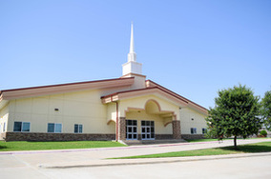
Illustration 1:
布蘭諾華人宣道會 / Plano Chinese Alliance Church

Slide 16
¹摩西從摩押平原登尼波山，上了那與耶利哥相對的毘斯迦山頂。耶和華把基列全地直到但，²拿弗他利全地，以法蓮、瑪拿西的地，猶大全地直到西海，³南地和棕樹城耶利哥的平原，直到瑣珥，都指給他看。⁴耶和華對他說：這就是我向亞伯拉罕、以撒、雅各起誓應許之地，
¹Then Moses went up from the plains of Moab to Mount Nebo, to the top of Pisgah, which is opposite Jericho. And the Lord showed him all the land, Gilead as far as Dan, ²all Naphtali, the land of Ephraim and Manasseh, all the land of Judah as far as the western sea, ³the Negeb, and the Plain, that is, the Valley of Jericho the city of palm trees, as far as Zoar. ⁴And the Lord said to him, "This is the land of which I swore to Abraham, to Isaac, and to Jacob,

Slide 17
說：我必將這地賜給你的後裔。現在我使你眼睛看見了，你卻不得過到那裡去。⁵於是，耶和華的僕人摩西死在摩押地，正如耶和華所說的。⁶耶和華將他埋葬在摩押地、伯毘珥對面的谷中，只是到今日沒有人知道他的墳墓。⁷摩西死的時候年一百二十歲；眼目沒有昏花，精神沒有衰敗。【申 34:1~7】
'I will give it to your offspring.' I have let you see it with your eyes, but you shall not go over there." ⁵So Moses the servant of the Lord died there in the land of Moab, according to the word of the Lord, ⁶and he buried him in the valley in the land of Moab opposite Beth-peor; but no one knows the place of his burial to this day. ⁷Moses was 120 years old when he died. His eye was undimmed, and his vigor unabated. 【Deut 34:1~7】

Slide 18
¹²小子們哪，我寫信給你們，因為你們的罪藉著主名得了赦免。¹³父老阿，我寫信給你們，因為你們認識那從起初原有的。少年人哪，我寫信給你們，因為你們勝了那惡者。小子們哪，我曾寫信給你們，因為你們認識父。【約一 2:12~13】
¹²I am writing to you, little children, because your sins are forgiven for his name's sake. ¹³I am writing to you, fathers, because you know him who is from the beginning. I am writing to you, young men, because you have overcome the evil one. I write to you, children, because you know the Father. 【1John 2:12~13】

Slide 19
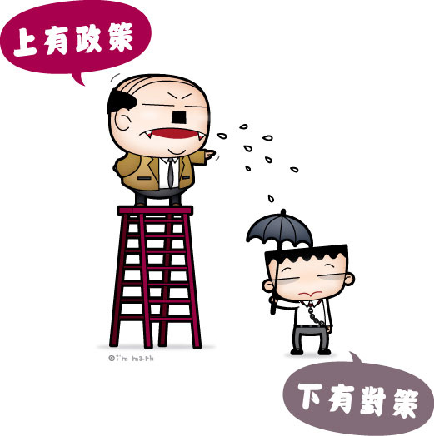
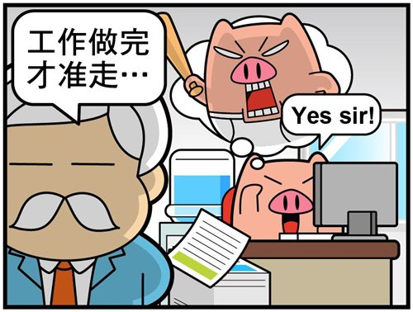
II. 主要的是實際的聽話, 而不是表面的應付.
The important thing is true obedience instead of
being merely cosmetic.
☒“陽奉陰違”/fake obedience
☒

Slide 20
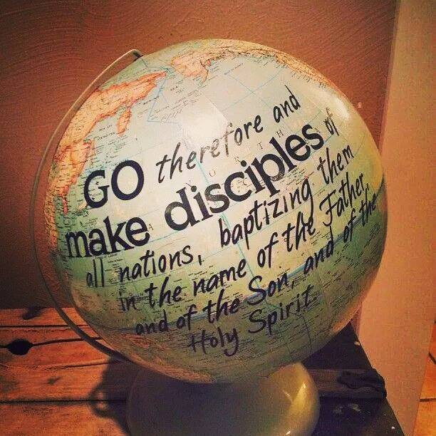

Slide 21
³⁷你們的話，是，就說是；不是，就說不是；若再多說，就是出於那惡者（或作：是從惡裡出來的）。
【太 5:37】
³⁷Simply let your 'Yes' be 'Yes,' and your 'No,' 'No'; anything beyond this comes from the evil one.
【Matt 5:37】
➔所以在神的國度裡面, 首先要求的就是誠實, 做不做都可以, 但是就是要表裡合一.
Therefore, in the kingdom of God, the first requirement is honesty.

Slide 22
III. 神國度的工作是動態的不是靜態的.
The work of the kingdom of God is dynamic rather than
being static.
選擇題/multiple choice question:
( )當神設立教會, (如: 把祭司長文士建立妥當)
After God established the church (e.g. the chief priests and scribes)
2
①神就說, 開始上班, 行禮如儀, 等待主耶穌的再臨.
God said, treat church like an employment, day in and day out, waiting for the return of the Lord Jesus.
②神就說, 開始工作, 把神的國度帶進來.
God said, start working and bring in the kingdom of God.

Slide 23
➔所以神會在國度進行的時候, 在不同的時間, 號召起不同的人來帶領不同的教會作不同的事工.
Therefore, when the kingdom of God is going on, at different times, God will call different leaders to lead different church for different ministry.
➔穌講這故事的時候, 神所用的人是施洗約翰.
In this story, the person God used was John the Baptist.

Slide 24
Conclusion:
真正順服的人是敬畏神而不是害怕人.
The true obedient person fears God rather than
being afraid of people.

Slide 25
²³耶穌進了殿，正教訓人的時候，祭司長和民間的長老來問他說：你仗著甚麼權柄做這些事？給你這權柄的是誰呢？²⁴耶穌回答說：我也要問你們一句話，你們若告訴我，我就告訴你們我仗著甚麼權柄做這些事。 ²⁵約翰的洗禮是從那裡來的？是從天上來的？是從人間來的呢？
²³And when he entered the temple, the chief priests and the elders of the people came up to him as he was teaching, and said, "By what authority are you doing these things, and who gave you this authority?" ²⁴Jesus answered them, ""I also will ask you one question, and if you tell me the answer, then I also will tell you by what authority I do these things." ²⁵"The baptism of John, from where did it come? From heaven or from man?"

Slide 26
他們彼此商議說：我們若說從天上來，他必對我們說：這樣，你們為甚麼不信他呢？²⁶若說從人間來，我們又怕百姓，因為他們都以約翰為先知。²⁷於是回答耶穌說：我們不知道。耶穌說：我也不告訴你們我仗著甚麼權柄做這些事。【太 21:23~27】
"And they discussed it among themselves, saying, "If we say, 'From heaven,' he will say to us, 'Why then did you not believe him?' ²⁶But if we say, 'From man,' we are afraid of the crowd, for they all hold that John was a prophet." ²⁷So they answered Jesus, "We do not know." And he said to them, ""Neither will I tell you by what authority I do these things. " 【Matt 21:23~27】

Slide 27
Q:你們覺得耶穌是靠著天上的權柄教訓人,
還是地上的權柄?
Do you think that Jesus was teaching the people by the
authority of heaven, or the authority of the earth?
➔當然是天上的權柄
the authority of heaven

Slide 28
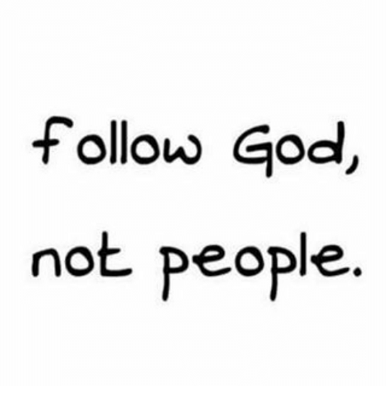
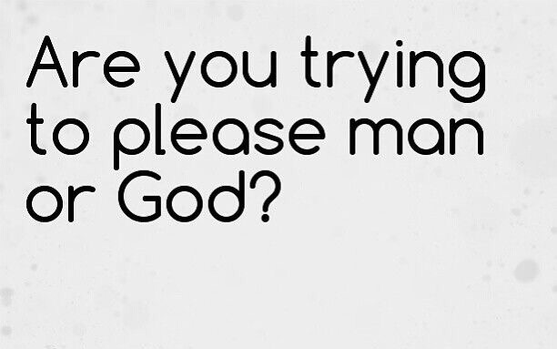
Q:我們做決定是要討人喜歡呢? 還是要討神喜歡呢?
➔
➔要真正的順服, 就要討神的喜歡, 而不是要懼怕人.
To be truly obedient, it is necessary to please God, not
to fear people.

