Slide 1
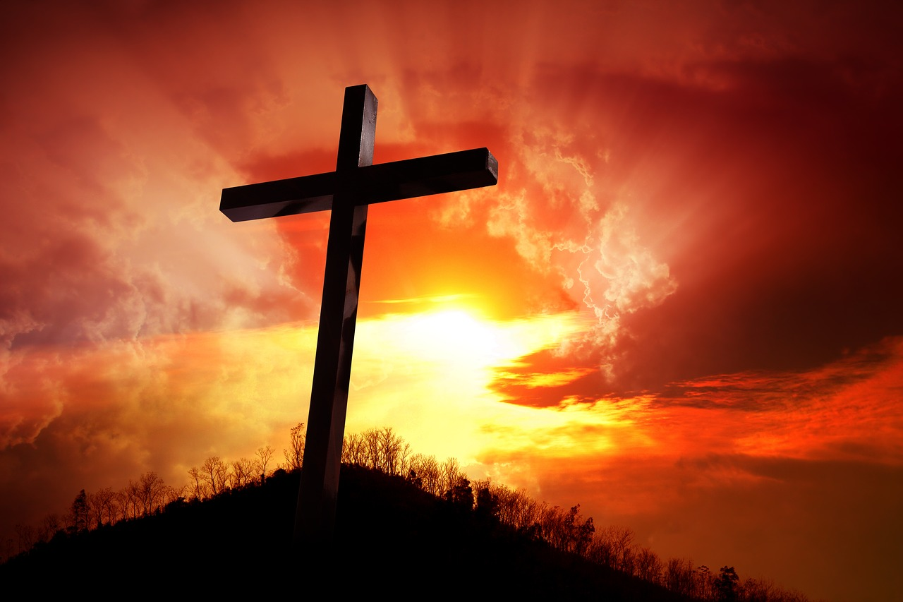
7
Abominations
8/25/2019
Rev. Joseph Chang
BOLGPC 爾灣大公園靈糧堂

Slide 2
根據所羅門的箴言6：16-19，有七項耶和華所憎惡的事情。
According to Solomon’s Proverbs 6:16-19, there are 7
Abominations to the Lord.
⁶耶和華所恨惡的有六樣，連他心所憎惡的共有七樣：¹⁷就是高傲的眼，撒謊的舌，流無辜人血的手，¹⁸圖謀惡計的心，飛跑行惡的腳，¹⁹吐謊言的假見證，並弟兄中布散紛爭的人。
【箴 6:16~19】 ¹⁶There are six things that the Lord hates, seven that are an abomination to him: ¹⁷haughty eyes, a lying tongue, and hands that shed innocent blood, ¹⁸a heart that devises wicked plans, feet that make haste to run to evil, ¹⁹a false witness who breathes out lies, and one who sows discord among brothers. 【Prov 6:16~19】

Slide 3
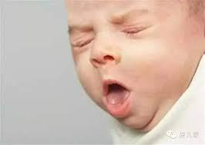
Q: What is abomination?
➔
就是讓人噁心, 看了讓人家全身產生厭惡感,要把你
吐出來.
A thing that causes disgust or hatred , which makes you
want to spit it out.

Slide 4
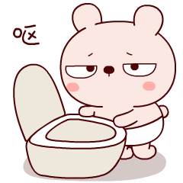
上帝處理abomination的方法.
¹⁵所以，災難必忽然臨到他身；他必頃刻敗壞，無法可治。【箴 6:15】 ¹⁵therefore calamity will come upon him suddenly; in a moment he will be broken beyond healing. 【Prov 6:15】

Slide 5
7 Abominations to the Lord /七個讓神憎惡的罪
(1)高傲的眼 / haughty eyes
(2)撒謊的舌/ a lying tongue
(3)流無辜人血的手/ hands that shed innocent blood
(4)圖謀惡計的心/ a heart that devises wicked plans
(5)飛跑行惡的腳/ feet that make haste to run to evil
(6)吐謊言的假見證/ a false witness who breathes out lies
(7)弟兄中布散紛爭的人/ one who sows discord among
brothers

Slide 6
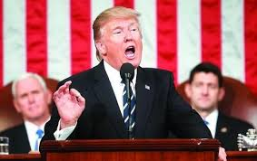
I. 高傲的眼/Haughty Eyes
這種entertaining 式的高傲 ≠不把上帝放在眼裡的那種高傲
this kind of entertaining arrogance≠ the arrogance that
shows no respect for God

Slide 7
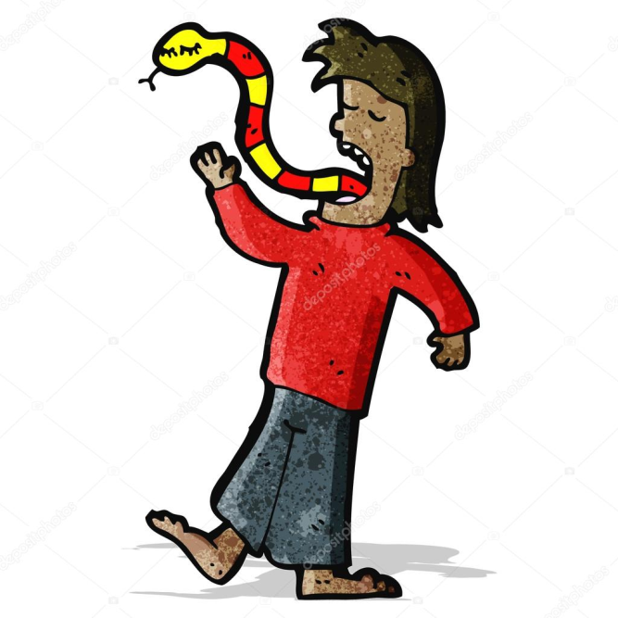
II. Sins of the Tongue/從舌頭來的罪
七個讓神憎惡的罪裡面有三個來自舌頭:
Three of the seven abominations come from the tongue:
1)撒謊的舌
a lying tongue
2) 吐謊言的假見證
a false witness who breathes out lies
3)在弟兄中布散紛爭的人
one who sows discord among brothers

Slide 8
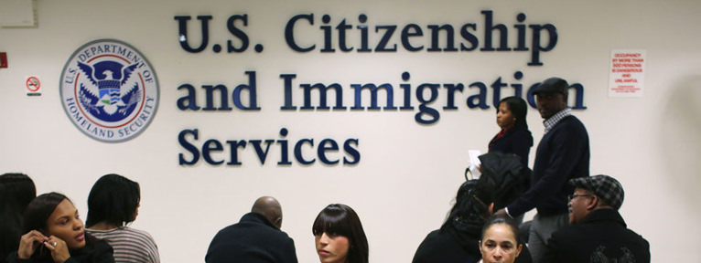
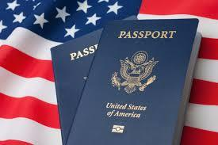
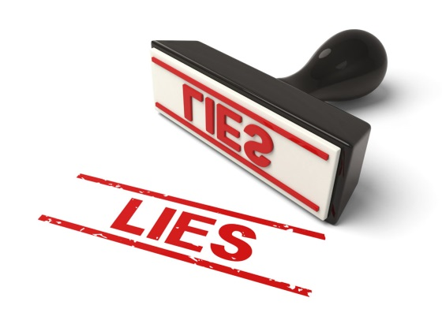
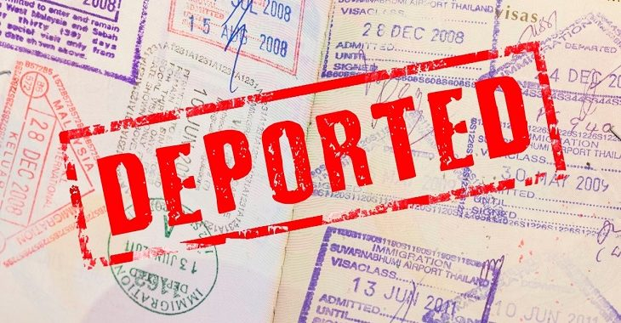
A. 撒謊的舌/a lying tongue
Illustration 1:
➔

Slide 9
Illustration 2:

Slide 10
B. 吐謊言的假見證/a false witness who breathes out lies
神要如何對待他們:/How God wants to treat a false witness :
¹⁵人無論犯甚麼罪，作甚麼惡，不可憑一個人的口作見證，總要憑兩三個人的口作見證才可定案。¹⁶若有兇惡的見證人起來，見證某人作惡，¹⁷這兩個爭訟的人就要站在耶和華面前，和當時的祭司，並審判官面前，
¹⁵"A single witness shall not suffice against a person for any crime or for any wrong in connection with any offense that he has committed. Only on the evidence of two witnesses or of three witnesses shall a charge be established. ¹⁶If a malicious witness arises to accuse a person of wrongdoing, ¹⁷then both parties to the dispute shall appear before the Lord, before the priests and the judges who are in office in those days.

Slide 11
⁸審判官要細細的查究，若見證人果然是作假見證的，以假見證陷害弟兄，¹⁹你們就要待他如同他想要待的弟兄。這樣，就把那惡從你們中間除掉。²⁰別人聽見都要害怕，就不敢在你們中間再行這樣的惡了。²¹你眼不可顧惜，要以命償命，以眼還眼，以牙還牙，以手還手，以腳還腳。【申 19:15~21】
¹⁸The judges shall inquire diligently, and if the witness is a false witness and has accused his brother falsely, ¹⁹then you shall do to him as he had meant to do to his brother. So you shall purge the evil from your midst. ²⁰And the rest shall hear and fear, and shall never again commit any such evil among you. ²¹Your eye shall not pity. It shall be life for life, eye for eye, tooth for tooth, hand for hand, foot for foot. 【Deut 19:15~21】

Slide 12
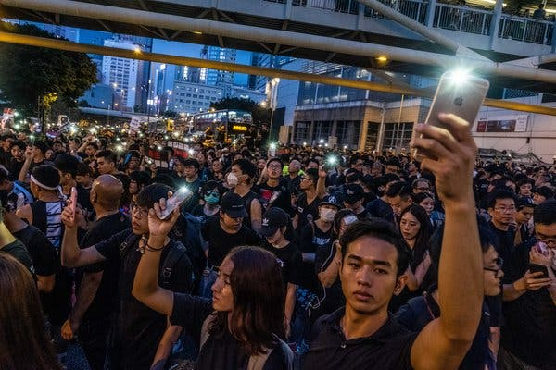
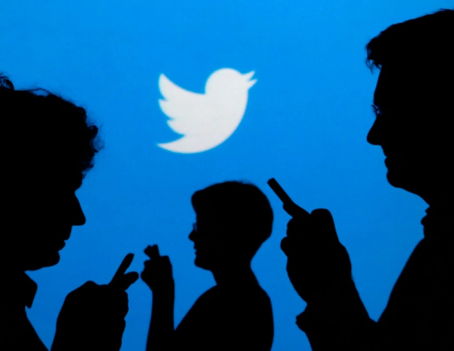
C. 在弟兄中布散紛爭的人/one who sows discord among brothers
march in Hong Kong
"sow political discord in Hong Kong,"
"involved in coordinated inauthentic behavior."

Slide 13
III. Sins of Hands, Heart and Feet/手, 心, 和腳的罪.
A. Hands that shed innocent blood/流無辜人血的手.
在目前的社會有兩種情形是耶和華所憎惡的:
There are two situations in the current society that the
Lord hates:
1. Abortion墮胎.
“上帝憎惡做墮胎的醫生的手.”
“God hates the hands of doctors who do abortion."
2. Assisted Suicide 幫助自殺

Slide 14
B. 圖謀惡計的心/a heart that devises wicked plans
上帝用洪水滅掉人類, 聖經所寫的理由乃是,
The reason why God destroyed humans with floods was
⁵耶和華見人在地上罪惡很大，終日所思想的盡都是惡，⁶耶和華就後悔造人在地上，心中憂傷。【創 6:5~6】 ⁵The Lord saw that the wickedness of man was great in the earth, and that every intention of the thoughts of his heart was only evil continually. ⁶And the Lord was sorry that he had made man on the earth, and it grieved him to his heart. 【Gen 6:5~6】

Slide 15
B. 圖謀惡計的心/a heart that devises wicked plans
上帝用洪水滅掉人類, 聖經所寫的理由乃是,
The reason why God destroyed humans with floods was
⁵耶和華見人在地上罪惡很大，終日所思想的盡都是惡，⁶耶和華就後悔造人在地上，心中憂傷。【創 6:5~6】 ⁵The Lord saw that the wickedness of man was great in the earth, and that every intention of the thoughts of his heart was only evil continually. ⁶And the Lord was sorry that he had made man on the earth, and it grieved him to his heart. 【Gen 6:5~6】

Slide 16
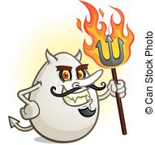
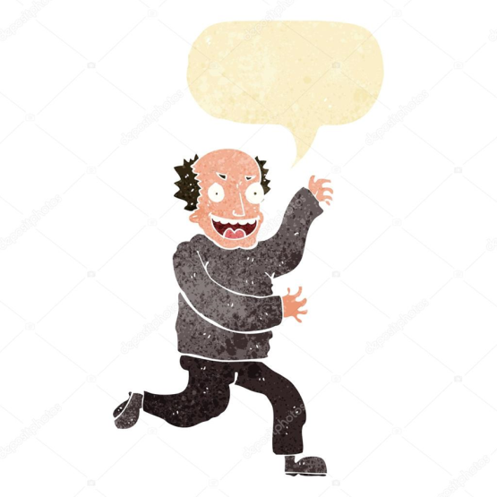
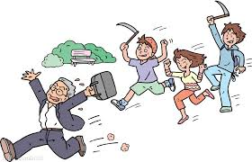
C. 飛跑行惡的腳/feet that make haste to run to evil

Slide 17
這七件耶和華所憎惡的事情, 是緊緊連在一起的. 我們要用一個聖經上的故事來闡明這個真理:
These seven abominations that the Lord hates are closely linked. We will use a biblical story to clarify this truth.

Slide 18
¹這事以後，又有一事。耶斯列人拿伯在耶斯列有一個葡萄園，靠近撒瑪利亞王亞哈的宮。²亞哈對拿伯說：你將你的葡萄園給我作菜園，因為是靠近我的宮；我就把更好的葡萄園換給你，或是你要銀子，我就按著價值給你。³拿伯對亞哈說：我敬畏耶和華，萬不敢將我先人留下的產業給你。
¹Now Naboth the Jezreelite had a vineyard in Jezreel, beside the palace of Ahab king of Samaria. ²And after this Ahab said to Naboth, "Give me your vineyard, that I may have it for a vegetable garden, because it is near my house, and I will give you a better vineyard for it; or, if it seems good to you, I will give you its value in money." ³But Naboth said to Ahab, "The Lord forbid that I should give you the inheritance of my fathers."

Slide 19
⁴亞哈因耶斯列人拿伯說我不敢將我先人留下的產業給你，就悶悶不樂地回宮，躺在床上，轉臉向內，也不吃飯。⁵王后耶洗別來問他說：你為甚麼心裡這樣憂悶，不吃飯呢？⁶他回答說：因我向耶斯列人拿伯說：你將你的葡萄園給我，我給你價銀，或是你願意，我就把別的葡萄園換給你；他卻說：我不將我的葡萄園給你。
⁴And Ahab went into his house vexed and sullen because of what Naboth the Jezreelite had said to him, for he had said, "I will not give you the inheritance of my fathers." And he lay down on his bed and turned away his face and would eat no food. ⁵But Jezebel his wife came to him and said to him, "Why is your spirit so vexed that you eat no food?" ⁶And he said to her, "Because I spoke to Naboth the Jezreelite and said to him, 'Give me your vineyard for money, or else, if it please you, I will give you another vineyard for it.' And he answered, 'I will not give you my vineyard.' "

Slide 20
⁷王后耶洗別對亞哈說：你現在是治理以色列國不是？只管起來，心裡暢暢快快地吃飯，我必將耶斯列人拿伯的葡萄園給你。⁸於是託亞哈的名寫信，用王的印印上，送給那些與拿伯同城居住的長老貴冑。⁹信上寫著說：你們當宣告禁食，叫拿伯坐在民間的高位上，¹⁰又叫兩個匪徒坐在拿伯對面，作見證告他說：你謗瀆 神和王了；隨後就把他拉出去用石頭打死。
" ⁷And Jezebel his wife said to him, "Do you now govern Israel? Arise and eat bread and let your heart be cheerful; I will give you the vineyard of Naboth the Jezreelite." ⁸So she wrote letters in Ahab's name and sealed them with his seal, and she sent the letters to the elders and the leaders who lived with Naboth in his city. ⁹And she wrote in the letters, "Proclaim a fast, and set Naboth at the head of the people. ¹⁰And set two worthless men opposite him, and let them bring a charge against him, saying, 'You have cursed God and the king.' Then take him out and stone him to death."

Slide 21
¹¹那些與拿伯同城居住的長老貴冑得了耶洗別的信，就照信而行，¹²宣告禁食，叫拿伯坐在民間的高位上。¹³有兩個匪徒來，坐在拿伯的對面，當著眾民作見證告他說：拿伯謗瀆 神和王了！眾人就把他拉到城外，用石頭打死。¹⁴於是打發人去見耶洗別，說：拿伯被石頭打死了。
¹¹And the men of his city, the elders and the leaders who lived in his city, did as Jezebel had sent word to them. As it was written in the letters that she had sent to them, ¹²they proclaimed a fast and set Naboth at the head of the people. ¹³And the two worthless men came in and sat opposite him. And the worthless men brought a charge against Naboth in the presence of the people, saying, "Naboth cursed God and the king." So they took him outside the city and stoned him to death with stones. ¹⁴Then they sent to Jezebel, saying, "Naboth has been stoned; he is dead."

Slide 22
¹⁵耶洗別聽見拿伯被石頭打死，就對亞哈說：你起來得耶斯列人拿伯不肯為價銀給你的葡萄園罷！現在他已經死了。¹⁶亞哈聽見拿伯死了，就起來，下去要得耶斯列人拿伯的葡萄園。
【王上 21:1~16】
¹⁵As soon as Jezebel heard that Naboth had been stoned and was dead, Jezebel said to Ahab, "Arise, take possession of the vineyard of Naboth the Jezreelite, which he refused to give you for money, for Naboth is not alive, but dead." ¹⁶And as soon as Ahab heard that Naboth was dead, Ahab arose to go down to the vineyard of Naboth the Jezreelite, to take possession of it. 【1King 21:1~16】

Slide 23
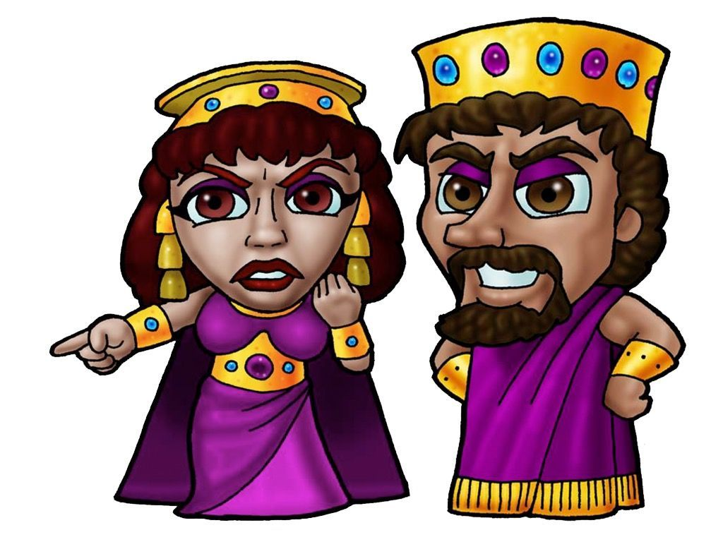
Q:這裡面的壞蛋是誰? Who are the bad guys ?
➔亞哈王, 還有他的王后耶洗別.
King Ahab and his queen Jezebel
➔這對夫婦沒有把上帝放在他們的眼裡. 高傲的眼是他
們的最大的問題.
The couple showed no respect for God. The haughty
eyes is their biggest problem.

Slide 24
➔於是耶和華所憎惡的事的接二連三的演出.
The abominations to the Lord happened one after another.
1. 高傲的眼/haughty eyes
2. 在心中圖謀惡計/a heart that devises wicked plans
3-5. 於是耶洗別說謊/lying tongue,
藉著長老在以色列人當中散播紛爭/sows discord,
用兩個匪徒作假見證控告拿伯/false witness.
6. 流無辜人血的手/hands that shed innocent blood
—很快地就把拿伯打死了
7. 飛跑行惡的腳/ feet that make haste to run to evil.
—長老們

Slide 25
Q:上帝對這樣子的罪, 上帝的反應是甚麼呢?
What is God's reaction to these sins?
➔“憎惡” 要把他/她吐出來.
"Abomination“! Should spit him/her out.

Slide 26
➔整篇聖經的話, 你會看到對話的順序是像這樣:
In this story, you can see the order of the dialogue is like this:
1. Ahab←→Naboth
2. Ahab←→Jezebel
3. Jezebel←→Elders
Naboth killed
3’ Elders←→Jezebel
2’ Jezebel←→Ahab
1’ 應該是 Naboth←→Ahab
但是拿伯已死了. 怎麼辦呢? 耶和華代替拿伯來說話. 所以在王上21:17-19
Naboth was dead. The Lord spoke for Naboth. So in the King 21:17-19

Slide 27
¹⁷耶和華的話臨到提斯比人以利亞說：¹⁸你起來，去見住撒瑪利亞的以色列王亞哈，他下去要得拿伯的葡萄園，現今正在那園裡。¹⁹你要對他說：耶和華如此說：你殺了人，又得他的產業麼？又要對他說：耶和華如此說：狗在何處舔拿伯的血，也必在何處舔你的血。【王上 21:17~19】 ¹⁷Then the word of the Lord came to Elijah the Tishbite, saying, ¹⁸"Arise, go down to meet Ahab king of Israel, who is in Samaria; behold, he is in the vineyard of Naboth, where he has gone to take possession. ¹⁹And you shall say to him, 'Thus says the Lord, "Have you killed and also taken possession?" ' And you shall say to him, 'Thus says the Lord: "In the place where dogs licked up the blood of Naboth shall dogs lick your own blood." ' " 【1King 21:17~19】

Slide 28
Conclusion結論
¹²無賴的惡徒，行動就用乖僻的口，¹³用眼傳神，用腳示意，用指點劃，¹⁴心中乖僻，常設惡謀，布散紛爭。¹⁵所以，災難必忽然臨到他身；他必頃刻敗壞，無法可治。¹⁶耶和華所恨惡的有六樣，連他心所憎惡的共有七樣：¹⁷就是高傲的眼，撒謊的舌，流無辜人血的手，¹⁸圖謀惡計的心，飛跑行惡的腳，¹⁹吐謊言的假見證，並弟兄中布散紛爭的人。【箴 6:12~19】 ¹²A worthless person, a wicked man, goes about with crooked speech, ¹³winks with his eyes, signals with his feet, points with his finger, ¹⁴with perverted heart devises evil, continually sowing discord; ¹⁵therefore calamity will come upon him suddenly; in a moment he will be broken beyond healing. ¹⁶There are six things that the Lord hates, seven that are an abomination to him: ¹⁷haughty eyes, a lying tongue, and hands that shed innocent blood, ¹⁸a heart that devises wicked plans, feet that make haste to run to evil, ¹⁹a false witness who breathes out lies, and one who sows discord among brothers. 【Prov 6:12~19】

Slide 29
所以保羅這樣子忠告我們: So Paul advised us like this:
¹²所以，不要容罪在你們必死的身上作王，使你們順從身子的私慾。¹³也不要將你們的肢體獻給罪作不義的器具；倒要像從死裡復活的人，將自己獻給神，並將肢體作義的器具獻給神。¹⁴罪必不能作你們的主，因你們不在律法之下，乃在恩典之下。【羅 6:12~14】 ¹²Let not sin therefore reign in your mortal bodies, to make you obey their passions. ¹³Do not present your members to sin as instruments for unrighteousness, but present yourselves to God as those who have been brought from death to life, and your members to God as instruments for righteousness. ¹⁴For sin will have no dominion over you, since you are not under law but under grace. 【Rom 6:12~14】

Slide 30
最重要的就是所羅門所說的, 對神的一個敬畏的心
The most important thing is, what Solomon said, a fearful
heart for God.
¹⁰敬畏耶和華是智慧的開端；認識至聖者便是聰明。【箴 9:10】 ¹⁰The fear of the Lord is the beginning of wisdom, and the knowledge of the Holy One is insight. 【Prov 9:10】

