Slide 1
Set Priority in Life
生命的首要
8/18/2019
Rev. Joseph Chang
BOLGPC 爾灣大公園靈糧堂

Slide 2
Last Sunday…
1. We do not have enough hours for a day.
神沒有給我在一天中有足夠的小時數.
2. We cannot afford one day rest a week. 神要我管理整個世界, 卻要我七天要休息一天.
3. We are not built strong enough to take the stress and the
anxiety that the world is laying upon us. 神沒有給我一個強健的身體來勝過壓力或焦慮.

Slide 3
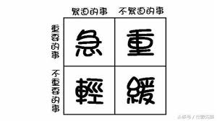
How to set priority in our lives?
如何設定我們的生活中事情的優先順序？

Slide 4
所羅門告訴我們/ Solomon tells us :
¹¹ 神造萬物，各按其時成為美好，又將永生安置在世人心裡。（永生原文作永遠）然而 神從始至終的作為，人不能參透。【傳 3:11a】 ¹¹He has made everything beautiful in its time. Also, he has put eternity into man's heart, yet so that he cannot find out what God has done from the beginning to the end.
【Eccl 3:11a】

Slide 5
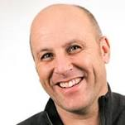
Mark Buchanan says,
Our deepest instinct is heaven. Heaven is the ache in our bones, the splinter in our heart. Like the whisper of faraway waves we hear crashing in the whorls of a conch shell, the music of heaven echoes, faint, elusive, haunting, beneath and within our daily routines….
Eternity will cry within us from time to time. Heed the voice of heaven. Heed the voice of eternity.
There is crying of eternity in our hearts, yet the mystery of God does not allow us to see it in absolute clearness.

Slide 6
我們今天就要來尋求這讓我們心可以得到滿
足的生活的優先, 生命中的首要的次序
We are here today to seek the priority of life that
allows our hearts to be satisfied.

Slide 7
1) A seemingly godly yet not correct approach:
一個看似敬虔但卻不正確的方法:
God—1st priority/上帝 - 第一優先
Family—2nd priority/家庭-第二
Work—3rd priority/工作 - 第三
Recreation—4th priority /娛樂 - 第四

Slide 8
Illustration:
the night before you make the trip
He is sick and asks for your help.
Q: Do you forgo the vacation and stay at home to
lead the worship in this coming Sunday?

Slide 9
2) Some suggests that put God in no priority, and set
the priority as:
Family: 1st priority/家庭-第一
Work: 2nd priority/工作 - 第二
Recreation: 3rd priority/娛樂 - 第三

Slide 10
➔因此，我建議採取主耶穌所提出的優先權制度。
So, may I suggest the priority system as proposed by our Lord.
³¹所以，不要憂慮說：吃甚麼？喝甚麼？穿甚麼？³²這都是外邦人所求的，你們需用的這一切東西，你們的天父是知道的。³³你們要先求他的國和他的義，這些東西都要加給你們了。【太 6:31~33】 ³¹"Therefore do not be anxious, saying, 'What shall we eat?' or 'What shall we drink?' or 'What shall we wear?'" ³²"For the Gentiles seek after all these things, and your heavenly Father knows that you need them all." ³³"But seek first the kingdom of God and his righteousness, and all these things will be added to you. " 【Matt 6:31~33 】

Slide 11
See Ye First His Kingdom and His Righteousness
首先尋求祂的國和祂的義

Slide 12
I. Seek His Kingdom求祂的國
Q1:What is his kingdom? Is it the Church?
祂的國是什麼？ 是教會嗎？
➔ No.
Q2:Where in this world do you think resembles better with
the kingdom of heaven?
在這個世界上你認為哪個地方較像祂的國？
➔For me, it is United States of America and some Christian
nations.
對我來說，它是美利堅合眾國和一些基督教國家。

Slide 13
So, let me give you a few examples about seek his kingdom in the country of United States and in Britain.
那麼，讓我舉幾個發生在美國和英國尋求祂的國的例子。

Slide 14
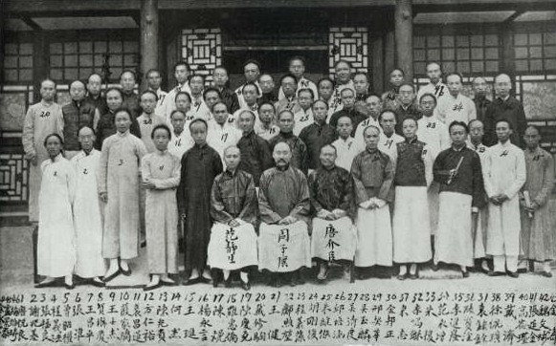
A. 庚子賠款退款Boxer Indemnity Remittance
1901: The Boxer Protocol Signed
1908: Remittance of the Boxer Indemnity

Slide 15
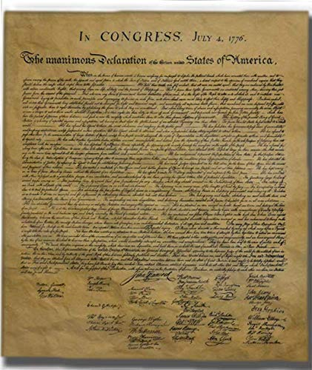
B. American Revolution 美國革命
美國革命的獨立宣言其實是一個神學作品. 是基於基督教的人權, 政治思想而提出的一個立國主張.
The Declaration of Independence of the American Revolution is actually a theological work. It is based on Christian human rights and political ideas.

Slide 16
We hold these truths to be self-evident, that all men are created equal, that they are endowed by their Creator with certain unalienable Rights, that among these are Life, Liberty and the pursuit of Happiness. — That to secure these rights, Governments are instituted among Men, deriving their just powers from the consent of the governed, — That whenever any Form of Government becomes destructive of these ends, it is the Right of the People to alter or to abolish it, and to institute new Government, laying its foundation on such principles and organizing its powers in such form, as to them shall seem most likely to effect their Safety and Happiness.

Slide 17
我們相信下列的真理是不問自明的, 每個人心裡可以曉得, 無可推諉的: 所有的人是受造而平等的,每個人都擁有創造主付與他們不可分離, 不能被剝奪的權力, 譬如:生命, 自由, 和追求幸福的權力. 為了要保有這些權力, 政府就由人民當中產生, 政府的權柄是由接受統治的人民同意後產生的. 如果任何時候政府為要破壞這些權力, 那麼人民有權改變或甚至除掉這樣的政府,另立新的政府, 設下新的政治原則, 政治制度, 使得人民可以享受安全和幸福.

Slide 18
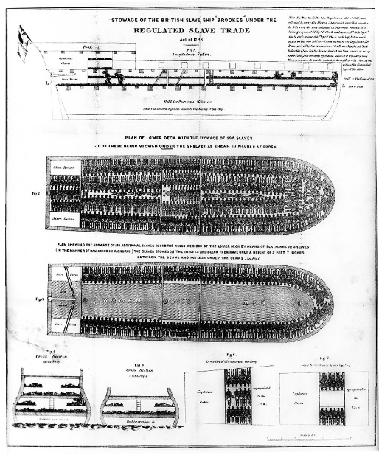
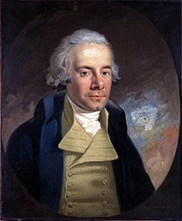
C. William Wilberforce (1759-1833)
經過數十年在英國國會的努力, Wilberforce 成功的藉著立法 Slavery Abolition Act 1833, 在英國廢除了奴隸制度.
After decades of efforts in the British Parliament, Wilberforce succeeded in abolishing slavery in the UK through the legislation Slavery Abolition Act 1833.

Slide 19
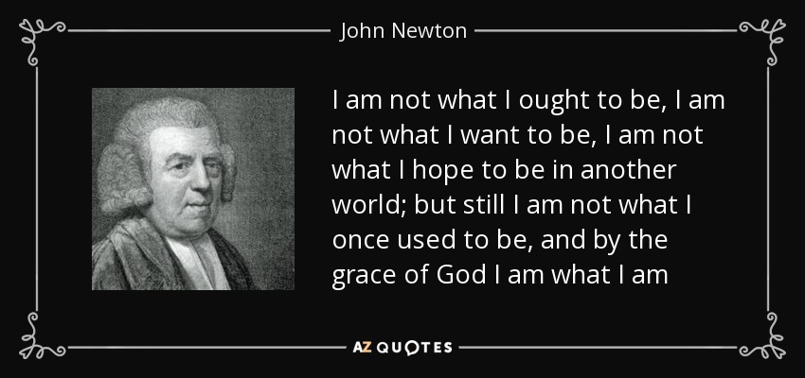
Amazing Grace這首詩個的作者, John Newton
Author of Amazing Grace, John Newton

Slide 20
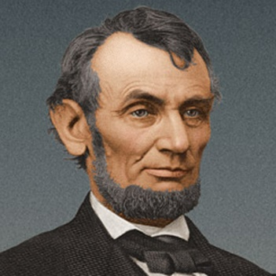
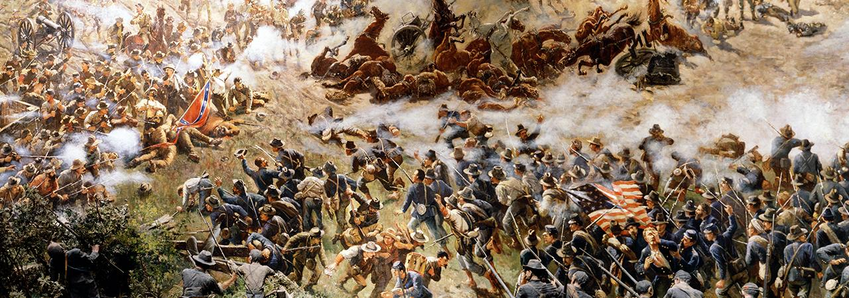
D. Abraham Lincoln (1809-1865)
16th President, led the nation through the Civil War, and the Emancipation of Slaves (1/1/1863).

Slide 21
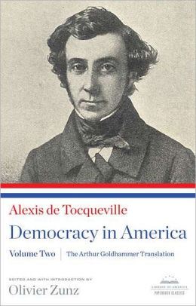
When a Frenchman came to us in 19th century, he discovered that the strength of America is in the pulpit of the church.
I sought for the greatness and genius of America in her commodious harbors and her ample rivers – and it was not there . . . in her fertile fields and boundless forests and it was not there . . . in her rich mines and her vast world commerce – and it was not there . . . in her democratic Congress and her matchless Constitution – and it was not there. Not until I went into the churches of America and heard her pulpits aflame with righteousness did I understand the secret of her genius and power. America is great because she is good, and if America ever ceases to be good, she will cease to be great.
(Alexis de Tocqueville, Democracy in America)

Slide 22
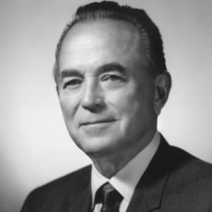
E. McDonald Restaurant
Ray Kroc (1902-1984)

Slide 23
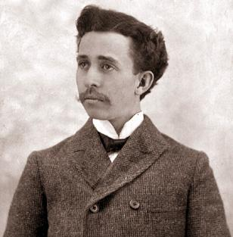
F. J.C. Penny (1875-1971)
James Cash Penney (1875-1971)

Slide 24
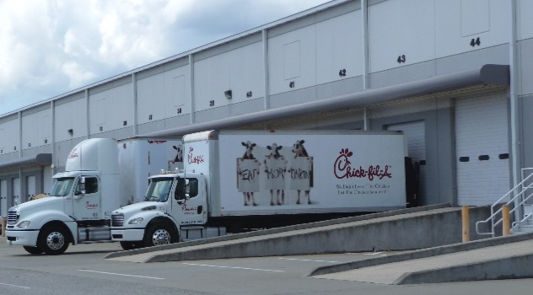
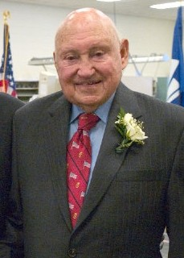
G. Chick-Fil-A
Samuel Truett Cathy (March 14, 1921 – September 8, 2014)

Slide 25
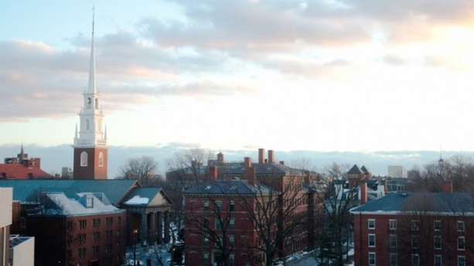
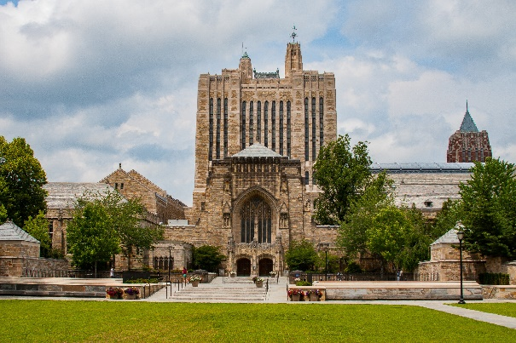
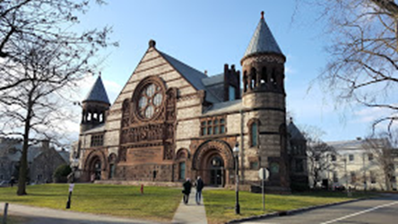
H. Harvard University, Yale University, and Princeton University
all started with an intention to train the pastors．
哈佛大學，耶魯大學，普林斯頓大學，設立初期都是為
了訓練牧師
Harvard University,
Cambridge, Massachusetts
Yale University,
New Haven, Connecticut
Princeton University,
Princeton, New Jersey

Slide 26
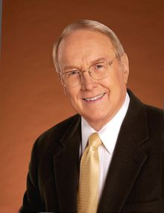
I. James Dobson (1936-now)

Slide 27
我們再來複習一下主耶穌所說的:
Let’s review what the Lord Jesus said:
³¹所以，不要憂慮說：吃甚麼？喝甚麼？穿甚麼？³²這都是外邦人所求的，你們需用的這一切東西，你們的天父是知道的。³³你們要先求他的國和他的義，這些東西都要加給你們了。
【太 6:31~33】 ³¹"Therefore do not be anxious, saying, 'What shall we eat?' or 'What shall we drink?' or 'What shall we wear?'" ³²"For the Gentiles seek after all these things, and your heavenly Father knows that you need them all." ³³"But seek first the kingdom of God and his righteousness, and all these things will be added to you. " 【Matt 6:31~33】

Slide 28
➔It looks like in doing anything, we need to think, is it for his kingdom? Is it for his righteousness?
我們在做任何事情時，需要思考，這是為了求祂的國嗎？ 這是為了求祂的義嗎？
➔Paul in Ephesians mentioned a few golden principles and they last for eternity.
在以弗所書中保羅提到了一些黃金原則，他們可以持續永恆。

Slide 29
1. 夫妻的關係/Between Husband and Wife
²²你們作妻子的，當順服自己的丈夫，如同順服主。²³因為丈夫是妻子的頭，如同基督是教會的頭；他又是教會全體的救主。²⁴教會怎樣順服基督，妻子也要怎樣凡事順服丈夫。【弗 5:22~24】 ²²Wives, submit to your own husbands, as to the Lord. ²³For the husband is the head of the wife even as Christ is the head of the church, his body, and is himself its Savior. ²⁴Now as the church submits to Christ, so also wives should submit in everything to their husbands. 【Eph 5:22~24】

Slide 30
2. 父母和子女的關係/Between Parents and Children
¹你們作兒女的，要在主裡聽從父母，這是理所當然的。²要孝敬父母，使你得福，在世長壽。這是第一條帶應許的誡命。³〔同上。〕⁴你們作父親的，不要惹兒女的氣，只要照著主的教訓和警戒養育他們。【弗 6:1~4】 ¹Children, obey your parents in the Lord, for this is right. ²"Honor your father and mother" (this is the first commandment with a promise), ³"that it may go well with you and that you may live long in the land." ⁴Fathers, do not provoke your children to anger, but bring them up in the discipline and instruction of the Lord. 【Eph 6:1~4】

Slide 31
3. 僱主和員工的關係/Employment Relationship
⁵你們作僕人的，要懼怕戰兢，用誠實的心聽從你們肉身的主人，好像聽從基督一般。⁶不要只在眼前事奉，像是討人喜歡的，要像基督的僕人，從心裡遵行神的旨意。⁷甘心事奉，好像服事主，不像服事人。【弗 6:5~9】
⁵Slaves, obey your earthly masters with fear and trembling, with a sincere heart, as you would Christ, ⁶not by the way of eye-service, as people-pleasers, but as servants of Christ, doing the will of God from the heart, ⁷rendering service with a good will as to the Lord and not to man,

Slide 32
⁸因為曉得各人所行的善事，不論是為奴的，是自主的，都必按所行的得主的賞賜。⁹你們作主人的，待僕人也是一理，不要威嚇他們。因為知道，他們和你們同有一位主在天上；他並不偏待人。【弗 6:5~9】
⁸knowing that whatever good anyone does, this he will receive back from the Lord, whether he is a slave or free. ⁹Masters, do the same to them, and stop your threatening, knowing that he who is both their Master and yours is in heaven, and that there is no partiality with him. 【Eph 6:5~9】

Slide 33
II. Seek His Righteousness. 追求祂的義
神的國和神的義有不可分割的關係.
God‘s kingdom and God’s righteousness have an inseparable relationship．
¹⁴公義和公平是你寶座的根基；慈愛和誠實行在你前面。【詩 89:14】 ¹⁴Righteousness and justice are the foundation of your throne; steadfast love and faithfulness go before you.
【Ps 89:14】

Slide 34
也因此基督徒全副的軍裝一開始就是…
Therefore, the entire military uniform of Christians is….
¹⁴所以要站穩了，用真理當作帶子束腰，用公義當作護心鏡遮胸，【弗 6:14】 ¹⁴Stand therefore, having fastened on the belt of truth, and having put on the breastplate of righteousness, 【Eph 6:14】

Slide 35
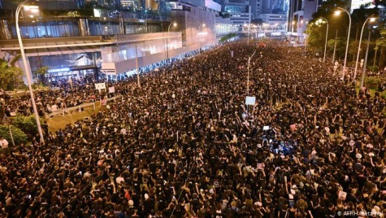
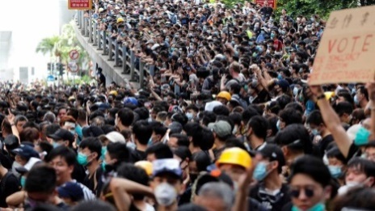
我們所做的事情, 不能夠不合乎神的公義.
What we do can't be inconsistent with God's righteousness.
➔The Unrest of Hong Kong is a test of the righteousness.
香港的不安定是一個公義的考驗。

Slide 36
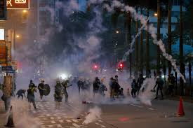
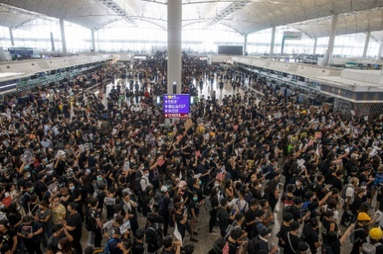
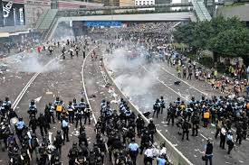
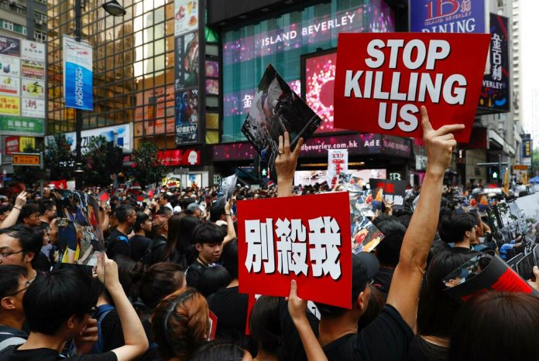
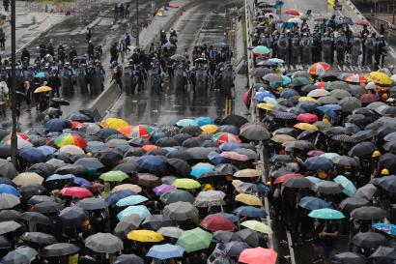
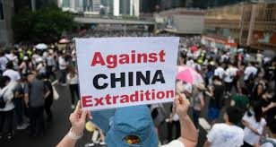

Slide 37
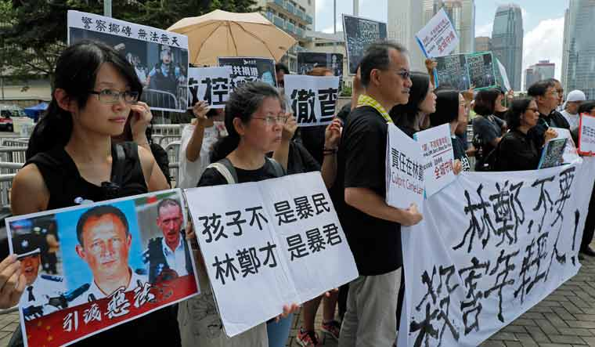
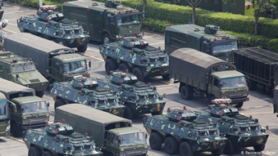
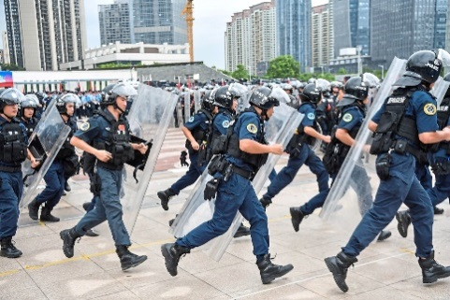
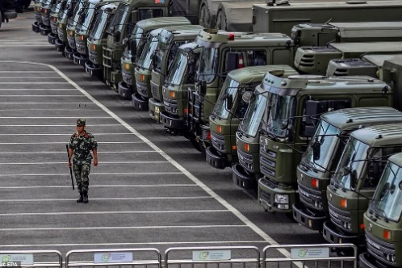

Slide 38
Conclusion 結論
⁸你們得救是本乎恩，也因著信；這並不是出於自己，乃是神所賜的；⁹也不是出於行為，免得有人自誇。¹⁰我們原是他的工作，在基督耶穌裡造成的，為要叫我們行善，就是神所預備叫我們行的。【弗 2:8~10】 ⁸For by grace you have been saved through faith. And this is not your own doing; it is the gift of God, ⁹not a result of works, so that no one may boast. ¹⁰For we are his workmanship, created in Christ Jesus for good works, which God prepared beforehand, that we should walk in them. 【Eph 2:8~10】

Slide 39
Conclusion 結論
⁸你們得救是本乎恩，也因著信；這並不是出於自己，乃是神所賜的；⁹也不是出於行為，免得有人自誇。¹⁰我們原是他的工作，在基督耶穌裡造成的，為要叫我們行善，就是神所預備叫我們行的。【弗 2:8~10】 ⁸For by grace you have been saved through faith. And this is not your own doing; it is the gift of God, ⁹not a result of works, so that no one may boast. ¹⁰For we are his workmanship, created in Christ Jesus for good works, which God prepared beforehand, that we should walk in them. 【Eph 2:8~10】

