Slide 1
孤兒,寡婦,和寄居者的神
God of the Fatherless , the Widow, and the Alien
申命記Deuteronomy 10:18
10/20/2019
Rev. Joseph Chang
BOLGPC 爾灣大公園靈糧堂

Slide 2
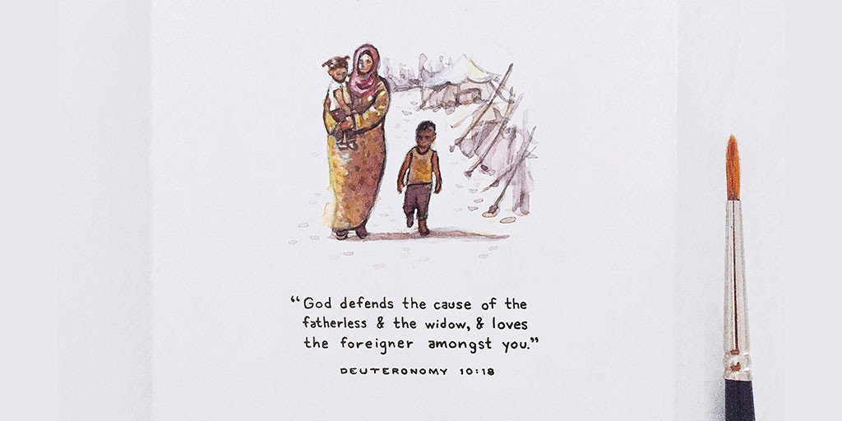
我們的神是孤兒寡婦, 寄居者的神
God of the Fatherless, the Widow, and the Aliens

Slide 3
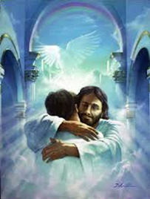
¹⁸他為孤兒寡婦伸冤，又憐愛寄居的，賜給他衣食。
【申 10:18】 ¹⁸He executes justice for the fatherless and the widow, and loves the sojourner, giving him food and clothing. 【Deut 10:18】

Slide 4
這三種人, 我們都知道是可憐的人.因為:
These three kinds of people are poor because:
➔孤兒沒有愛
The fatherless has no one to love him.
➔寡婦沒有人供養她
The widow has no one to support her.
➔寄居者沒有產業
The sojourner has no inheritance.

Slide 5
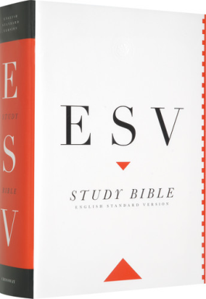
在美國有綠卡的人, 叫做 “resident alien”
A person with a green card in the United States called
“resident alien”.
before “Man in Black”
after “Man in Black”
寄居者/sojourner
表示是外鄉人
寄居者/alien

Slide 6
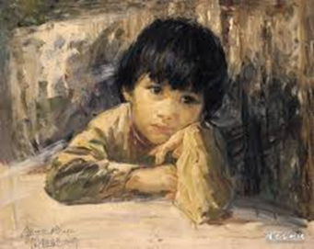
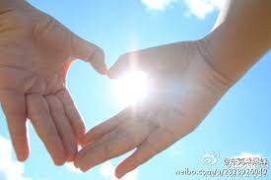
I. God of the Fatherless/孤兒的神
孤兒沒有愛/The fatherless has no one to love him.
We are adopted, but in God’s adoption, it is more than our natural birth. Even if a mother forgets her baby, I will not forget you.
It is not by your effort to hold unto this relationship but by the accomplishment of Jesus, so you do not need to struggle for approval. Eph 2:8-9
He is not our master but father, so we do not need to fear管家—》父親

Slide 7
We are born of God. 我們是從神而生的.
¹凡信耶穌是基督的，都是從神而生，凡愛生他之神的，也必愛從神生的。【約一 5:1】 ¹Everyone who believes that Jesus is the Christ has been born of God, and everyone who loves the Father loves whoever has been born of him. 【1John 5:1】

Slide 8
How God loves us! 神何等的愛我們.
¹⁵婦人焉能忘記他吃奶的嬰孩，不憐恤他所生的兒子？即或有忘記的，我卻不忘記你。【賽 49:15】 ¹⁵"Can a woman forget her nursing child, that she should have no compassion on the son of her womb? Even these may forget, yet I will not forget you. 【Isa 49:15】

Slide 9
Assurance. 確據.
⁸你們得救是本乎恩，也因著信；這並不是出於自己，乃是神所賜的；⁹也不是出於行為，免得有人自誇。【弗 2:8~9】 ⁸For by grace you have been saved through faith. And this is not your own doing; it is the gift of God, ⁹not a result of works, so that no one may boast. 【Eph 2:8~9】

Slide 10
Don’t Compare. 不要比較.
¹⁸我實實在在的告訴你，你年少的時候，自己束上帶子，隨意往來；但年老的時候，你要伸出手來，別人要把你束上，帶你到不願意去的地方。【約 21:18】 ¹⁸"Truly, truly, I say to you, when you were young, you used to dress yourself and walk wherever you wanted, but when you are old, you will stretch out your hands, and another will dress you and carry you where you do not want to go."" 【John 21:18】

Slide 11
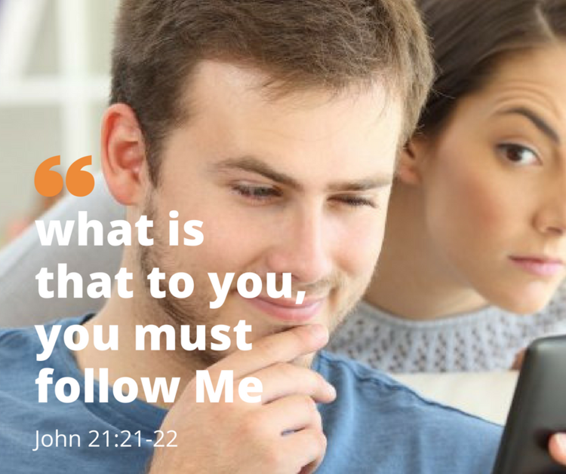
Don’t Compare. 不要比較.
²¹彼得看見他，就問耶穌說：主阿，這人將來如何？²²耶穌對他說：我若要他等到我來的時候，與你何干？你跟從我罷！【約 21:21~22】 ²¹When Peter saw him, he said to Jesus, "Lord, what about this man?" ²²Jesus said to him, ""If it is my will that he remain until I come, what is that to you? You follow me!"" 【John 21:21~22】

Slide 12
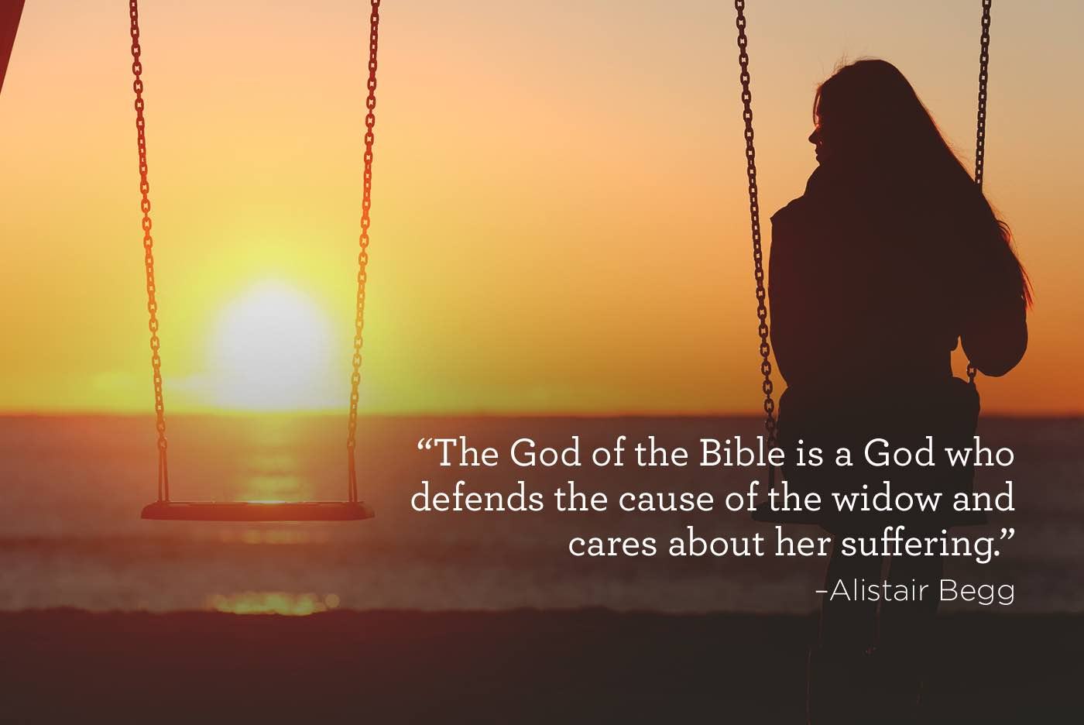
II. God of the Widow/寡婦的神
寡婦沒有供養/The widow has no one to support her.

Slide 13
⁴不要懼怕，因你必不致蒙羞；也不要抱愧，因你必不致受辱。你必忘記幼年的羞愧，不再記念你寡居的羞辱。⁵因為造你的是你的丈夫；萬軍之耶和華是他的名。救贖你的是以色列的聖者；他必稱為全地之 神。【賽 54:4~5】 ⁴" Fear not, for you will not be ashamed; be not confounded, for you will not be disgraced; for you will forget the shame of your youth, and the reproach of your widowhood you will remember no more. ⁵For your Maker is your husband, the Lord of hosts is his name; and the Holy One of Israel is your Redeemer, the God of the whole earth he is called. 【Isa 54:4~5】

Slide 14
上帝的供養是沒有帶著強迫壓力的供養. 是豐富
的, 而且帶著愛的供養.
God's support is rich, and it is with love.

Slide 15
舊約有一個先知何西阿(“戴著綠帽子的先知” )
the prophet Hosea in The Old Testament
("The Prophet in a Green Hat." )

Slide 16
➔第一個是兒子叫做耶斯列/Jezreel
The first one is the son called Jezreel .
➔第二個是女兒, 叫做羅路哈瑪/Lo-Ruhamah
(就是不蒙憐恤/not loved的意思)
The second is the daughter called Lo-Ruhamah (not loved).
➔第三個是兒子叫做羅阿米/Lo-Ammi
(就是非我民/not my people的意思)
The third is the son called Lo-Ammi (not my people).

Slide 18
神就用何西阿的例子來形容神和以色列的 “婚姻關係”.
藉著這個關係來說明以色列人不認識他們的神.
God used the example of Hosea to describe the “marriage relationship” between God and Israel. This relationship is used to illustrate that the Israelites do not know their God.

Slide 19
The Lord provides all your needs.
上帝供養你一切的需要.
⁸她不知道是我給她五穀、新酒，和油，又加增她的金銀；她卻以此供奉（或作：製造）巴力。【何 2:8】
⁸And she did not know that it was I who gave her the grain, the wine, and the oil, and who lavished on her silver and gold, which they used for Baal. 【Hos 2:8】

Slide 20
B. The Lord accommodate your need with all kindness.
神用恩典和慈愛提供你一切的需要.
16耶和華說：那日你必稱呼我伊施（就是我夫的意思），不再稱呼我巴力（就是我主的意思）；17因為我必從我民的口中除掉諸巴力的名號，這名號不再提起。
【何 2:16~17】
16"And in that day, declares the Lord, you will call me 'My Husband,' and no longer will you call me 'My Baal.' 17For I will remove the names of the Baals from her mouth, and they shall be remembered by name no more. 【Hos 2:16~17】

Slide 21
III. God of the Sojourner/寄居者的神
➔寄居者沒有產業/The Sojourner has no heritage.
➔我們是有產業的，這個產業是屬天的產業，遠遠超過
這個世界上的，而且是真正屬於我們直到永恆的.
We have a heritage from the Lord . This is far more than
anything in the world, and it really belongs to us until eternal.

Slide 22
²⁸耶穌說：我實在告訴你們，你們這跟從我的人，到復興的時候，人子坐在他榮耀的寶座上，你們也要坐在十二個寶座上，審判以色列十二個支派。²⁹凡為我的名撇下房屋，或是弟兄、姐妹、父親、母親、（有古卷添妻子）兒女、田地的，必要得著百倍，並且承受永生。【太 19:28~29】 ²⁸Jesus said to them, ""Truly, I say to you, in the new world, when the Son of Man will sit on his glorious throne, you who have followed me will also sit on twelve thrones, judging the twelve tribes of Israel." ²⁹"And everyone who has left houses or brothers or sisters or father or mother or children or lands, for my name's sake, will receive a hundredfold and will inherit eternal life." 【Matt 19:28~29】

Slide 23
神給我們地上的產業. God gives us earthly inheritance.
神給我們地上的關係. God gives us relationship.
神給我們天上的產業. God gives us heavenly inheritance.

Slide 24
聖靈是我們的憑據/Holy Spirit is our Guarantee.
¹³你們既聽見真理的道，就是那叫你們得救的福音，也信了基督，既然信他，就受了所應許的聖靈為印記。¹⁴這聖靈是我們得基業的憑據（原文作：質），直等到神之民（民原文作：產業）被贖，使他的榮耀得著稱讚。【弗 1:13~14】 ¹³In him you also, when you heard the word of truth, the gospel of your salvation, and believed in him, were sealed with the promised Holy Spirit, ¹⁴who is the guarantee of our inheritance until we acquire possession of it, to the praise of his glory. 【Eph 1:13~14】

Slide 25
Conclusion/結論
⁹惟有你們是被揀選的族類，是有君尊的祭司，是聖潔的國度，是屬神的子民，要叫你們宣揚那召你們出黑暗入奇妙光明者的美德。【彼前 2:9】 ⁹But you are a chosen race, a royal priesthood, a holy nation, a people for his own possession, that you may proclaim the excellencies of him who called you out of darkness into his marvelous light. 【1Pet 2:9】

