Slide 1
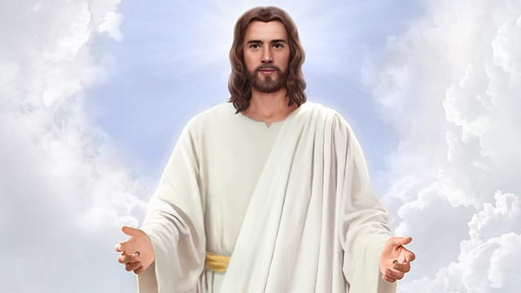
So Religious that fails to see God
活在宗教中, 卻看不見神
12/22/2019
Rev. Joseph Chang
BOLGPC 爾灣大公園靈糧堂

Slide 2
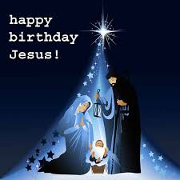
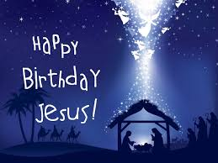
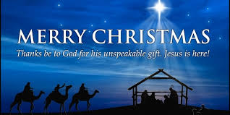
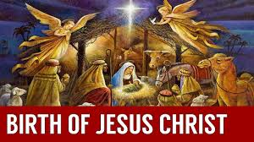

Slide 3
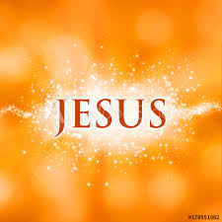
Q:你今天來教會, 是來參加一個每年一次的宗教活動, 或
者來尋找這個宗教活動所紀念的這位神?
Do you come to church today to attend an annual religious
event, or to look for the God remembered by this religious
event?

Slide 4
I. 第一個故事/The 1st Story
¹這事以後，到了猶太人的一個節期，耶穌就上耶路撒冷去。²在耶路撒冷，靠近羊門有一個池子，希伯來話叫作畢士大，旁邊有五個廊子；³裡面躺著瞎眼的、瘸腿的、血氣枯乾的許多病人。（有古卷在此有：等候水動；⁴因為有天使按時下池子攪動那水，水動之後，誰先下去，無論害甚麼病就痊愈了。）⁵在那裡有一個人，病了三十八年。
¹After this there was a feast of the Jews, and Jesus went up to Jerusalem. ²Now there is in Jerusalem by the Sheep Gate a pool, in Aramaic called Bethesda, which has five roofed colonnades. ³In these lay a multitude of invalids-blind, lame, and paralyzed. ⁴[Sam as Above.] ⁵One man was there who had been an invalid for thirty-eight years.

Slide 5
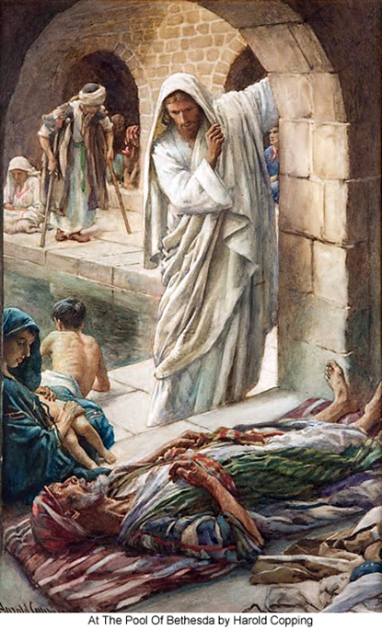
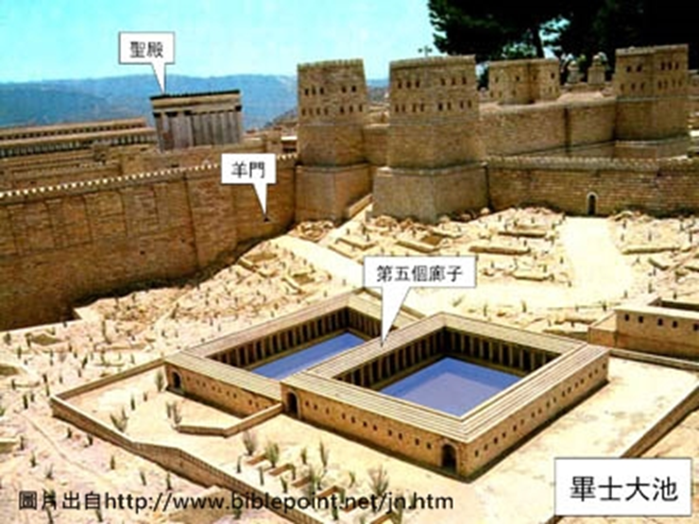

Slide 6
⁶耶穌看見他躺著，知道他病了許久，就問他說：你要痊愈麼？⁷病人回答說：先生，水動的時候，沒有人把我放在池子裡；我正去的時候，就有別人比我先下去。⁸耶穌對他說：起來，拿你的褥子走罷！⁹那人立刻痊愈，就拿起褥子來走了。¹⁰那天是安息日，所以猶太人對那醫好的人說：今天是安息日，你拿褥子是不可的。
⁶When Jesus saw him lying there and knew that he had already been there a long time, he said to him, ""Do you want to be healed?"" ⁷The sick man answered him, "Sir, I have no one to put me into the pool when the water is stirred up, and while I am going another steps down before me." ⁸Jesus said to him, ""Get up, take up your bed, and walk."" ⁹And at once the man was healed, and he took up his bed and walked. Now that day was the Sabbath. ¹⁰So the Jews said to the man who had been healed, "It is the Sabbath, and it is not lawful for you to take up your bed."

Slide 7
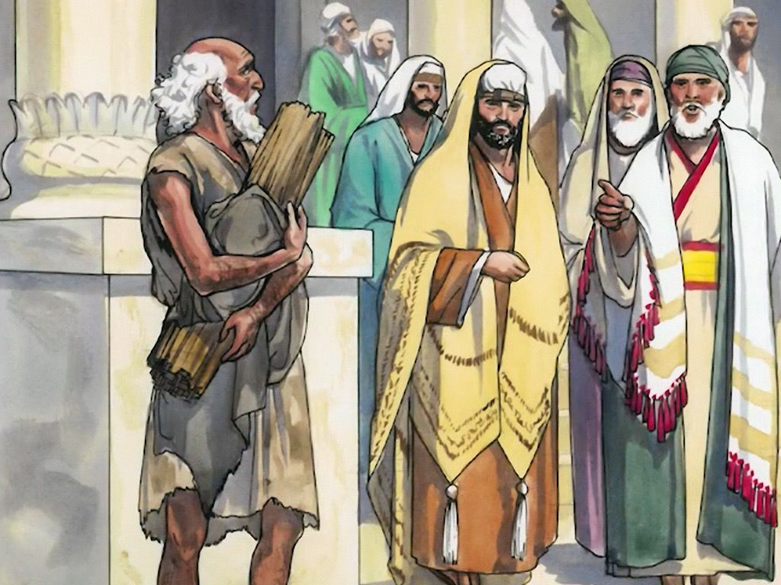

Slide 8
¹¹他卻回答說：那使我痊愈的，對我說：拿你的褥子走罷。¹²他們問他說：對你說拿褥子走的是甚麼人？¹³那醫好的人不知道是誰；因為那裡的人多，耶穌已經躲開了。¹⁴後來耶穌在殿裡遇見他，對他說：你已經痊愈了，不要再犯罪，恐怕你遭遇的更加利害。¹⁵那人就去告訴猶太人，使他痊愈的是耶穌。【約 5:1~15】
¹¹But he answered them, "The man who healed me, that man said to me, "'Take up your bed, and walk.'"" ¹²They asked him, "Who is the man who said to you, 'Take up your bed and walk'?" ¹³Now the man who had been healed did not know who it was, for Jesus had withdrawn, as there was a crowd in the place. ¹⁴Afterward Jesus found him in the temple and said to him, ""See, you are well! Sin no more, that nothing worse may happen to you."" ¹⁵The man went away and told the Jews that it was Jesus who had healed him. 【John 5:1~15】

Slide 9
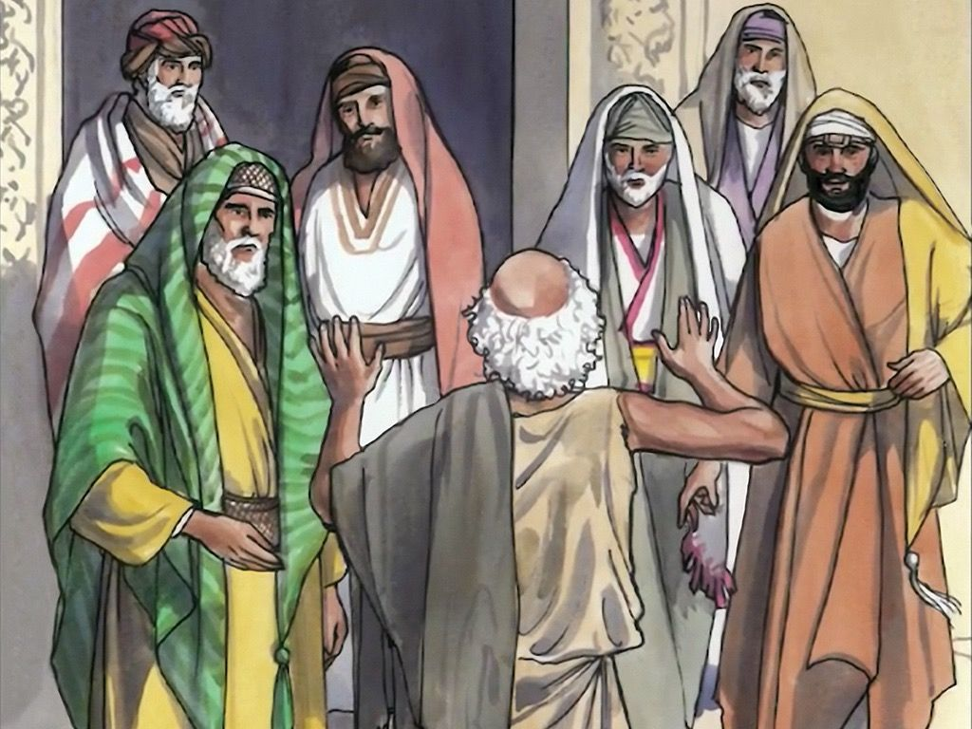

Slide 10
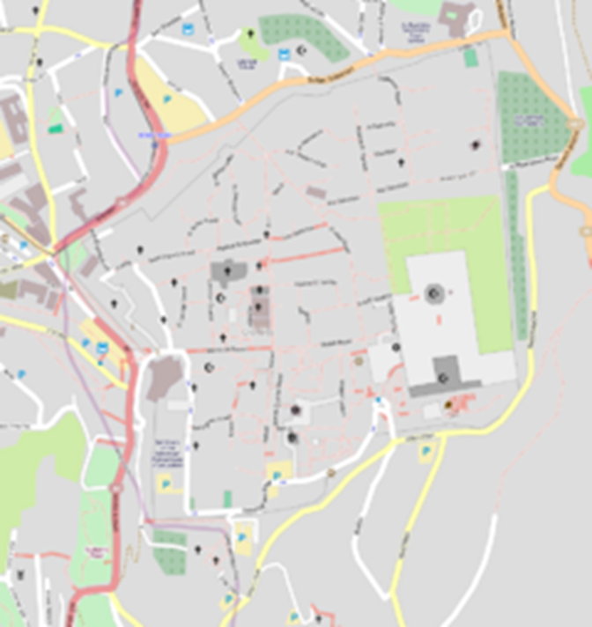
Pool of Bethesda 畢士大池
In the current Muslim quarter
在當前的穆斯林地區

Slide 11
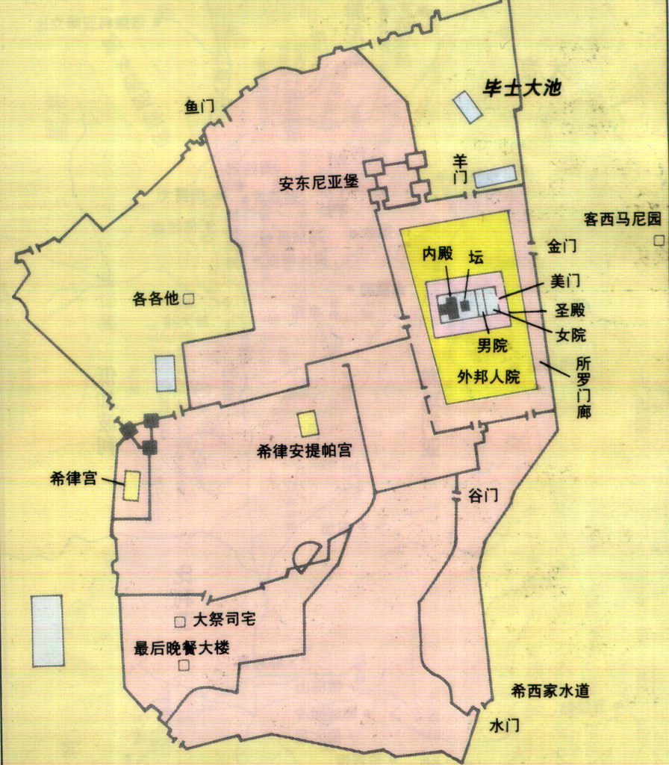

Slide 12
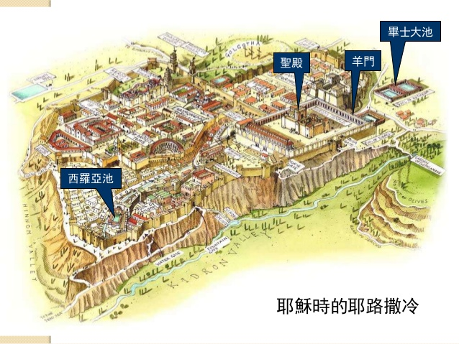

Slide 13
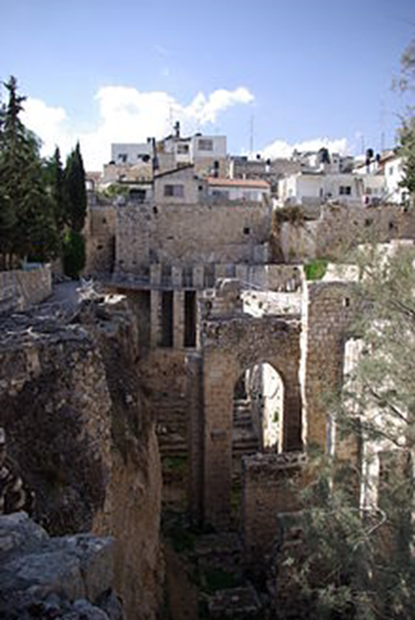
The ruins of the Byzantine Church, adjacent to the site of the Pool of Bethesda
拜占庭教堂遺址，毗鄰畢士大池

Slide 14
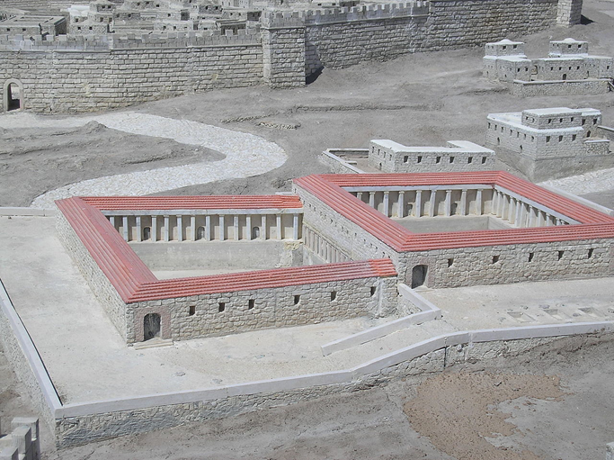
Model of the pools during the Second Temple Period (Israel Museum)
第二聖殿時期的水池模型（以色列博物館）

Slide 15
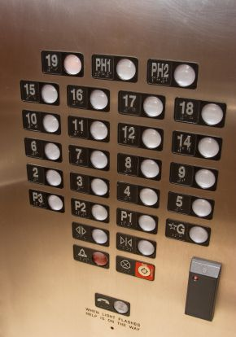
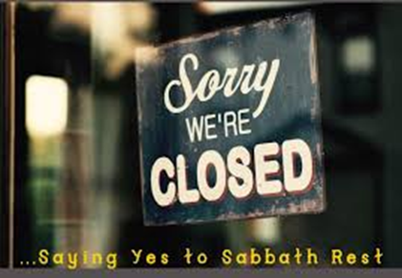
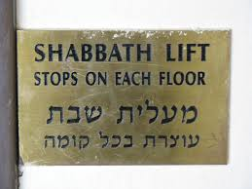
Illustration: Sabbath安息日
(1)
(2)

Slide 16
宗教不能夠真正幫助你, 只有宗教所要帶你認識的這位耶穌
能夠幫助你.
Religion can't really help you, only finding Jesus in religion
can help you.
➔你們發現沒有, 約翰福音第5章的這個人在宗教裡面找到了
耶穌, 卻因為宗教的束縛, 讓他出賣了耶穌.
The man in John 5 found Jesus in religion, but he betrayed
Jesus because of the constraints of religion.

Slide 17
II. 第二個故事/The 2nd Story
Q:為什麼主耶穌誕生的時候, 首先讓牧羊人知道?
Why shepherds were invited to witness Christ's birth—
and not somebody else?
➔因為他們不需要擔心“政治正確”，沒有人的負擔。
They didn’t need to worry about "political correctness“ and
what others thought of them.

Slide 18
⁸在伯利恆之野地裡有牧羊的人，夜間按著更次看守羊群。⁹有主的使者站在他們旁邊，主的榮光四面照著他們；牧羊的人就甚懼怕。¹⁰那天使對他們說：不要懼怕！我報給你們大喜的信息，是關乎萬民的；¹¹因今天在大衛的城裡，為你們生了救主，就是主基督。
⁸And in the same region there were shepherds out in the field, keeping watch over their flock by night. ⁹And an angel of the Lord appeared to them, and the glory of the Lord shone around them, and they were filled with fear. ¹⁰And the angel said to them, "Fear not, for behold, I bring you good news of a great joy that will be for all the people. ¹¹For unto you is born this day in the city of David a Savior, who is Christ the Lord.

Slide 19
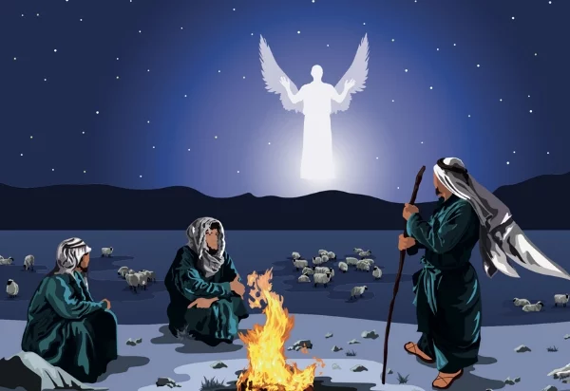

Slide 20
¹²你們要看見一個嬰孩，包著布，臥在馬槽裡，那就是記號了。¹³忽然，有一大隊天兵同那天使讚美神說：¹⁴在至高之處榮耀歸與神！在地上平安歸與他所喜悅的人（有古卷作：喜悅歸與人）！¹⁵眾天使離開他們，升天去了。牧羊的人彼此說：我們往伯利恆去，看看所成的事，就是主所指示我們的。
¹²And this will be a sign for you: you will find a baby wrapped in swaddling cloths and lying in a manger." ¹³And suddenly there was with the angel a multitude of the heavenly host praising God and saying, ¹⁴" Glory to God in the highest, and on earth peace among those with whom he is pleased!" ¹⁵When the angels went away from them into heaven, the shepherds said to one another, "Let us go over to Bethlehem and see this thing that has happened, which the Lord has made known to us."

Slide 21
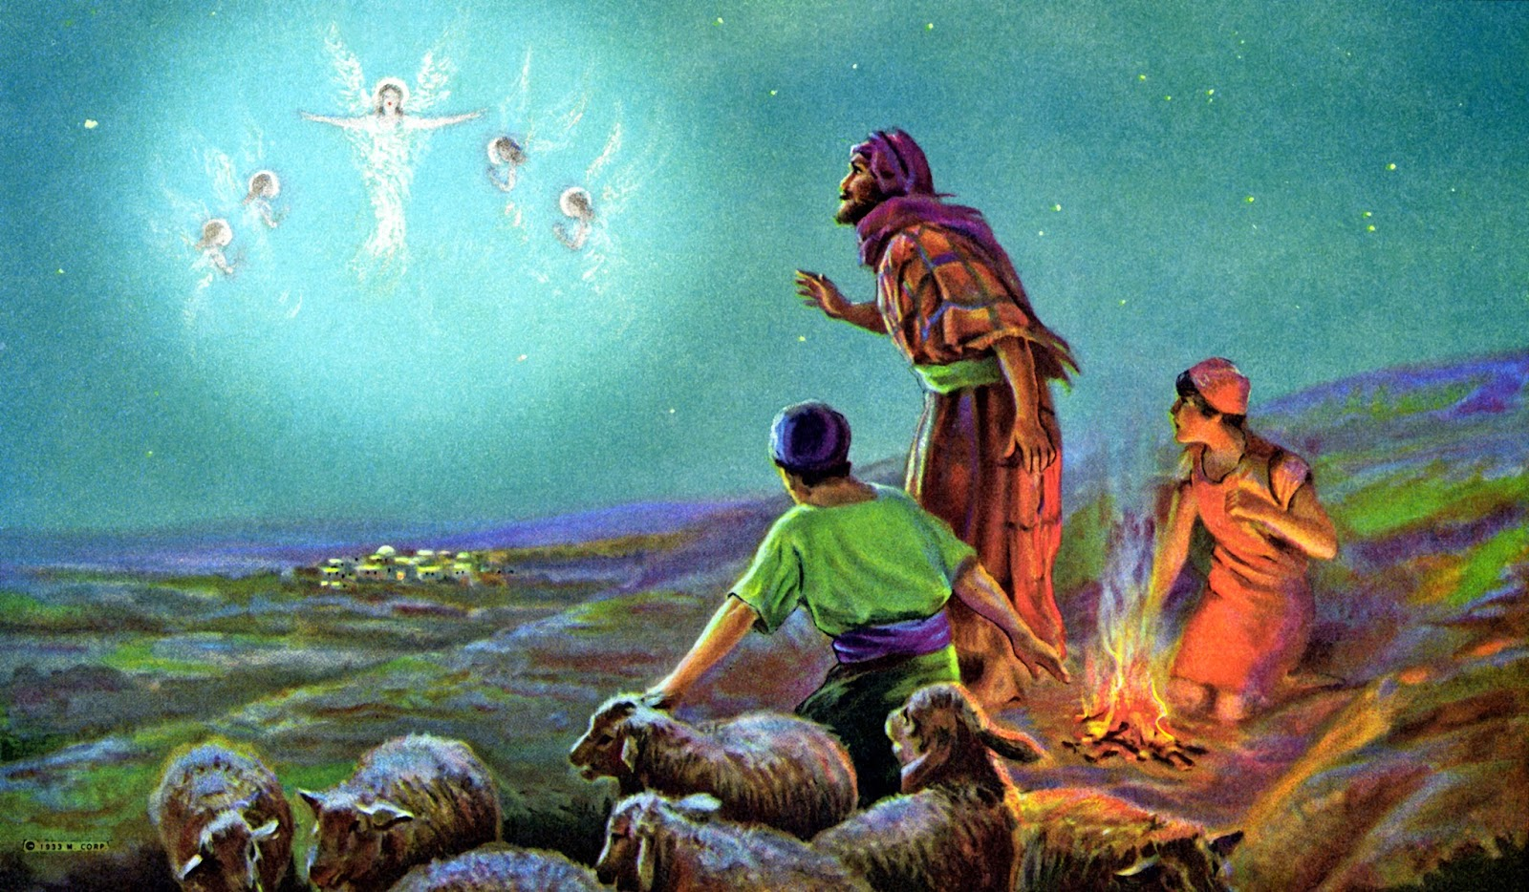

Slide 22
¹⁶他們急忙去了，就尋見馬利亞和約瑟，又有那嬰孩臥在馬槽裡；¹⁷既然看見，就把天使論這孩子的話傳開了。¹⁸凡聽見的，就詫異牧羊之人對他們所說的話。¹⁹馬利亞卻把這一切的事存在心裡，反復思想。²⁰牧羊的人回去了，因所聽見所看見的一切事，正如天使向他們所說的，就歸榮耀與神，讚美他。【路 2:8~20】
¹⁶And they went with haste and found Mary and Joseph, and the baby lying in a manger. ¹⁷And when they saw it, they made known the saying that had been told them concerning this child. ¹⁸And all who heard it wondered at what the shepherds told them. ¹⁹But Mary treasured up all these things, pondering them in her heart. ²⁰And the shepherds returned, glorifying and praising God for all they had heard and seen, as it had been told them. 【Luke 2:8~20】

Slide 23
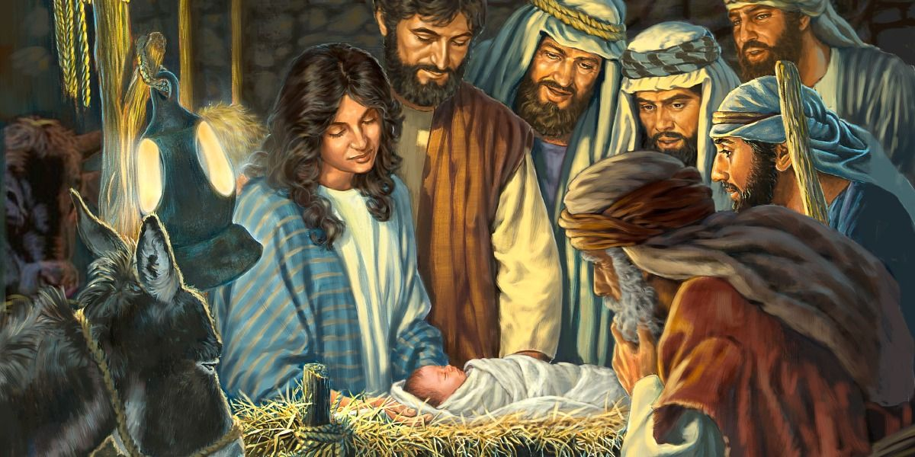

Slide 24
III. 第三個故事/The 3rd Story
上帝引導東方三博士來尋找主耶穌, 因為他們沒有宗教的
束縛.
God led the three wise men from the East to seek the Lord
Jesus because they were not bound by religion.

Slide 25
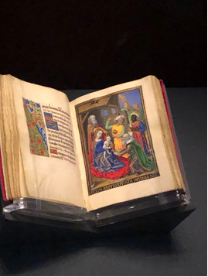
這三個博士不是猶太教徒, 乃是追求真神的人。
The three wise men are not Jews, but people who pursue the
true God.
最近在Getty’s Museum展出的一個中世紀的聖經, 畫的三博士, 一個是從亞洲, 一個是從歐洲, 一個是從非洲來的.
The three wise men, painted in a medieval Bible exhibited recently at the Getty ’s Museum, one was from Asia, one was from Europe, and one was from Africa.

Slide 26
¹當希律王的時候，耶穌生在猶太的伯利恆。有幾個博士從東方來到耶路撒冷，說：²那生下來作猶太人之王的在那裡？我們在東方看見他的星，特來拜他。³希律王聽見了，就心裡不安；耶路撒冷合城的人也都不安。⁴他就召齊了祭司長和民間的文士，問他們說：基督當生在何處？
¹Now after Jesus was born in Bethlehem of Judea in the days of Herod the king, behold, wise men from the east came to Jerusalem, ²saying, "Where is he who has been born king of the Jews? For we saw his star when it rose and have come to worship him." ³When Herod the king heard this, he was troubled, and all Jerusalem with him; ⁴and assembling all the chief priests and scribes of the people, he inquired of them where the Christ was to be born.

Slide 27
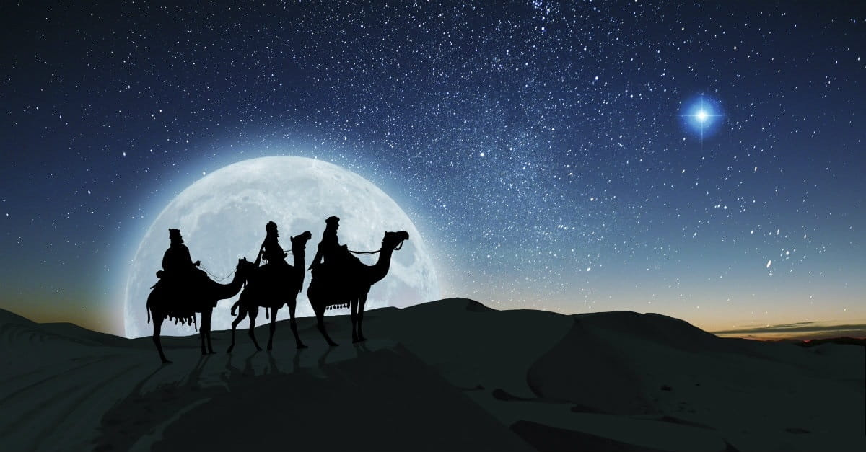

Slide 28
⁵他們回答說：在猶太的伯利恆。因為有先知記著，說：⁶猶大地的伯利恆阿，你在猶大諸城中並不是最小的；因為將來有一位君王要從你那裡出來，牧養我以色列民。⁷當下，希律暗暗的召了博士來，細問那星是甚麼時候出現的，⁸就差他們往伯利恆去，說：你們去仔細尋訪那小孩子，尋到了，就來報信，我也好去拜他。
⁵They told him, "In Bethlehem of Judea, for so it is written by the prophet: ⁶"' And you, O Bethlehem, in the land of Judah, are by no means least among the rulers of Judah; for from you shall come a ruler who will shepherd my people Israel.'" ⁷Then Herod summoned the wise men secretly and ascertained from them what time the star had appeared. ⁸And he sent them to Bethlehem, saying, "Go and search diligently for the child, and when you have found him, bring me word, that I too may come and worship him."

Slide 29
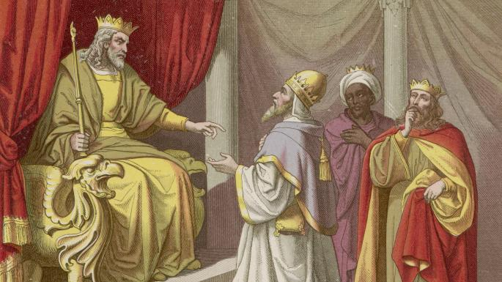

Slide 30
⁹他們聽見王的話就去了。在東方所看見的那星忽然在他們前頭行，直行到小孩子的地方，就在上頭停住了。¹⁰他們看見那星，就大大的歡喜；¹¹進了房子，看見小孩子和他母親馬利亞，就俯伏拜那小孩子，揭開寶盒，拿黃金、乳香、沒藥為禮物獻給他。【太 2:1~11】
⁹After listening to the king, they went on their way. And behold, the star that they had seen when it rose went before them until it came to rest over the place where the child was. ¹⁰When they saw the star, they rejoiced exceedingly with great joy. ¹¹And going into the house they saw the child with Mary his mother, and they fell down and worshiped him. Then, opening their treasures, they offered him gifts, gold and frankincense and myrrh. 【Matt 2:1~11】

Slide 31
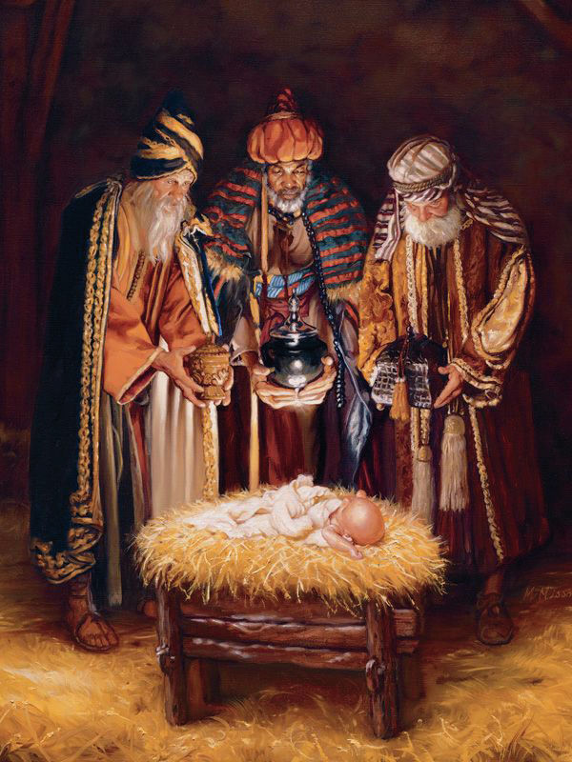
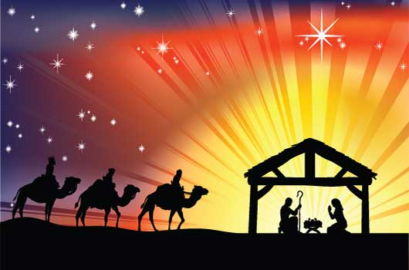

Slide 32
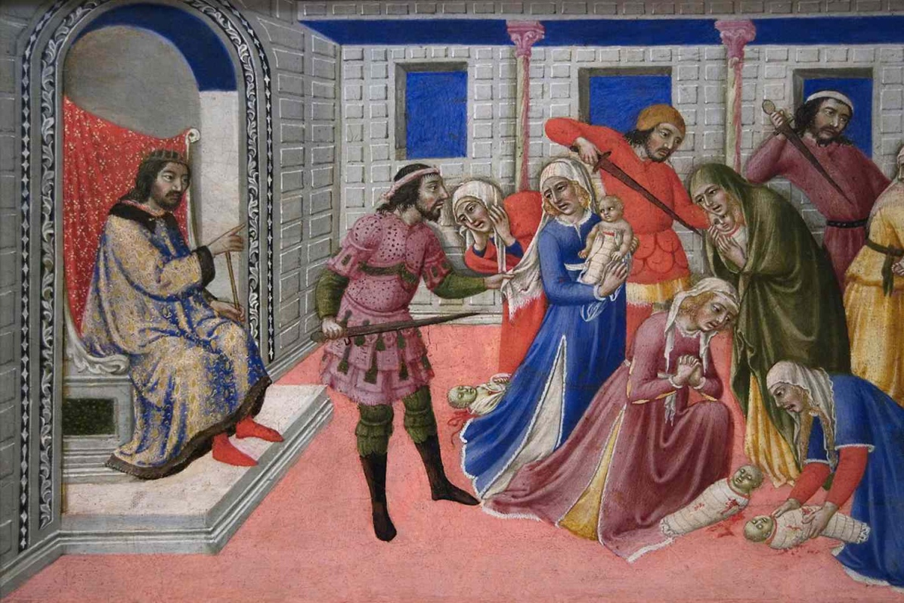
➔而猶大君王所給主耶穌的禮物, 就是把伯利恆的兩歲以下的孩
子都殺了.
The gift given to the Lord Jesus by the King of Judah was to kill
all children under two years old in Bethlehem.

Slide 33
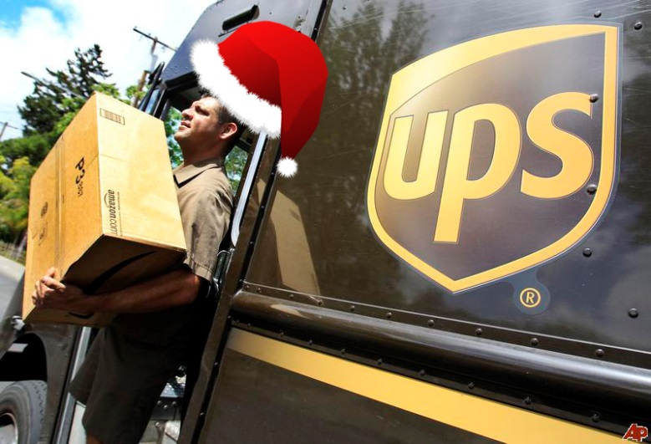
IV. 我們怎麼樣來慶祝聖誕節/How to celebrate Christmas?
1. Get rid of the men’s sound. Focus on God in the midst of
religious celebration.
就是要認識聖誕節所紀念的主, 而不是只享受聖誕節這一個節
日的熱鬧好玩而已.
Happy Holiday
2. No fear of men.
現在多少人為了political correctness, 都不說 Merry Christmas了. 把慶祝主耶穌的節日, 當成是大家都喜歡的holiday. 但是不敢提主耶穌的名字.

Slide 34
Conclusion:
今天這個基督教的建立就是因為主耶穌. 我們來教會就
是要找到主耶穌. 不要進了教會, 不見了耶穌!
Christianity is established because of the Lord Jesus. We
come to church to find the Lord Jesus. Don’t love religion
more than love the relationship with the Lord Jesus .

Slide 35
Two Baptisms/兩個洗禮
李真 Grace Li
邱詩婷 Mona Chiu

