Slide 1
TRUE
FAITH
真正的信心
1/5/2020 Rev. Joseph Chang
BOLGPC 爾灣 大公園靈糧堂

Slide 2
Show me your faith without the work
and I will show you my faith by my work.
將你沒有行為的信心指給我看,
我便藉著我的行為, 將我的信心指給你看

Slide 3
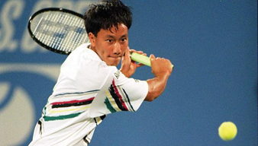
Illustration 1:
張德培(Michael Chang)
September 1, 1987 - Chang is youngest winner at US Open
Michael Te-Pei Chang (born February 22, 1972) is an American former tennis player. He became the youngest male player to win a Grand Slam singles title when he won the French Open in 1989 at the age of 17 years and 4 months.

Slide 4
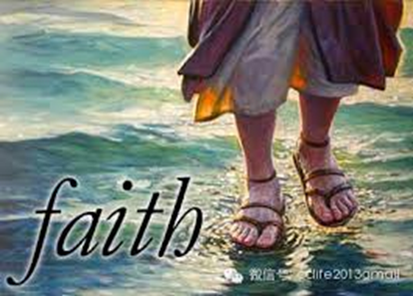
¹⁸. . . . . 你將你沒有行為的信心指給我看，我便藉著我的行為，將我的信心指給你看。」
【雅 2:18】 ¹⁸. . . . . Show me your faith apart from your works, and I will show you my faith by my works.
【Jam 2:18】

Slide 5
Illustration 2:
這是一個資訊爆炸的時代…….
This is an era of information explosion……..

Slide 6
甚麼是 “信心”?
What is “faith"?

Slide 7
I. 信心的對象是“神”, 信心的目標是 “將來的事”.
The object of our faith is God, the focus is on the future
things.
¹信就是所望之事的實底，是未見之事的確據。【來 11:1】 ¹Now faith is the assurance of things hoped for, the conviction of things not seen. 【Heb 11:1】

Slide 8
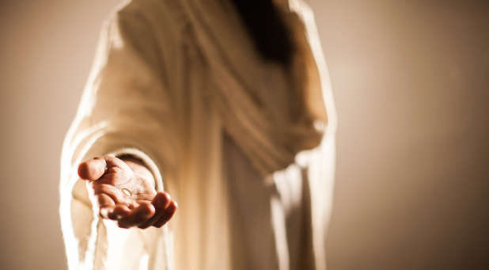
Illustration 3:
30年前/30 years ago

Slide 9
¹⁹你信神只有一位，你信的不錯；
鬼魔也信，卻是戰驚。
【雅 2:19】
¹⁹You believe that God is one; you do well.
Even the demons believe-and shudder!
【Jam 2:19】

Slide 10
II. 這樣的信心是要經過試煉的.
Such faith is to be tested.
¹作神和主耶穌基督僕人的雅各請散住十二個支派之人的安。²我的弟兄們，你們落在百般試煉中，都要以為大喜樂；³因為知道你們的信心經過試驗，就生忍耐。
¹James, a servant of God and of the Lord Jesus Christ, To the twelve tribes in the Dispersion: Greetings. ²Count it all joy, my brothers, when you meet trials of various kinds, ³for you know that the testing of your faith produces steadfastness.

Slide 11
⁴但忍耐也當成功，使你們成全、完備，毫無缺欠。 ⁵你們中間若有缺少智慧的，應當求那厚賜與眾人、也不斥責人的神，主就必賜給他。⁶只要憑著信心求，一點不疑惑；因為那疑惑的人，就像海中的波浪，被風吹動翻騰。
【雅 1:1~6】
⁴And let steadfastness have its full effect, that you may be perfect and complete, lacking in nothing. ⁵If any of you lacks wisdom, let him ask God, who gives generously to all without reproach, and it will be given him. ⁶But let him ask in faith, with no doubting, for the one who doubts is like a wave of the sea that is driven and tossed by the wind.
【Jam 1:1~6】

Slide 12
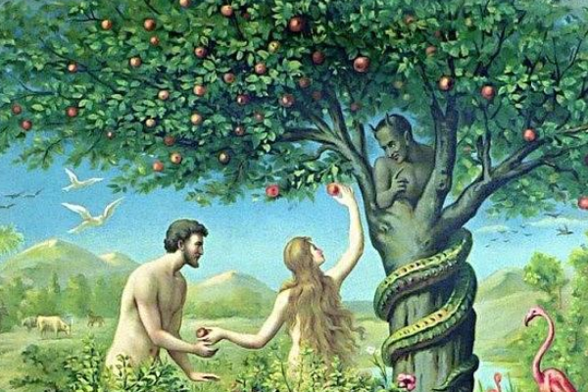
Illustration 4:
人類的第一個試煉/考試
Human's First Trial / Examination

Slide 13
Illustration 5:

Slide 14
¹³人被試探，不可說：「我是被神試探」；因為神不能被惡試探，他也不試探人。¹⁴但各人被試探，乃是被自己的私慾牽引誘惑的。¹⁵私慾既懷了胎，就生出罪來；罪既長成，就生出死來。
【雅 1:13~15】 ¹³Let no one say when he is tempted, "I am being tempted by God," for God cannot be tempted with evil, and he himself tempts no one. ¹⁴But each person is tempted when he is lured and enticed by his own desire. ¹⁵Then desire when it has conceived gives birth to sin, and sin when it is fully grown brings forth death. 【Jam 1:13~15】

Slide 15
試探和試煉/試驗的差異 the difference between the temptation form God and Satan
試探/temptation
從撒旦而來/From Satan
目的:惡
Purpose: Evil
讓我們的信心拖離正路, 把好的事情變成不好的事情。用來讓我們跌倒, 讓我們犯罪。
It is to derail our faith and turn good things into bad things. It will make us fall and make us sin.
試煉/試驗 temptation(trial / test )
從神而來/From God
目的:善
Purpose: Good
是要我們變得更好，能夠支取從上帝來的應許, 和從上帝來的祝福。
It is to better us to be able
to take promises and blessings
from God.

Slide 16
III. 這樣的信心當更加的成全, 完備以後, 能夠得到智慧
When the faith is perfected, we shall increase in our
wisdom. (各1:5).
所羅門說,
¹⁰敬畏耶和華是智慧的開端；認識至聖者便是聰明。【箴 9:10】 ¹⁰The fear of the Lord is the beginning of wisdom, and the knowledge of the Holy One is insight. 【Prov 9:10】

Slide 17
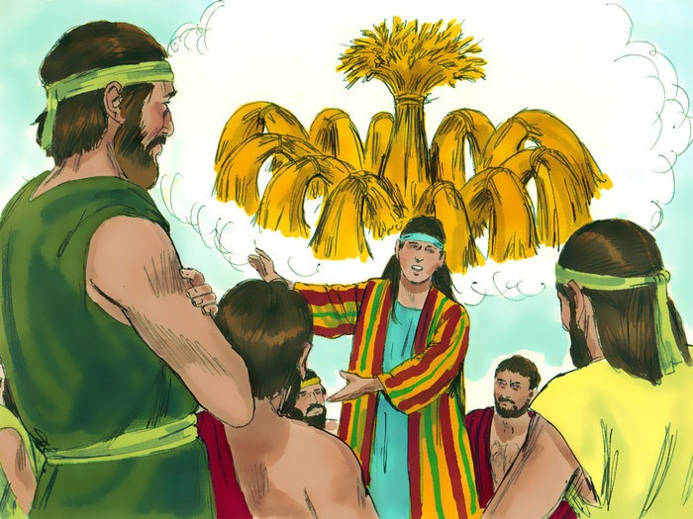
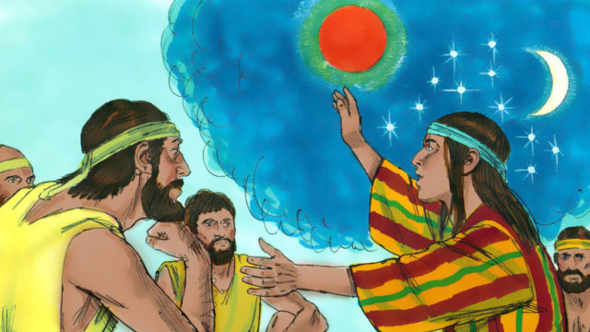
➔上帝讓約瑟有解夢的能力.
God gave Joseph the power to interpret dreams.

Slide 18
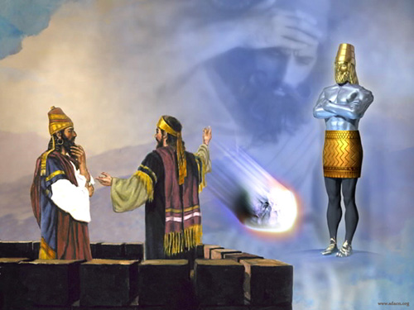
➔上帝讓但以理有解夢的能力.
God gave Daniel the ability to interpret dreams.

Slide 19
. 快快地聽, 慢慢地說, 慢慢地動怒
Quick to listen, slow to speak, slow to become angry
(James 1:19).
. 看顧在患難中的孤兒寡婦
Look after orphans and widows in their distress
(James 1:27).
. 不偏心對待窮人或富人
Treat the rich and the poor without partiality
(James 2:1).
. 制伏舌頭/Taming the tongue (James 3:1).

Slide 20
IV. 這樣的信心當更加的成熟以後, 能夠代表神, 做許
多的神蹟, 如同為人禱告, 讓人的身體疾病得到醫
治(各5:16).
When this kind of faith is more mature, it can represent
God and do many miracles, just like praying for people,
so that people's physical diseases can be healed.

Slide 21
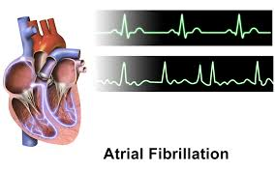
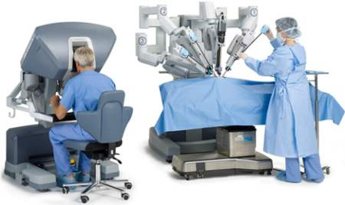
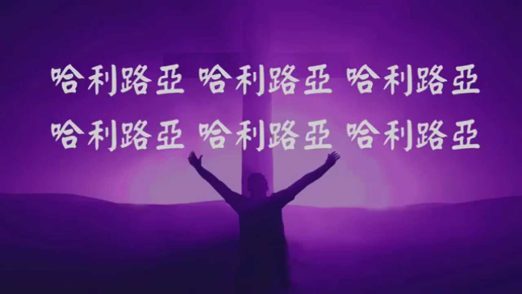
Illustration:

Slide 22
¹⁴你們中間有病了的呢，他就該請教會的長老來；他們可以奉主的名用油抹他，為他禱告。¹⁵出於信心的祈禱要救那病人，主必叫他起來；他若犯了罪，也必蒙赦免。¹⁶所以你們要彼此認罪，互相代求，使你們可以得醫治。義人祈禱所發的力量是大有功效的。【雅 5:14~16】 ¹⁴Is anyone among you sick? Let him call for the elders of the church, and let them pray over him, anointing him with oil in the name of the Lord. ¹⁵And the prayer of faith will save the one who is sick, and the Lord will raise him up. And if he has committed sins, he will be forgiven. ¹⁶Therefore, confess your sins to one another and pray for one another, that you may be healed. The prayer of a righteous person has great power as it is working. 【Jam 5:14~16】

Slide 23
不單單只是醫治而已, 上帝讓有信心的人成為他的代言
人, 成為他神蹟的執行者.
It's not just healing. God makes a faithful person to be his
spokesman and his miracle performer.
¹⁷以利亞與我們是一樣性情的人，他懇切禱告，求不要下雨，雨就三年零六個月不下在地上。¹⁸他又禱告，天就降下雨來，地也生出土產。【雅 5:17~18】 ¹⁷Elijah was a man with a nature like ours, and he prayed fervently that it might not rain, and for three years and six months it did not rain on the earth. ¹⁸Then he prayed again, and heaven gave rain, and the earth bore its fruit.
【Jam 5:17~18】

Slide 24
Conclusion:
信心是我們認識神的起步, 也是和神關係愈來愈密切的鑰匙, 信心是活潑, 是美麗, 是陽光的, 他不會是負面, 頹喪, 失望, 黑暗的. 我們的神是超過我們力量的神, 我們的神也是創始成終的神.
Faith is the starting point for us to know God, and also the key to getting closer to God. Faith is lively, beautiful, and sunny. Faith will never be negative, sorrowful, disappointed, and dark. Our God is awesome in power, and He is the one who created the world and the one who will end it.

