Slide 1
5/3/2020 Rev. Joseph Chang BOLGPC 爾灣大公園靈糧堂

Slide 2
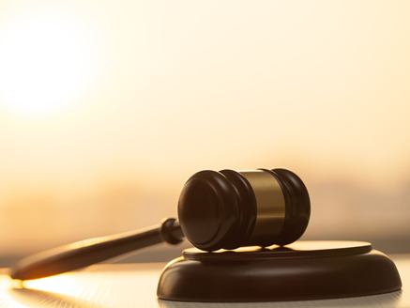
“審判”的英文是 Judge,
希臘文是 krino, “krivnw”.
→中文翻譯成為兩個詞,
一個是 “審判” 表是好的
一個是 “論斷” 表示是不好的.

Slide 3
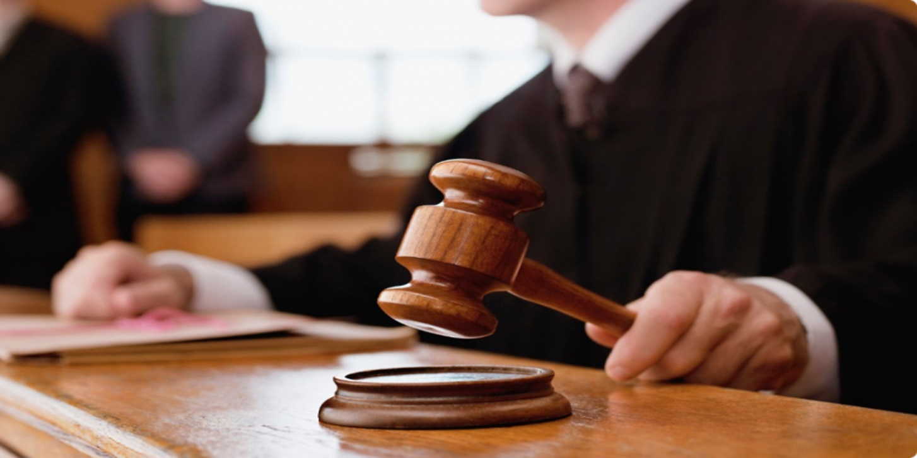
I. Can we judge? 我們可以審判嗎?

Slide 4
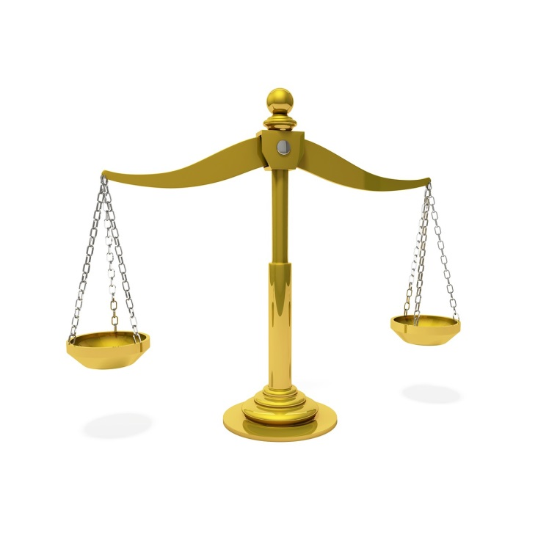
³⁵你們施行審判，不可行不義；在尺、秤、升、斗上也是如此。【利 19:35】 ³⁵"You shall do no wrong in judgment, in measures of length or weight or quantity. 【Lev 19:35】

Slide 5
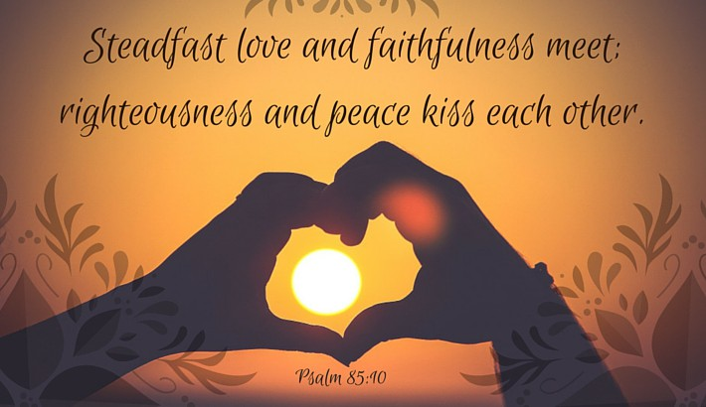
¹⁰慈愛和誠實彼此相遇；公義和平安彼此相親。
【詩 85:10】 ¹⁰Steadfast love and faithfulness meet; righteousness and peace kiss each other. 【Ps 85:10】

Slide 7
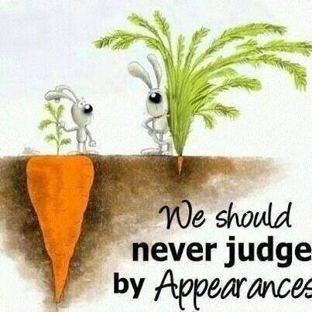
²⁴不可按外貌斷定是非，總要按公平斷定是非。【約 7:24】 ²⁴"Do not judge by appearances, but judge with right judgment." " 【John 7:24】

Slide 8
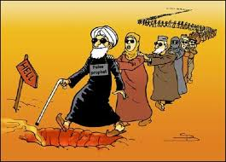
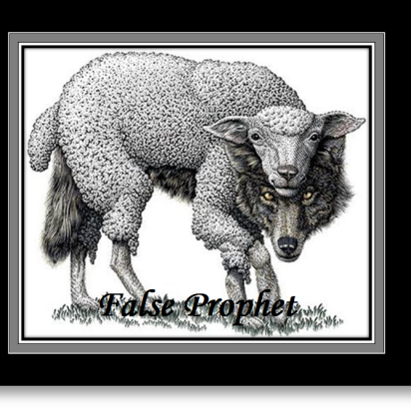
¹親愛的弟兄阿，一切的靈，你們不可都信，總要試驗那些靈是出於神的不是，因為世上有許多假先知已經出來了。【約一 4:1】 ¹Beloved, do not believe every spirit, but test the spirits to see whether they are from God, for many false prophets have gone out into the world. 【1John 4:1】

Slide 9
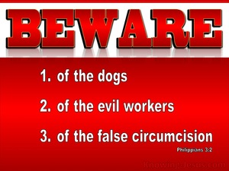
²應當防備犬類，防備作惡的，防備妄自行割的。【腓 3:2】 ²Look out for the dogs, look out for the evildoers, look out for those who mutilate the flesh. 【Phil 3:2】

Slide 10
錯誤的審判/wrong judgments =“論斷”
這兩個 “論斷”, 是我們所不應該做的:
The following two judgments are what we
should not do.

Slide 11
II. Do not judge with different standard.
用不同的 標準, 是論斷.
假冒為善的問題就是兩套標準.
A hypocrite has two sets of standards.

Slide 12
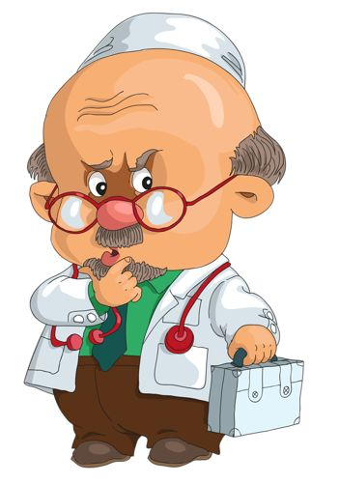
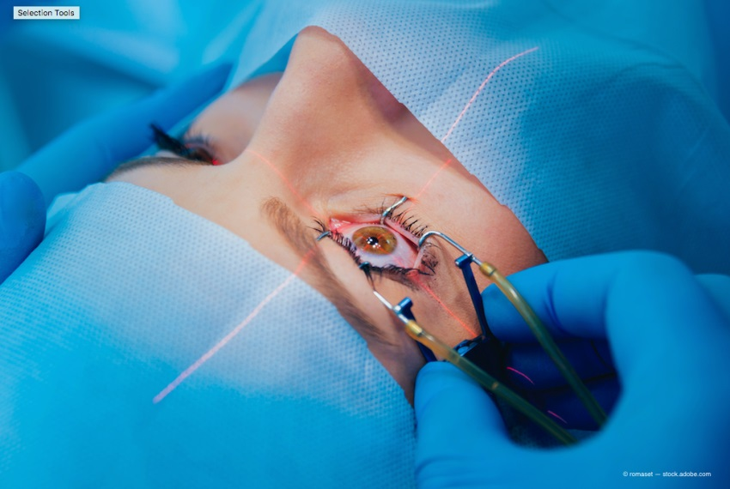
Illustration 1:
白內障手術
Cataract surgery

Slide 13
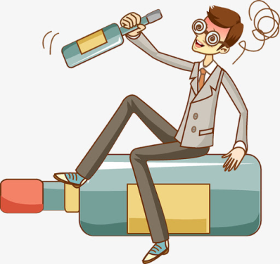
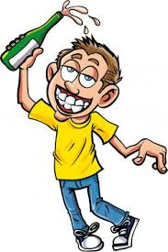
Illustration 2:

Slide 14
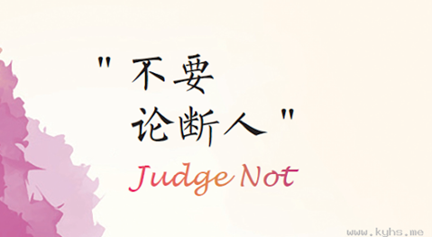
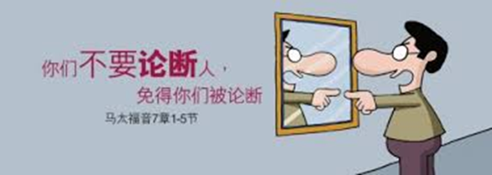

Slide 15
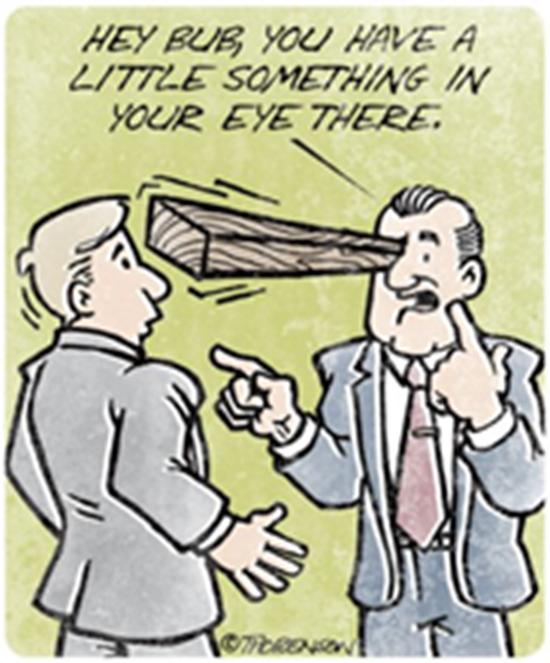
¹你們不要論斷人，免得你們被論斷。²因為你們怎樣論斷人，也必怎樣被論斷；你們用甚麼量器量給人，也必用甚麼量器量給你們。³為甚麼看見你弟兄眼中有刺，卻不想自己眼中有梁木呢？
¹""Judge not, that you be not judged." ²"For with the judgment you pronounce you will be judged, and with the measure you use it will be measured to you." ³"Why do you see the speck that is in your brother's eye, but do not notice the log that is in your own eye?"

Slide 16
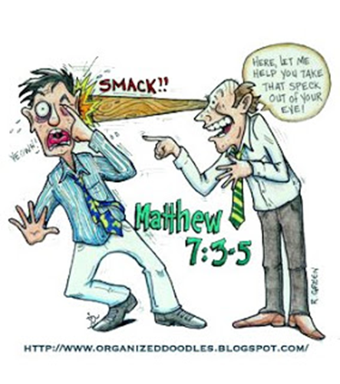
⁴你自己眼中有梁木，怎能對你弟兄說：容我去掉你眼中的刺呢？⁵你這假冒為善的人！先去掉自己眼中的梁木，然後才能看得清楚，去掉你弟兄眼中的刺。【太 7:1~5】
⁴"Or how can you say to your brother, 'Let me take the speck out of your eye,' when there is the log in your own eye?" ⁵"You hypocrite, first take the log out of your own eye, and then you will see clearly to take the speck out of your brother's eye. " 【Matt 7:1~5】

Slide 17
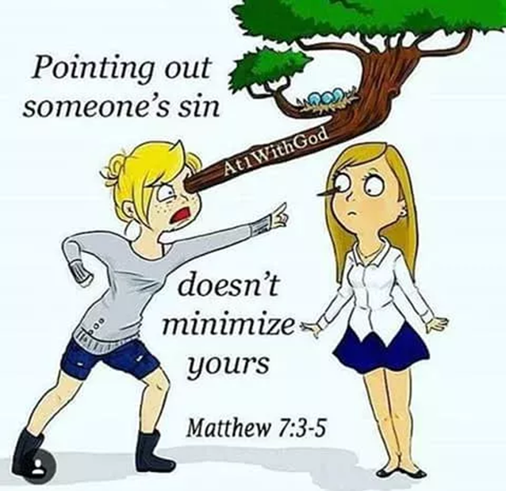
假冒為善的人
hypocrite

Slide 18
Illustration 3:

Slide 19
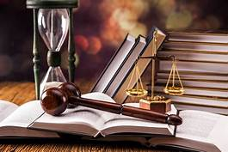
III. Do not judge the motive lightly.
不要輕易論斷別人的動機

Slide 20
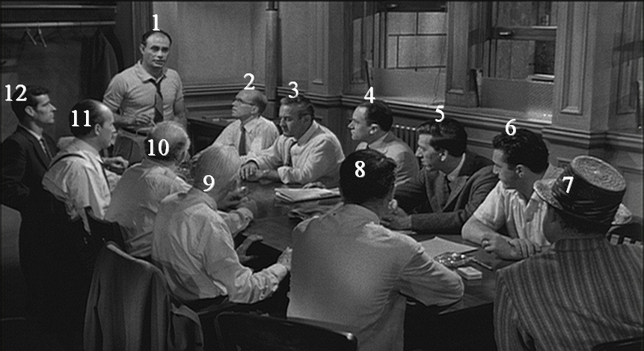
Illustration 4:
Murder trial

Slide 21
¹人應當以我們為基督的執事，為神奧祕事的管家。²所求於管家的，是要他有忠心。³我被你們論斷，或被別人論斷，我都以為極小的事；連我自己也不論斷自己。⁴我雖不覺得自己有錯，卻也不能因此得以稱義；但判斷我的乃是主。 ¹This is how one should regard us, as servants of Christ and stewards of the mysteries of God. ²Moreover, it is required of stewards that they be found trustworthy. ³But with me it is a very small thing that I should be judged by you or by any human court. In fact, I do not even judge myself.

Slide 22
⁴我雖不覺得自己有錯，卻也不能因此得以稱義；但判斷我的乃是主。⁵所以，時候未到，甚麼都不要論斷，只等主來，他要照出暗中的隱情，顯明人心的意念。那時，各人要從神那裡得著稱讚。【林前 4:1~5】
⁴I am not aware of anything against myself, but I am not thereby acquitted. It is the Lord who judges me. ⁵Therefore do not pronounce judgment before the time, before the Lord comes, who will bring to light the things now hidden in darkness and will disclose the purposes of the heart. Then each one will receive his commendation from God.
【1Cor 4:1~5】

Slide 23
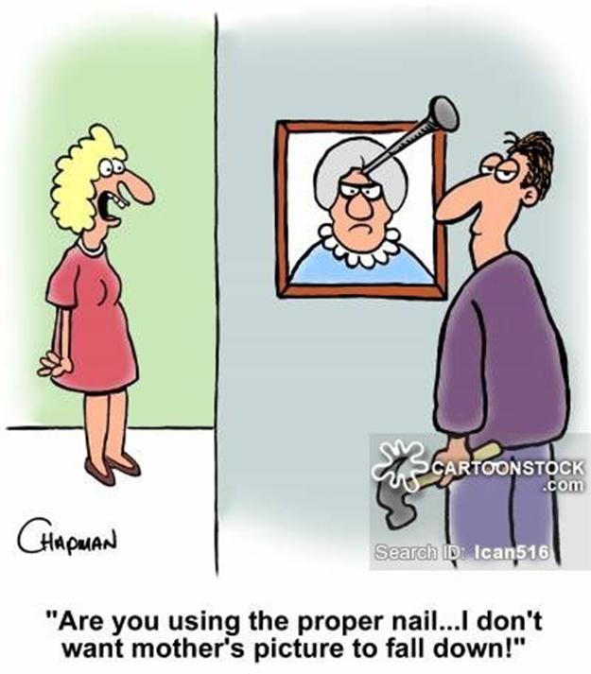
Illustration 5:

Slide 24
Summary 小結
我們需要做公平公正的判斷. 因為這是平安健康的社會所需要的基本要素.
We need to make fair and equitable judgments because this is the basic element required for a safe and healthy society.
兩種不對的審判, 或者說論斷是:The two wrong judgments are:
1. 假冒為善—兩種不同的標準.
Hypocrite-two different standards.
2. 論斷人家的動機—沒有經過審慎的調查和求證, 就怪別人動機不
良.
Judging the motives of others-Without careful investigation and
verification, you blame others for their poor motivations.

Slide 25
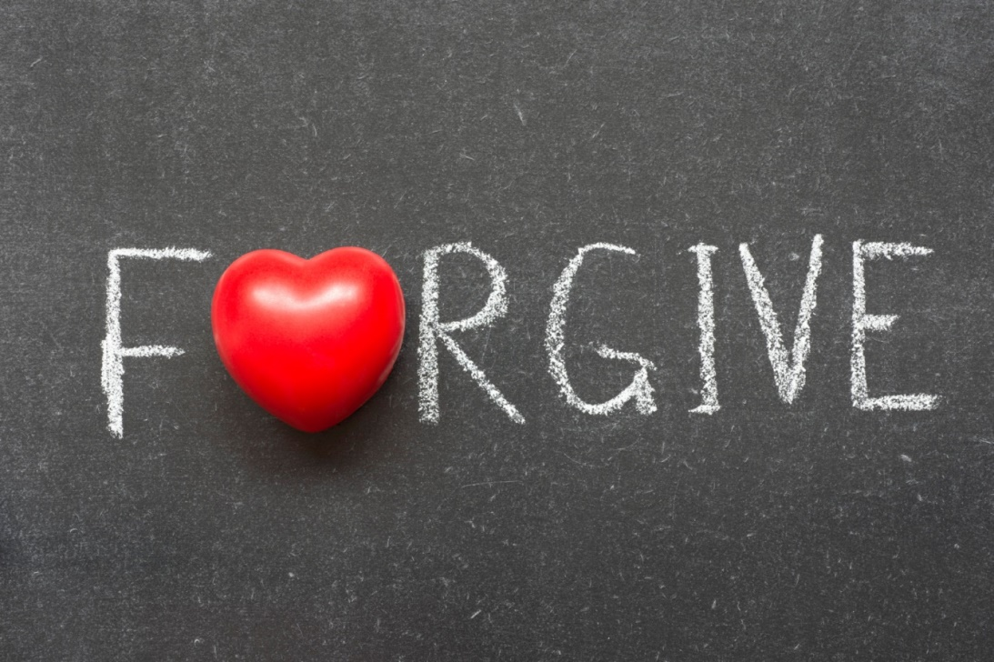
IV. Better Way—Forgiveness
更好的方法—赦免.

Slide 26
Illustration 6:

Slide 27
¹耶穌卻往橄欖山去，²清早又回到殿裡。眾百姓都到他那裡去，他就坐下，教訓他們。³文士和法利賽人帶著一個行淫時被拿的婦人來，叫他站在當中，⁴就對耶穌說：夫子，這婦人是正行淫之時被拿的。
¹but Jesus went to the Mount of Olives. ²Early in the morning he came again to the temple. All the people came to him, and he sat down and taught them. ³The scribes and the Pharisees brought a woman who had been caught in adultery, and placing her in the midst

Slide 28
⁵摩西在律法上吩咐我們把這樣的婦人用石頭打死。你說該把他怎麼樣呢？⁶他們說這話，乃試探耶穌，要得著告他的把柄。耶穌卻彎著腰，用指頭在地上畫字。⁷他們還是不住的問他，耶穌就直起腰來，對他們說：你們中間誰是沒有罪的，誰就可以先拿石頭打他。
⁵Now in the Law Moses commanded us to stone such women. So what do you say?" ⁶This they said to test him, that they might have some charge to bring against him. Jesus bent down and wrote with his finger on the ground. ⁷And as they continued to ask him, he stood up and said to them, "Let him who is without sin among you be the first to throw a stone at her."

Slide 29
⁸於是又彎著腰，用指頭在地上畫字。⁹他們聽見這話，就從老到少，一個一個的都出去了，只剩下耶穌一人，還有那婦人仍然站在當中。¹⁰耶穌就直起腰來，對他說：婦人，那些人在那裡呢？沒有人定你的罪麼？¹¹他說：主阿，沒有。耶穌說：我也不定你的罪。去罷，從此不要再犯罪了！【約 8:1~11】 ⁸And once more he bent down and wrote on the ground. ⁹But when they heard it, they went away one by one, beginning with the older ones, and Jesus was left alone with the woman standing before him. ¹⁰Jesus stood up and said to her, "Woman, where are they? Has no one condemned you?" ¹¹She said, "No one, Lord." And Jesus said, "Neither do I condemn you; go, and from now on sin no more."【John 8:1~11】

Slide 30
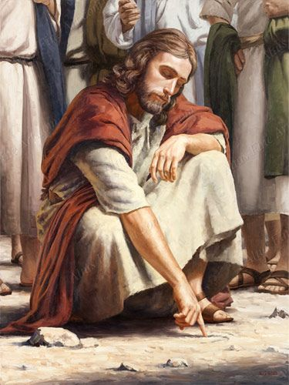
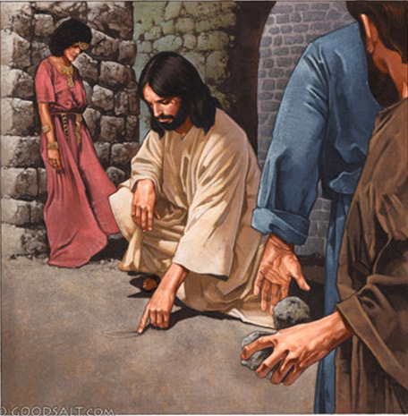

Slide 31
摩西的律法/Moses' Law:
²³若有處女已經許配丈夫，有人在城裡遇見他，與他行淫，²⁴你們就要把這二人帶到本城門，用石頭打死─女子是因為雖在城裡卻沒有喊叫；男子是因為玷污別人的妻。這樣，就把那惡從你們中間除掉。【申 22:23~24】
²³"If there is a betrothed virgin, and a man meets her in the city and lies with her, ²⁴then you shall bring them both out to the gate of that city, and you shall stone them to death with stones, the young woman because she did not cry for help though she was in the city, and the man because he violated his neighbor's wife. So you shall purge the evil from your midst. 【Deut 22:23~24】

Slide 32
Q:為什麼主耶穌可以不定婦人的罪呢?
Why didn’t the Lord Jesus convict the woman?
¹⁷莫想我來要廢掉律法和先知。我來不是要廢掉，乃是要成全。¹⁸我實在告訴你們，就是到天地都廢去了，律法的一點一畫也不能廢去，都要成全。【太 5:17~18】 ¹⁷""Do not think that I have come to abolish the Law or the Prophets; I have not come to abolish them but to fulfill them." ¹⁸"For truly, I say to you, until heaven and earth pass away, not an iota, not a dot, will pass from the Law until all is accomplished." 【Matt 5:17~18】

Slide 33
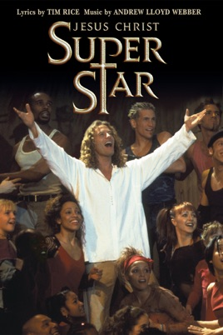
Illustration 7:

Slide 34
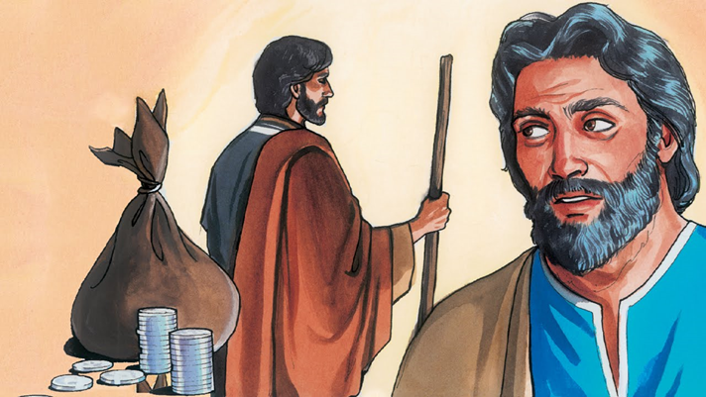
²¹人子必要去世，正如經上指著他所寫的；但賣人子的人有禍了！那人不生在世上倒好。【可 14:21】 ²¹"For the Son of Man goes as it is written of him, but woe to that man by whom the Son of Man is betrayed! It would have been better for that man if he had not been born." "
【Mark 14:21】

Slide 35
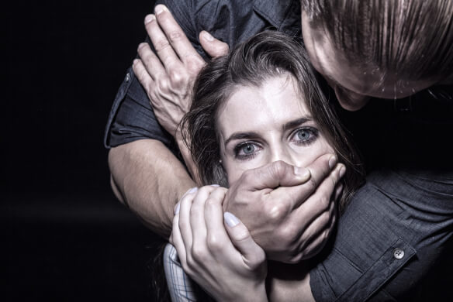
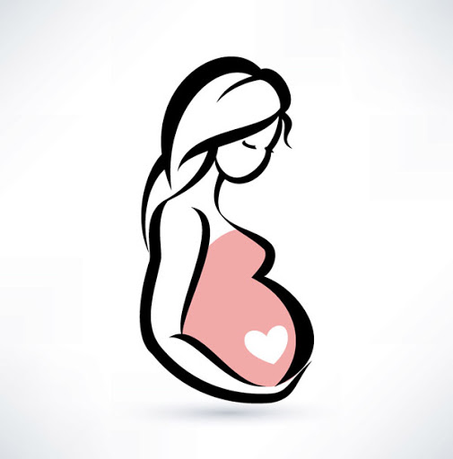
Illustration 8:

Slide 36
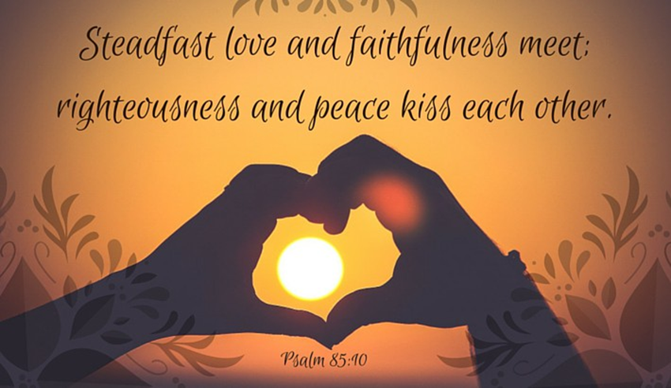
¹⁰慈愛(守約的愛)和誠實(真理)彼此相遇；公義和平安彼此相親。【詩 85:10】 ¹⁰Steadfast love and faithfulness meet; righteousness and peace kiss each other. 【Ps 85:10】

