Slide 1
管理你的時間
6/7/2019
Rev. Joseph Chang
BOLGPC 爾灣大公園靈糧堂

Slide 2
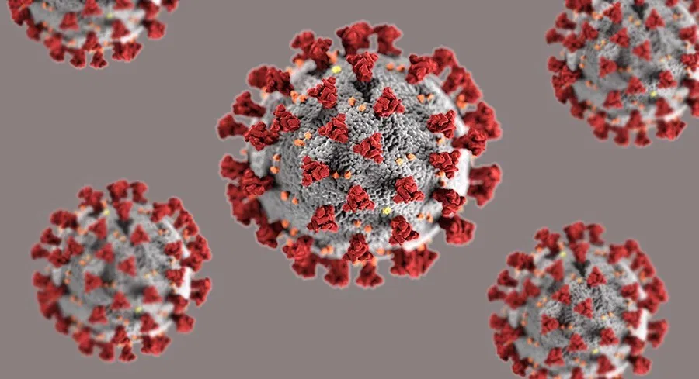

Slide 3
聖經的時間管理的觀念:
Biblical concept of time management:

Slide 4
I. We are not slaves. 我們不是奴隸.

Slide 5
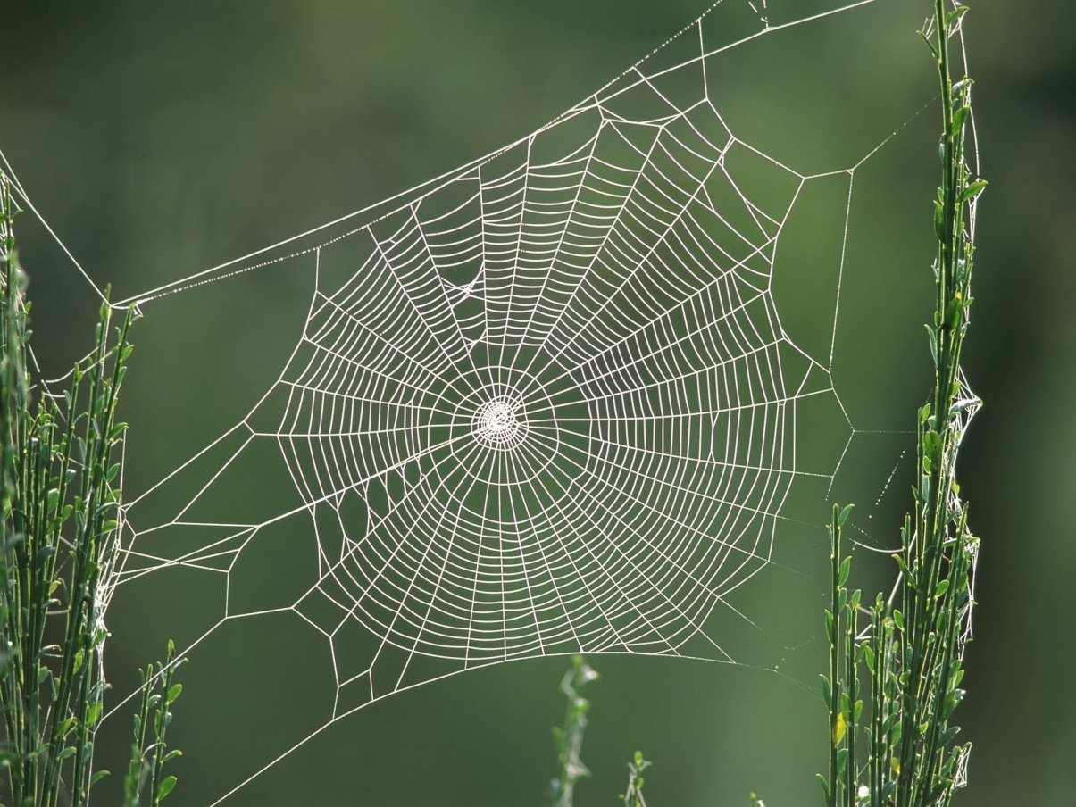
Illustration 1:

Slide 6
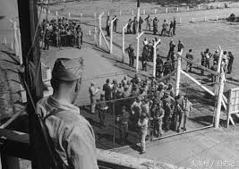
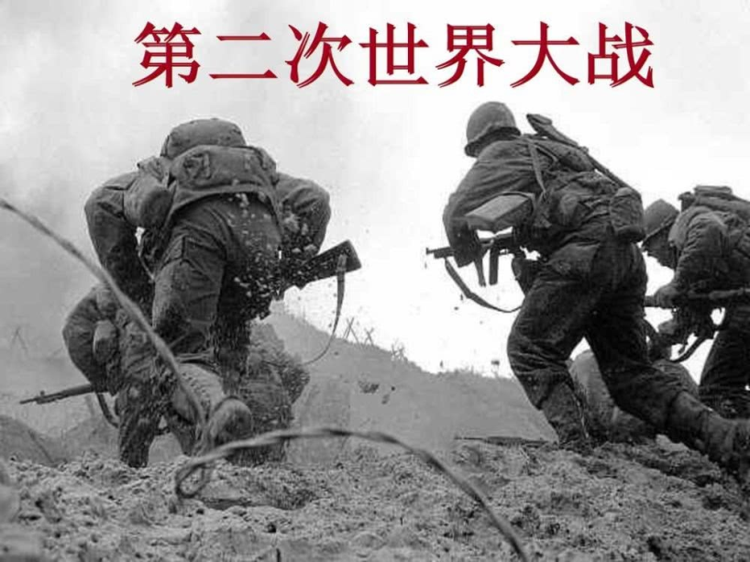
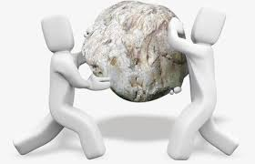
Illustration 2:

Slide 7
Illustration 3:
¹（所羅門上行之詩。）若不是耶和華建造房屋，建造的人就枉然勞力；若不是耶和華看守城池，看守的人就枉然警醒。²你們清晨早起，夜晚安歇，吃勞碌得來的飯，本是枉然；惟有耶和華所親愛的，必叫他安然睡覺。
【詩 127:1~2】 ¹Unless the Lord builds the house, those who build it labor in vain. Unless the Lord watches over the city, the watchman stays awake in vain. ²It is in vain that you rise up early and go late to rest, eating the bread of anxious toil; for he gives to his beloved sleep. 【Ps 127:1~2】

Slide 8
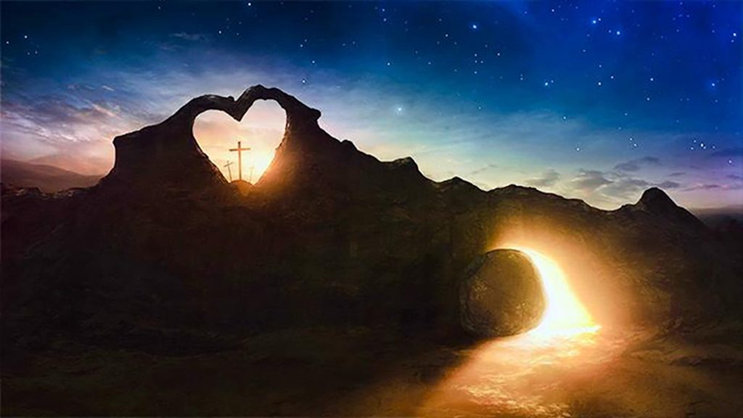
1. 我們是耶和華所親愛的. We are beloved of God.
2. 神要我們每個晚上睡得很好.
God wants us to sleep well every night.
3. 要我們有住的舒適, 與住的安全.
God wants us to live comfortably and safely.

Slide 9
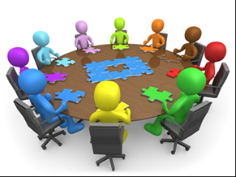
II. Develop the Strength of Others.
發展別人的長處.

Slide 10
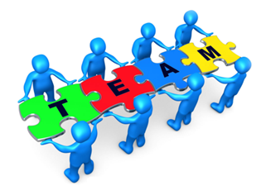
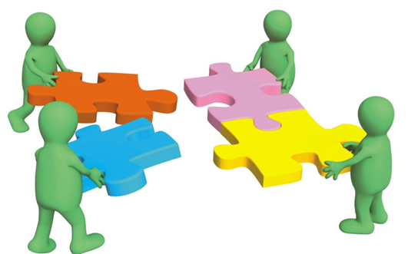
A. Discover the strength of others.
發掘出別人的長處.

Slide 11
²⁵人心憂慮，屈而不伸；一句良言，使心歡樂。
【箴 12:25】 ²⁵Anxiety in a man's heart weighs him down, but a good word makes him glad. 【Prov 12:25】

Slide 12
¹¹所以，你們該彼此勸慰，互相建立，正如你們素常所行的。【帖前 5:11】 ¹¹Therefore encourage one another and build one another up, just as you are doing. 【1Thess 5:11】

Slide 13
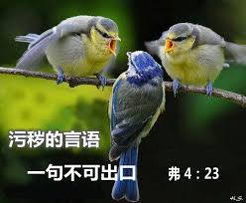
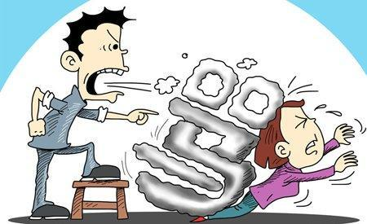
²⁹污穢的言語一句不可出口，只要隨事說造就人的好話，叫聽見的人得益處。【弗 4:29】 ²⁹Let no corrupting talk come out of your mouths, but only such as is good for building up, as fits the occasion, that it may give grace to those who hear. 【Eph 4:29】

Slide 14
B. Do not let yourself become the bottleneck. 不要讓自己成為瓶頸.

Slide 15
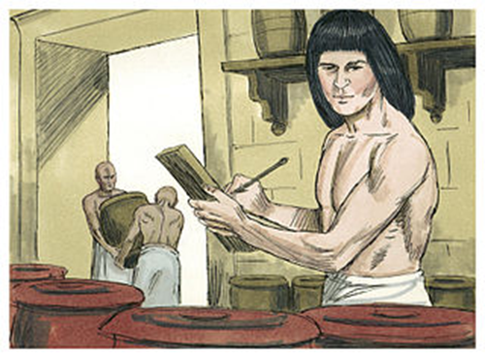
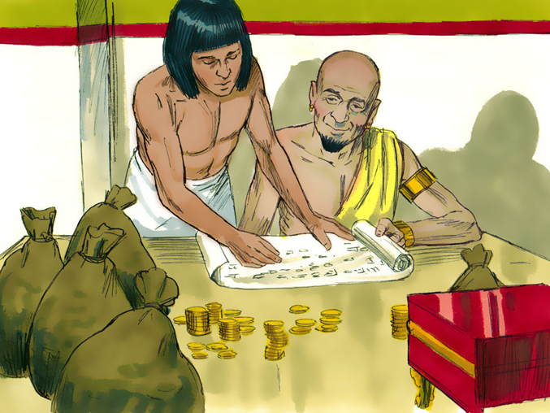
坡提乏是一個知人善任的人:
Potiphar is a man who knows how to delegate:

Slide 16
⁵自從主人派約瑟管理家務和他一切所有的，耶和華就因約瑟的緣故賜福與那埃及人的家；凡家裡和田間一切所有的都蒙耶和華賜福。⁶波提乏將一切所有的都交在約瑟的手中，除了自己所吃的飯，別的事一概不知。. . .
【創 39:5~6a】 ⁵From the time that he made him overseer in his house and over all that he had the Lord blessed the Egyptian's house for Joseph's sake; the blessing of the Lord was on all that he had, in house and field. ⁶So he left all that he had in Joseph's charge, and because of him he had no concern about anything but the food he ate. . . .【Gen 39:5~6a】

Slide 17
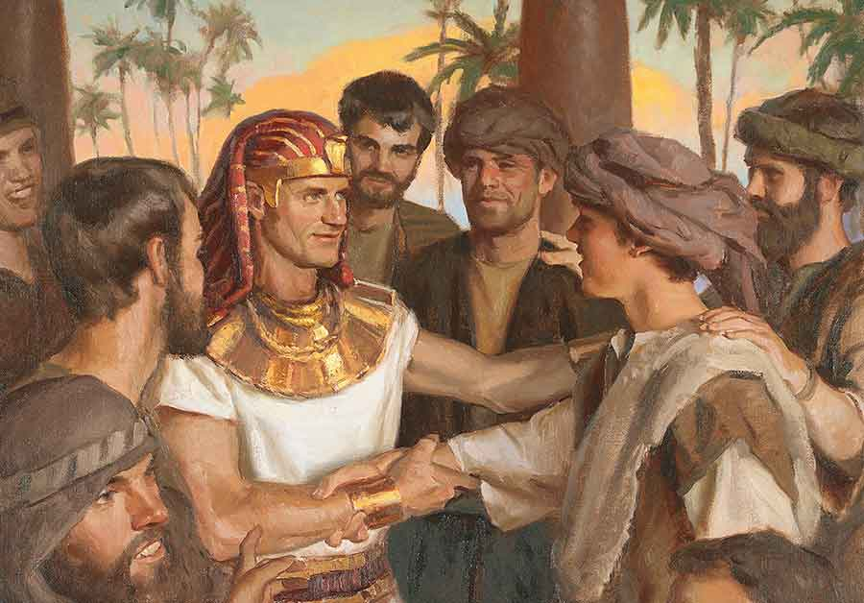

Slide 18
³⁸法老對臣僕說：像這樣的人，有 神的靈在他裡頭，我們豈能找得著呢？³⁹法老對約瑟說： 神既將這事都指示你，可見沒有人像你這樣有聰明有智慧。⁴⁰你可以掌管我的家；我的民都必聽從你的話。惟獨在寶座上我比你大。
【創 41:38~40】 ³⁸And Pharaoh said to his servants, "Can we find a man like this, in whom is the Spirit of God?" ³⁹Then Pharaoh said to Joseph, "Since God has shown you all this, there is none so discerning and wise as you are. ⁴⁰You shall be over my house, and all my people shall order themselves as you command. Only as regards the throne will I be greater than you."
【Gen 41:38~40】

Slide 19
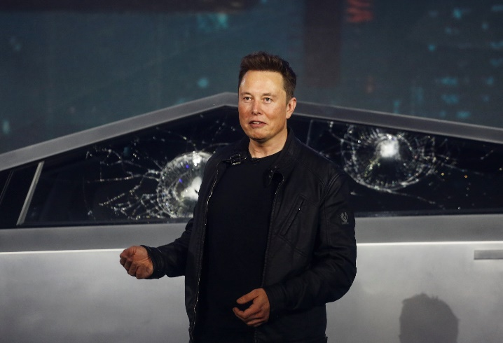
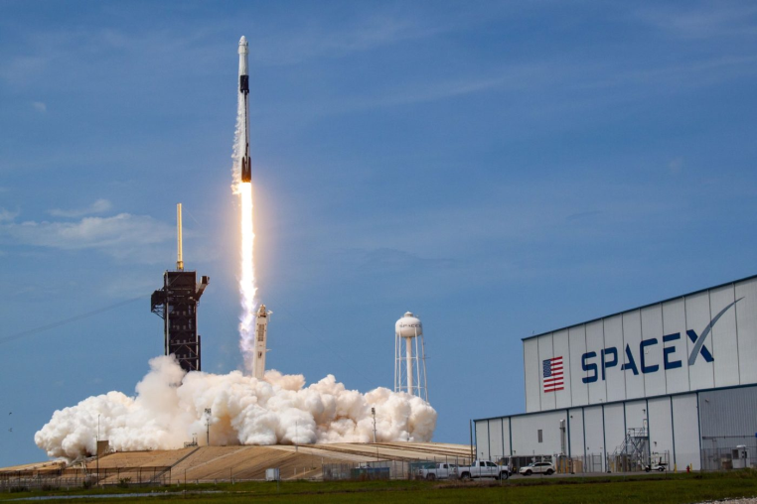
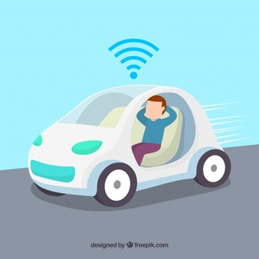
Illustration 4:
Elon Musk
→你必須要Think ahead for your coworkers.
→你必須要delegate, and empower.

Slide 20
C. 那麼你也是要Keep Track of the progress.

Slide 21
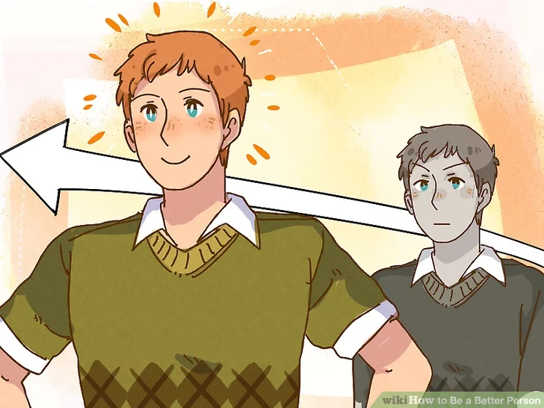
III. Evaluation:/衡量的方法:
Have I made the person better, if the project failed.
如果工作失敗了, 我有沒有讓工作者變得更好?

Slide 22
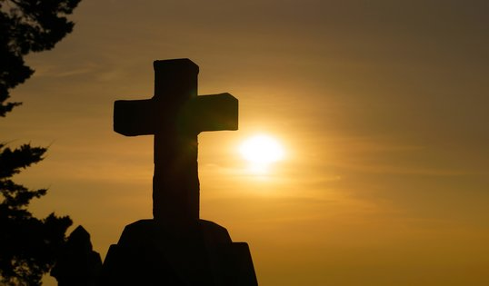
⁵你們來到主面前，也就像活石，被建造成為靈宮，作聖潔的祭司，藉著耶穌基督奉獻神所悅納的靈祭。【彼前 2:5】 ⁵you yourselves like living stones are being built up as a spiritual house, to be a holy priesthood, to offer spiritual sacrifices acceptable to God through Jesus Christ.
【1Pet 2:5】

Slide 23
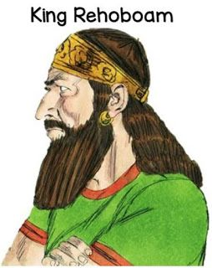
歷史上有兩個失敗者:
There are two losers in history:
(1)羅波安王

Slide 24
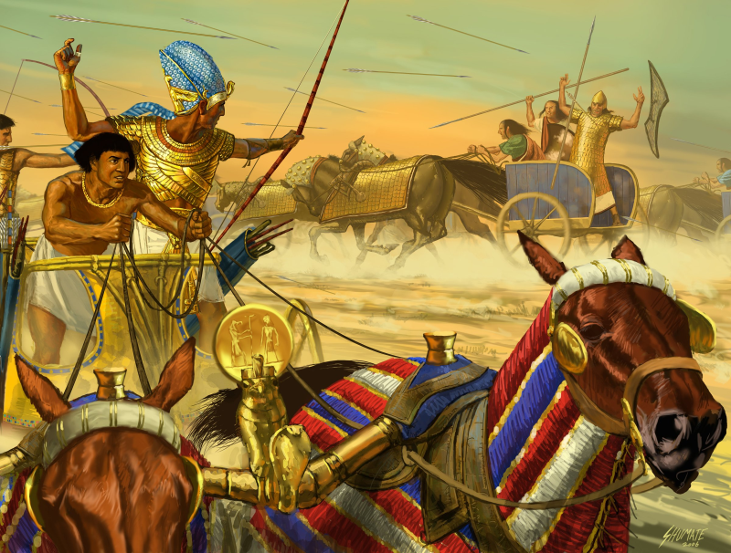
²⁵羅波安王第五年，埃及王示撒上來攻取耶路撒冷，【王上 14:25】 ²⁵In the fifth year of King Rehoboam, Shishak king of Egypt came up against Jerusalem.【1King 14:25】

Slide 25
⁹於是，埃及王示撒上來攻取耶路撒冷，奪了耶和華殿和王宮裡的寶物，盡都帶走，又奪去所羅門製造的金盾牌。¹⁰羅波安王製造銅盾牌代替那金盾牌，交給守王宮門的護衛長看守。
⁹So Shishak king of Egypt came up against Jerusalem. He took away the treasures of the house of the Lord and the treasures of the king's house. He took away everything. He also took away the shields of gold that Solomon had made, ¹⁰and King Rehoboam made in their place shields of bronze and committed them to the hands of the officers of the guard, who kept the door of the king's house.

Slide 26
¹¹王每逢進耶和華的殿，護衛兵就拿這盾牌，隨後仍將盾牌送回，放在護衛房。¹²王自卑的時候，耶和華的怒氣就轉消了，不將他滅盡，並且在猶大中間也有善益的事。
【代下 12:9~12】
¹¹And as often as the king went into the house of the Lord, the guard came and carried them and brought them back to the guardroom. ¹²And when he humbled himself the wrath of the Lord turned from him, so as not to make a complete destruction. Moreover, conditions were good in Judah.
【2Chr 12:9~12】

Slide 27
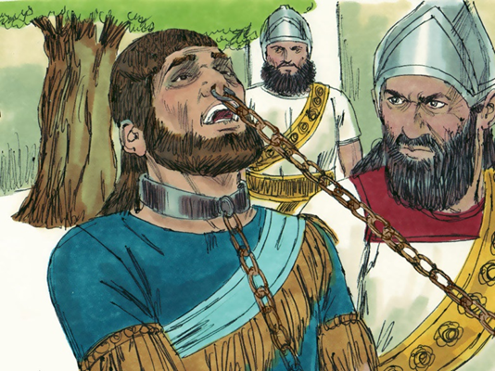
(2)瑪拿西王King Manasseh

Slide 28
¹⁰耶和華警戒瑪拿西和他的百姓，他們卻是不聽。¹¹所以耶和華使亞述王的將帥來攻擊他們，用鐃鉤鉤住瑪拿西，用銅鍊鎖住他，帶到巴比倫去。¹²他在急難的時候，就懇求耶和華─他的 神，且在他列祖的 神面前極其自卑。
¹⁰The Lord spoke to Manasseh and to his people, but they paid no attention. ¹¹Therefore the Lord brought upon them the commanders of the army of the king of Assyria, who captured Manasseh with hooks and bound him with chains of bronze and brought him to Babylon. ¹²And when he was in distress, he entreated the favor of the Lord his God and humbled himself greatly before the God of his fathers.

Slide 29
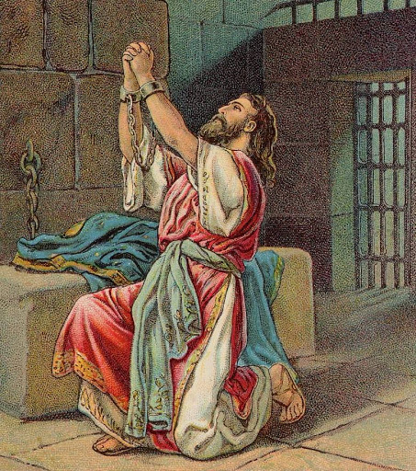
¹³他祈禱耶和華，耶和華就允准他的祈求，垂聽他的禱告，使他歸回耶路撒冷，仍坐國位。瑪拿西這才知道惟獨耶和華是 神。【代下 33:10~13】 ¹³He prayed to him, and God was moved by his entreaty and heard his plea and brought him again to Jerusalem into his kingdom. Then Manasseh knew that the Lord was God. 【2Chr 33:10~13】

