Slide 1
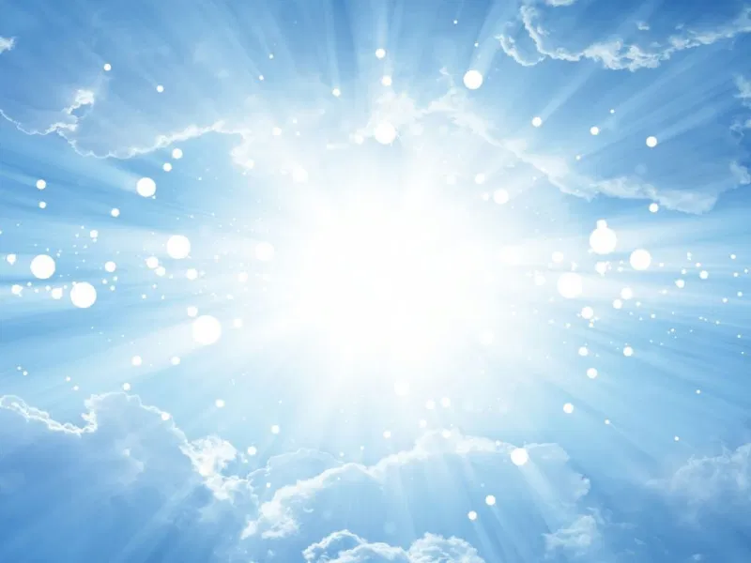
Two Advents
耶穌的第一次與第二次降臨
12/6/2020
Rev. Joseph Chang
BOLGPC 爾灣大公園靈糧堂

Slide 2
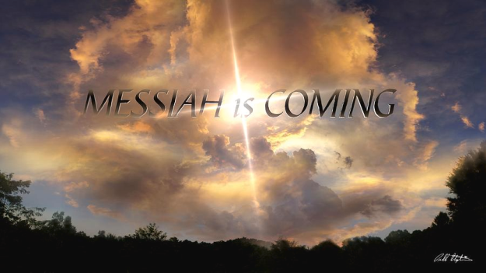
神親自降臨來到人間, 這是歷史上許多信徒的盼望. God himself came to the world, this is the hope of many believers in history.
歷世歷代的信徒把這樣的一天稱之為彌賽亞 (受膏者Hebrew/基督Greek)的來臨.
Believers throughout the ages call such a day the coming of the Messiah .

Slide 3
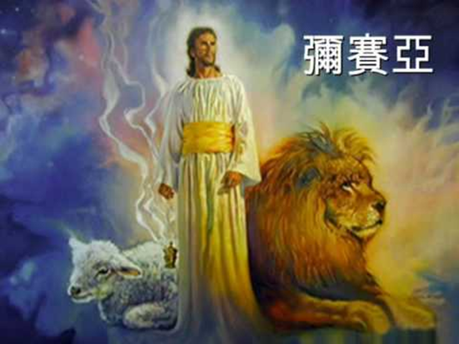
彌賽亞的身分/Identity of Messiah

Slide 4
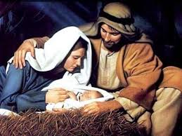
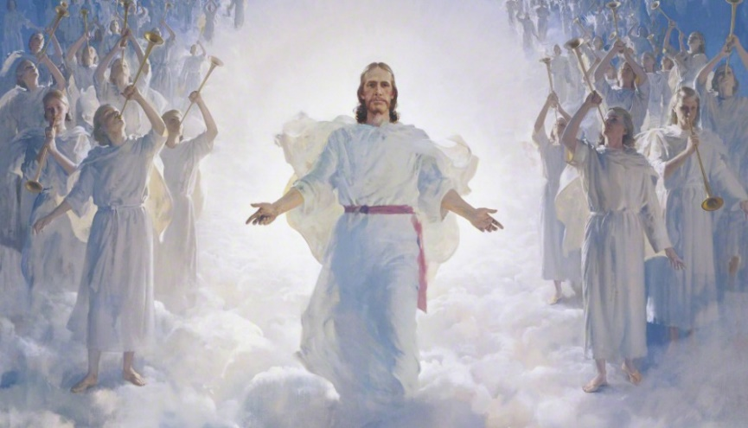
I. The Two Advents
主耶穌第一次與第二次的降臨

Slide 5
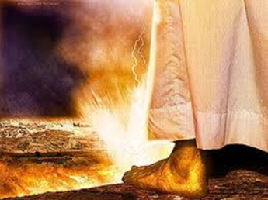
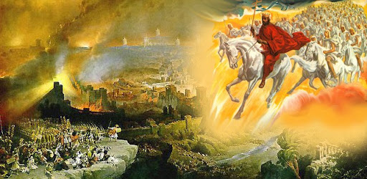
1. 得勝的君王/ Victorious King
耶和華要爭戰得勝. 要在橄欖山裂山而降.
The Lord will fight and win. He will fall on the Mount of Olives.

Slide 6
¹耶和華的日子臨近，. . . ³那時，耶和華必出去與那些國爭戰，好像從前爭戰一樣。⁴那日，他的腳必站在耶路撒冷前面朝東的橄欖山上。這山必從中間分裂，自東至西成為極大的谷。山的一半向北挪移，一半向南挪移。
¹Behold, a day is coming for the Lord, . . . ³Then the Lord will go out and fight against those nations as when he fights on a day of battle. ⁴On that day his feet shall stand on the Mount of Olives that lies before Jerusalem on the east, and the Mount of Olives shall be split in two from east to west by a very wide valley, so that one half of the Mount shall move northward, and the other half southward.

Slide 7
⁵你們要從我山的谷中逃跑，因為山谷必延到亞薩。你們逃跑，必如猶大王烏西雅年間的人逃避大地震一樣。耶和華─我的 神必降臨，有一切聖者同來。⁶那日，必沒有光，三光必退縮。⁷那日，必是耶和華所知道的，不是白晝，也不是黑夜，到了晚上才有光明。
⁵And you shall flee to the valley of my mountains, for the valley of the mountains shall reach to Azal. And you shall flee as you fled from the earthquake in the days of Uzziah king of Judah. Then the Lord my God will come, and all the holy ones with him. ⁶On that day there shall be no light, cold, or frost. ⁷And there shall be a unique day, which is known to the Lord, neither day nor night, but at evening time there shall be light.

Slide 8
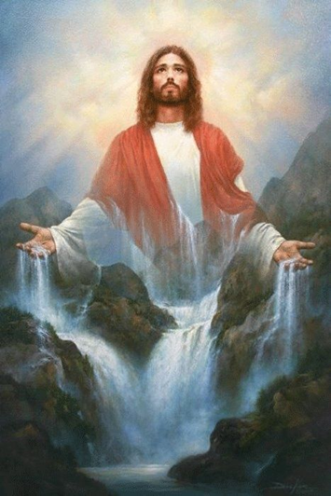
⁸那日，必有活水從耶路撒冷出來，一半往東海流，一半往西海流；冬夏都是如此。⁹耶和華必作全地的王。那日耶和華必為獨一無二的，他的名也是獨一無二的。
【亞 14:1 3~9】
⁸On that day living waters shall flow out from
Jerusalem, half of them to the eastern sea and
half of them to the western sea. It shall continue
in summer as in winter. ⁹And the Lord will be
king over all the earth. On that day the Lord will
be one and his name one. 【Zech 14:1 3~9】

Slide 9
2.
¹我們所傳的（或作：所傳與我們的）有誰信呢？耶和華的膀臂向誰顯露呢？²他在耶和華面前生長如嫩芽，像根出於乾地。他無佳形美容；我們看見他的時候，也無美貌使我們羨慕他。³他被藐視，被人厭棄；多受痛苦，常經憂患。他被藐視，好像被人掩面不看的一樣；我們也不尊重他。
¹Who has believed what they heard from us? And to whom has the arm of the Lord been revealed? ²For he grew up before him like a young plant, and like a root out of dry ground; he had no form or majesty that we should look at him, and no beauty that we should desire him. ³He was despised and rejected by men; a man of sorrows, and acquainted with grief; and as one from whom men hide their faces he was despised, and we esteemed him not.

Slide 10
⁴他誠然擔當我們的憂患，背負我們的痛苦；我們卻以為他受責罰，被 神擊打苦待了。⁵哪知他為我們的過犯受害，為我們的罪孽壓傷。因他受的刑罰，我們得平安；因他受的鞭傷，我們得醫治。⁶我們都如羊走迷；各人偏行己路；耶和華使我們眾人的罪孽都歸在他身上。
⁴Surely he has borne our griefs and carried our sorrows; yet we esteemed him stricken, smitten by God, and afflicted. ⁵But he was wounded for our transgressions; he was crushed for our iniquities; upon him was the chastisement that brought us peace, and with his stripes we are healed. ⁶All we like sheep have gone astray; we have turned every one to his own way; and the Lord has laid on him the iniquity of us all.

Slide 11
⁷他被欺壓，在受苦的時候卻不開口（或作：他受欺壓，卻自卑不開口）；他像羊羔被牽到宰殺之地，又像羊在剪毛的人手下無聲，他也是這樣不開口。⁸因受欺壓和審判，他被奪去，至於他同世的人，誰想他受鞭打、從活人之地被剪除，是因我百姓的罪過呢？
⁷He was oppressed, and he was afflicted, yet he opened not his mouth; like a lamb that is led to the slaughter, and like a sheep that before its shearers is silent, so he opened not his mouth. ⁸By oppression and judgment he was taken away; and as for his generation, who considered that he was cut off out of the land of the living, stricken for the transgression of my people?

Slide 12
⁹他雖然未行強暴，口中也沒有詭詐，人還使他與惡人同埋；誰知死的時候與財主同葬。¹⁰耶和華卻定意（或作：喜悅）將他壓傷，使他受痛苦。耶和華以他為贖罪祭（或作：他獻本身為贖罪祭）。他必看見後裔，並且延長年日。耶和華所喜悅的事必在他手中亨通。【賽 53:1~10】 ⁹And they made his grave with the wicked and with a rich man in his death, although he had done no violence, and there was no deceit in his mouth. ¹⁰Yet it was the will of the Lord to crush him; he has put him to grief; when his soul makes an offering for sin, he shall see his offspring; he shall prolong his days; the will of the Lord shall prosper in his hand.
【Isa 53:1~10】

Slide 13
按照猶太人拉比的了解, 舊約聖經預言了兩個彌賽亞
Acc. to Rabbis, the Old Testament prophesied two Messiahs.
1. 一個是來做君王的彌賽亞, 那是從猶大的支派來的.
One was the Messiah who came to be the king, and he
came from the tribe of Judah.
2. 一個是來受苦的彌賽亞, 他們把祂歸為約瑟的後代.
The other was the Messiah who came to suffer, and they
attributed him to Joseph's descendant.

Slide 14
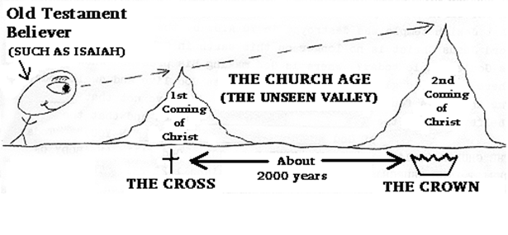
只有一個彌賽亞, 但是有兩次的來臨.
There is only one Messiah, but there are two comings.
一個是2000年前的聖誕節, 一個是不會太久的將來
One is the Christmas 2,000 years ago, and the other is not
too long in the future.

Slide 16
We are here.

Slide 17
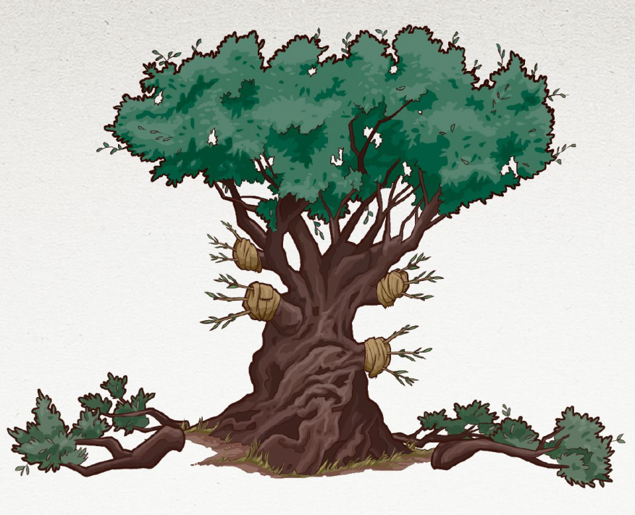
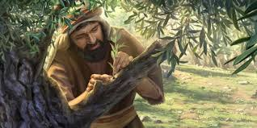
→教會時期/Church Age
野橄欖枝就是外邦人/The wild olive branches are the Gentile.

Slide 18
→保羅在整個以弗所書第三章, 就是在談神這個插入的動作. 保
羅稱之為 “奧秘/mystery”:
Throughout the third chapter of Ephesians, Paul is talking about
the intervening action of God. Paul calls it "mystery":
¹因此，我─保羅為你們外邦人作了基督耶穌被囚的，替你們祈禱（此句乃對照十四節所加）。²諒必你們曾聽見神賜恩給我，將關切你們的職分託付我，³用啟示使我知道福音的奧祕，正如我以前略略寫過的。
¹For this reason I, Paul, a prisoner for Christ Jesus on behalf of you Gentiles- ²assuming that you have heard of the stewardship of God's grace that was given to me for you, ³how the mystery was made known to me by revelation, as I have written briefly.

Slide 19
⁴你們念了，就能曉得我深知基督的奧祕。⁵這奧祕在以前的世代沒有叫人知道，像如今藉著聖靈啟示他的聖使徒和先知一樣。⁶這奧祕就是外邦人在基督耶穌裡，藉著福音，得以同為後嗣，同為一體，同蒙應許。
【弗 3:1~6】 ⁴When you read this, you can perceive my insight into the mystery of Christ, ⁵which was not made known to the sons of men in other generations as it has now been revealed to his holy apostles and prophets by the Spirit. ⁶This mystery is that the Gentiles are fellow heirs, members of the same body, and partakers of the promise in Christ Jesus through the gospel. 【Eph 3:1~6】

Slide 20
→聖城新耶路撒冷 神奇妙的設計:
The miraculous design of the holy city of New Jerusalem :
第一次來臨的耶穌是整個神國度的房角石, 而教會是根基, 在這根基上面建造的才是以色列的12個支派.
The first coming of Jesus is the cornerstone of the entire kingdom of God, and the church is the foundation, and on this foundation are the 12 tribes of Israel built.

Slide 21
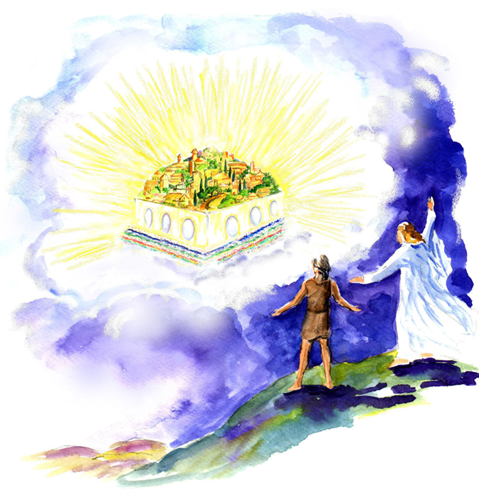
¹⁰我被聖靈感動，天使就帶我到一座高大的山，將那由神那裡、從天而降的聖城耶路撒冷指示我。¹¹城中有神的榮耀；城的光輝如同極貴的寶石，好像碧玉，明如水晶。
¹⁰And he carried me away in the Spirit to
a great, high mountain, and showed me
the holy city Jerusalem coming down out
of heaven from God, ¹¹having the glory of
God, its radiance like a most rare jewel,
like a jasper, clear as crystal.

Slide 22
¹²有高大的牆，有十二個門，門上有十二位天使；門上又寫著以色列十二個支派的名字。¹³東邊有三門、北邊有三門、南邊有三門、西邊有三門。¹⁴城牆有十二根基，根基上有羔羊十二使徒的名字。【啟 21:10~14】
¹²It had a great, high wall, with twelve gates, and at the gates twelve angels, and on the gates the names of the twelve tribes of the sons of Israel were inscribed-¹³on the east three gates, on the north three gates, on the south three gates, and on the west three gates. ¹⁴And the wall of the city had twelve foundations, and on them were the twelve names of the twelve apostles of the Lamb. 【Rev 21:10~14】

Slide 23
II. God’s Design神的設計
神的設計實在是奇妙, 這樣子分兩次的來臨,
有美好的準備.
God's design is really wonderful. There are beautiful preparations during the two advents.

Slide 24
A. 主耶穌第一次來臨時, 開宗明義就是講到神的國來臨了.
In the 1st Advent, Jesus clearly mentioned that the kingdom of God is at hand.
¹⁵說：日期滿了，神的國近了。你們當悔改，信福音！【可 1:15】 ¹⁵and saying, ""The time is fulfilled, and the kingdom of God is at hand; repent and believe in the gospel." " 【Mark 1:15】

Slide 25
→主耶穌要人信福音, 因為這是入門, 入天國的門的首要條件:
The Lord Jesus wants people to believe in the gospel, because
this is the first condition for entry and the gate to heaven:
³耶穌回答說：「我實實在在地告訴你，人若不重生，就不能見神的國。」. . . ⁵耶穌說：「我實實在在的告訴你，人若不是從水和聖靈生的，就不能進神的國。
【約 3:3 5】 ³Jesus answered him, ""Truly, truly, I say to you, unless one is born again he cannot see the kingdom of God."" . . . ⁵Jesus answered, ""Truly, truly, I say to you, unless one is born of water and the Spirit, he cannot enter the kingdom of God." 【John 3:3 5】

Slide 26
→但是神是一步一步的來,神的國是從我們的心裡開始:
But God comes step by step, and this kingdom of God begins
in our hearts:
²⁰法利賽人問：神的國幾時來到？耶穌回答說：神的國來到不是眼所能見的。²¹人也不得說：看哪，在這裡！看哪，在那裡！因為神的國就在你們心裡（心裡：或作中間）。
【路 17:20~21】 ²⁰Being asked by the Pharisees when the kingdom of God would come, he answered them, ""The kingdom of God is not coming with signs to be observed," ²¹"nor will they say, 'Look, here it is!' or 'There!' for behold, the kingdom of God is in the midst of you." " 【Luke 17:20~21】

Slide 27
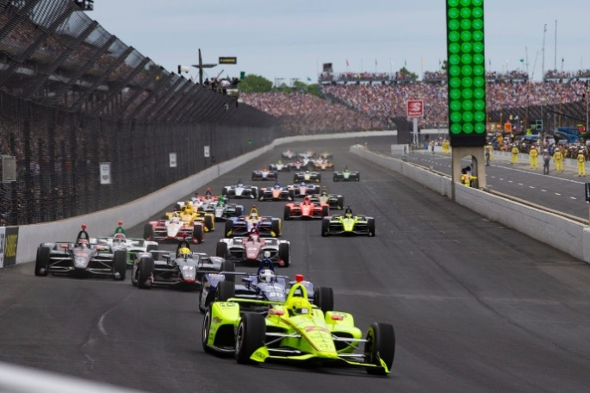
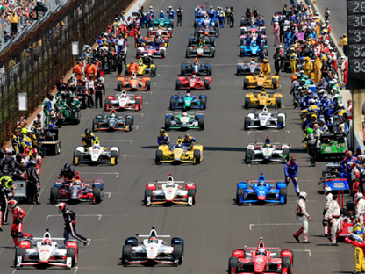
Illustration:
Indy 500

Slide 28
B. 主耶穌現在到父神那裏, 第二次來臨時, 會帶著國度來.
Jesus is with the Father, He will return the 2nd time with
God’s Kingdom.
¹¹眾人正在聽見這些話的時候，耶穌因為將近耶路撒冷，又因他們以為神的國快要顯出來，就另設一個比喻，說：¹²有一個貴冑往遠方去，要得國回來，
¹¹As they heard these things, he proceeded to tell a parable, because he was near to Jerusalem, and because they supposed that the kingdom of God was to appear immediately. ¹²He said therefore, ""A nobleman went into a far country to receive for himself a kingdom and then return."

Slide 29
¹³便叫了他的十個僕人來，交給他們十錠（錠：原文作彌拿，一彌拿約銀十兩）銀子，說：你們去作生意，直等我回來。¹⁴他本國的人卻恨他，打發使者隨後去，說：我們不願意這個人作我們的王。
¹³"Calling ten of his servants, he gave them ten minas, and said to them, 'Engage in business until I come.'" ¹⁴"But his citizens hated him and sent a delegation after him, saying, 'We do not want this man to reign over us.'" ¹⁵"When he returned, having received the kingdom, he ordered these servants to whom he had given the money to be called to him, that he might know what they had gained by doing business."

Slide 30
¹⁵他既得國回來，就吩咐叫那領銀子的僕人來，要知道他們做生意賺了多少。¹⁶頭一個上來，說：主阿，你的一錠銀子已經賺了十錠。¹⁷主人說：好！良善的僕人，你既在最小的事上有忠心，可以有權柄管十座城。【路 19:11~17】 ¹⁵"When he returned, having received the kingdom, he ordered these servants to whom he had given the money to be called to him, that he might know what they had gained by doing business." ¹⁶"The first came before him, saying, 'Lord, your mina has made ten minas more.'" ¹⁷"And he said to him, 'Well done, good servant! Because you have been faithful in a very little, you shall have authority over ten cities.'"
【Luke 19:11~17】

Slide 31
→主現在離開我們, 將要帶著國度回來, 這段時間, 他給我們
不同的恩賜讓我們來使用, 回來就要論功行賞.
The Lord now leaves us and will come back with the kingdom.
During this time, He has given us different gifts for us to use,
and when He returns, He will give us a reward according our
performance.

Slide 32
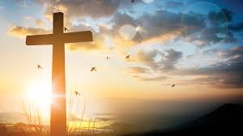
III. Our choice and our responsibility
我們的選擇和我們的責任.
對於我們的選擇和我們的責任, 保羅在以弗所書2:8-10很清楚的告訴了我們:
Regarding our choices and our responsibilities, Paul clearly told us in Ephesians 2:8-10:

Slide 33
⁸你們得救是本乎恩，也因著信；這並不是出於自己，乃是神所賜的；⁹也不是出於行為，免得有人自誇。¹⁰我們原是他的工作，在基督耶穌裡造成的，為要叫我們行善，就是神所預備叫我們行的。【弗 2:8~10】 ⁸For by grace you have been saved through faith. And this is not your own doing; it is the gift of God, ⁹not a result of works, so that no one may boast. ¹⁰For we are his workmanship, created in Christ Jesus for good works, which God prepared beforehand, that we should walk in them. 【Eph 2:8~10】

Slide 34
A. Our choice我們的選擇
救恩, 就是上帝所做的, 不是我們的工作.
Salvation is what God does, not our job.
我們唯一能夠做的就是選擇: 選擇用信心接受, 或是選擇拒
絕. 當你真正的用你的心來接受耶穌的時候, 你才能夠和救
恩有關係.
The only thing we can do is to choose: choose to accept with
faith, or choose to reject. Only when you truly accept Jesus
with your heart can you have a relationship with salvation.

Slide 35
→主耶穌談到我們選擇接受的時候, 祂是這麼樣的說,
When the Lord Jesus talked about our choice to accept, He
said this way,
¹³除了從天降下、仍舊在天的人子，沒有人升過天。¹⁴摩西在曠野怎樣舉蛇，人子也必照樣被舉起來，¹⁵叫一切信他的都得永生（或作：叫一切信的人在他裡面得永生）。
【約 3:13~15】 ¹³"No one has ascended into heaven except he who descended from heaven, the Son of Man." ¹⁴"And as Moses lifted up the serpent in the wilderness, so must the Son of Man be lifted up," ¹⁵"that whoever believes in him may have eternal life. " " 【John 3:13~15】

Slide 36
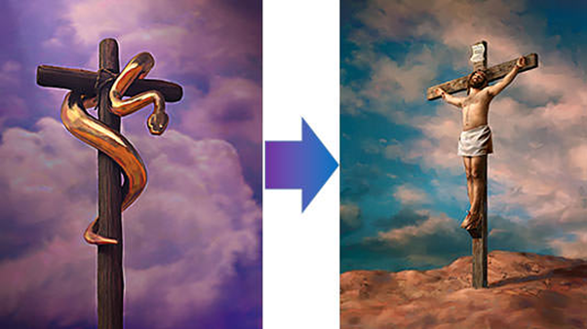

Slide 37
這個故事的背景/The background of this story:
⁴他們從何珥山起行，往紅海那條路走，要繞過以東地。百姓因這路難行，心中甚是煩燥，⁵就怨讟 神和摩西說：你們為甚麼把我們從埃及領出來、使我們死在曠野呢？這裡沒有糧，沒有水，我們的心厭惡這淡薄的食物。
⁴From Mount Hor they set out by the way to the Red Sea, to go around the land of Edom. And the people became impatient on the way. ⁵And the people spoke against God and against Moses, "Why have you brought us up out of Egypt to die in the wilderness? For there is no food and no water, and we loathe this worthless food."

Slide 38
⁶於是耶和華使火蛇進入百姓中間，蛇就咬他們。以色列人中死了許多。⁷百姓到摩西那裡，說：我們怨讟耶和華和你，有罪了。求你禱告耶和華，叫這些蛇離開我們。於是摩西為百姓禱告。
⁶Then the Lord sent fiery serpents among the people, and they bit the people, so that many people of Israel died. ⁷And the people came to Moses and said, "We have sinned, for we have spoken against the Lord and against you. Pray to the Lord, that he take away the serpents from us." So Moses prayed for the people.

Slide 39
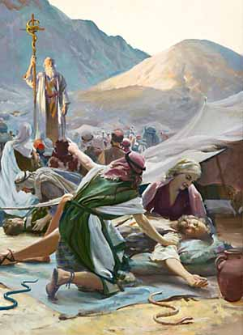
⁸耶和華對摩西說：你製造一條火蛇，掛在杆子上；凡被咬的，一望這蛇，就必得活。⁹摩西便製造一條銅蛇，掛在杆子上；凡被蛇咬的，一望這銅蛇就活了。【民 21:4~9】 ⁸And the Lord said to Moses, "Make a
fiery serpent and set it on a pole, and
everyone who is bitten, when he sees
it, shall live." ⁹So Moses made a bronze
serpent and set it on a pole. And if a
serpent bit anyone, he would look at the
bronze serpent and live. 【Num 21:4~9】

Slide 40
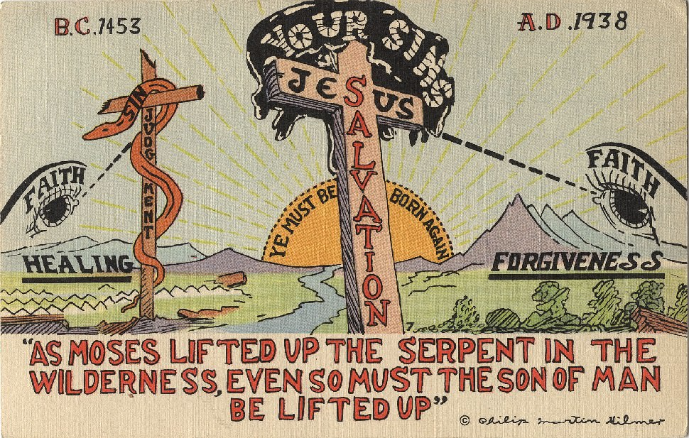

Slide 41
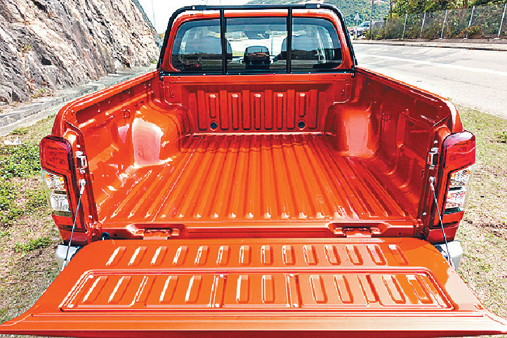
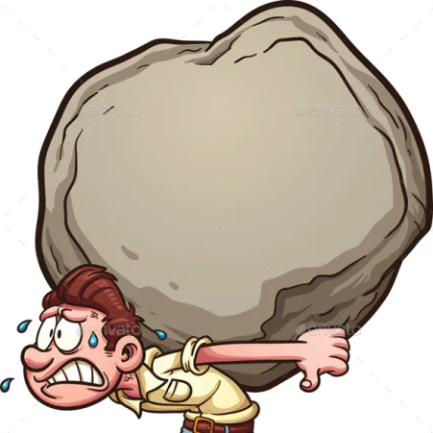
B. Our Responsibility我們的責任
1.

Slide 42
2. 我們應該怎麼做呢?/ What should we do?
我們應該放下我們身上所揹的重擔. 也就是放下自己習慣的做事方法, 因為很多都是有罪的, 錯誤的做事方法. We should let go of the burdens that we carry. That is, let go of the way we are used to doing things because many of them are sinful and wrong ways of doing things.

Slide 43
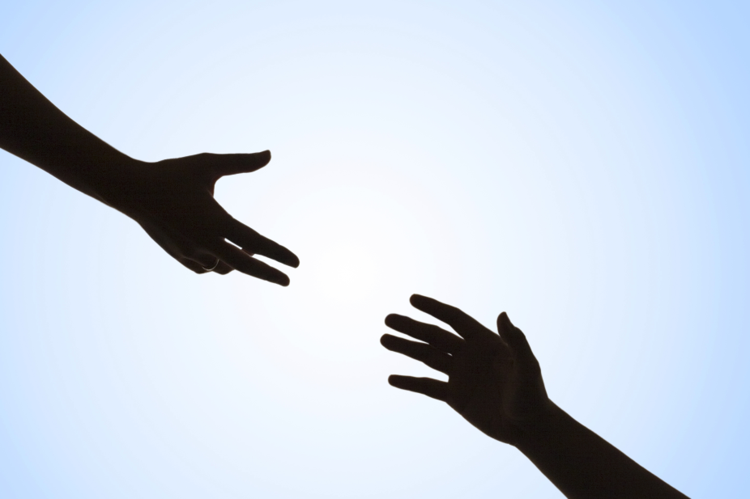
¹⁰我們原是他的工作，在基督耶穌裡造成的，為要叫我們行善，就是神所預備叫我們行的。【弗 2:10】 ¹⁰For we are his workmanship, created in Christ Jesus for good works, which God prepared beforehand, that we should walk in them. 【Eph 2:10】

Slide 44
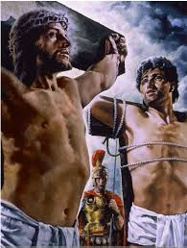
Conclusion結論
在主耶穌旁邊被釘十字架的強盜, 在死前接受了耶穌作為他的救主. 他很懂得向前看, 他對耶穌說,
The robber who was crucified next to the
Lord Jesus accepted Jesus as his Savior
before he died. He knew how to look
forward. He said to Jesus,

Slide 45
⁴²就說：耶穌阿，你得國降臨的時候，求你記念我！
⁴³耶穌對他說：我實在告訴你，今日你要同我在樂園裡了。【路 23:42~43】 ⁴²And he said, "Jesus, remember me when you come into your kingdom." ⁴³And he said to him, ""Truly, I say to you, today you will be with me in Paradise." "
【Luke 23:42~43】

Slide 46
我們是不是有這個強盜的智慧和遠見, 希望主耶穌帶著祂的國度, 第二次降臨的時候, 能夠紀念我們? 若是我們有這樣的遠見, 那我們就要問耶穌, 我已經在你的pick up 上面了, 我應該為你做甚麼?
Do we have the wisdom and foresight like this robber? If we have such a vision and hope that the Lord Jesus will remember me when bringing his kingdom with his second coming, then we must ask Jesus ,”I am already in your pick up. What should I
do for you?”

