Slide 1
Act, and Count Your Cost
行動, 計算你的成本
1/17/2021 Rev. Joseph Chang BOLGPC 爾灣大公園靈糧堂

Slide 2
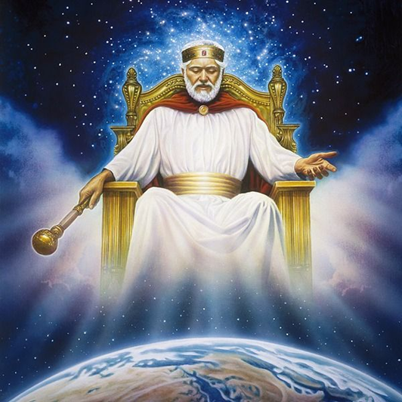
I. God is a God of Action, especially in the turmoil time.
神是行動的神, 特別是在亂世的時候.

Slide 3
The Book of Acts is full of action/使徒行傳充滿了行動
⁸但聖靈降臨在你們身上，你們就必得著能力，並要在耶路撒冷、猶太全地，和撒瑪利亞，直到地極，作我的見證。【徒 1:8】 ⁸"But you will receive power when the Holy Spirit has come upon you, and you will be my witnesses in Jerusalem and in all Judea and Samaria, and to the end of the earth."" 【Acts 1:8】

Slide 4
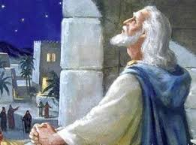
我們現在的情形是好像哈巴谷質問上帝所說的:
Our current situation is like
what Habakkuk questioned God :
⁴因此律法放鬆，公理也不顯明，惡人圍困義人，所以公理顯然顛倒。【哈 1:4】 ⁴So the law is paralyzed, and justice never goes forth. For the wicked surround the righteous; so justice goes forth perverted. 【Hab 1:4】

Slide 5
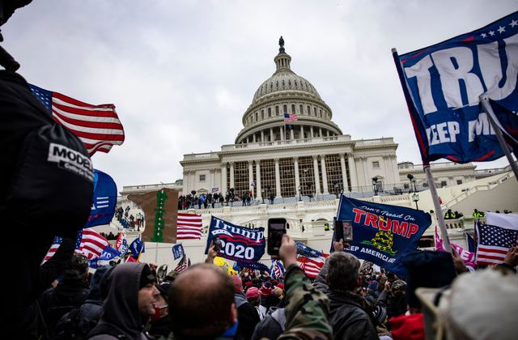
對於百姓的抗議, 深層政府想用Internal Terrorist的稱號, 來把他們壓下去. 這是一個公理顯然顛倒的時代.
In response to the protests of the people, the deep state wants to impose Internal Terrorist on them to suppress them. This is an era when justice is clearly reversed.

Slide 6
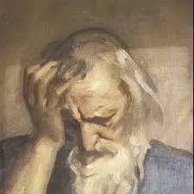
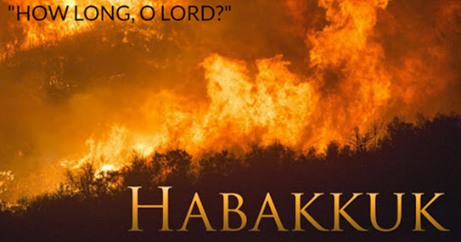
¹先知哈巴谷所得的默示。²他說：耶和華啊！我呼求你，你不應允，要到幾時呢？我因強暴哀求你，你還不拯救。³你為何使我看見罪孽？你為何看著奸惡而不理呢？毀滅和強暴在我面前，又起了爭端和相鬥的事。【哈 1:1~3】 ¹The oracle that Habakkuk the prophet saw. ²O Lord, how long shall I cry for help, and you will not hear? Or cry to you "Violence!" and you will not save? ³Why do you make me see iniquity, and why do you idly look at wrong? Destruction and violence are before me; strife and contention arise. 【Hab 1:1~3】

Slide 7
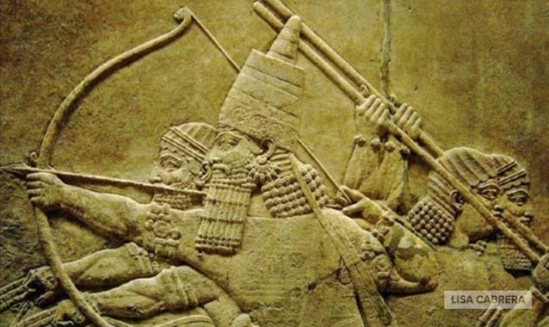
→神對哈巴谷的回答是/God's answer to Habakkuk was:
⁵耶和華說：你們要向列國中觀看，大大驚奇；因為在你們的時候，我行一件事，雖有人告訴你們，你們總是不信。⁶我必興起迦勒底人，就是那殘忍暴躁之民，通行遍地，佔據那不屬自己的住處。
⁵" Look among the nations, and see; wonder and be astounded. For I am doing a work in your days that
you would not believe if told. ⁶For
behold, I am raising up the Chaldeans,
that bitter and hasty nation, who
march through the breadth of the
earth, to seize dwellings not their own.

Slide 8
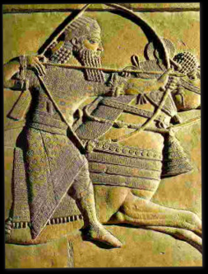
⁷他威武可畏，判斷和勢力都任意發出。⁸他的馬比豹更快，比晚上的豺狼更猛。馬兵踴躍爭先，都從遠方而來；他們飛跑如鷹抓食，【哈 1:5~8】
⁷They are dreaded and fearsome; their justice
and dignity go forth from themselves. ⁸Their
horses are swifter than leopards, more fierce
than the evening wolves; their horsemen
press proudly on. Their horsemen come from
afar; they fly like an eagle swift to devour.
【Hab 1:5~8】

Slide 10
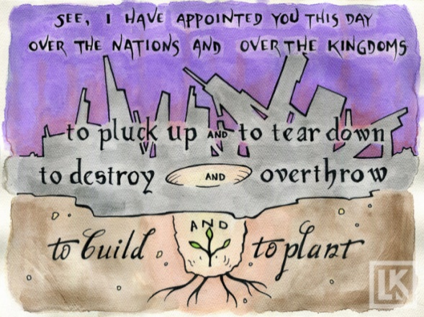
God is also a God of drastic action:
神也是一個採取極端作為的神:
¹⁰看哪，我今日立你在列邦列國之上，為要施行拔出、拆毀、毀壞、傾覆，又要建立、栽植。【耶 1:10】 ¹⁰See, I have set you this day over nations and over kingdoms, to pluck up and to break down, to destroy and to overthrow, to build and to plant." 【Jer 1:10】

Slide 11
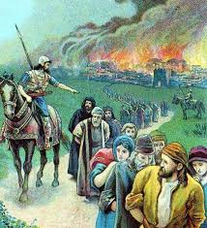
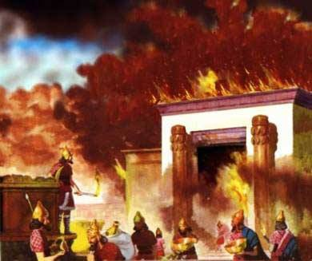
拆毀, 毀壞, 傾覆
to pluck up and to break down, to destroy and to overthrow
→南國猶大被滅, 被擄到巴比倫去.
The southern kingdom of Judah was destroyed and taken
captive to Babylon.

Slide 12
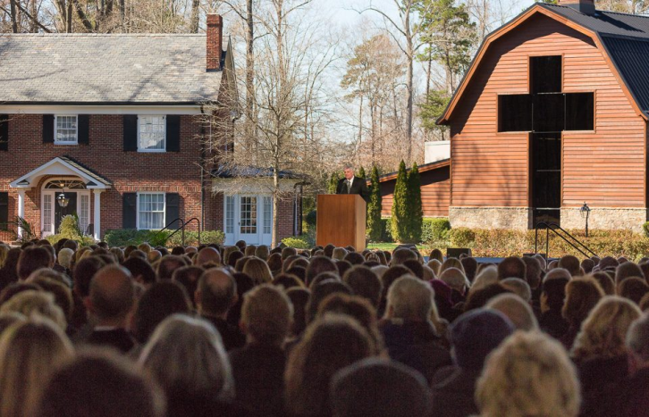
Billy Graham Crusade

Slide 13
account suspended

Slide 15
Telegram

Slide 16
²⁹猶大王亞撒三十八年，暗利的兒子亞哈登基作了以色列王。暗利的兒子亞哈在撒瑪利亞作以色列王二十二年。³⁰暗利的兒子亞哈行耶和華眼中看為惡的事，比他以前的列王更甚，³¹犯了尼八的兒子耶羅波安所犯的罪；他還以為輕，
²⁹In the thirty- eighth year of Asa king of Judah, Ahab the son of Omri began to reign over Israel, and Ahab the son of Omri reigned over Israel in Samaria twenty-two years. ³⁰And Ahab the son of Omri did evil in the sight of the Lord, more than all who were before him. ³¹And as if it had been a light thing for him to walk in the sins of Jeroboam the son of Nebat,

Slide 17
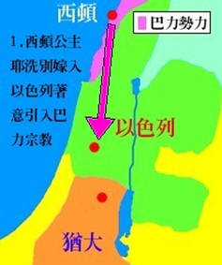
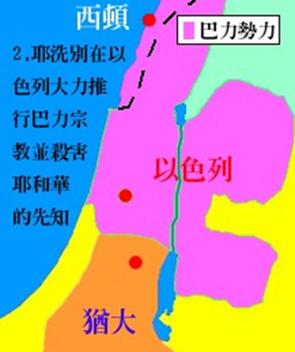
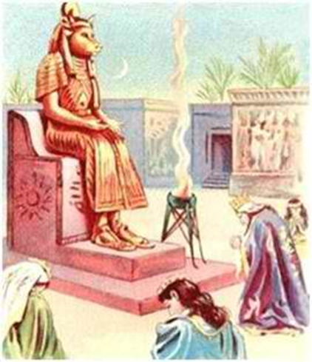
，又娶了西頓王謁巴力的女兒耶洗別為妻，去事奉敬拜巴力，³²在撒瑪利亞建造巴力的廟，在廟裡為巴力築壇。
he took for his wife Jezebel the daughter of Ethbaal king of the Sidonians, and went and served Baal and worshiped him. ³²He
erected an altar for Baal in the house of Baal, which he built in Samaria.

Slide 18
³³亞哈又做亞舍拉，他所行的惹耶和華─以色列 神的怒氣，比他以前的以色列諸王更甚。³⁴亞哈在位的時候，有伯特利人希伊勒重修耶利哥城；立根基的時候，喪了長子亞比蘭；安門的時候，喪了幼子西割，正如耶和華藉嫩的兒子約書亞所說的話。【王上 16:29~34】 ³³And Ahab made an Asherah. Ahab did more to provoke the Lord, the God of Israel, to anger than all the kings of Israel who were before him. ³⁴In his days Hiel of Bethel built Jericho.
He laid its foundation at the cost of Abiram his firstborn, and set up its gates at the cost of his youngest son Segub, according to the word of the Lord,which he spoke by Joshua the son of Nun. 【1King 16:29~34】

Slide 19
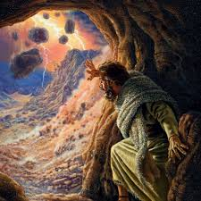
Q: 神的作法是甚麼? What is God's way?
→神對跑到何烈山, 躲在山洞裏面的以利亞這樣子說:
God said this to Elijah, who ran to Mount Horeb and hid
in the cave.

Slide 20
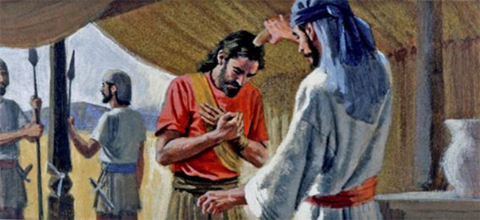
¹⁵耶和華對他說：你回去，從曠野往大馬色去。到了那裡，就要膏哈薛作亞蘭王，¹⁶又膏寧示的孫子耶戶作以色列王，並膏亞伯米何拉人沙法的兒子以利沙作先知接續你。
¹⁵And the Lord said to him, "Go, return on your way to the wilderness of Damascus. And when you arrive, you shall anoint Hazael to be king over Syria. ¹⁶And Jehu the son of Nimshi you shall anoint to be king over Israel, and Elisha the son of Shaphat of Abel-meholah you shall anoint to be prophet in your place.

Slide 21
¹⁷將來躲避哈薛之刀的，必被耶戶所殺；躲避耶戶之刀的，必被以利沙所殺。¹⁸但我在以色列人中為自己留下七千人，是未曾向巴力屈膝的，未曾與巴力親嘴的。
【王上 19:15~18】 ¹⁷And the one who escapes from the sword of Hazael shall Jehu put to death, and the one who escapes from the sword of Jehu shall Elisha put to death. ¹⁸Yet I will leave seven thousand in Israel, all the knees that have not bowed to Baal, and every mouth that has not kissed him." 【1King 19:15~18】

Slide 22
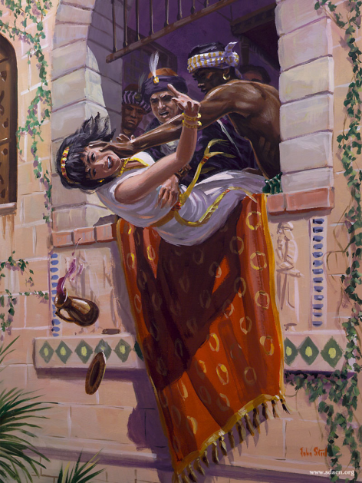
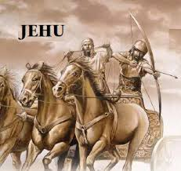
→耶戶推翻亞哈王的政權/Jehu overthrew King Ahab's regime
耶洗別被處決
Jezebel was executed

Slide 23
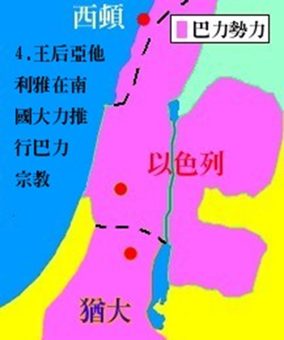
→當耶洗別被殺之後,巴力的敬拜藉著耶洗別的女兒跑到了南
國猶大.耶洗別的女兒叫做亞他利雅.
After Jezebel was executed, Baal’s worship went to the southern
kingdom of Judah through Jezebel’s daughter. The daughter of
Jezebel was called Athaliah.

Slide 24
¹⁶以色列王亞哈的兒子約蘭第五年，猶大王約沙法還在位的時候，約沙法的兒子約蘭登基作了猶大王。¹⁷約蘭登基的時候年三十二歲，在耶路撒冷作王八年。¹⁸他行以色列諸王所行的，與亞哈家一樣；因為他娶了亞哈的女兒(就是亞他利雅)為妻，行耶和華眼中看為惡的事。【王下 8:16~18】 ¹⁶In the fifth year of Joram the son of Ahab, king of Israel, when Jehoshaphat was king of Judah, Jehoram the son of Jehoshaphat, king of Judah, began to reign. ¹⁷He was thirty-two years old when he became king, and he reigned eight years in Jerusalem. ¹⁸And he walked in the way of the kings of Israel, as the house of Ahab had done, for the daughter of Ahab (that is, Athaliah) was his wife. And he did what was evil in the sight of the Lord.
【2King 8:16~18】

Slide 25
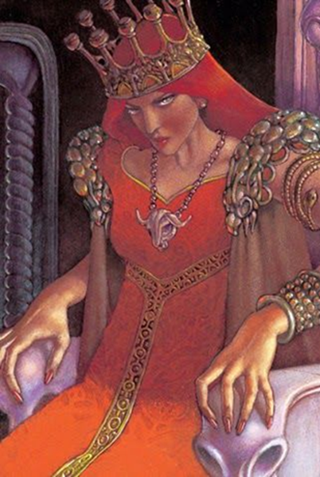
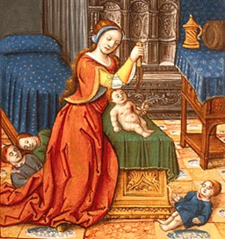
→亞他利雅, 在自己的兒子死了以後, 就起來剿滅了大衛的
王室, 自己做了王.
Athaliah, after his son died, arose and destroyed David's
royal family and reigned over the land.

Slide 26
¹亞哈謝的母親亞他利雅見他兒子死了，就起來剿滅王室。²但約蘭王的女兒，亞哈謝的妹子約示巴，將亞哈謝的兒子約阿施從那被殺的王子中偷出來，把他和他的乳母都藏在臥房裡，躲避亞他利雅，免得被殺。³約阿施和他的乳母藏在耶和華的殿裡六年；亞他利雅篡了國位。【王下 11:1~3】 ¹Now when Athaliah the mother of Ahaziah saw that her son was dead, she arose and destroyed all the royal family. ²But Jehosheba, the daughter of King Joram, sister of Ahaziah, took Joash the son of Ahaziah and stole him away from among the king's sons who were being put to death, and she put him and his nurse in a bedroom. Thus they hid him from Athaliah, so that he was not put to death. ³And he remained with her six years, hidden in the house of the Lord, while Athaliah reigned over the land. 【2King 11:1~3】

Slide 27
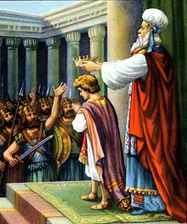
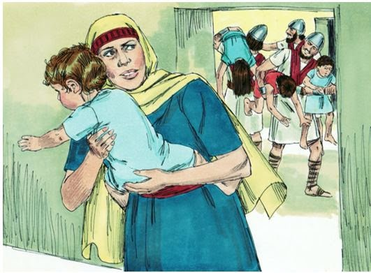

Slide 28
所以我們看到這個歷史的故事, 上帝的參與, 你知
道神是一個action的神, 而且他有計畫, 有步驟.
So from this historical story, we saw that God is an
action God, and He has plans and steps.

Slide 29
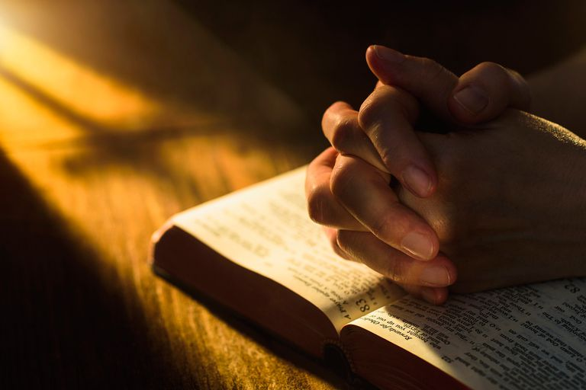
II. What shall we do, as Christians in time like this?
做為一個基督徒, 我現在應該做甚麼?

Slide 30
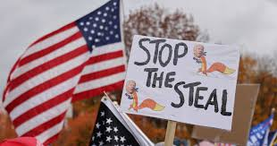
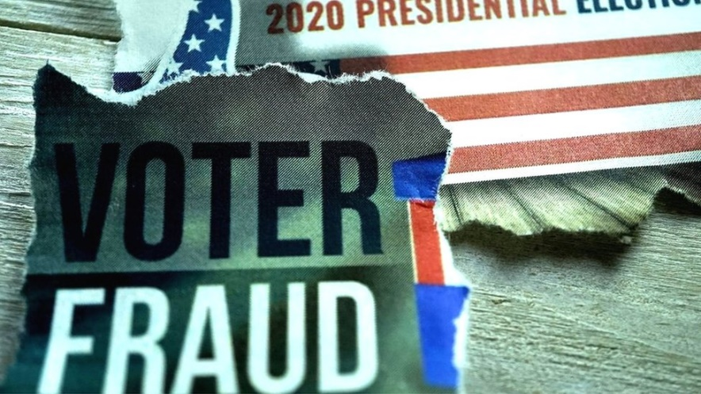
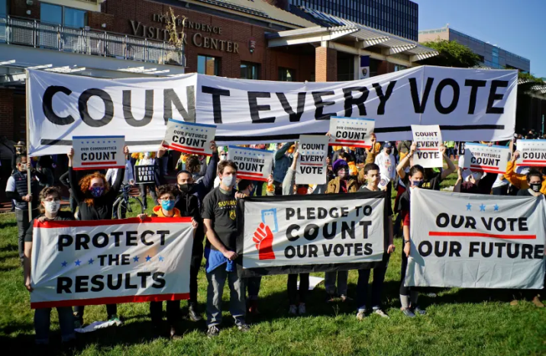

Slide 31
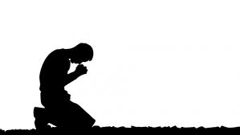
基督徒應該如何看待社會的不公義？
How should Christians view social injustice?
美國這次選舉的亂象，神的心意到底是什麼？
What is God's will in the chaos of this election in the United States?

Slide 32
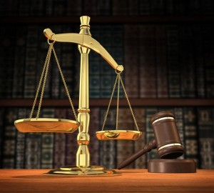
¹⁴公義和公平是你寶座的根基；慈愛和誠實行在你前面。【詩 89:14】 ¹⁴Righteousness and justice are the foundation of your throne; steadfast love and faithfulness go before you. 【Ps 89:14】

Slide 33
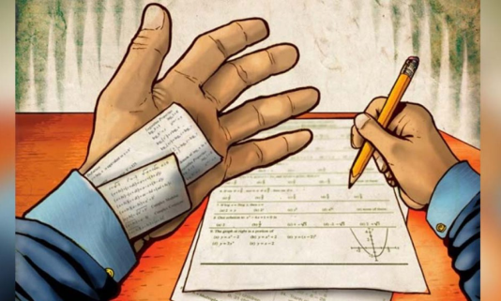
Illustration:
¹⁰慈愛和誠實彼此相遇；公義和平安彼此相親。【詩 85:10】 ¹⁰Steadfast love and faithfulness meet; righteousness and peace kiss each other. 【Ps 85:10】

Slide 34
→我們要愛我們的仇敵但是愛的定義是:
We want to love our enemies but the definition of love is:
⁴愛是恆久忍耐，又有恩慈；愛是不嫉妒；愛是不自誇，不張狂，⁵不做害羞的事，不求自己的益處，不輕易發怒，不計算人的惡，⁶不喜歡不義，只喜歡真理；⁷凡事包容，凡事相信，凡事盼望，凡事忍耐。⁸愛是永不止息。先知講道之能終必歸於無有；說方言之能終必停止；知識也終必歸於無有。【林前 13:4~8】 ⁴Love is patient and kind; love does not envy or boast; it is not arrogant ⁵or rude. It does not insist on its own way; it is not irritable or resentful; ⁶it does not rejoice at wrongdoing, but rejoices with the truth. ⁷Love bears all things, believes all things, hopes all things, endures all things. ⁸Love never ends. As for prophecies, they will pass away; as for tongues, they will cease; as for knowledge, it will pass away. 【1Cor 13:4~8】

Slide 35
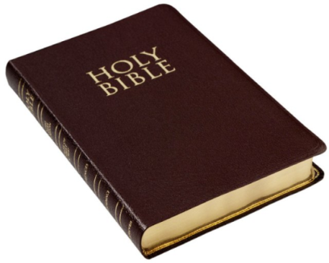
Q: 為什麼牧師們都支持共和黨?
Why do many pastors support the Republican Party?
其實不是我們支持共和黨, 而是我們支持聖經, 而共和黨的黨綱和聖經是大部分吻合的.
In fact, it is not that we support the Republican Party, but that we support the Bible because the Republican Party's party platform is mostly consistent with the Bible.
大部分吻合
is mostly consistent with

Slide 36
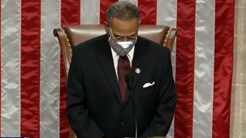
→民主黨愈來離神愈遠了
The Democratic Party is getting further and further away
from God.
1/4/2021請了一個民主黨的國會議員Rev. Emanuel/Ewomanuel Cleaver來禱告:
Democratic Congressman Rev. Emanuel Cleaver prayed on 1/4/2021:
“We ask it in the name of the monotheistic God, Brahma, and ‘God’ known by many names by many different faiths. Amen and awoman.”

Slide 37
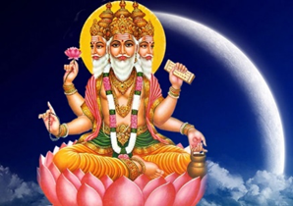
印度的神: Brahma/梵天, 其實是和泰國的四面佛一樣的都是基路伯,
唯一會接受人類敬拜的基路伯, 就是撒旦路希弗.
Hindu god: Brahma, in fact, like the four-faced Buddha in Thailand, they are all cherubim. The only cherubim who will accept
human worship is Satan Lucifer.

Slide 38
Q: Could I act? 我可以採取行動嗎？
A: Of course you can, or even you need to.
當然可以，甚至你必需要。

Slide 39
III. Act, but Count Your Cost
行動, 但是要計算你的成本
但是在採取行動之前，您需要了解三件事。
But before you act, there are three things you need to know.

Slide 40
A. Know where you are going.
知道你要去哪裡。

Slide 41
1) You are to pull down the deep state.
你要推翻深層政府,暗深勢力集團。
2) You are to destroy the giant tech company.
你要摧毀巨型科技公司。
3) You are to pull out the corruption within the election.
你要消除選舉中的腐弊。

Slide 42
My choice is already made for me by my employer,
our heavenly Father—to save people from the sinful
corruption of the heart through the gospel of Jesus
Christ.
我的雇主我們的天父已經為我做出了選擇，就是要
通過耶穌基督的福音使人們從罪惡的心中拯救出來。

Slide 43
²⁸耶穌說：我實在告訴你們，你們這跟從我的人，到復興的時候，人子坐在他榮耀的寶座上，你們也要坐在十二個寶座上，審判以色列十二個支派。²⁹凡為我的名撇下房屋，或是弟兄、姐妹、父親、母親、（有古卷添妻子）兒女、田地的，必要得著百倍，並且承受永生。³⁰然而，有許多在前的，將要在後；在後的，將要在前。【太 19:28~30】 ²⁸Jesus said to them, “”Truly, I say to you, in the new world, when the Son of Man will sit on his glorious throne, you who have followed me will also sit on twelve thrones, judging the twelve tribes of Israel." ²⁹"And everyone who has left houses or brothers or sisters or father or mother or children or lands, for my name's sake, will receive a hundredfold and will inherit eternal life." ³⁰"But many who are first will be last, and the last first. " 【Matt 19:28~30】

Slide 44
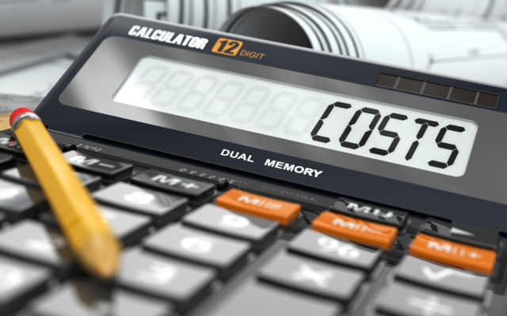
B. Count the Cost/計算成本

Slide 45
²⁸你們那一個要蓋一座樓，不先坐下算計花費，能蓋成不能呢？²⁹恐怕安了地基，不能成功，看見的人都笑話他，³⁰說：這個人開了工，卻不能完工。³¹或是一個王出去和別的王打仗，豈不先坐下酌量，能用一萬兵去敵那領二萬兵來攻打他的麼？
【路 14:28~31】 ²⁸"For which of you, desiring to build a tower, does not first sit down and count the cost, whether he has enough to complete it?" ²⁹"Otherwise, when he has laid a foundation and is not able to finish, all who see it begin to mock him," ³⁰"saying, 'This man began to build and was not able to finish.'" ³¹"Or what king, going out to encounter another king in war, will not sit down first and deliberate whether he is able with ten thousand to meet him who comes against him with twenty thousand?" 【Luke 14:28~31】

Slide 46
C. Alliance, he who is not against us is for us.
聯盟，不敵擋我們的，就是幫助我們的。

Slide 47
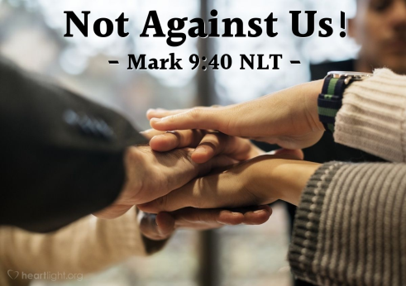
⁴⁰不敵擋我們的，就是幫助我們的。⁴¹凡因你們是屬基督，給你們一杯水喝的，我實在告訴你們，他不能不得賞賜。【可 9:40~41】 ⁴⁰"For the one who is not against us is for us." ⁴¹"For truly, I say to you, whoever gives you a cup of water to drink because you belong to Christ will by no means lose his reward. " 【Mark 9:40~41】

Slide 48
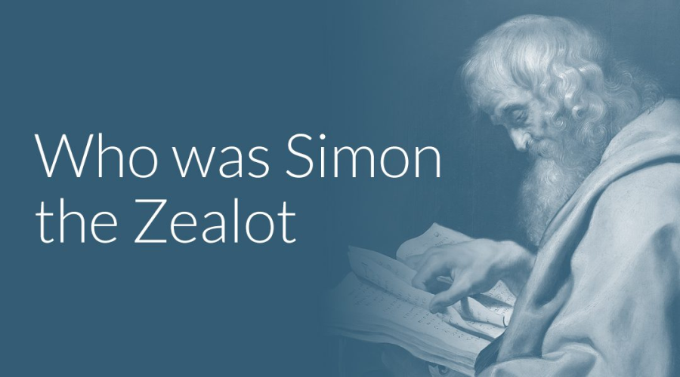
Conclusion結論
奮銳黨的西門,耶穌基督的十二個門徒之一.
Simon the Zealot is one of 12 disciples of Jesus Christ.

Slide 49
¹²那時，耶穌出去，上山禱告，整夜禱告神；¹³到了天亮，叫他的門徒來，就從他們中間挑選十二個人，稱他們為使徒。¹⁴這十二個人有西門，耶穌又給他起名叫彼得，還有他兄弟安得烈，又有雅各和約翰，腓力和巴多羅買，¹⁵馬太和多馬，亞勒腓的兒子雅各和奮銳黨的西門，¹⁶雅各的兒子（兒子或作：兄弟）猶大，和賣主的加略人猶大。
【路 6:12~16】 ¹²In these days he went out to the mountain to pray, and all night he continued in prayer to God. ¹³And when day came, he called his disciples and chose from them twelve, whom he named apostles: ¹⁴Simon, whom he named Peter, and Andrew his brother, and James and John, and Philip, and Bartholomew, ¹⁵and Matthew, and Thomas, and James the son of Alphaeus, and Simon who was called the Zealot, ¹⁶and Judas the son of James, and Judas Iscariot, who became a traitor. 【Luke 6:12~16】

Slide 50
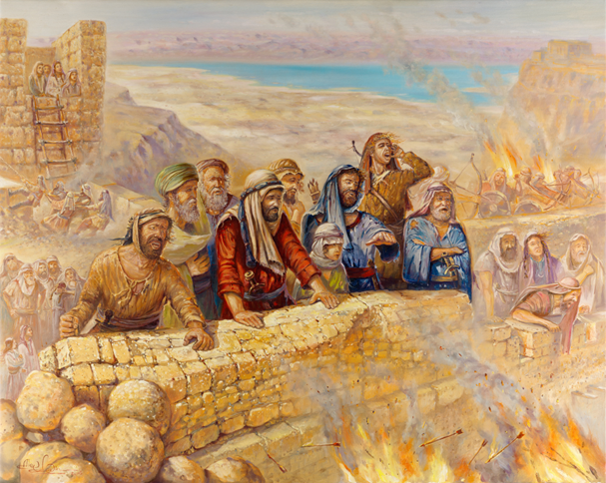
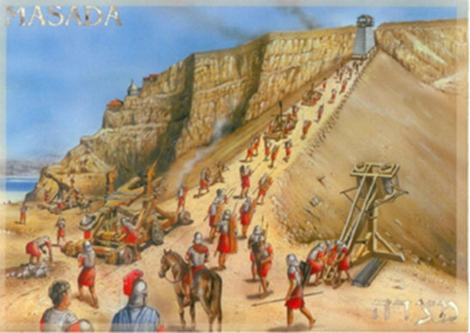
Q: 什麼是Zealot呢？What is Zealot?
Eleazar ben Ya’ir率領的奮銳黨的一個支派叫做 Sicarii一共有960人
羅馬第十軍團 (Roman Legion X Fretensis) 15,000人
Zealot
Masada war

Slide 51
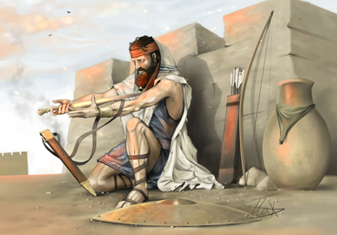
→軍隊圍城半年之後, 全數自殺身亡
After being under siege for half a year , they all committed suicide.
The last Jewish zealot at the Siege of Masada

Slide 52
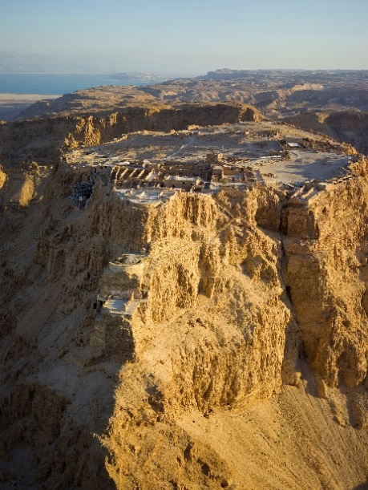
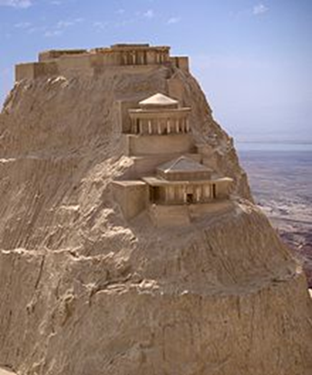
IDF的slogan 就是
“Masada shall not fall again”

Slide 53
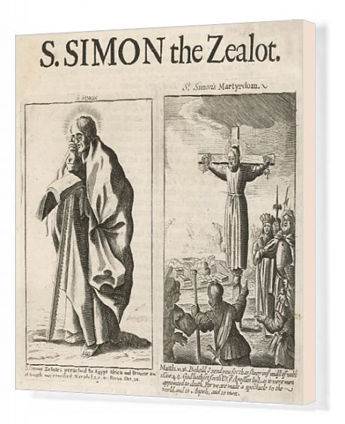

Slide 54
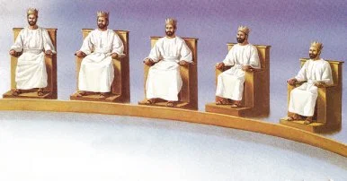
²⁸耶穌說：我實在告訴你們，你們這跟從我的人，到復興的時候，人子坐在他榮耀的寶座上，你們也要坐在十二個寶座上，審判以色列十二個支派。【太 19:28】 ²⁸Jesus said to them, ""Truly, I say to you, in the new world, when the Son of Man will sit on his glorious throne, you who have followed me will also sit on twelve thrones, judging the twelve tribes of Israel." 【Matt 19:28】

Slide 55
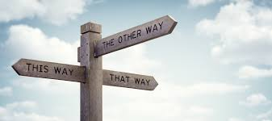
Let us ask God to give us a wise decision in this
difficult time.
讓我們請上帝在這個困難時期給我們一個明
智的決定。

