Slide 1
Reflection of 2020, Vision for 2021
回顧2020, 展望2021
1/10/2021 Rev. Joseph Chang BOLGPC 爾灣 大公園靈糧堂

Slide 3
Q: 2021年我們所要做的是甚麼? What is our vision for 2021?

Slide 4
★ 我們的教會是一個遵守大使命的教會.
Our church observes the Great Commission.

Slide 5
¹⁸耶穌進前來，對他們說：天上地下所有的權柄都賜給我了。¹⁹所以，你們要去，使萬民作我的門徒，奉父、子、聖靈的名給他們施洗（或作：給他們施洗，歸於父、子、聖靈的名）。²⁰凡我所吩咐你們的，都教訓他們遵守，我就常與你們同在，直到世界的末了。
【太 28:18~20】 ¹⁸And Jesus came and said to them, ""All authority in heaven and on earth has been given to me." ¹⁹"Go therefore and make disciples of all nations, baptizing them in the name of the Father and of the Son and of the Holy Spirit," ²⁰"teaching them to observe all that I have commanded you. And behold, I am with you always, to the end of the age."" 【Matt 28:18~20】

Slide 6
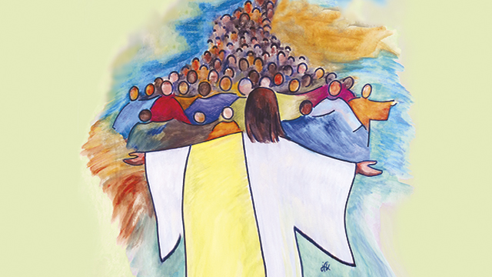
Purpose:
Make Disciples of all nations
使萬民作耶穌的門徒.

Slide 7
Steps:
By going
藉著去. —— 到沒有信主的人群當中
By baptizing
藉著帶人信主, 使人受洗——使沒有信主的人信主
By teaching
藉著教導——使信主的人成為門徒

Slide 8
我們教會的事工方向
By teaching
藉著教導
By going 藉著去
Make Disciples 使人作門徒
By baptizing
藉著施洗

Slide 9
在教會的生活裡面, 主耶穌要我們彼此相愛, 這是最大的
誡命:
In the church, the Lord Jesus wants us to love each other.
This is the greatest commandment.

Slide 10
²⁸有一個文士來，聽見他們辯論，曉得耶穌回答的好，就問他說：誡命中那是第一要緊的呢？²⁹耶穌回答說：第一要緊的就是說：以色列阿，你要聽，主─我們神是獨一的主。³⁰你要盡心、盡性、盡意、盡力愛主─你的神。³¹其次就是說：要愛人如己。再沒有比這兩條誡命更大的了。【可 12:28~31】 ²⁸And one of the scribes came up and heard them disputing with one another, and seeing that he answered them well, asked him, "Which commandment is the most important of all?" ²⁹Jesus answered, ""The most important is, 'Hear, O Israel: The Lord our God, the Lord is one." ³⁰"And you shall love the Lord your God with all your heart and with all your soul and with all your mind and with all your strength.'" ³¹"The second is this: 'You shall love your neighbor as yourself.' There is no other commandment greater than these."" 【Mark 12:28~31】

Slide 11
Q: 我們要怎麼做呢?

Slide 13
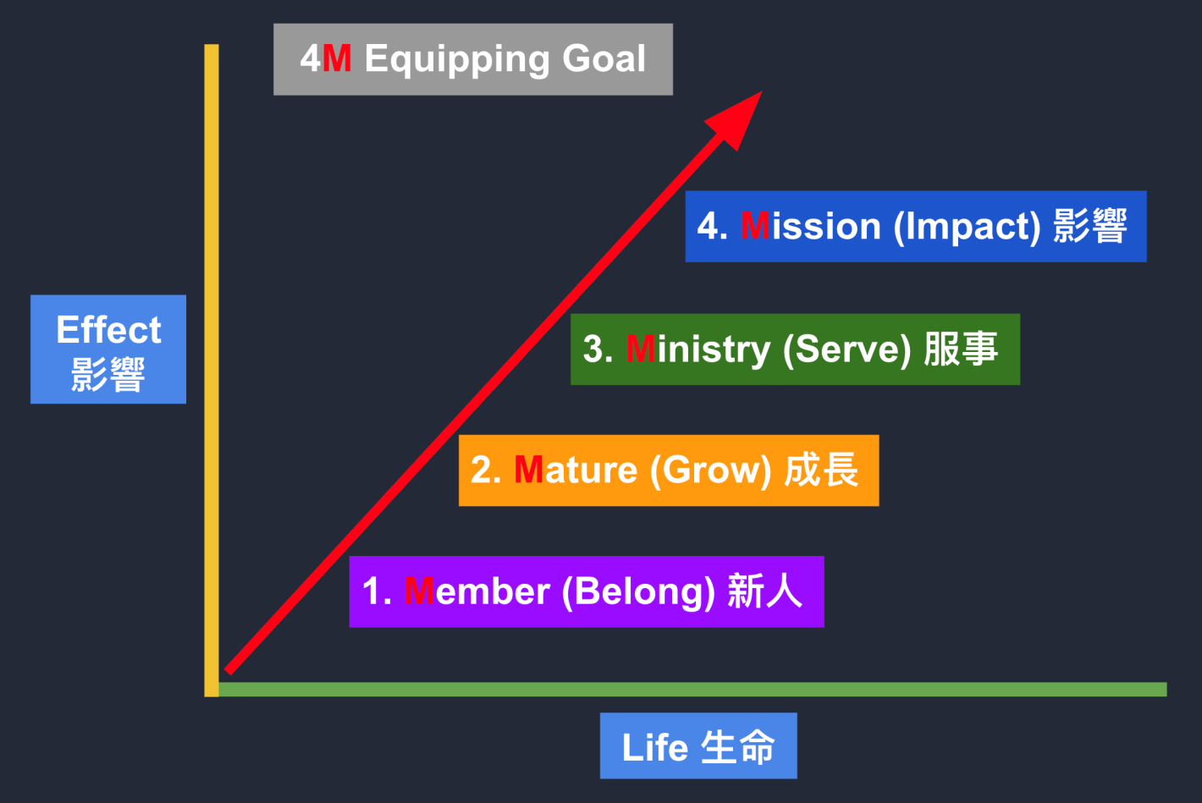

Slide 14
Serving, Impacting
服事， 影響
Example/例子:
我們做幸福小組. We can hold Happiness groups.
我們到墨西哥去幫人蓋房子, 並傳福音.
We can go to Mexico to help people build houses and preach the gospel.
我們計畫3年內, 有一次全組到台灣參加一次Advent的英文教學.
We can plan to have the whole group go to Taiwan to participate in the Advent within 3 years.

Slide 15
我們計畫5年內, 有一次全組到阿根廷去華人教會中做見證, 傳福音.
We can plan to have the whole group go to Argentina to witness and preach the gospel in a Chinese church once in 5 years.
我們到soup kitchen 來serve homeless people.
We can go to the soup kitchen to serve homeless people.
我們參與meals on wheel. We can participate in meals on wheel.
我們到LA去做街頭佈道. We can go to LA to do street sermons.
我們到99 Ranch去做發傳單的工作.
We can go to 99 Ranch markets to give out leaflets.

Slide 16
我們幫忙教會換所有的冷氣機的air filter.
We can help the church to replace all the air filters of air conditioners.
幫忙媽媽班辦一次招待媽媽們全家的福音BBQ餐會.
We can help the Mom-In–Touch organize a gospel BBQ dinner for the mothers and their whole family.

Slide 17
Training, Equipping Class
裝備訓練
因著這個行動目標, 我們才來設計主日學的訓練課程.
To achieve the goal, we design the Sunday school training course.
是一個目標導向的訓練. It is a goal-oriented training.

Slide 18
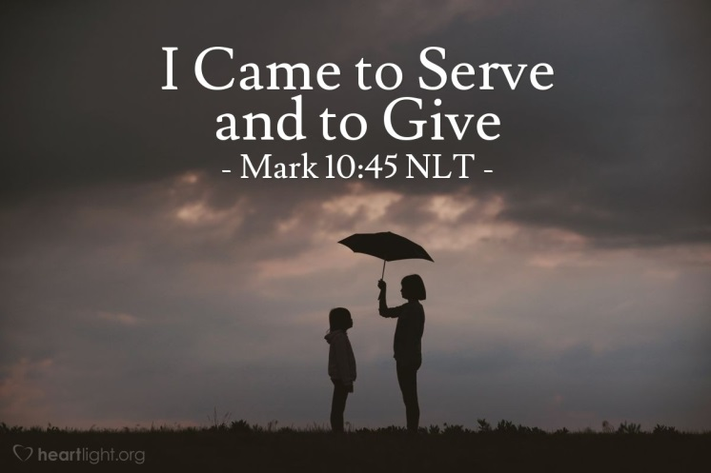
²⁸正如人子來，不是要受人的服事，乃是要服事人，並且要捨命，作多人的贖價。【太 20:28】 ²⁸"even as the Son of Man came not to be served but to serve, and to give his life as a ransom for many." " 【Matt 20:28】

