Slide 1

Ash Wednesday
聖灰星期三
2/21/2021
Rev. Joseph Chang
BOLGPC 爾灣大公園靈糧堂

Slide 2



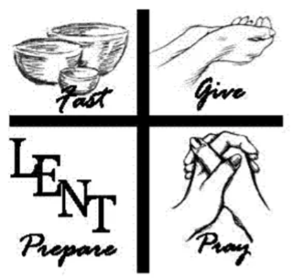
今年的復活節是4/4, 所以聖灰星期三是2/17.
Easter is 4/4 this year , so Ash Wednesday is 2/17.

Slide 3

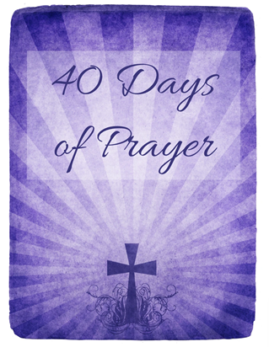

我們要利用這一段時間一齊來操練禁食禱告和其他敬虔的紀律, 讓我們的心更加的接近神.
We intend to use this period of time to practice fasting, prayer and other godly disciplines to bring our hearts closer to God

Slide 4
Explanation:
這個是40天連鎖禱告的連接
This is the link for our 40 days' fasting schedule.
https://docs.google.com/spreadsheets/d/1OFD0OYdSL1t3se1BBfQoDOPeViYY7hBgD0THwUIXns8/edit#gid=0

Slide 5
教會的網頁 bolgpc.org → News

Slide 6
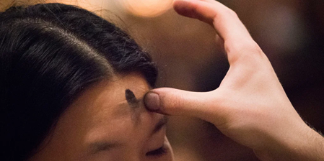
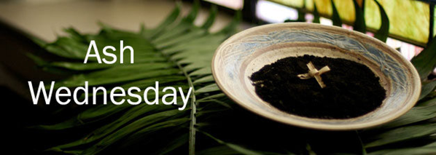
"Repent, and believe in the Gospel."
你要悔改, 接受福音.
"Remember that you are dust, and to dust you shall return."
記得你是從塵土而來, 仍要歸回塵土.

Slide 7
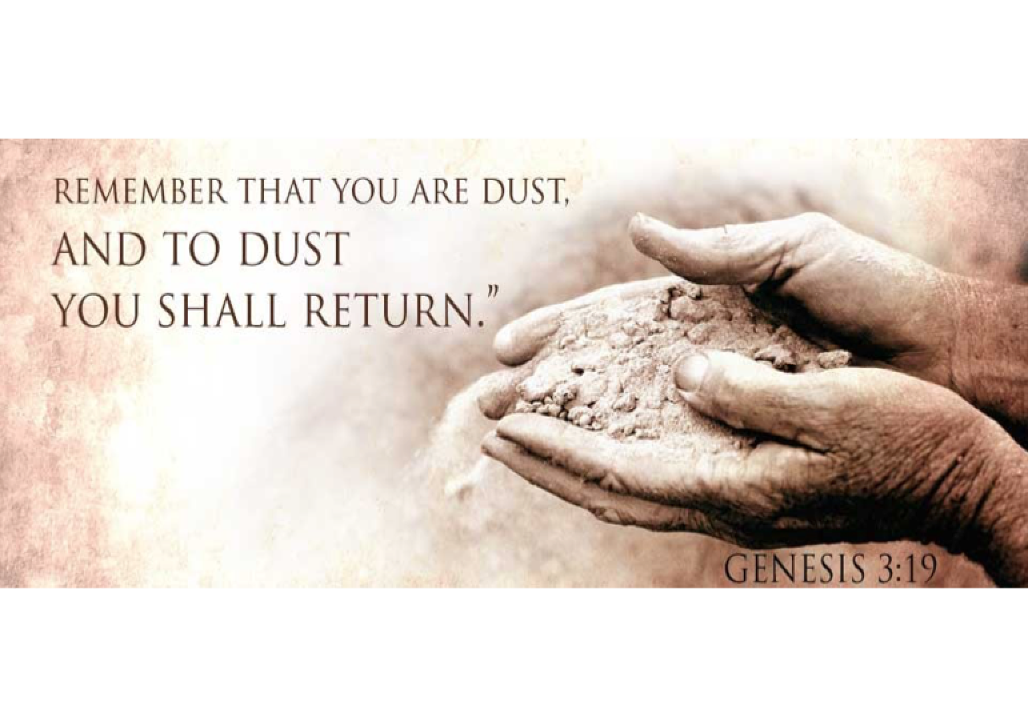
I. Remember that you are dust, and to dust you shall return.
記得你是從塵土而來, 仍要歸回塵土.

Slide 8

Illustration:

Slide 9
所羅門王 他說過一句話/King Roma said :
¹⁵他怎樣從母胎赤身而來，也必照樣赤身而去；他所勞碌得來的，手中分毫不能帶去。【傳 5:15】
¹⁵As he came from his mother's womb he shall go again, naked as he came, and shall take nothing for his toil that he may carry away in his hand. 【Eccl 5:15】

Slide 10
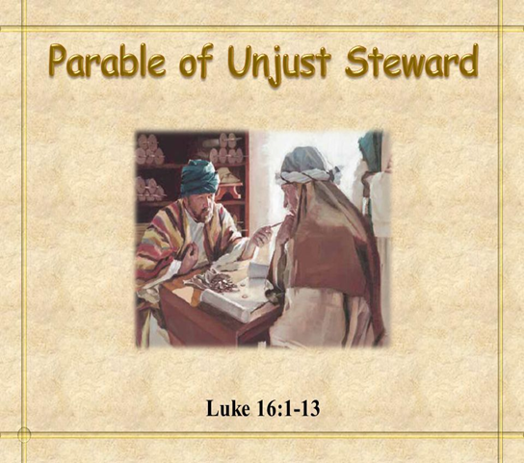
不義的管家的比喻:

Slide 11
¹耶穌又對門徒說：有一個財主的管家，別人向他主人告他浪費主人的財物。²主人叫他來，對他說：我聽見你這事怎麼樣呢？把你所經管的交代明白，因你不能再作我的管家。³那管家心裡說：主人辭我，不用我再作管家，我將來作甚麼？鋤地呢？無力；討飯呢？怕羞。
¹He also said to the disciples, ""There was a rich man who had a manager, and charges were brought to him that this man was wasting his possessions." ²"And he called him and said to him, 'What is this that I hear about you? Turn in the account of your management, for you can no longer be manager.'" ³"And the manager said to himself, 'What shall I do, since my master is taking the management away from me? I am not strong enough to dig, and I am ashamed to beg."

Slide 12
⁴我知道怎麼行，好叫人在我不作管家之後，接我到他們家裡去。⁵於是把欠他主人債的，一個一個的叫了來，問頭一個說：你欠我主人多少？⁶他說：一百簍（每簍約五十斤）油。管家說：拿你的賬，快坐下，寫五十。⁷又問一個說：你欠多少？他說：一百石麥子。管家說：拿你的賬，寫八十。
⁴"I have decided what to do, so that when I am removed from management, people may receive me into their houses.'" ⁵"So, summoning his master's debtors one by one, he said to the first, 'How much do you owe my master?'" ⁶"He said, 'A hundred measures of oil.' He said to him, 'Take your bill, and sit down quickly and write fifty.'" ⁷"Then he said to another, 'And how much do you owe?' He said, 'A hundred measures of wheat. 'He said to him, 'Take your bill, and write eighty.'"

Slide 13
⁸主人就誇獎這不義的管家做事聰明。因為今世之子，在世事之上，較比光明之子更加聰明。⁹我又告訴你們，要藉著那不義的錢財結交朋友，到了錢財無用的時候，他們可以接你們到永存的帳幕裡去。【路 16:1~9】
⁸"The master commended the dishonest manager for his shrewdness. For the sons of this world are more shrewd in dealing with their own generation than the sons of light." ⁹"And I tell you, make friends for yourselves by means of unrighteous wealth, so that when it fails they may receive you into the eternal dwellings. " 【Luke 16:1~9】

Slide 14

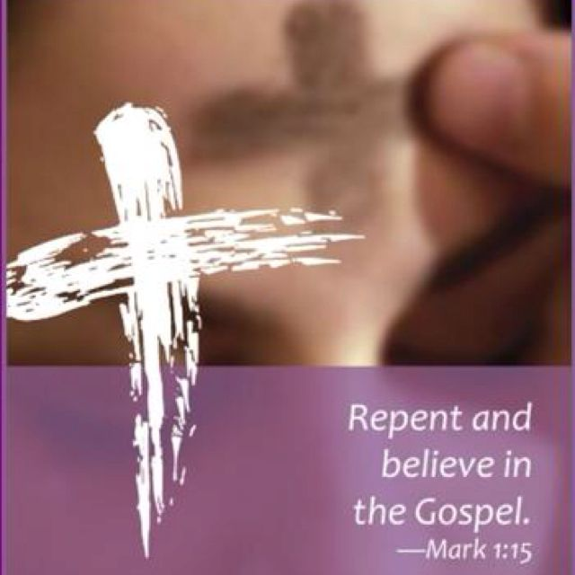
II. "Repent, and believe in the Gospel"
你要悔改, 接受福音.

Slide 15
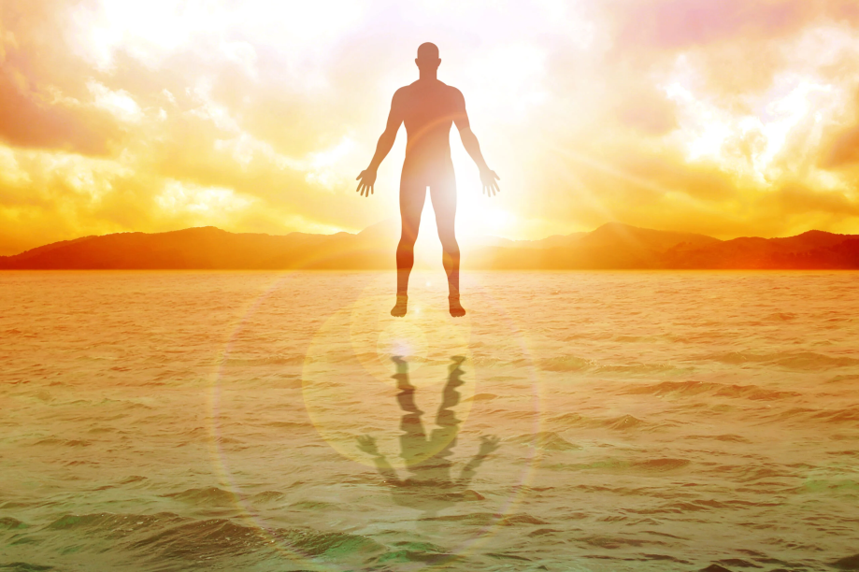
人的靈魂離開世界上以後, 有兩個去處:
After the human spirit leaves the world,
there are two places to go:

Slide 16
A. Hell 地獄
¹⁹有一個財主穿著紫色袍和細麻布衣服，天天奢華宴樂。²⁰又有一個討飯的，名叫拉撒路，渾身生瘡，被人放在財主門口，²¹要得財主桌子上掉下來的零碎充飢；並且狗來餂他的瘡。 ²²後來那討飯的死了，被天使帶去放在亞伯拉罕的懷裡。財主也死了，並且埋葬了。
¹⁹""There was a rich man who was clothed in purple and fine linen and who feasted sumptuously every day." ²⁰"And at his gate was laid a poor man named Lazarus, covered with sores," ²¹"who desired to be fed with what fell from the rich man's table. Moreover, even the dogs came and licked his sores." ²²"The poor man died and was carried by the angels to Abraham's side. The rich man also died and was buried,"

Slide 17
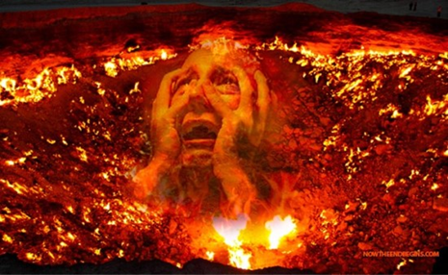
²³他在陰間受痛苦，舉目遠遠的望見亞伯拉罕，又望見拉撒路在他懷裡，²⁴就喊著說：我祖亞伯拉罕哪，可憐我罷！打發拉撒路來，用指頭尖蘸點水，涼涼我的舌頭；因為我在這火焰裡，極其痛苦。
²³"and in Hades, being in torment, he
lifted up his eyes and saw Abraham
far off and Lazarus at his side." ²⁴"And
he called out, 'Father Abraham, have
mercy on me, and send Lazarus to dip
the end of his finger in water and cool
my tongue, for I am in anguish in this
flame.'"

Slide 18
²⁵亞伯拉罕說：兒阿，你該回想你生前享過福，拉撒路也受過苦；如今他在這裡得安慰，你倒受痛苦。²⁶不但這樣，並且在你我之間，有深淵限定，以致人要從這邊過到你們那邊是不能的；要從那邊過到我們這邊也是不能的。²⁷財主說：我祖阿！既是這樣，求你打發拉撒路到我父家去；
²⁵"But Abraham said, 'Child, remember that you in your lifetime received your good things, and Lazarus in like manner bad things; but now he is comforted here, and you are in anguish." ²⁶"And besides all this, between us and you a great chasm has been fixed, in order that those who would pass from here to you may not be able, and none may cross from there to us.'" ²⁷"And he said, 'Then I beg you, father, to send him to my father's house-"

Slide 19
²⁸因為我還有五個弟兄，他可以對他們作見證，免得他們也來到這痛苦的地方。²⁹亞伯拉罕說：他們有摩西和先知的話可以聽從。³⁰他說：我祖亞伯拉罕哪，不是的，若有一個從死裡復活的，到他們那裡去的，他們必要悔改。³¹亞伯拉罕說：若不聽從摩西和先知的話，就是有一個從死裡復活的，他們也是不聽勸。【路 16:19~31】
²⁸"for I have five brothers -so that he may warn them, lest they also come into this place of torment.'" ²⁹"But Abraham said, 'They have Moses and the Prophets; let them hear them.'" ³⁰"And he said, 'No, father Abraham, but if someone goes to them from the dead, they will repent.'" ³¹"He said to him, 'If they do not hear Moses and the Prophets, neither will they be convinced if someone should rise from the dead.' " " 【Luke 16:19~31】

Slide 20
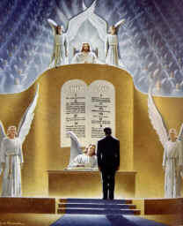
→啟示錄提到了罪人受審判的地方:
Revelation mentions the place where sinners are judged:
¹¹我又看見一個白色的大寶座與坐在上面的；從他面前天地都逃避，再無可見之處了。¹²我又看見死了的人，無論大小，都站在寶座前。案卷展開了，並且另有一卷展開，就是生命冊。死了的人都憑著這些案卷所記載的，照他們所行的受審判。
¹¹Then I saw a great white throne and him who was seated on it. From his presence earth and sky fled away, and no place was
found for them. ¹²And I saw the dead, great and small,
standing before the throne, and books were opened.
Then another book was opened, which is the book of
life. And the dead were judged by what was written in
the books, according to what they had done.

Slide 21
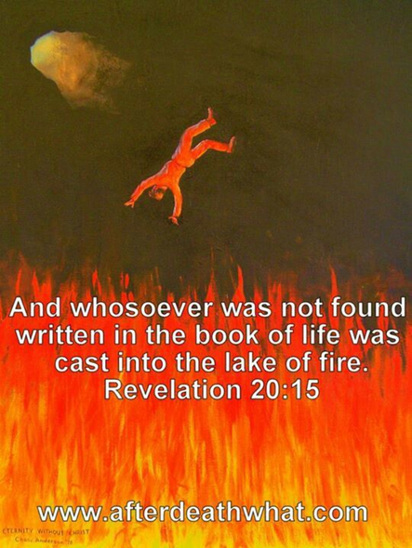
¹³於是海交出其中的死人；死亡和陰間也交出其中的死人；他們都照各人所行的受審判。¹⁴死亡和陰間也被扔在火湖裡；這火湖就是第二次的死。¹⁵若有人名字沒記在生命冊上，他就被扔在火湖裡。【啟 20:11~15】
¹³And the sea gave up the dead who were in it,
Death and Hades gave up the dead who were in
them, and they were judged, each one of them,
according to what they had done. ¹⁴Then Death
and Hades were thrown into the lake of fire.
This is the second death, the lake of fire. ¹⁵And
if anyone's name was not found written in the
book of life, he was thrown into the lake of fire.
【Rev 20:11~15】

Slide 22
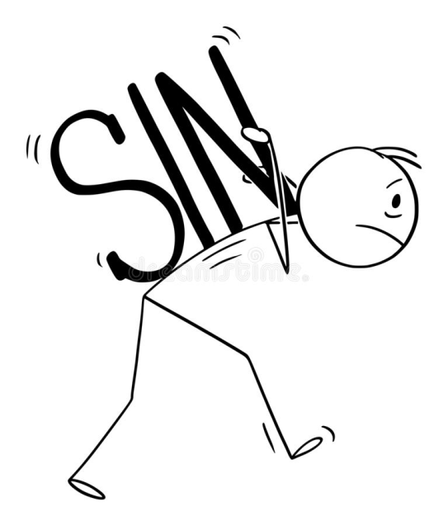
B. Heaven 天堂
²³因為世人都犯了罪，虧缺了神的榮耀；【羅 3:23】
²³for all have sinned and fall short of the glory of God, 【Rom 3:23】

Slide 23

⁸惟有基督在我們還作罪人的時候為我們死，神的愛就在此向我們顯明了。【羅 5:8】
⁸but God shows his love for us in that while we were still sinners, Christ died for us. 【Rom 5:8】

Slide 24
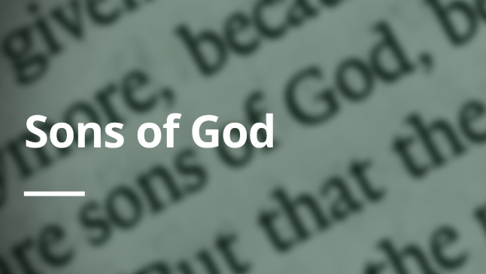
³⁴耶穌說：這世界的人有娶有嫁；³⁵惟有算為配得那世界，與從死裡復活的人也不娶也不嫁；³⁶因為他們不能再死，和天使一樣；既是復活的人，就為神的兒子。【路 20:34~36】
³⁴And Jesus said to them, ""The sons of this age marry and are given in marriage," ³⁵"but those who are considered worthy to attain to that age and to the resurrection from the dead neither marry nor are given in marriage," ³⁶"for they cannot die anymore, because they are equal to angels and are sons of God, being sons of the resurrection." 【Luke 20:34~36】

Slide 25
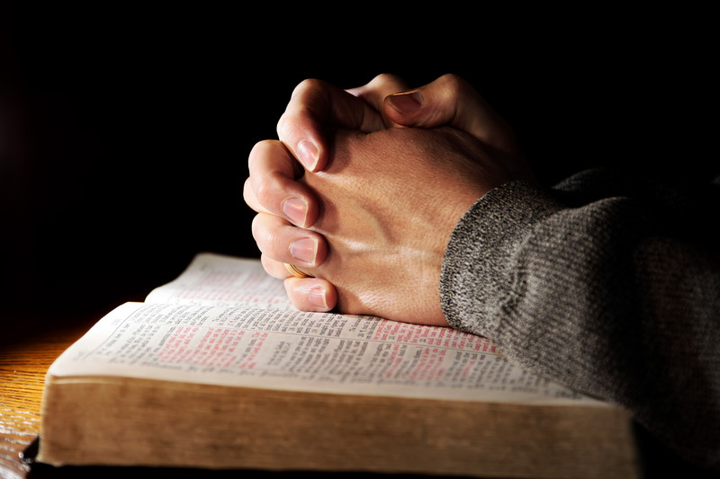
禱告接受福音/Pray to receive the gospel

Slide 26

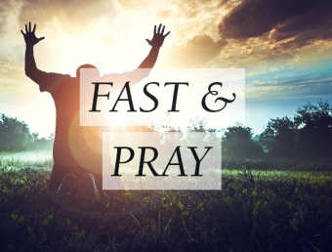
III. Why we fast and pray?
為什麼我們禁食禱告?

Slide 27
禁食禱告是讓我們能夠更接近上帝.
Fasting and praying allow us to be closer to God.
¹我們原知道，我們這地上的帳棚若拆毀了，必得神所造，不是人手所造，在天上永存的房屋。²我們在這帳棚裡嘆息，深想得那從天上來的房屋，好像穿上衣服；³倘若穿上，被遇見的時候就不至於赤身了。
¹For we know that if the tent, which is our earthly home, is destroyed, we have a building from God, a house not made with hands, eternal in the heavens. ²For in this tent we groan, longing to put on our heavenly dwelling, ³if indeed by putting it on we may not be found naked.

Slide 28
⁴我們在這帳棚裡嘆息勞苦，並非願意脫下這個，乃是願意穿上那個，好叫這必死的被生命吞滅了。. . . ¹⁰因為我們眾人必要在基督臺前顯露出來，叫各人按著本身所行的，或善或惡受報。【林後 5:1~4 10】
⁴For while we are still in this tent, we groan, being burdened-not that we would be unclothed, but that we would be further clothed, so that what is mortal may be swallowed up by life. . . . ¹⁰For we must all appear before the judgment seat of Christ, so that each one may receive what is due for what he has done in the body, whether good or evil. 【2Cor 5:1~4 10】

Slide 29
Conclusion結論
我們是從土而來也要歸回塵土.唯一永恆的就是我們的靈魂.
Remember that we are dust, and to dust we shall return.
The only thing that is eternal is our spirit.
如果你的罪在這個世界上沒有解決的話. 陰間和地獄是你靈魂的歸處.
If your sin is not resolved in this world, Hades will be the place for your spirit .
已經接受了耶穌作為他的救主, 也就是承認耶穌在十字架上死是為他的罪而死.這個靈魂要到天堂去.
One has accepted Jesus as his Savior and acknowledges that Jesus died on the cross for his sins. His spirit after death is going to heaven.

Slide 30

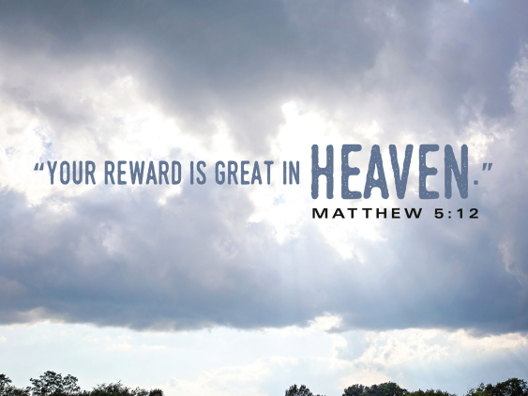

早點接受主, 就可以早點為主耶穌的國度做工, 那麼將來在基督的審判台前要因為你在世界上為主所做的事情, 得到主特別的賞賜. 這個賞賜, 才是永恆的, 才是真正屬於你的.
If you accept the Lord early, you can work early for the kingdom of the Lord Jesus. Then you will receive a special reward from the Lord for what you do in the world in front of the judgment seat of Christ. This reward is eternal and truly belongs to you.

