Slide 1
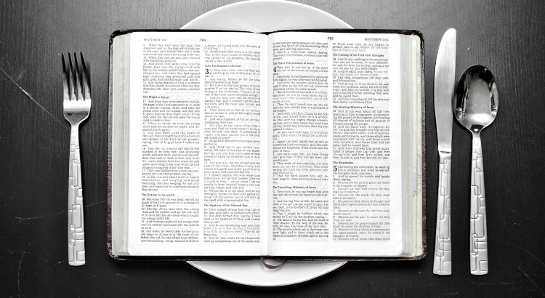
Fast & Pray
禁食禱告
2/28/2021 Rev. Joseph Chang
BOLGPC 爾灣大公園靈糧堂

Slide 2
Q: Fast & Pray 禁食禱告
你的重心在哪裡? Where is your focus?
☑
禁食/fasting
or
禱告親近神/praying to get close to God

Slide 3
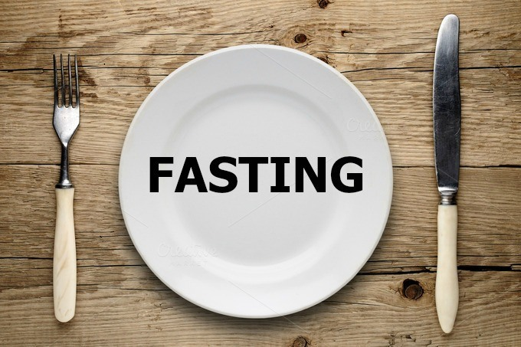
I. What is fasting? 甚麼是禁食?

Slide 4
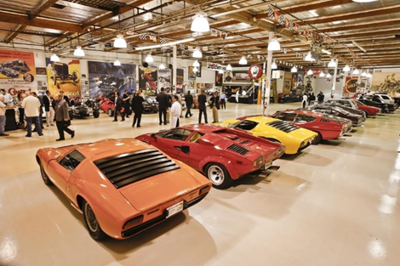
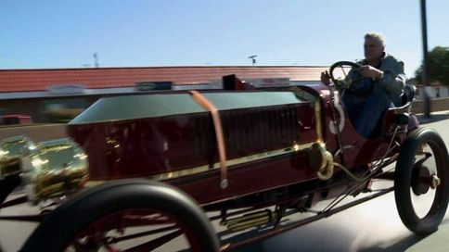
Illustration 1:
Jay Leno has so many cars. /Jay Leno有很多輛汽車。

Slide 5
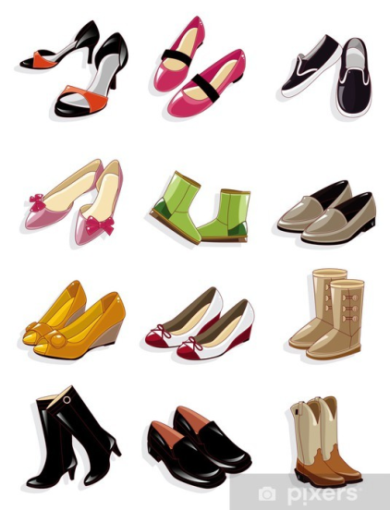
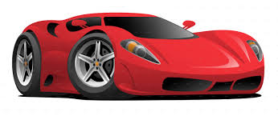
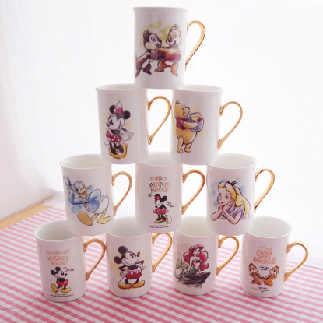
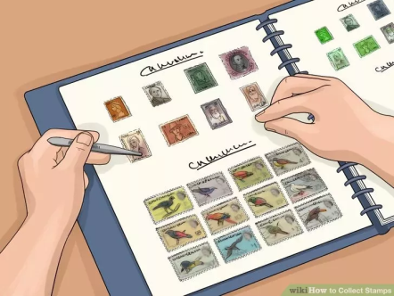
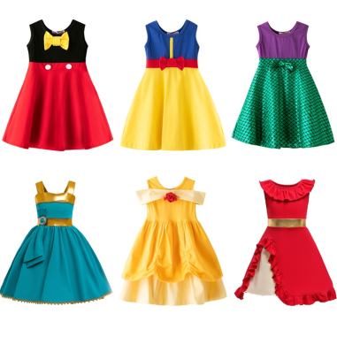
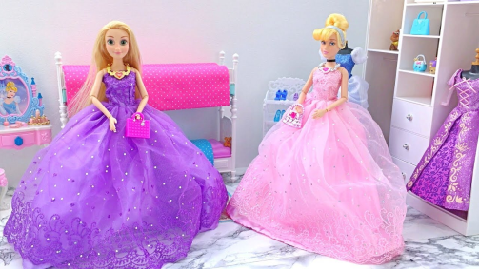
→這些可能是你 “fast/禁止, 棄絕” 的對象
These may be the objects you "fast“.

Slide 6
我們要把禁食禱告的重點放在後面的禱告親近神, 而不是放
在前面的禁食:
We should put the focus of fasting and prayer on praying to get
closer to God, not on fasting:
³他們說：我們禁食，你為何不看見呢？我們刻苦己心，你為何不理會呢？看哪，你們禁食的日子仍求利益，勒逼人為你們做苦工。⁴你們禁食，卻互相爭競，以兇惡的拳頭打人。你們今日禁食，不得使你們的聲音聽聞於上。
³' Why have we fasted, and you see it not? Why have we humbled ourselves, and you take no knowledge of it?' Behold, in the day of your fast you seek your own pleasure, and oppress all your workers. ⁴Behold, you fast only to quarrel and to fight and to hit with a wicked fist. Fasting like yours this day will not make your voice to be heard on high.

Slide 7
⁵這樣禁食豈是我所揀選、使人刻苦己心的日子麼？豈是叫人垂頭像葦子，用麻布和爐灰鋪在他以下麼？你這可稱為禁食、為耶和華所悅納的日子麼？⁶我所揀選的禁食不是要鬆開兇惡的繩，解下軛上的索，使被欺壓的得自由，折斷一切的軛麼？⁷不是要把你的餅分給飢餓的人，將飄流的窮人接到你家中，見赤身的給他衣服遮體，顧恤自己的骨肉而不掩藏麼？
⁵Is such the fast that I choose, a day for a person to humble himself? Is it to bow down his head like a reed, and to spread sackcloth and ashes under him? Will you call this a fast, and a day acceptable to the Lord? ⁶" Is not this the fast that I choose: to loose the bonds of wickedness, to undo the straps of the yoke, to let the oppressed go free, and to break every yoke? ⁷Is it not to share your bread with the hungry and bring the homeless poor into your house; when you see the naked, to cover him, and not to hide yourself from your own flesh?

Slide 8
⁸這樣，你的光就必發現如早晨的光，你所得的醫治要速速發明。你的公義必在你前面行；耶和華的榮光必作你的後盾。⁹那時你求告，耶和華必應允；你呼求，他必說：我在這裡。你若從你中間除掉重軛和指摘人的指頭，並發惡言的事，¹⁰你心若向飢餓的人發憐憫，使困苦的人得滿足，你的光就必在黑暗中發現；你的幽暗必變如正午。
⁸Then shall your light break forth like the dawn, and your healing shall spring up speedily; your righteousness shall go before you; the glory of the Lord shall be your rear guard. ⁹Then you shall call, and the Lord will answer; you shall cry, and he will say, 'Here I am.' If you take away the yoke from your midst, the pointing of the finger, and speaking wickedness, ¹⁰if you pour yourself out for the hungry and satisfy the desire of the afflicted, then shall your light rise in the darkness and your gloom be as the noonday.

Slide 9
¹¹耶和華也必時常引導你，在乾旱之地使你心滿意足，骨頭強壯。你必像澆灌的園子，又像水流不絕的泉源。¹²那些出於你的人必修造久已荒廢之處；你要建立拆毀累代的根基。你必稱為補破口的，和重修路徑與人居住的。【賽 58:3~12】 ¹¹And the Lord will guide you continually and satisfy your desire in scorched places and make your bones strong; and you shall be like a watered garden, like a spring of water, whose waters do not fail. ¹²And your ancient ruins shall be rebuilt; you shall raise up the foundations of many generations; you shall be called the repairer of the breach, the restorer of streets to dwell in. 【Isa 58:3~12】

Slide 10
當你的態度是為了要更親近神, 更討神的喜悅的時候, 你的
禁食禱告當然蒙神垂聽.你還會成為別人的祝福, 社會中的
堵住破口的人.
When your attitude is to get closer to God and to please God
more, your fasting and prayer will certainly be heard by God.
You will also be a blessing to others, and the repairer of the
breach in your society.

Slide 11
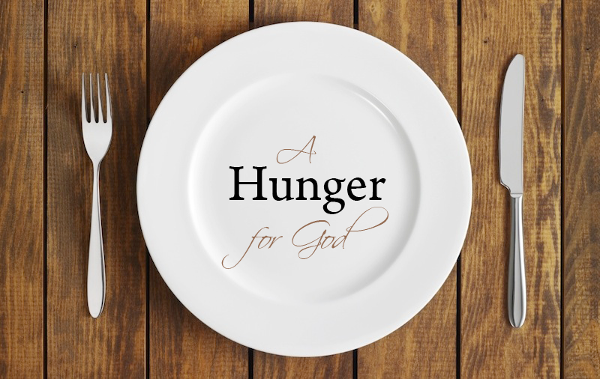
II. The target of your fast: 禁食禱告的對象:

Slide 12
¹⁶你們禁食的時候，不可像那假冒為善的人，臉上帶著愁容；因為他們把臉弄得難看，故意叫人看出他們是禁食。我實在告訴你們，他們已經得了他們的賞賜。¹⁷你禁食的時候，要梳頭洗臉，¹⁸不叫人看出你禁食來，只叫你暗中的父看見；你父在暗中察看，必然報答你。【太 6:16~18】 ¹⁶""And when you fast, do not look gloomy like the hypocrites, for they disfigure their faces that their fasting may be seen by others. Truly, I say to you, they have received their reward." ¹⁷"But when you fast, anoint your head and wash your face," ¹⁸"that your fasting may not be seen by others but by your Father who is in secret. And your Father who sees in secret will reward you. " 【Matt 6:16~18】

Slide 13
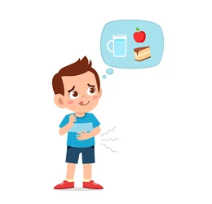
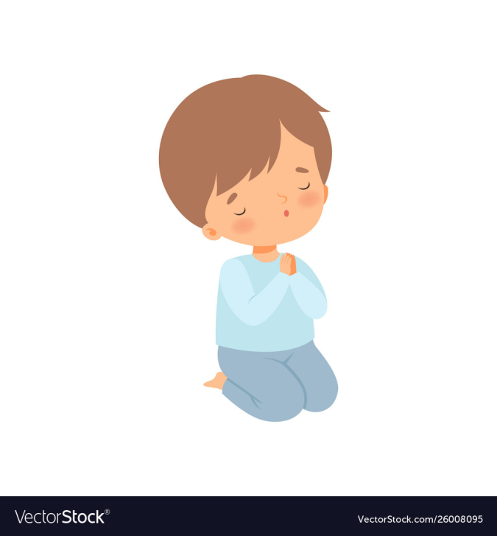
Illustration 2:

Slide 14
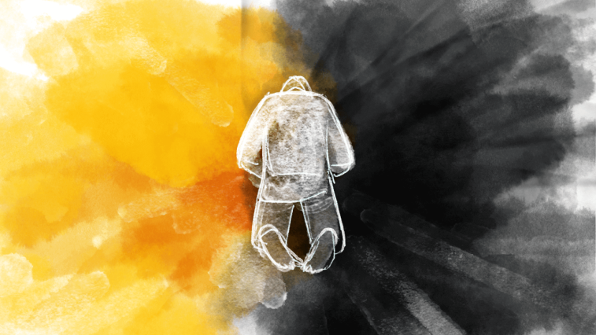
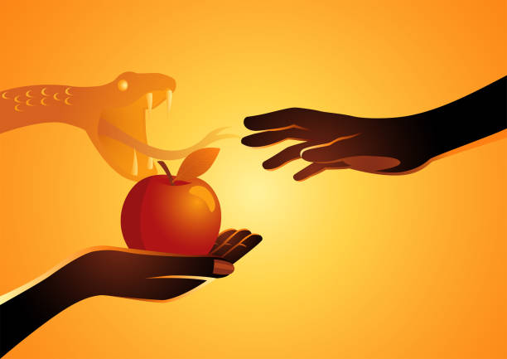
III. There will be spiritual battle during fasting.
禁食禱告的時候一定會有屬靈的爭戰.

Slide 15
⁹那時，耶穌從加利利的拿撒勒來，在約但河裡受了約翰的洗。¹⁰他從水裡一上來，就看見天裂開了，聖靈彷彿鴿子，降在他身上。¹¹又有聲音從天上來，說：你是我的愛子，我喜悅你。¹²聖靈就把耶穌催到曠野裡去。¹³他在曠野四十天，受撒但的試探，並與野獸同在一處，且有天使來伺候他。【可 1:9~13】 ⁹In those days Jesus came from Nazareth of Galilee and was baptized by John in the Jordan. ¹⁰And when he came up out of the water, immediately he saw the heavens opening and the Spirit descending on him like a dove. ¹¹And a voice came from heaven, "You are my beloved Son; with you I am well pleased." ¹²The Spirit immediately drove him out into the wilderness. ¹³And he was in the wilderness forty days, being tempted by Satan. And he was with the wild animals, and the angels were ministering to him. 【Mark 1:9~13】

Slide 16
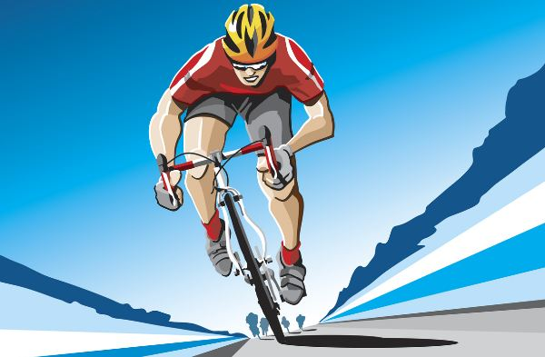
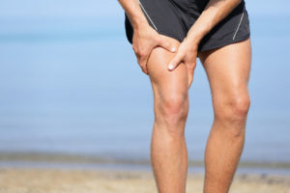
Illustration 3:

Slide 17
IV. Fasting is to force us to look away from the temporary things and to look into the eternal things.
禁食時候, 會強迫我們把眼光從暫時的事務上移開, 讓我
們有機會思想永恆的事物 (傳Eccl 3:18-22).

Slide 18
¹⁸我心裡說，這乃為世人的緣故，是 神要試驗他們，使他們覺得自己不過像獸一樣。¹⁹因為世人遭遇的，獸也遭遇，所遭遇的都是一樣：這個怎樣死，那個也怎樣死，氣息都是一樣。人不能強於獸，都是虛空。²⁰都歸一處，都是出於塵土，也都歸於塵土。
¹⁸I said in my heart with regard to the children of man that God is testing them that they may see that they themselves are but beasts. ¹⁹For what happens to the children of man and what happens to the beasts is the same; as one dies, so dies the other. They all have the same breath, and man has no advantage over the beasts, for all is vanity. ²⁰All go to one place. All are from the dust, and to dust all return.

Slide 19
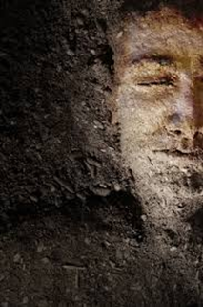
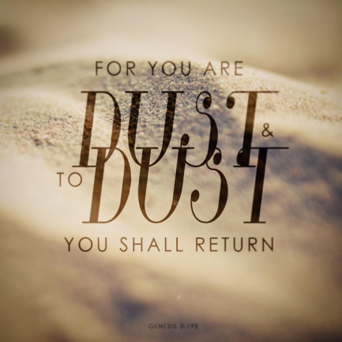
²¹誰知道人的靈是往上升，獸的魂是下入地呢？²²故此，我見人莫強如在他經營的事上喜樂，因為這是他的分。他身後的事誰能使他回來得見呢？【傳 3:18~22】
²¹Who knows whether the spirit of man goes upward and the spirit of the beast goes down into the earth? ²²So I saw that there is nothing better than that a man should rejoice in his work, for that is his lot. Who can bring him to see what will be after him? 【Eccl 3:18~22】

Slide 20
Conclusion結論
⁸你們得救是本乎恩，也因著信；這並不是出於自己，乃是神所賜的；⁹也不是出於行為，免得有人自誇。¹⁰我們原是他的工作，在基督耶穌裡造成的，為要叫我們行善，就是神所預備叫我們行的。【弗 2:8~10】 ⁸For by grace you have been saved through faith. And this is not your own doing; it is the gift of God, ⁹not a result of works, so that no one may boast. ¹⁰For we are his workmanship, created in Christ Jesus for good works, which God prepared beforehand, that we should walk in them. 【Eph 2:8~10】

