Slide 1
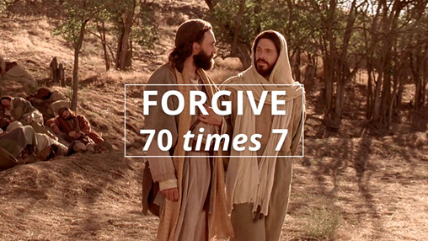
原諒70個7次
3/21/2021 Rev. Joseph Chang BOLGPC 爾灣大公園靈糧堂

Slide 2
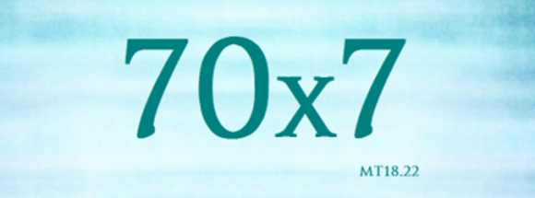
²¹那時，彼得進前來，對耶穌說：主阿，我弟兄得罪我，我當饒恕他幾次呢？到七次可以麼？²²耶穌說：我對你說，不是到七次，乃是到七十個七次。²³天國好像一個王要和他僕人算賬。²⁴才算的時候，有人帶了一個欠一千萬銀子的來。
²¹Then Peter came up and said to him, "Lord, how often will my brother sin against me, and I forgive him? As many as seven times?" ²²Jesus said to him, ""I do not say to you seven times, but seventy times seven. " ²³“"Therefore the kingdom of heaven may be compared to a king who wished to settle accounts
with his servants." ²⁴"When he began to settle, one was brought to him who owed him ten thousand talents."

Slide 3
²⁵因為他沒有甚麼償還之物，主人吩咐把他和他妻子兒女，並一切所有的都賣了償還。²⁶那僕人就俯伏拜他，說：主阿，寬容我，將來我都要還清。²⁷那僕人的主人就動了慈心，把他釋放了，並且免了他的債。²⁸那僕人出來，遇見他的一個同伴欠他十兩銀子，便揪著他，掐住他的喉嚨，
²⁵"And since he could not pay, his master ordered him to be sold, with his wife and children and all that he had, and payment to be made." ²⁶"So the servant fell on his knees, imploring him, 'Have patience with me, and I will pay you everything.'" ²⁷"And out of pity for him, the master of that servant released him and forgave him the debt."²⁸"But when that same servant went out, he found one of his fellow servants who owed him a hundred denarii, and seizing him, he began to choke him,

Slide 4
說：你把所欠的還我！²⁹他的同伴就俯伏央求他，說：寬容我罷，將來我必還清。³⁰他不肯，竟去把他下在監裡，等他還了所欠的債。³¹眾同伴看見他所做的事就甚憂愁，去把這事都告訴了主人。³²於是主人叫了他來，對他說：你這惡奴才！你央求我，我就把你所欠的都免了，
saying, 'Pay what you owe.'" ²⁹"So his fellow servant fell down and pleaded with him, 'Have patience with me, and I will pay you.'" ³⁰"He refused and went and put him in prison until he should pay the debt." ³¹"When his fellow servants saw what had taken place, they were greatly distressed, and they went and reported to their master all that had taken place." ³²"Then his master summoned him and said to him, 'You wicked servant! I forgave you all that debt because you pleaded with me."

Slide 5
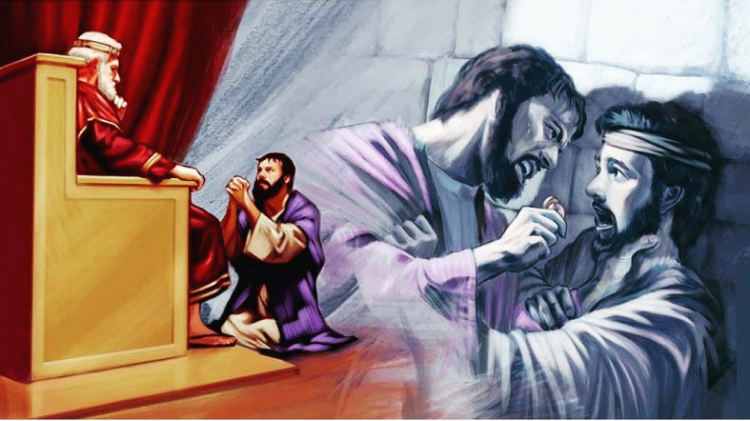
³³你不應當憐恤你的同伴，像我憐恤你麼？³⁴主人就大怒，把他交給掌刑的，等他還清了所欠的債。³⁵你們各人若不從心裡饒恕你的弟兄，我天父也要這樣待你們了。【太 18:21~35】 ³³"And should not you have had mercy on your fellow servant, as I had mercy on you?'" ³⁴"And in anger his master delivered him to the jailers, until he should pay all his debt." ³⁵"So also my heavenly Father will do to every one of you, if you do not forgive your brother from your heart." " 【Matt 18:21~35】

Slide 6
Q: 惡僕人欠他的主人的錢是10,000 talents, 有多大呢?
The unmerciful servant owes his master 10,000 talents. How much is it?
做工一天的薪水= 1 個denarius / one day’s salary = 1 denarius
1 talent = 6,000 denarii = work 6,000 days
平均一年工作300天/ working 300 days a year on average
6,000/300=20 → 1 talent=20年的工作薪水/20 years’ salary
20 x 10,000 = 200,000
→ 10,000 talents=200,000 年的工作薪水/200,000 years’ salary
惡僕人的朋友欠他100 denarii的錢, 也就是差不多是4個月的工資.
100 denarii ≈ 4 months' salary
600,000:1

Slide 7
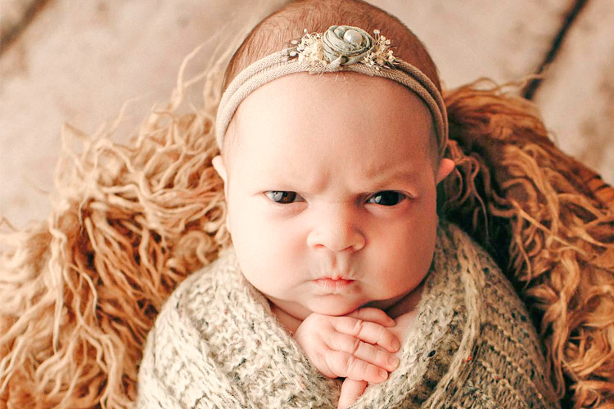
I. 我真的有欠你那麼多嗎?
Do I really owe you that much?

Slide 8
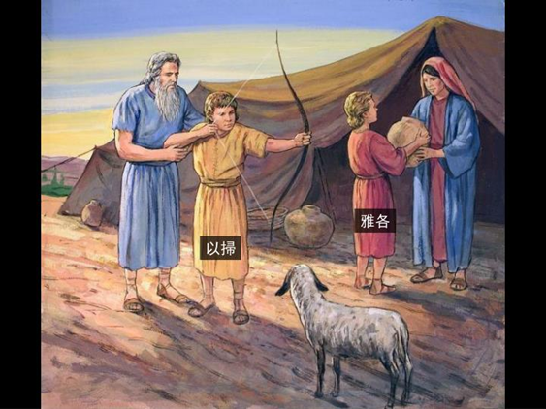
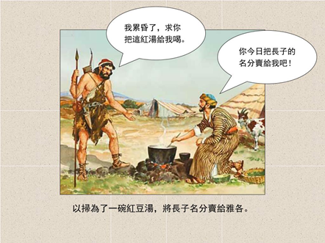
以撒和利百加這個家庭的互動
The interaction of the family of Isaac and Rebekah.

Slide 9
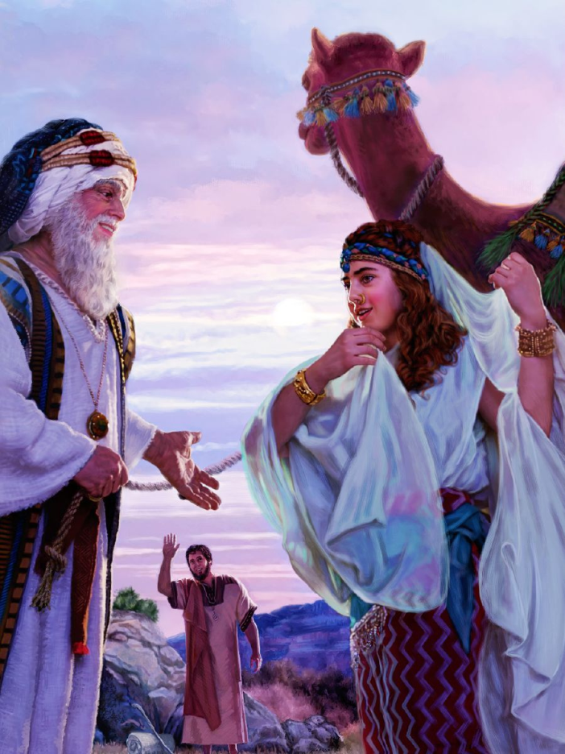
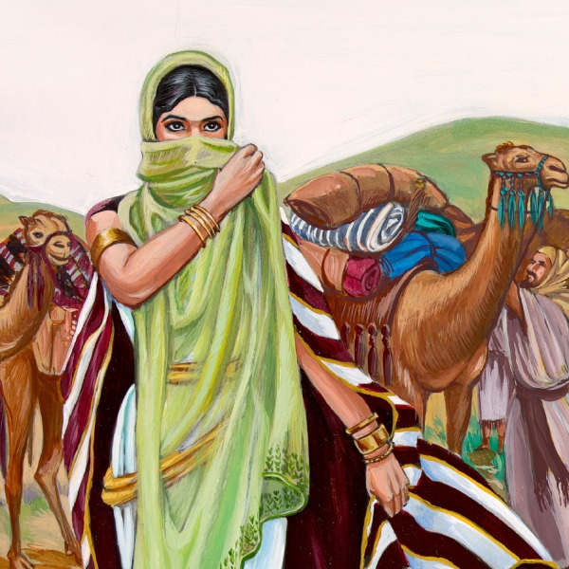
A. 利百加/Rebekah:

Slide 10
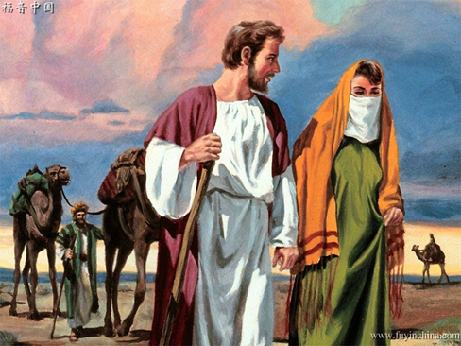
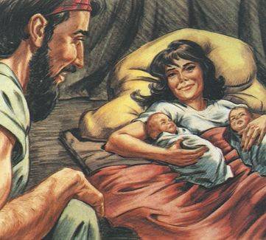
B. 以撒/Isaac :

Slide 11
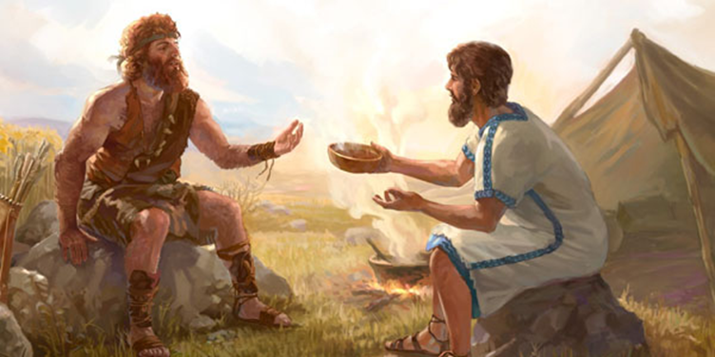
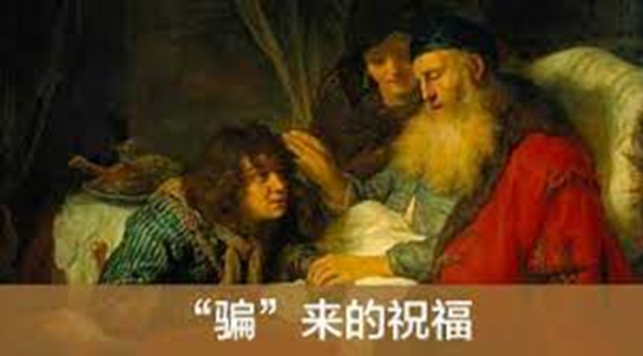
C. 雅各/Jacob:

Slide 12
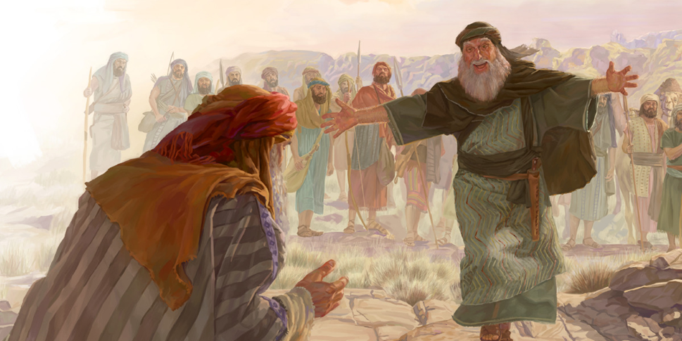
D. 以掃/Esau:
Esau
Jacob

Slide 13
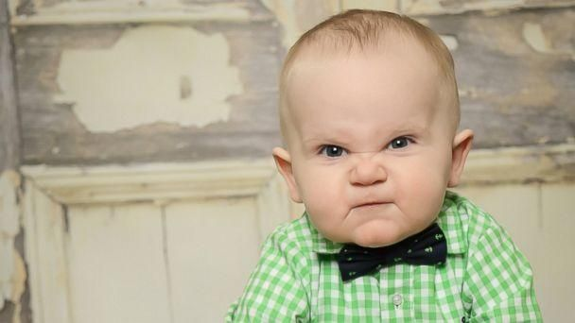
II. 你真的才欠我這麼多嗎?
Do you really owe me that little?
A. 看到自己的委屈. Focus on my own suffering.
B. 看到自己的好. Focus on my own goodness.

Slide 14
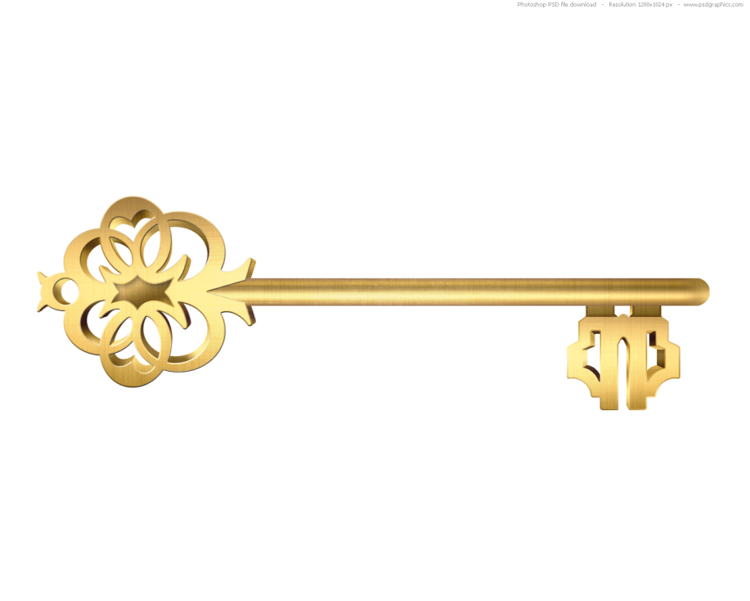
III. The Key to solve our problem
解決我們問題的鑰匙.

Slide 15
A. Are you able to have godly perspective?
就是從神的眼光來看事情.
¹⁴公義和公平是你寶座的根基；慈愛和誠實行在你前面。【詩 89:14】 ¹⁴Righteousness and justice are the foundation of your throne; steadfast love and faithfulness go before you.
【Ps 89:14】

Slide 16
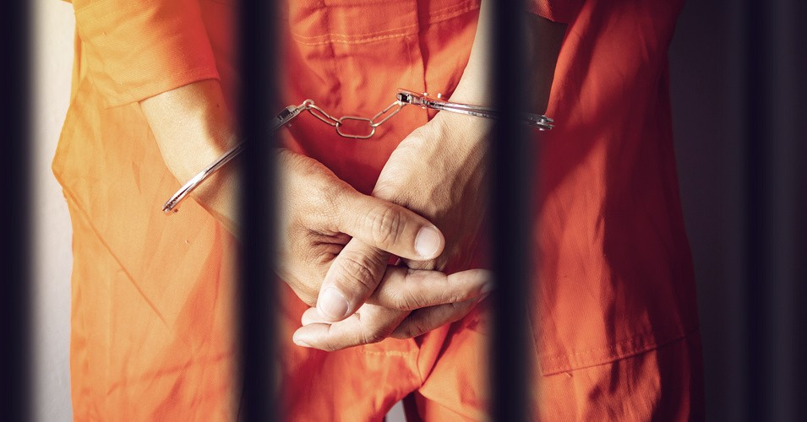
B. God wants us to live in freedom.
神要我們自由的生活.
在仇恨的監獄裡面接受那無止境的折磨
suffering the endless torture in the prison of hatred

Slide 17
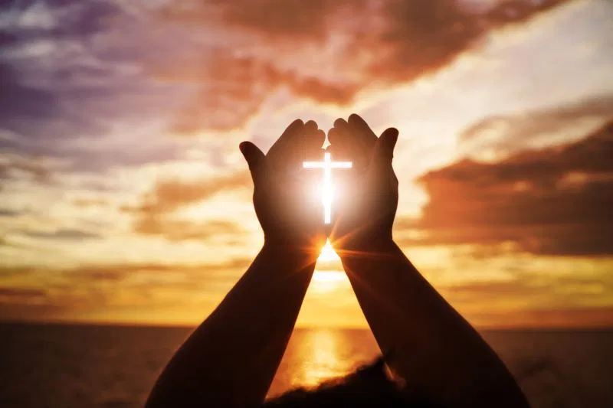
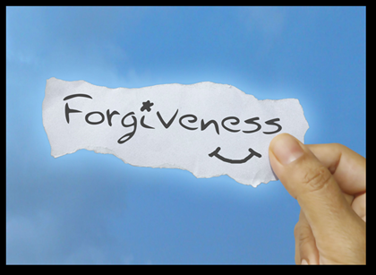
Illustration:

Slide 18
C. Be filled with the Holy Spirit要被聖靈充滿.
¹⁸不要醉酒，酒能使人放蕩；乃要被聖靈充滿。【弗 5:18】 ¹⁸And do not get drunk with wine, for that is debauchery, but be filled with the Spirit, 【Eph 5:18】

Slide 19
¹⁴我若用方言禱告，是我的靈禱告，但我的悟性沒有果效。¹⁵這卻怎麼樣呢？我要用靈禱告，也要用悟性禱告；我要用靈歌唱，也要用悟性歌唱。【林前 14:14~15】 ¹⁴For if I pray in a tongue, my spirit prays but my mind is unfruitful. ¹⁵What am I to do? I will pray with my spirit, but I will pray with my mind also; I will sing praise with my spirit, but I will sing with my mind also. 【1Cor 14:14~15】

Slide 20
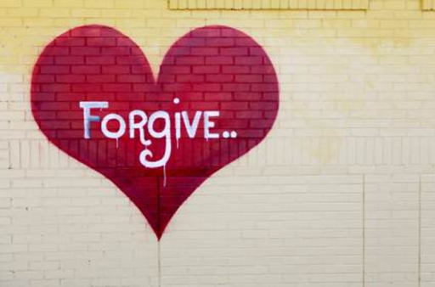
Conclusion:
From your heart is the key.
唯一的方法就是從心裡赦免,不再bother你了. 那麼,你就可以自由自在的生活了, 你的生命裡面就不再有你的敵人的陰影在那裏控制你了.
The only way is to forgive from the heart so that it will no longer
bother you. Then, you can live freely. The shadow of your enemy will no longer control you in your life.

Slide 21
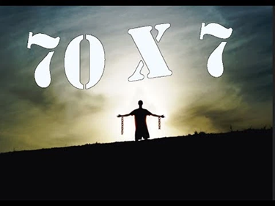
赦免不是說, 你就一再的受騙, 一再的受欺負. 赦免是不抓緊仇恨在我們的內心. 但是神不會要你傻傻地受騙70 x 7 = 490 次.
It does not mean that you are always ready to be cheated again. Forgiveness means not grasping the hatred in our hearts. But God will not want you to be fooled 70 x 7 = 490 times.

