Slide 1
Light & Salt of the World
地上的鹽, 世界的光
Matthew 5:13-16
5/16/2021 Rev. Joseph Chang BOLGPC 爾灣大公園靈糧堂

Slide 2
我們今天要來講建立神國度的方法.
Today we are going to talk about the method of
establishing the kingdom of God.

Slide 3
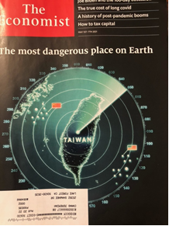
世界上很多國家建立他疆界的方法是軍隊.
Many countries in the world use armies to establish their borders.

Slide 4
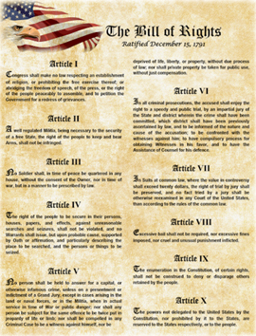
有的是藉著憲法, 人權來吸引人.
Some attract people by the constitution and human rights.

Slide 5
Q: 但神的國度是靠甚麼來擴展的呢?
But on what basis does the kingdom of God expand?

Slide 6
¹³你們是世上的鹽。鹽若失了味，怎能叫他再鹹呢？以後無用，不過丟在外面，被人踐踏了。¹⁴你們是世上的光。城造在山上是不能隱藏的。¹⁵人點燈，不放在斗底下，是放在燈臺上，就照亮一家的人。¹⁶你們的光也當這樣照在人前，叫他們看見你們的好行為，便將榮耀歸給你們在天上的父。【太 5:13~16】 ¹³""You are the salt of the earth, but if salt has lost its taste, how shall its saltiness be restored? It is no longer good for anything except to be thrown out and trampled under people's feet. " ¹⁴""You are the light of the world. A city set on a hill cannot be hidden." ¹⁵"Nor do people light a lamp and put it under a basket, but on a stand, and it gives light to all in the house." ¹⁶"In the same way, let your light shine before others, so that they may see your good works and give glory to your Father who is in heaven. " 【Matt 5:13~16】

Slide 7
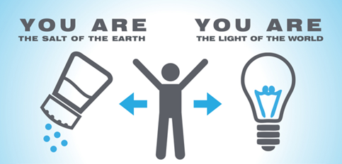
Q: 神的國度是靠甚麼來擴展的呢?
On what basis does the kingdom of God expand?
A: 我們拓展神國度的方法, 就是成為世上的光, 作地上的鹽, 讓
人能夠接受耶穌作為救主. 進入基督的國度.
The way we expand the kingdom of God is to be the light of
the world and the salt of the earth so that people can
accept Jesus as their savior and enter the kingdom of Christ.

Slide 8
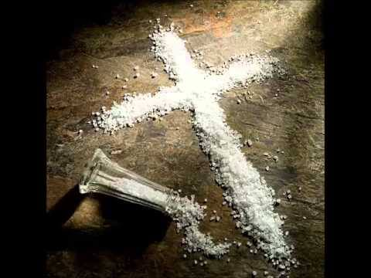
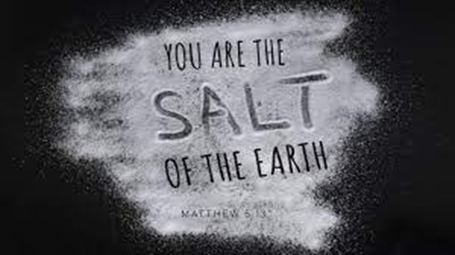
I. We are the salt of the earth. 我們是地上的鹽.

Slide 9
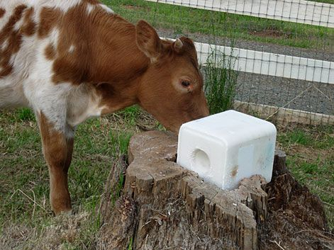
鹽有很多的功用. / Salt has many functions.
鹽可以防腐 / Preservation
鹽可以調味 / Seasoning
鹽可以增加胃口.
Salt can increase appetite.
我們做地上的鹽, 就是要引導人作對的事情.
To be the salt of the earth is to motivate people to do the right thing.

Slide 10
A. Contrast to the temptation from Satan
和撒旦伎倆的對比
¹³人被試探，不可說：「我是被神試探」；因為神不能被惡試探，他也不試探人。¹⁴但各人被試探，乃是被自己的私慾牽引誘惑的。¹⁵私慾既懷了胎，就生出罪來；罪既長成，就生出死來。【雅 1:13~15】 ¹³Let no one say when he is tempted, "I am being tempted by God," for God cannot be tempted with evil, and he himself tempts no one. ¹⁴But each person is tempted when he is lured and enticed by his own desire. ¹⁵Then desire when it has conceived gives birth to sin, and sin when it is fully grown brings forth death. 【Jam 1:13~15】

Slide 11
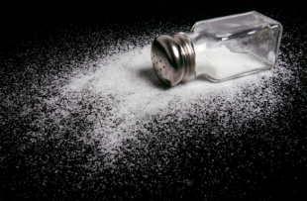
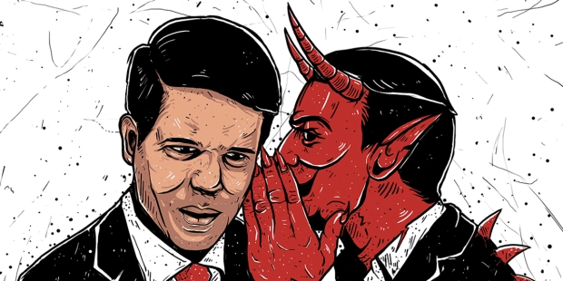
Illustration 1:
教會中美好的家庭, 就好像是鹽,
讓你有意願去建立好的家庭.
The beautiful family in the church
is like salt, giving you the will to
build a good family.
撒旦的試探
Satan's temptation

Slide 12
B. We are not the bread of the earth. 我們不是地上的麵包.

Slide 13
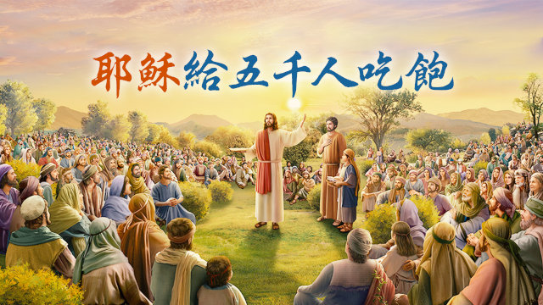
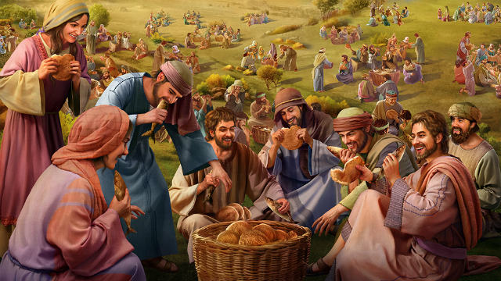
五餅二魚的神蹟

Slide 14
²⁶耶穌回答說：我實實在在的告訴你們，你們找我，並不是因見了神蹟，乃是因吃餅得飽。²⁷不要為那必壞的食物勞力，要為那存到永生的食物勞力，就是人子要賜給你們的，因為人子是父神所印證的。【約 6:26~27】 ²⁶Jesus answered them, ""Truly, truly, I say to you, you are seeking me, not because you saw signs, but because you ate your fill of the loaves." ²⁷"Do not labor for the food that perishes, but for the food that endures to eternal life, which the Son of Man will give to you. For on him God the Father has set his seal.""
【John 6:26~27】

Slide 15
⁵¹我是從天上降下來生命的糧；人若吃這糧，就必永遠活著。我所要賜的糧就是我的肉，為世人之生命所賜的。⁵²因此，猶太人彼此爭論說：這個人怎能把他的肉給我們吃呢？⁵³耶穌說：我實實在在的告訴你們，你們若不吃人子的肉，不喝人子的血，就沒有生命在你們裡面。
⁵¹"I am the living bread that came down from heaven. If anyone eats of this bread, he will live forever. And the bread that I will give for the life of the world is my flesh." " ⁵²The Jews then disputed among themselves, saying, "How can this man give us his flesh to eat?" ⁵³So Jesus said to them, ""Truly, truly, I say to you, unless you eat the flesh of the Son of Man and drink his blood, you have no life in you."

Slide 16
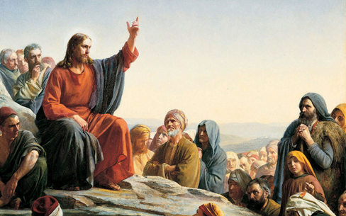
⁵⁴吃我肉、喝我血的人就有永生，在末日我要叫他復活。⁵⁵我的肉真是可吃的，我的血真是可喝的。
【約 6:51~55】
⁵⁴"Whoever feeds on my flesh and drinks my blood has eternal life, and I will raise him up on the last day." ⁵⁵"For my flesh is true food, and my blood is true drink." 【John 6:51~55】

Slide 17
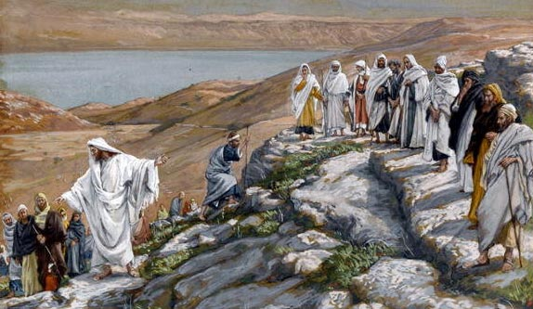
⁶⁶從此，他門徒中多有退去的，不再和他同行。⁶⁷耶穌就對那十二個門徒說：你們也要去麼？【約 6:66~67】 ⁶⁶After this many of his disciples turned back and no longer walked with him. ⁶⁷So Jesus said to the Twelve, ""Do you want to go away as well?"" 【John 6:66~67】

Slide 18
Q: 重點在哪裡呢?
What's the point?
教會要做慈善事業, 但是有一個目的, 就是要讓耶穌能夠成為接受人的信仰.
Church does charity with a purpose,
that is, to help people come to the
faith in Jesus Christ.

Slide 19
錯誤的觀念:Wrong idea
許多人把教會當成是做好事的地方.
Many people regard the church only as a place to do good things.
許多 Me Me Me Generation的想法:
教會最重要的就是要滿足我的需要, 教會好不好, 就是看教會能不能把我放在第一位, 滿足我任何時間發生, 任何時間提出來的需要.
The wrong “Me Me Me Generation “idea:
The most important thing for the church is to meet my needs. Whether the church is good or not depends on if the church can put me first and meet my needs at any time.

Slide 20
Q:為什麼主耶穌沒有說, “你們是地上的麵包!” ?
Why didn't the Lord Jesus say, "You are the bread on the earth!"?
A: 教會首要的是傳耶穌的救恩, 不是讓人 “吃餅得飽”!
The first thing in the church is to preach the salvation of Jesus,
not to let people “eat your fill of the loaves"!

Slide 21
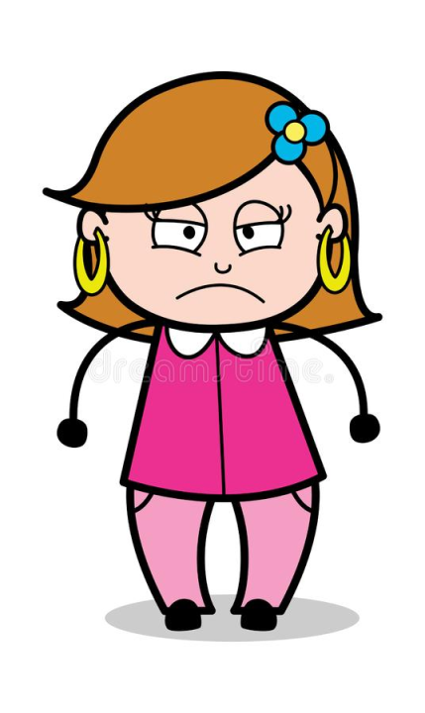
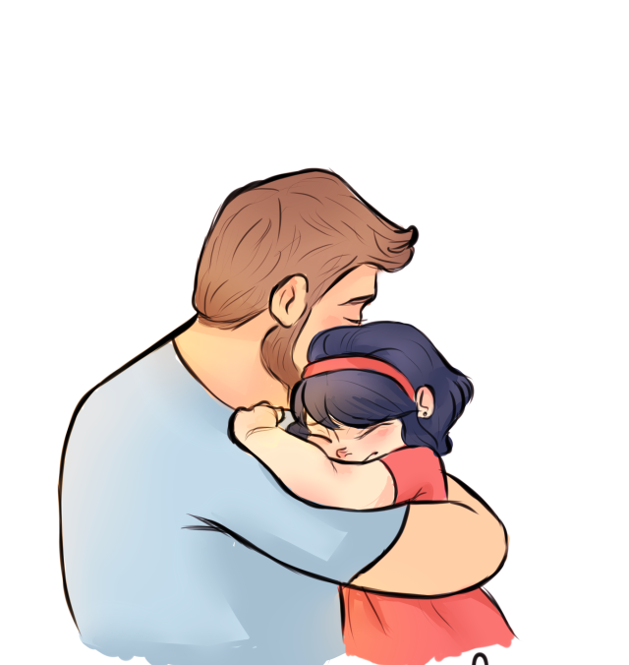
Illustration 2:

Slide 22
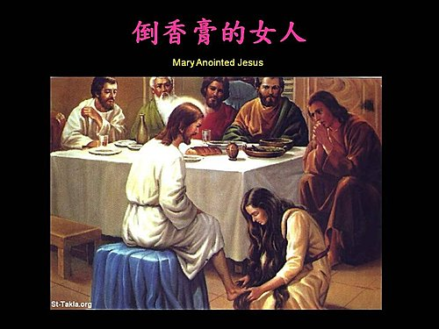
¹³我實在告訴你們，普天之下，無論在甚麼地方傳這福音，也要述說這女人所行的，作個記念。【太 26:13】 ¹³"Truly, I say to you, wherever this gospel is proclaimed in the whole world, what she has done will also be told in memory of her." " 【Matt 26:13】
主耶穌要聽到福音的人, 學習的是, 基督徒美好的生活是以耶穌為主, 而不是以自己為主.
The Lord Jesus wants those who receive the gospel to learn that the Christian lives center on Jesus, not on themselves.

Slide 23
→教會要有愛心, 但是不要傻到讓人家以愛心來分化自己的
弟兄姊妹.
The church must be caring, but don't be so stupid that people
use love to divide the brothers and sisters.
摩西這樣子說/ Moses said ,
⁸你們五個人要追趕一百人，一百人要追趕一萬人；仇敵必倒在你們刀下。【利 26:8】 ⁸Five of you shall chase a hundred, and a hundred of you shall chase ten thousand, and your enemies shall fall before you by the sword. 【Lev 26:8】

Slide 24
II. We are the light of the world
我們是世上的光

Slide 25
不是彰顯自己的好處, 而是彰顯神的榮耀.
Not to show your own good, but to show the glory of God.

Slide 26
Illustration 3:
愛爾灣的活動
1) Jessie Rees Foundation:
捐贈玩具和製作慰問卡給癌症病患兒童.
Toy donation and care card for children fighting cancer.
我們不參與/We won't participate in it.
禮物不能夠寫和宗教有關的字句. You cannot write anything related to religion on the gifts.
聖經上是講當人家看到你的好行為, 就歸榮要給你們在天上的父. The Bible says that let the world see our good deeds and give glory to
our Father in heaven.

Slide 27
2) Orange County Rescue Mission: 捐贈罐頭食品乾糧給OCRM遊民救助中心
Food Drive for Village of Hope residents.
我們參與/ We are glad to participate in it.
OCRM是傳耶穌的福音的, 使人生命獲得改變.
OCRM preaches the gospel of Jesus and makes people's lives change.

Slide 28
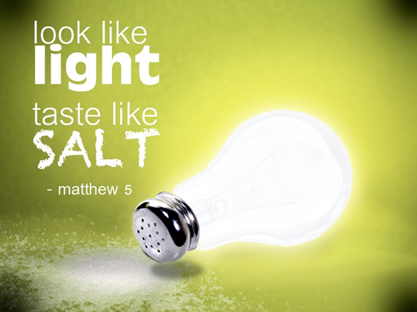
Conclusion 結論
主耶穌說, 我們是地上的鹽, 我們是世上的光. 目的呢, 就是要讓世人看到我們的好行為, 就歸榮要給我們在天上的父.
The purpose of what our Lord Jesus said that we are the salt of the earth and we are the light of the world is to let the world see our good deeds and give glory to our Father in heaven.

Slide 29
我們是鹽, 要讓人有胃口去做好的事情, 要讓人有胃口來尋求我們的救主. 我們不是麵包, 來滿足世人肉體的需要. 會有時間我們需要憐憫世人, 提供麵包給他們, 但目的是要他們接受耶穌, 這位生命的麵包. 而不是要讓教會成為麵包店.
We are the salt to make people have the appetite to do good things and to seek our Savior. We are not the bread only to satisfy the world’s physical needs. There will be times when we show compassion on the world and provide people with bread. The purpose is then for people to accept Jesus, the bread of life, not to make a bakery out of the church.

Slide 30
我們是光, 要照亮世人的眼睛, 讓世人看到我們所以這麼做, 是因為神的憐憫, 神的慈愛.
We are the light. We want to illuminate the eyes of the world and let the world see what we are doing is because of God's mercy and God's love.
讓世人能夠歸榮耀給神. 最美的表現, 就是接受神所賜的耶穌基督.
Let the world give glory to God, and be willing to accept Jesus Christ. This is the most beautiful picture!

